Slide 1
Arrays
http://www.alice.org/resources/lessons/arrays/

Slide 2
Arrays
What is an Array
An array is a type of data structure that is made up of a group of information (values or variables) in an organized arrangement often depicted in a column or row.
All items in an array must be of a similar data type.

Slide 3
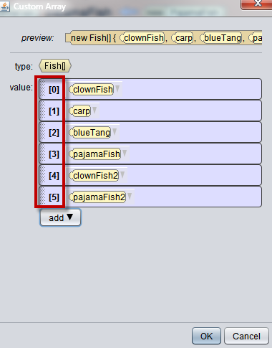
Arrays
An Ordered Array
Alice arrays are ordered with each element in the array identified by an index number.
The numbering in the list starts with 0 at the first position.
The index is a way to keep track of the element being stored in that location. In this example:
Fish[0] is holding the clownfish Fish[2] is holding the blue tang

Slide 4
Arrays
Why Use an Array
Arrays make it easier to store similar types of data and allows you to create programs that can perform the same function on each item in that array.
In Alice this allows you to do things like:
perform the same swim animation on a school of fish
create an array of dialogue and randomly select from it to create different dialogue
Create a group of items that all have the same collision logic on them

Slide 5
Arrays
Where to Create Arrays
There are a couple different places you can create arrays in Alice. Where you create the array will affect the type of data that can be used as well as where you will be able to access and use the array.
Class Properties - This creates an array that is a part of the class itself. These arrays will be accessible in all methods of that class but will need to be passed into other class methods as a parameter.
In Line - You can create an array using code inside of a method. This will make the array only accessible in that method after it has been created.
Inside a Control Structure or Event - You can create an array inside of a control structure. Alice will force you to do this on occasion in order to service the control structure. Many of our events will use an array as a parameter as an optional detail.

Slide 6
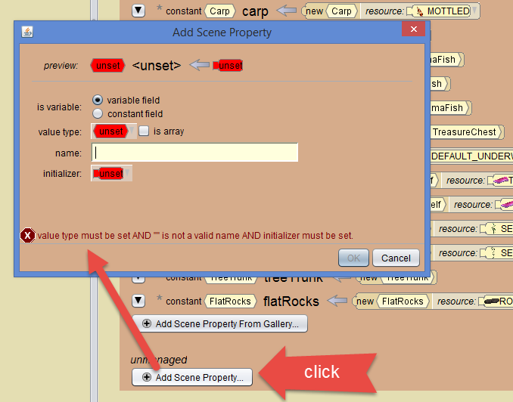
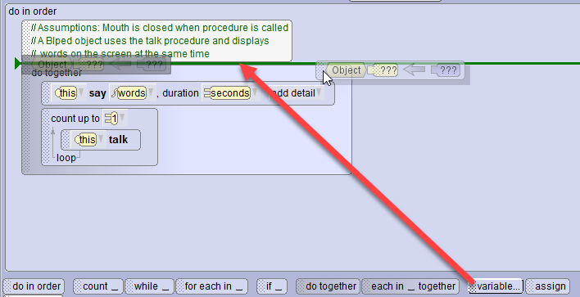
Arrays
Creating an Array
As a class property - Select Add Scene Property to create a new element.
This creates an array that can be used throughout the class. A scene property array can be accessed in all scene methods including eventListeners
As a variable inside of a method - you can create an array in line by using the variable block.
This creates an array that will only be accessible within the method it is created. It can be passed as a parameter that is set up as an array of the same data type.

Slide 7
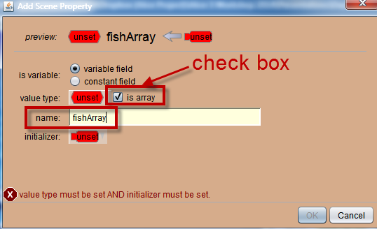
Arrays
Creating an Array
Select whether you want to the array to be a variable or a constant
Check the is array box
Enter a name for the array

Slide 8
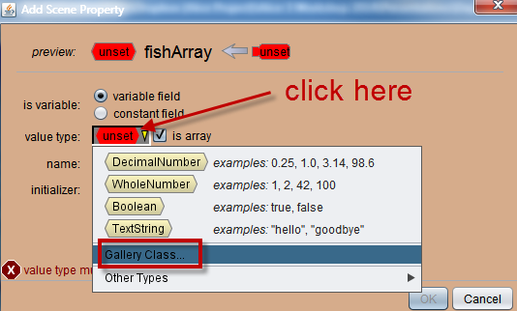
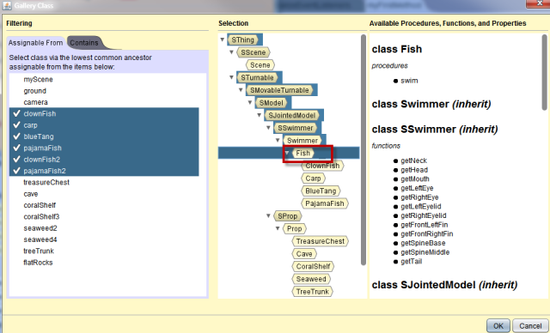
Arrays
Data Type Selection
When selecting the data type for the array it is important to think about the type of data that can be put in the array.
You should think about what information may be added later when considering the type. You might set it up only using bipeds but if you will be adding flyers or swimmers to it later you should select a higher class in the hierarchy such as sModel.

Slide 9
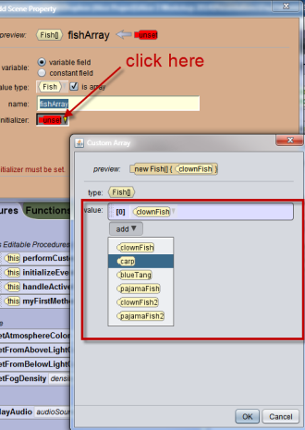
Arrays
Initializing the Array
When creating an array you will initialize the array by adding elements. An array can be any number of items including 1.
The number of items you add to the array when setting it up will define the size of the array in Alice.
You will not be able to add more elements to the array through code later.

Slide 10
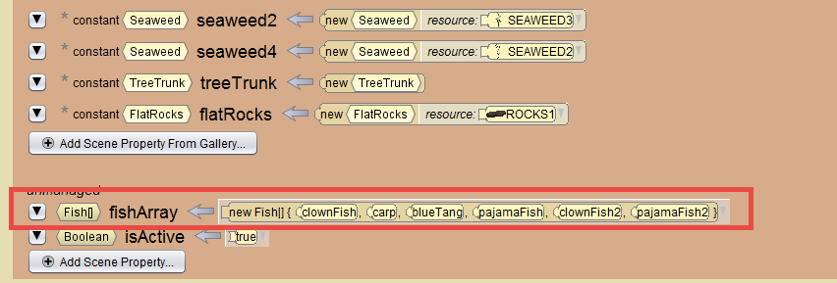
Arrays
Resulting Declaration
The array declaration is now listed in the Scene Class.
Fish[] indicates an array of Fish objects

Slide 11
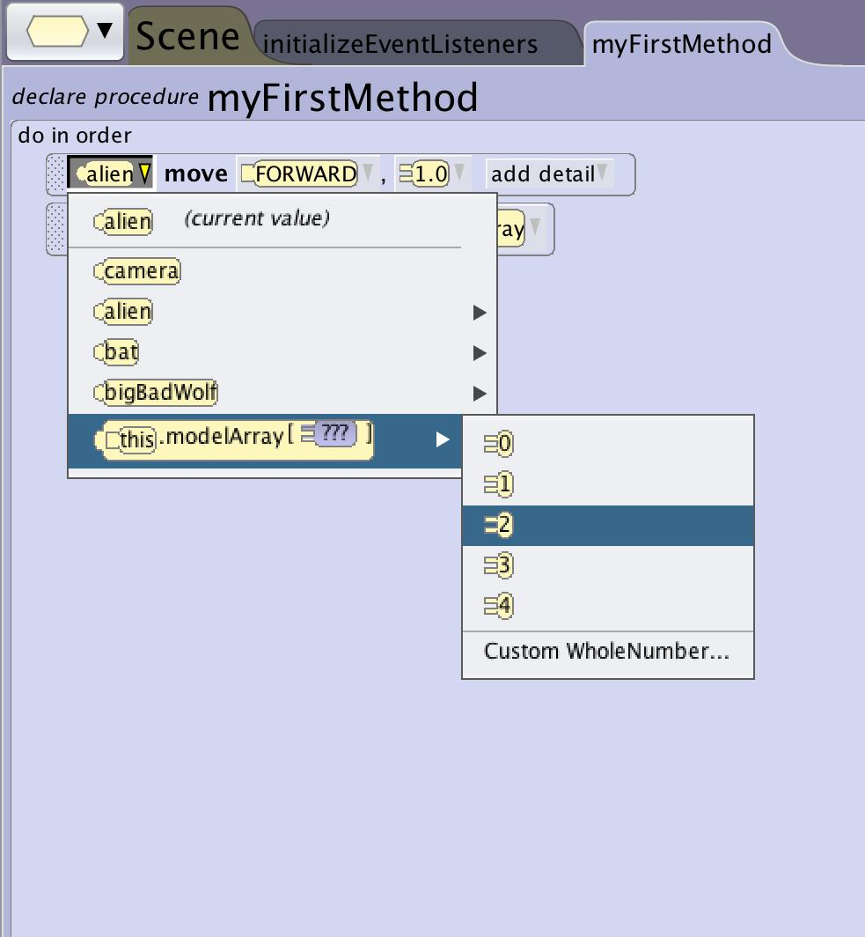
Arrays
Accessing an Array
Access means to set or get an object or value.
To access a specific object in an array you use the array name and select the correlating index.
*using the random number function is a great way to grab a random item from an array

Slide 12
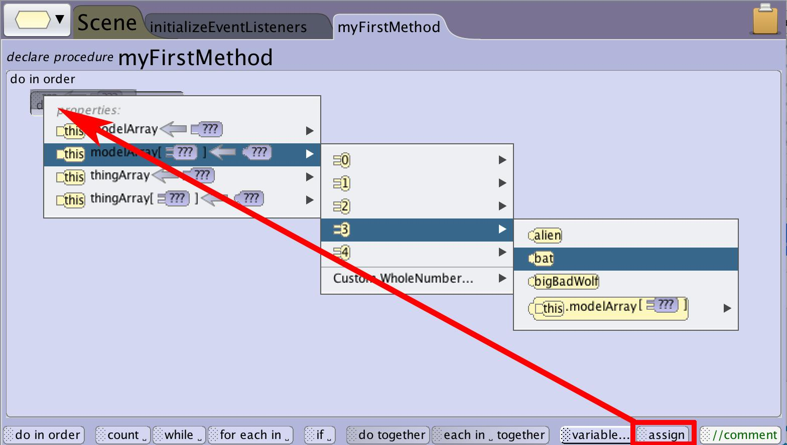
Arrays
Changing Elements of a Variable Array
The control block assign allows you to change the values inside an existing array.
When referencing a single element of an array you will see the array name followed by a number that represents the location in the array.

Slide 13
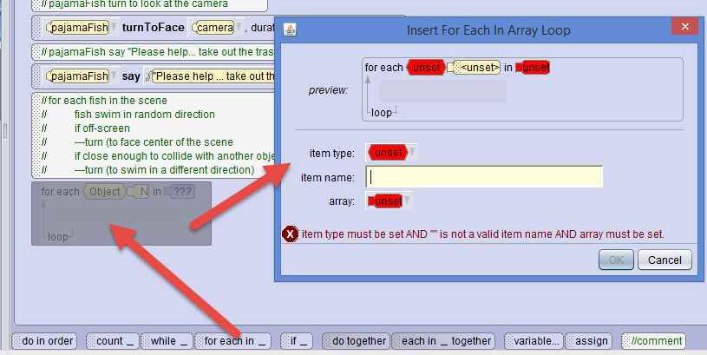
Arrays
Arrays in Control Structures
When creating for each in __ and each in __ together control structures you will need an array to support the functionality of the structure.
The program will either loop running once for each element in your array for each in__ or will process a do together for each element in your array each in__together.

Slide 14
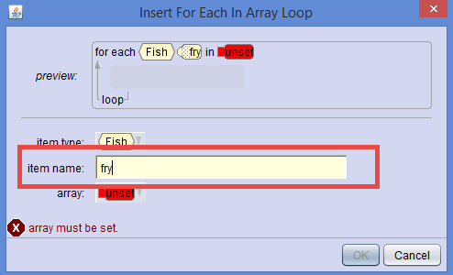
Arrays
Local Variable
When selecting a name remember you are creating a variable that will hold each item of the array for use in the procedures.
Name it something that helps you remember that it will be a placeholder for each item from the array.
You will use this as a representative variable that will pass through each element of the array when programming the content of the control block.

Slide 15
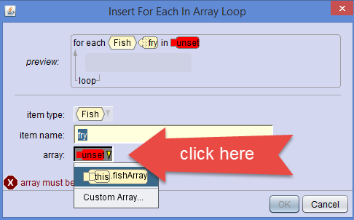
Arrays
Setting the Array
You can make a new custom array for use locally or you can access an array you created elsewhere.
If you don’t see the array you created remember that the class or method where you created the array matters for access.

Slide 16
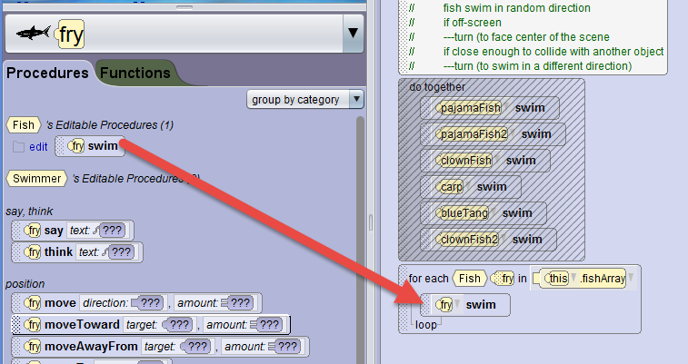
Arrays
Using the Element Variable
The resulting structure shows the variable and the array.
If the array is an object type you can access the variable as an object in the drop down and drag procedures into your control structure block that are populated with the array variable.
If the array is a non-object data type you will need to create the appropriate statements and access the variable in the drop down or drag the variable into the appropriate parameter.

Slide 17
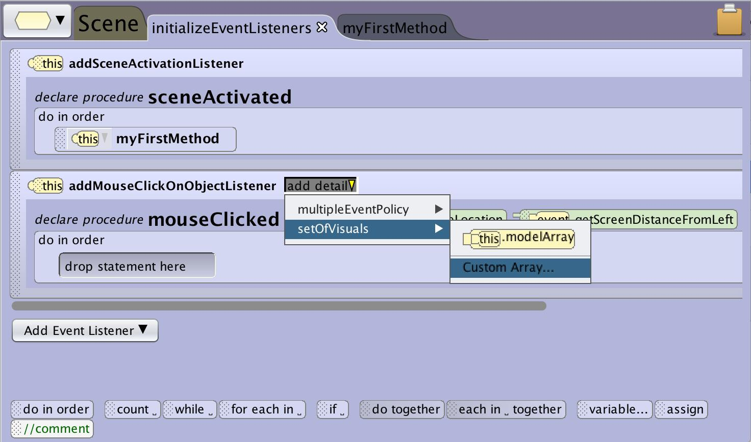
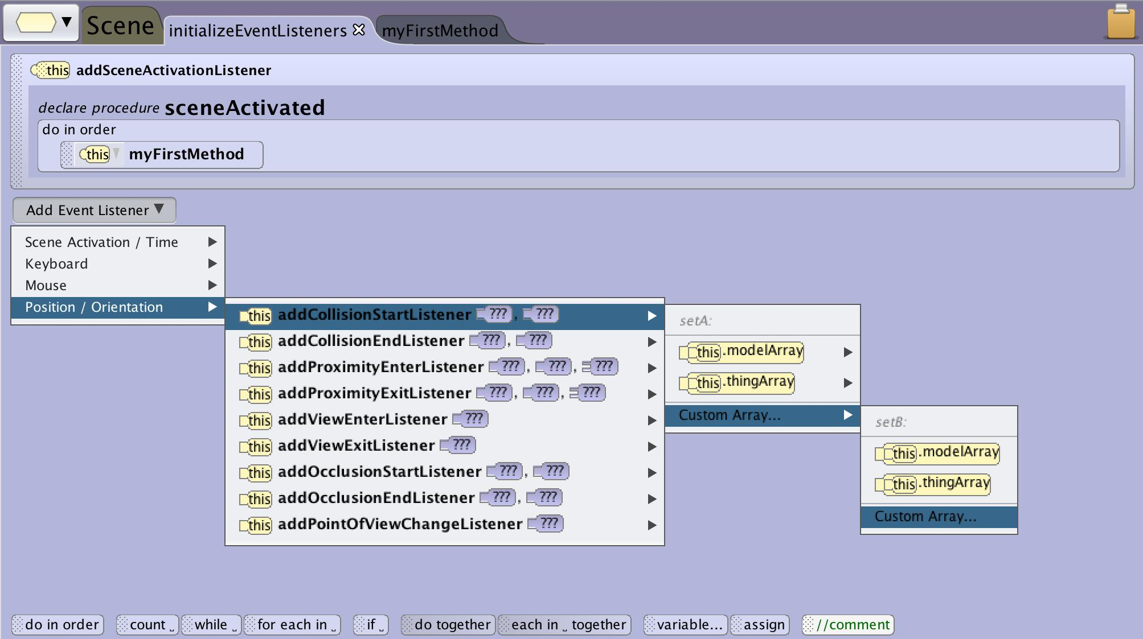
Arrays
Arrays in Event Listeners
Certain events can be modified with an add details to limit the listener using an array named setOfVisuals.
Other types of events require the use of an array such collision listeners.
The initializeEventListeners is a scene class method so recall that if you want to access existing arrays you will want to create them at the scene property level.

Slide 18
Arrays
setOfVisuals Parameter
Mouse click events are by default applied to all objects in the scene. To limit what objects are affected or will return data an an event you can use the set of visuals detail that will prompt you to create an array or you can make use of a scene class array giving you more flexibility (especially if it is a variable)

Slide 19
Arrays
Position Orientation Arrays
In Alice, the listeners for collision detection use two arrays
The first array will contain all the objects in the scene that are moving and may possibly run into something else.
The second array will contain all the objects in the scene that we do not want the moving objects to collide with.
It is possible that these arrays may contain only one object

