Slide 1
Control Structures Repetition
http://www.alice.org/resources/lessons/control-structures-loops/

Slide 2
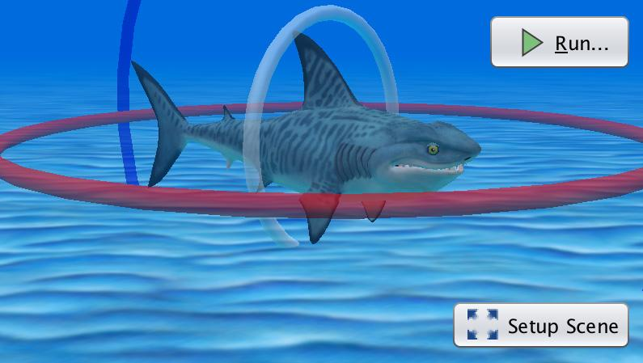
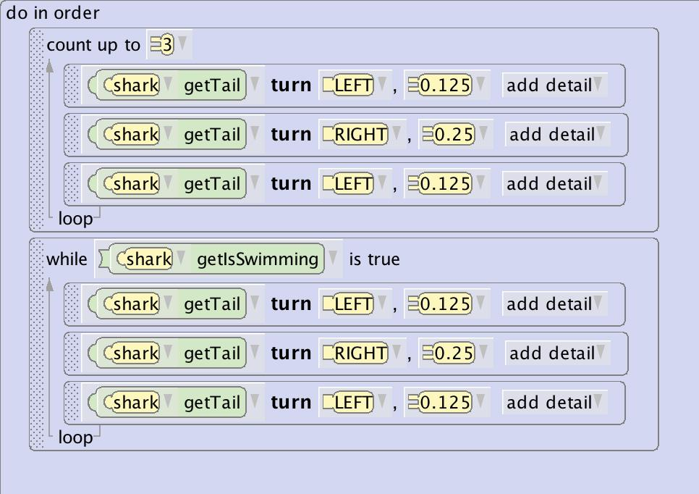
Repetition Overview
Repeating Execution
Computers don’t get bored and are happy to do the same thing over and over again. Lots of times you may want the same action to be repeated a number of times. There are two ways in Alice you can achieve this.
A count loop defines how many times you want the program to execute the contained code.
A while loop tells the program to continue to do the contained code until the defined condition is no longer fulfilled.

Slide 3
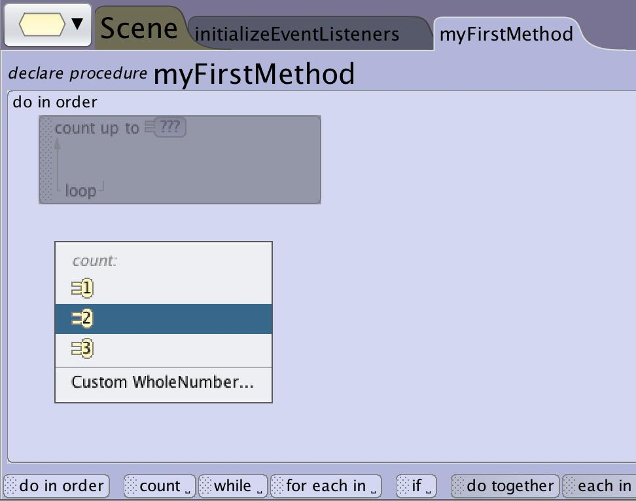
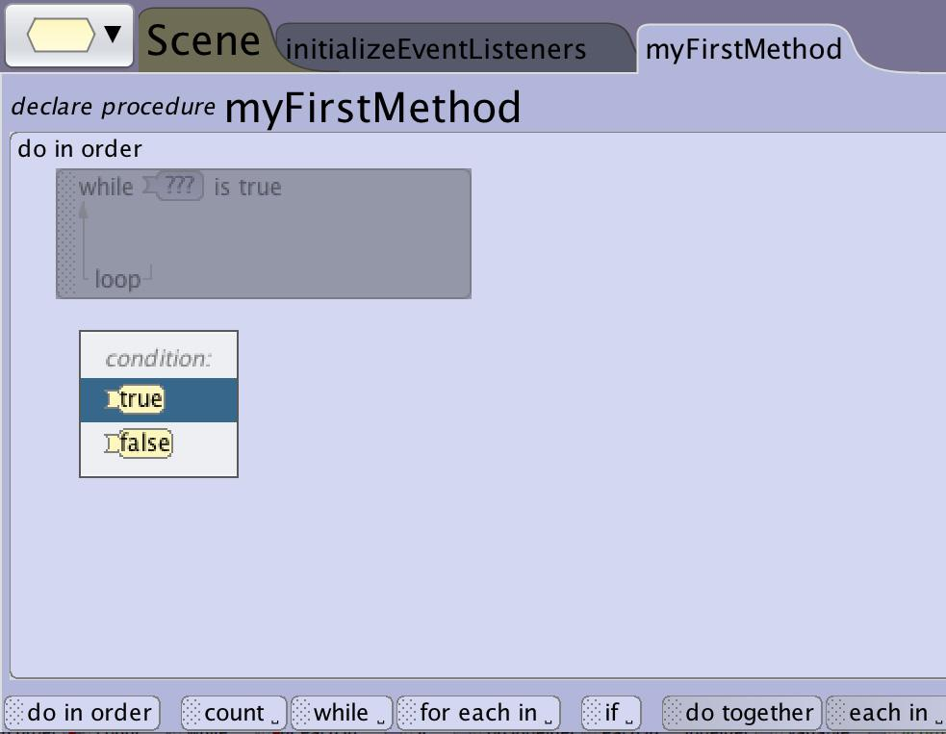
Repetition Overview
Repetition Control Blocks
Alice has 2 different control block that will allow you to create repeating code segments

Slide 4
Repetition Overview
Defined Looping Execution
A count_ block in Alice will execute a method the number of times that you define.
This is a great way to have your animation run the same animation multiple times without having to write the same code several times such as having a character jump up and down in excitement.
Start Counting to 10
Yes
Did I reach 10?
No
Do Something
Count Up

Slide 5
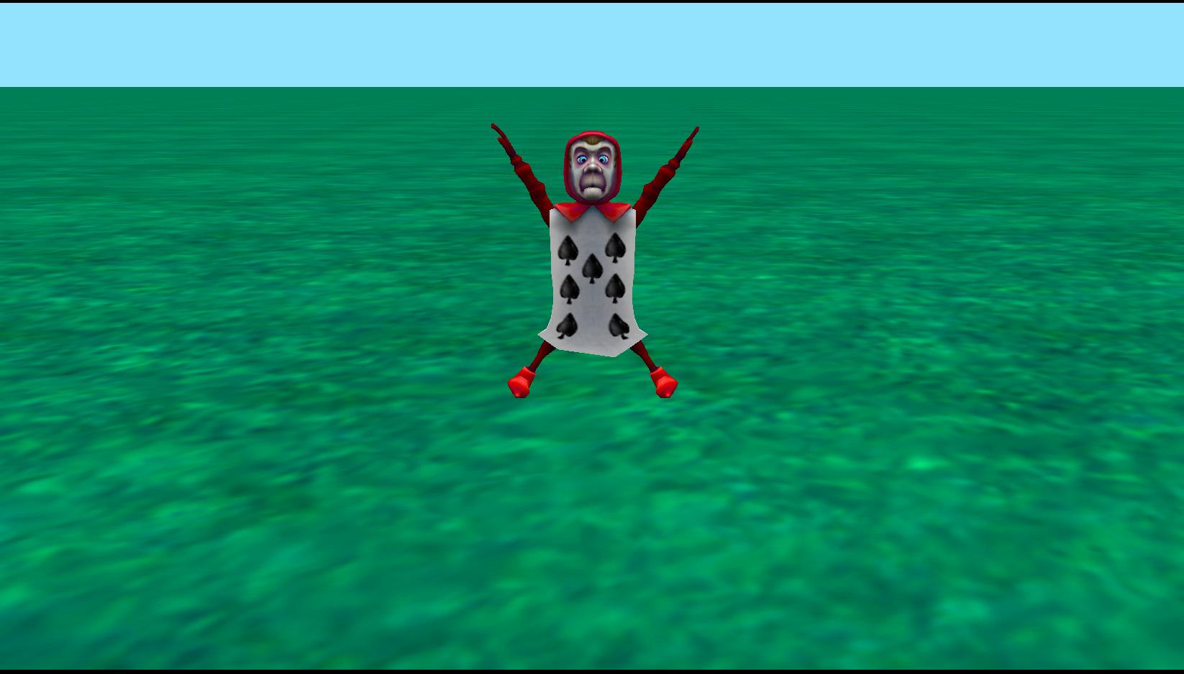
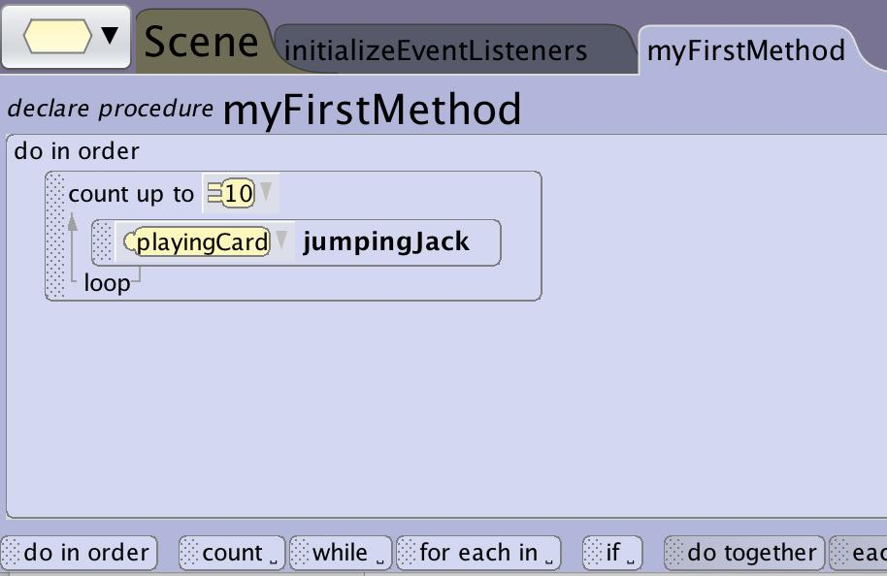
Repetition Overview
Do 10 Jumping Jacks
Adding a count loop to have the same animation happen 10 times saves you from having to copy and paste or write the same statements over and over again.

Slide 6
Repetition Overview
Defined Looping Execution
A for each in__ block in Alice will execute a method for each element in an array that you define (see Arrays).
This is a great way to have your animation run the same animation multiple times for a specific set of characters or substituting in a different parameter each time.
Grab items from array
Did I reach the last item
Yes
No
Do Something using the current array item
Grab next item

Slide 7
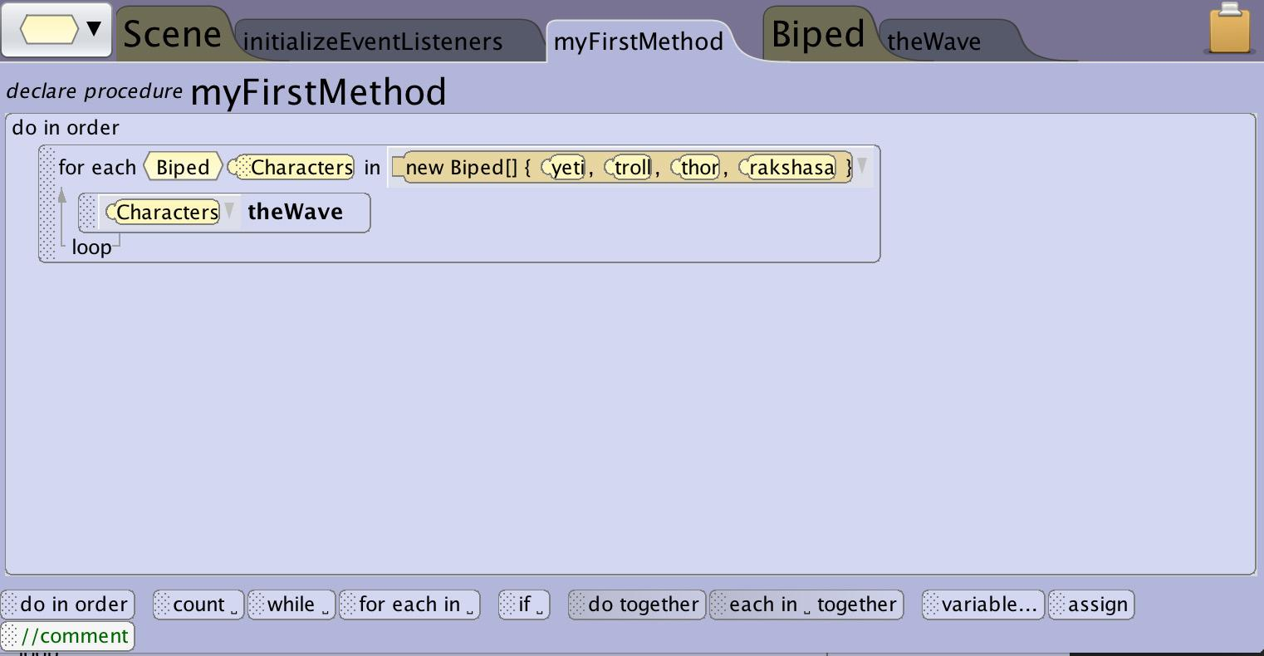
Repetition Overview
Do The Wave
Using an array of characters you can repeat the same statements multiple times replacing the object each time with a different character from an array. You could use this to have a row of characters raise their arms in order and do the wave.

Slide 8
Repetition Overview
Conditional Looping Execution
A while_ code block can be used to have your program execute the same instructions for an undefined amount of times based on conditions in the program.
A while_ can be used to make an animation repeat for the duration of your program using a “while program is active” condition to create continuous environmental animations.
Condition is true?
No
Yes
Do Something

Slide 9
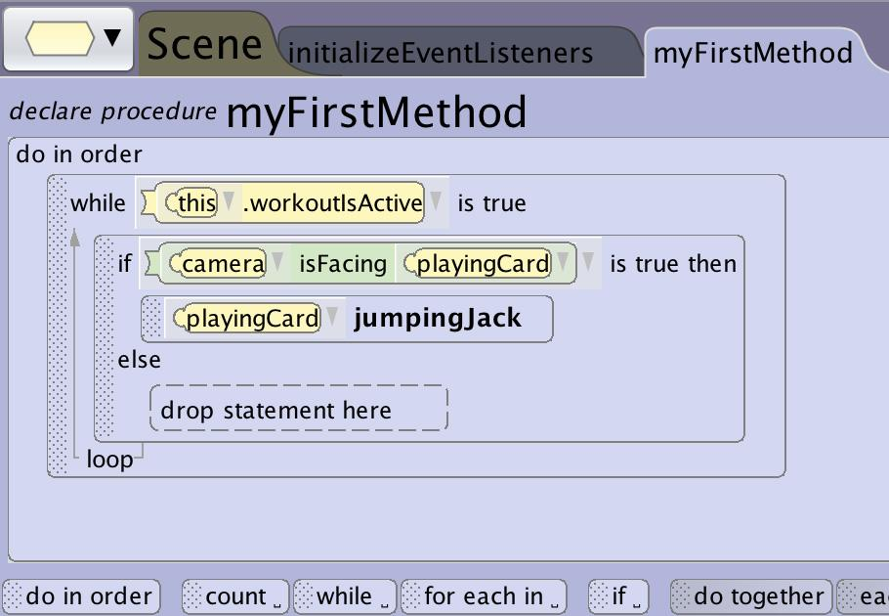
Repetition Overview
Do Jumping Jacks When Looking
Sometimes you will only want something to happen while a condition in the world is true or false. In this case we don’t even know how many times it should repeat and additionally we only want it to happen when the coach (camera) is looking.

Slide 10
Building a Count Loop

Slide 11
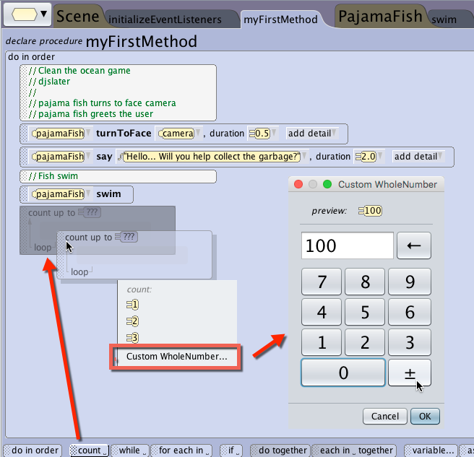
Building a Count Loop
Create a Count Loop
Adding a count loop will require you to enumerate the number of times you want the contained statements to repeat by selecting from the drop down or selecting a custom whole number.

Slide 12
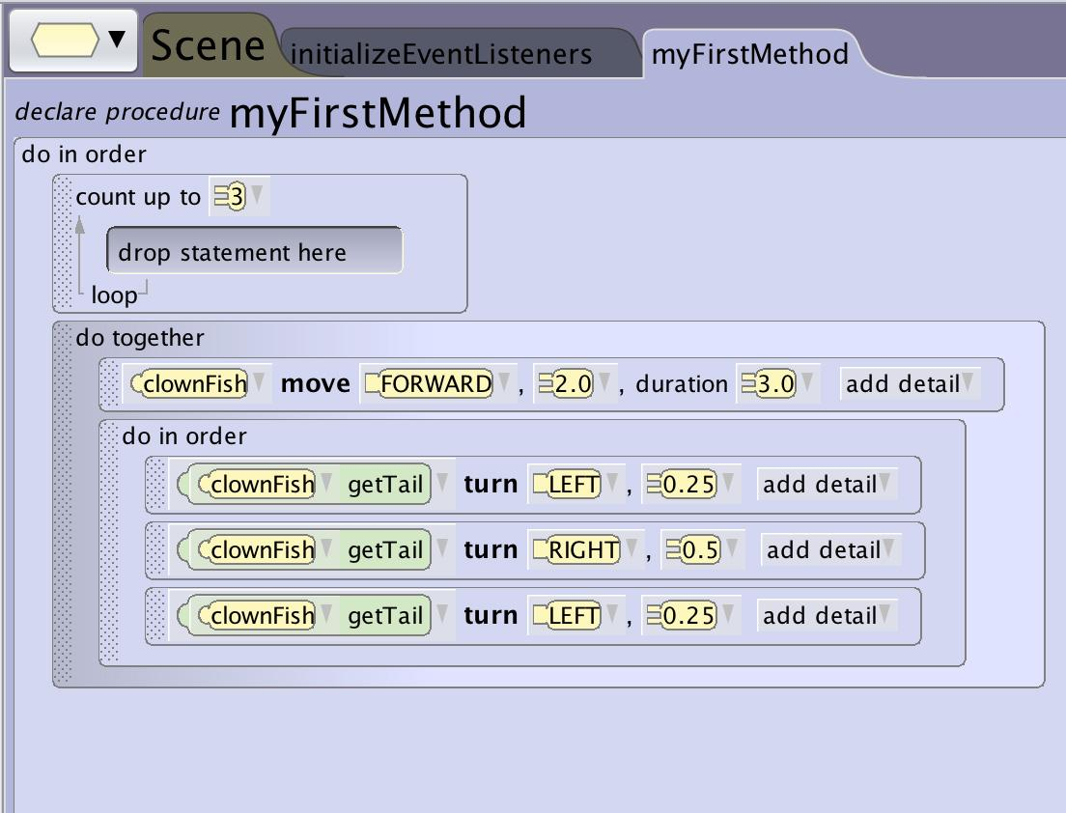
Building a Count Loop
Add Statements to the Loop
Once you have created the count loop you can add statements into the block to tell the program what to execute repeatedly.

Slide 13
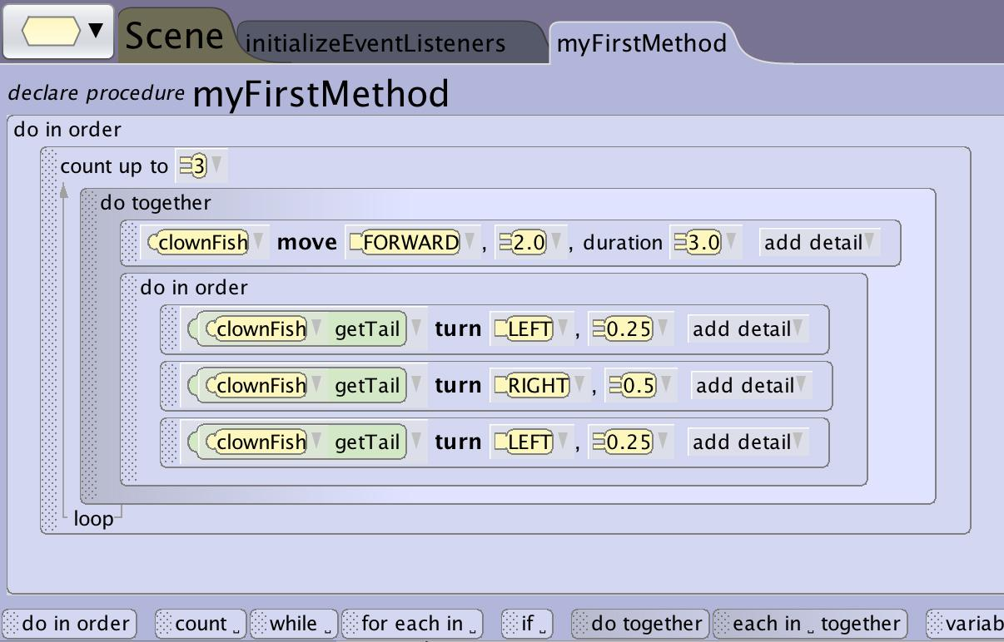
Building a Count Loop
Using Nested Blocks
As with other control structures you can nest other control structures inside the counted loop as needed.

Slide 14
Building a For Each in Loop

Slide 15
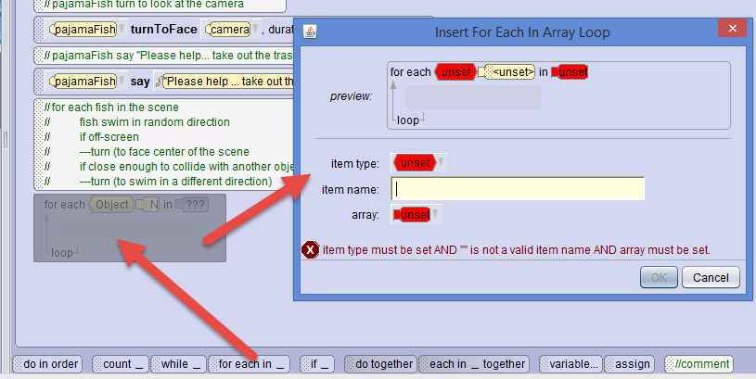
Building a For Each In Loop
Creating a For Each In Loop
When creating for each in __ control structures you will need an array.
That array can either be a new array created locally or reference an existing array (see Array)

Slide 16
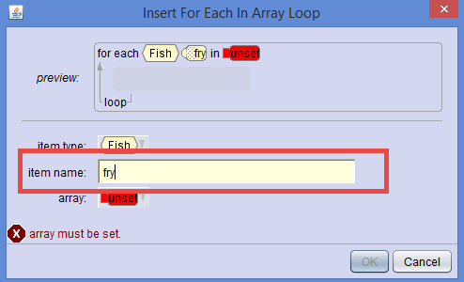
Building a For Each In Loop
Local Variable
When selecting a name you are creating a variable that will hold the item of the array for use in the loop substitution.
Name it something that helps you make sense of the fact that it will be a placeholder for each item from the array that will be stored here.
You will use this as a representative of the objects in the array when programming the content of the control block

Slide 17
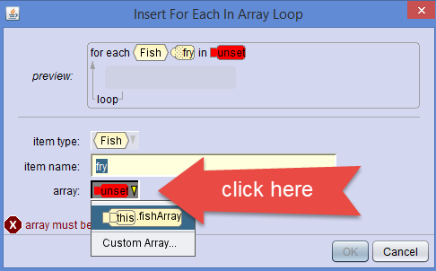
Building a For Each In Loop
Setting the Array
You can make a new custom array for use locally or you can access an array you created elsewhere.
If you don’t see the array you created remember that the class or method where you created the array matters for access as does the data type.

Slide 18
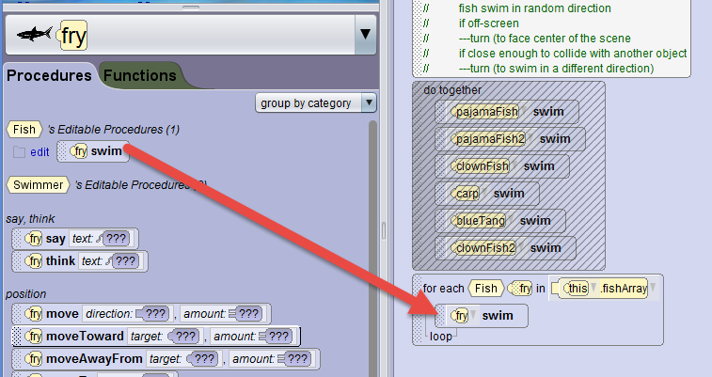
Building a For Each In Loop
Using the Element Variable
The resulting structure shows the variable and the array.
If the array is an object type then you can access the variable as an object in the drop down object menu. You can then drag procedures into your control structure block.
If the array is non-object data type you will need to create the appropriate statements and then access the variable in the drop down statement editor or drag the variable into the appropriate parameter.

Slide 19
Building a While Loop

Slide 20
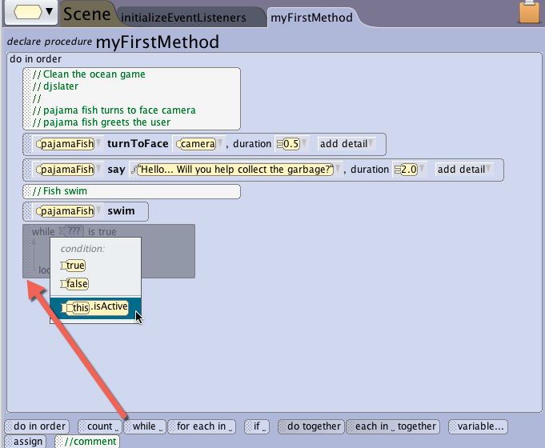
Building a While Loop
Create a While Loop
Drag the while control structure block into your program. You will be required to choose from true or false for the conditional state that will repeat or escape the loop.
If you have created other boolean variables (variables that can only be true or false) you will see them listed as well.

Slide 21
Building a While Loop
Default Conditions to the Loop
The default states will be:
While true is true - which will cause the loop to be repeated indefinitely as the statement will never be untrue
While false is true - will never execute as the statement will never be true to execute what is in the loop

Slide 22
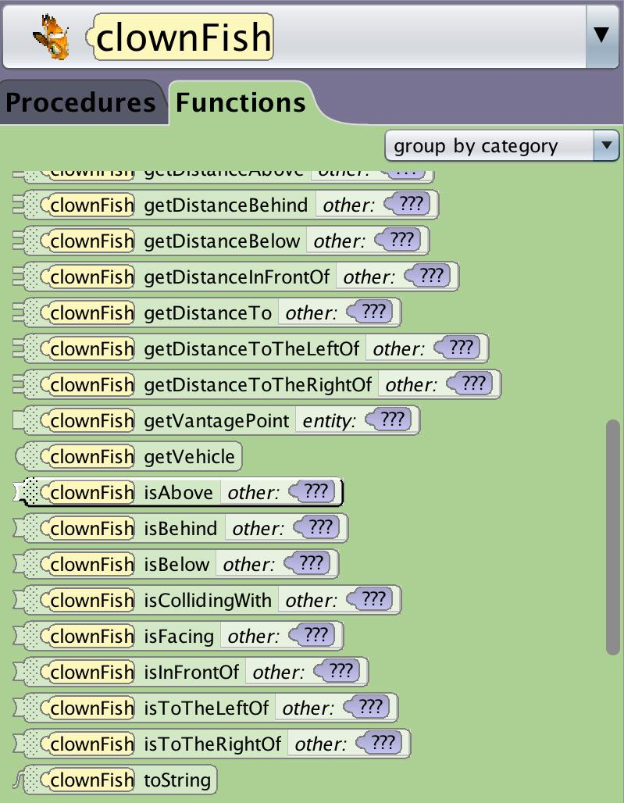
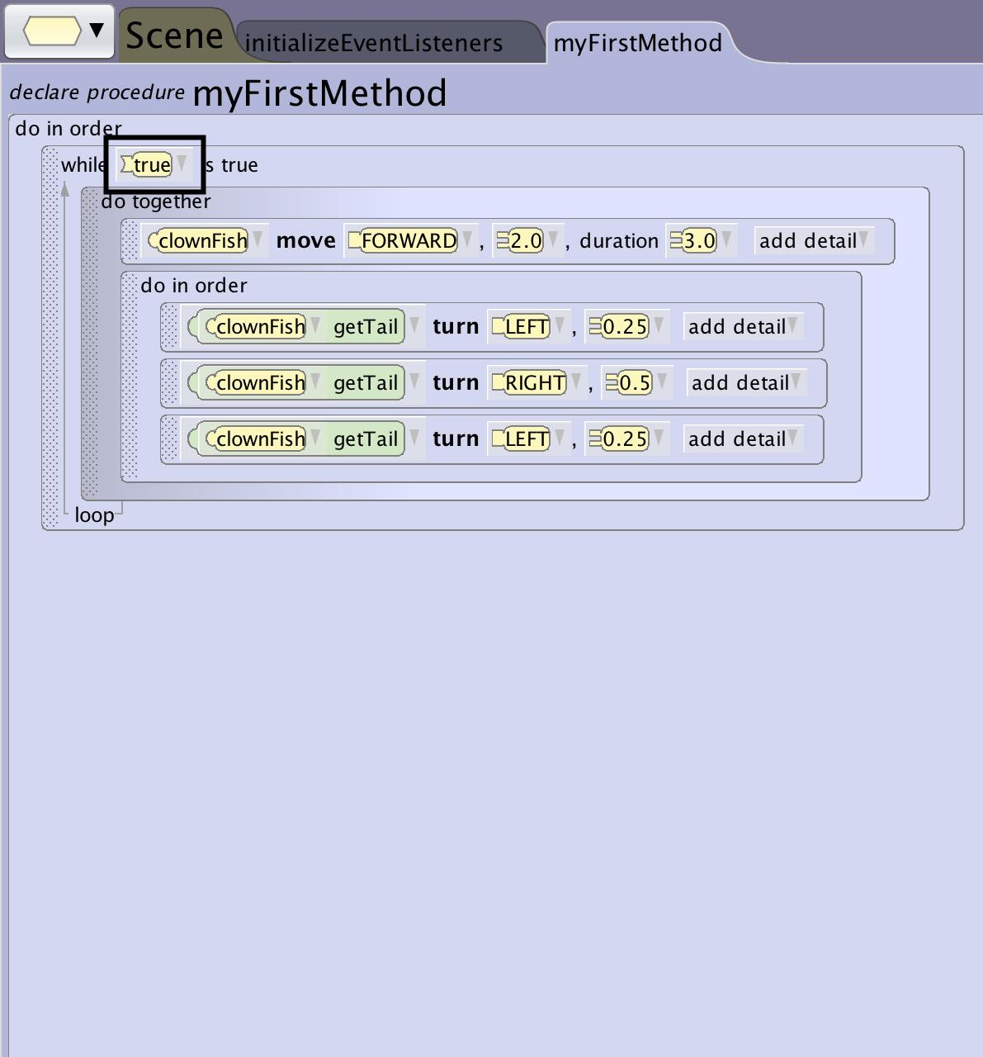
Building a While Loop
Adding Functions to a Loop
One option for creating conditions that can change on a while loops is to add a functional method to the statement.
You can do this by dragging a functional method statement into the condition or construct one from the drop down menu.
This can be used to add functions that ask the user for a boolean input (yes/no questions) or spatial relationships that can only be true or false such as (is above?)

Slide 23
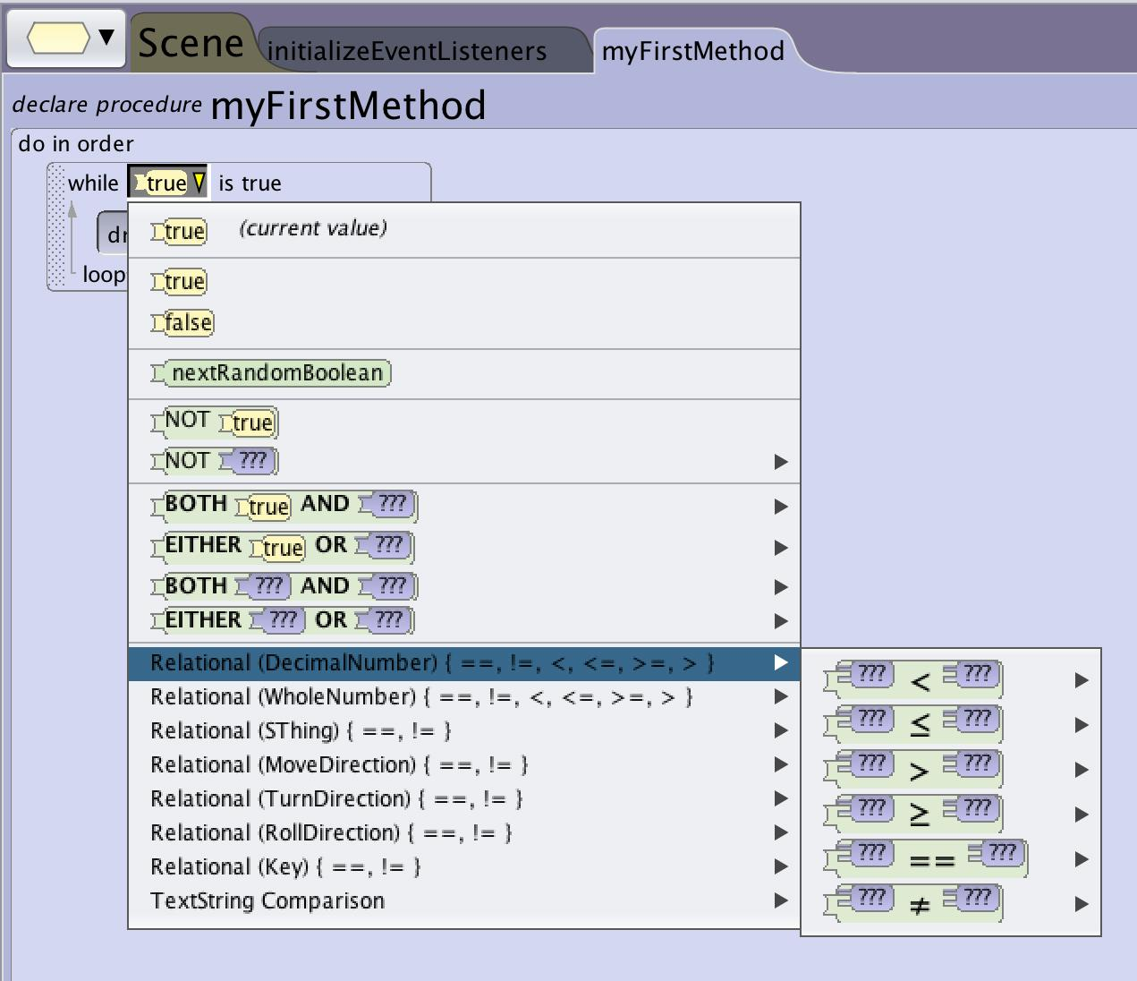
Building a While Loop
Adding Relational Expressions to the Loop
One option for creating conditions that can change in a while loops is to add a relational expression to the conditional statement.
In the drop down for the boolean you can build a relational expression that can change over time (see relational expressions).

Slide 24
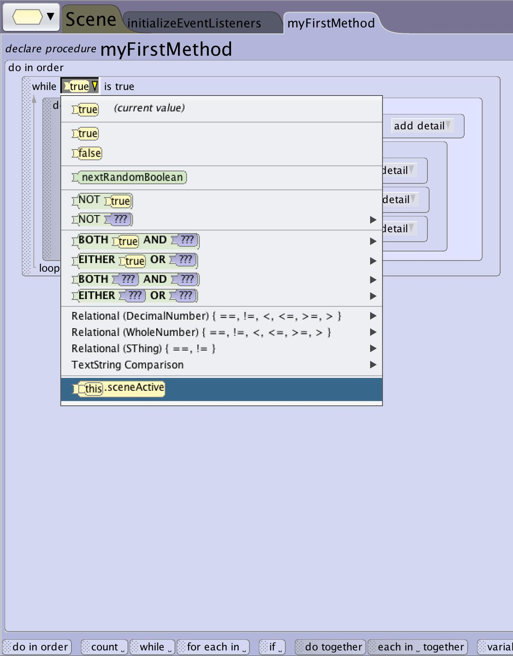
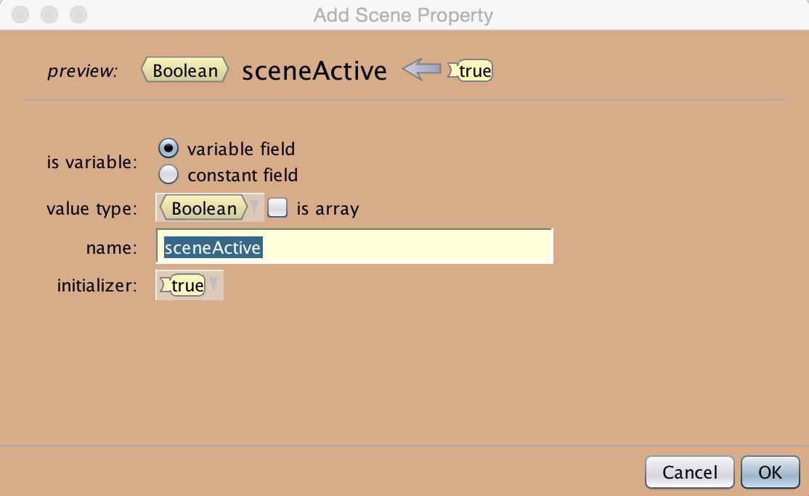
Building a While Loop
Adding Variables to the Loop
One option for creating conditions that can change in a while loops is to add a variable to the conditional statement.
You will need to create the variable outside of the loop (see creating variables).
You can then access the variable through the drop down edit menu.
This can be very useful for creating animations that are dependent on more complicated game or world states to trigger.

Slide 25
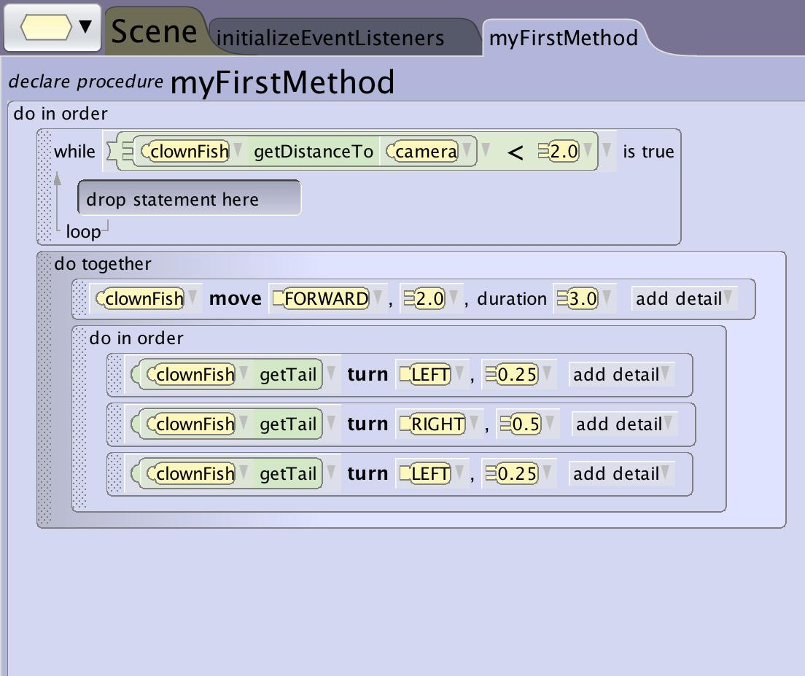
Building a While Loop
Add Statements to the Loop
Once you have created the count loop you can add statements into the block to tell the program what to execute repeatedly.

Slide 26
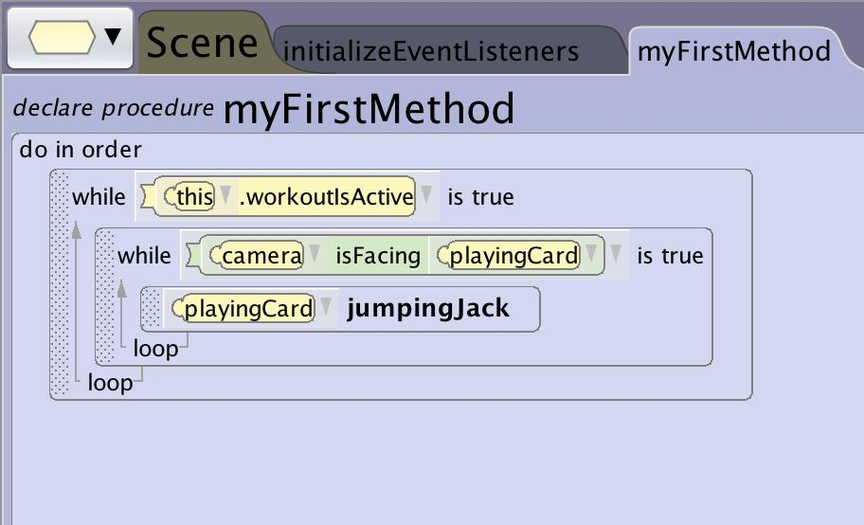
Building a While Loop
Using Nested Blocks
The conditional loop will often end in a construct that catches your program in an infinite loop or will end up being checked only once while the condition is false and never triggering.
If you want other things to execute in addition to or until the condition of a while loop changes you will want to:
Nest the while loop inside a do together allowing other things to occur.
Nest the while loop inside another loop so that it is checked more than once. This effect can also be achieved by creating a while loop using events (see building events)

Slide 27
Tips and Tricks

Slide 28
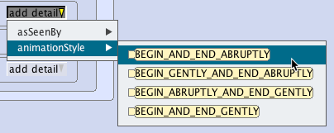
Tips and Tricks
Smoothing Looping Animations
Default animation style for Alice is to accelerate and decelerate for each animation statement. This will cause animations when strung together feel choppy.
Modifying the animation style through add details and selecting begin and end abruptly will allow you to taking away that perceived hesitation between animations.
1 sec
1 sec
1 sec duration
1 sec duration

Slide 29
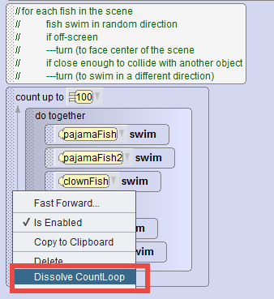
Dissolving Nested Blocks
As with other control structures you can dissolve the surrounding block by right clicking on the block and selecting dissolve.

