Slide 1
Data Types
http://www.alice.org/resources/lessons/data-types/

Slide 2
Data Types
What is a Data Type?
A data type is a classification of data that tells the computer how the data will be used in the program
It tells the computer how to store the information (variables).
Defines the kind of operations that can be performed on that data (parameters)

Slide 3
Data Types
Standard Data Types in Alice
In Alice, standard data types are defined by classes
DecimalNumber
number having a decimal point and digits before/after the decimal point
In mathematics, a DecimalNumber is a real value
WholeNumber
number that does not have a decimal point.
In mathematics, is an integer value
Boolean
has only two possible values: true or false
TextString.
a sequence of alphabetic letters, digits, and special symbols, enclosed in quotes.

Slide 4
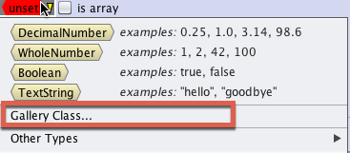
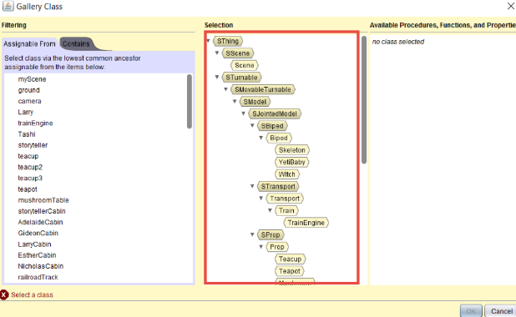
Data Types
Alice Gallery Data Types
Gallery Classes (Objects) - this data type is the base information for each type of object in Alice. This can be set at different levels of the object taxonomy to determine what object data can be accepted or saved

Slide 5
Data Types
Other Data Types in Alice
There are several other data types that Alice makes use of that save unique types of data for use in variables and parameters.
Joint - A sub type of Objects for joint data - this allows you to use this data type for orientation in ways that may not be compatible with all object types Paint - texture image or color data Color - sub type of paint that only allows digital color data Move Direction - cartesional data Turn Direction - orientation data Roll Direction - orientation data Key - keystroke data that can handle all keyboard characters including space bar Audio File - audio file reference data

Slide 6
Data Types
Where it Matters
Used to define Variables - to be able to store a variable you need to define what kind of data will be stored or expected. This will then insure that you only assign one type of data to that variable to insure it will comply with expectations when called.
Used to define Parameters - setting the data type for a parameter insures that the method or function will be able to process the data.
Used to define custom function returns - defines the data type that a function will return
Used to define arrays - making an array of similar types allows you to call them in methods and functions that require or expect a specific data type.

Slide 7
Data Types
What it Impacts
What type of data a variable can hold and where that variable can be used
What type of information can be passed through a parameter
Where a function can be used to return the right type of data
What type of information can be added to an array
Many of the places where you are given a drop down menu reflects a place where we have constrained the data type and are offering you options that conform to that data type
When trying to drag code into different blocks the highlighted area is reflecting places where the data type is consistent and a match

Slide 8
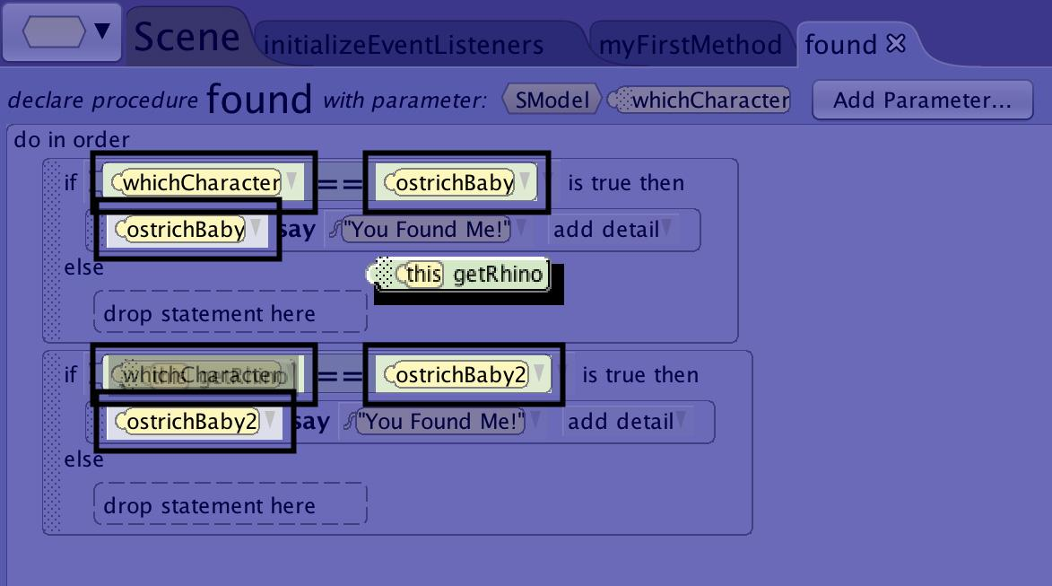
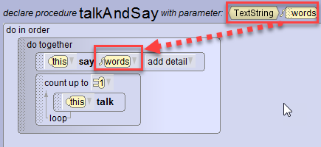
Data Types
Data Type Mismatch
Alice will constrain you so that you can’t make data type mismatches. You will know that you are aligned if the box appears surrounding the location you want to drag your function or variable. You should also see the desired options or variables in the required drop down. If you can’t use the data you want check for a data type mismatch.

