Slide 1
Design: Interactive Narrative
http://www.alice.org/resources/lessons/design-interactive-narrative/

Slide 2
Where do I start?

Slide 3
Problem Statement
Design Thinking and Problem Solving
Problem Statement
Define the Problem
Understand the Problem
Design a Plan
Implement the Design
Test the Design
Repeat as Necessary
Understand
the problem
Test
Design a
Plan
Implement
Design

Slide 4
Problem Statement
What is my Problem?
When thinking about creating an interactive narrative we will focus on a combination of these two problems:
I want to create a story where ….
I want to build a world where….
I want to build a game where…..

Slide 5
Understand the Problem
Understand the Problem
What tools can I use to help define the problem?
What are the important components to consider?
Problem Statement
Understand
the problem
Test
Design a
Plan
Implement
Design

Slide 6
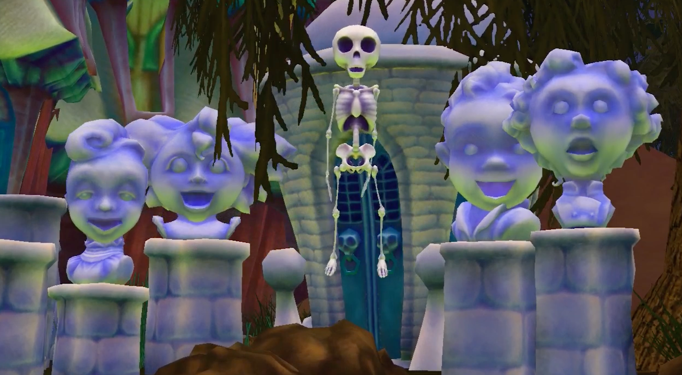
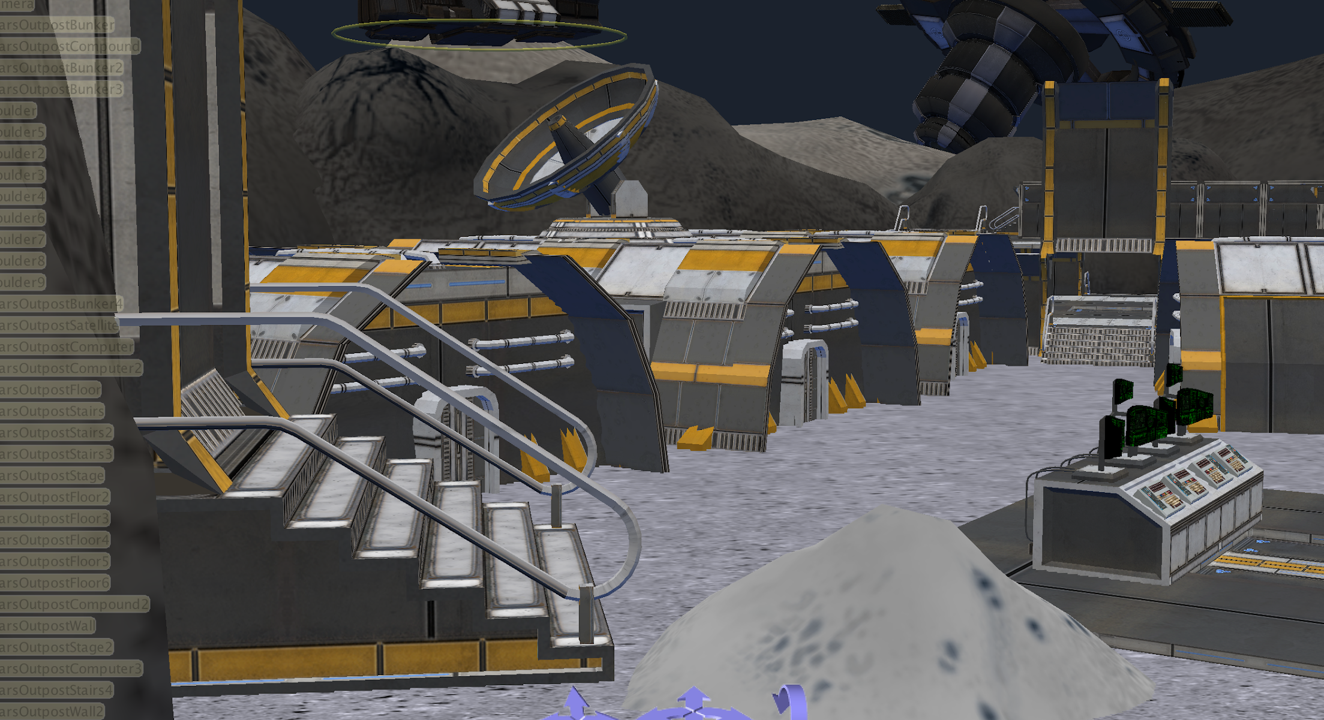
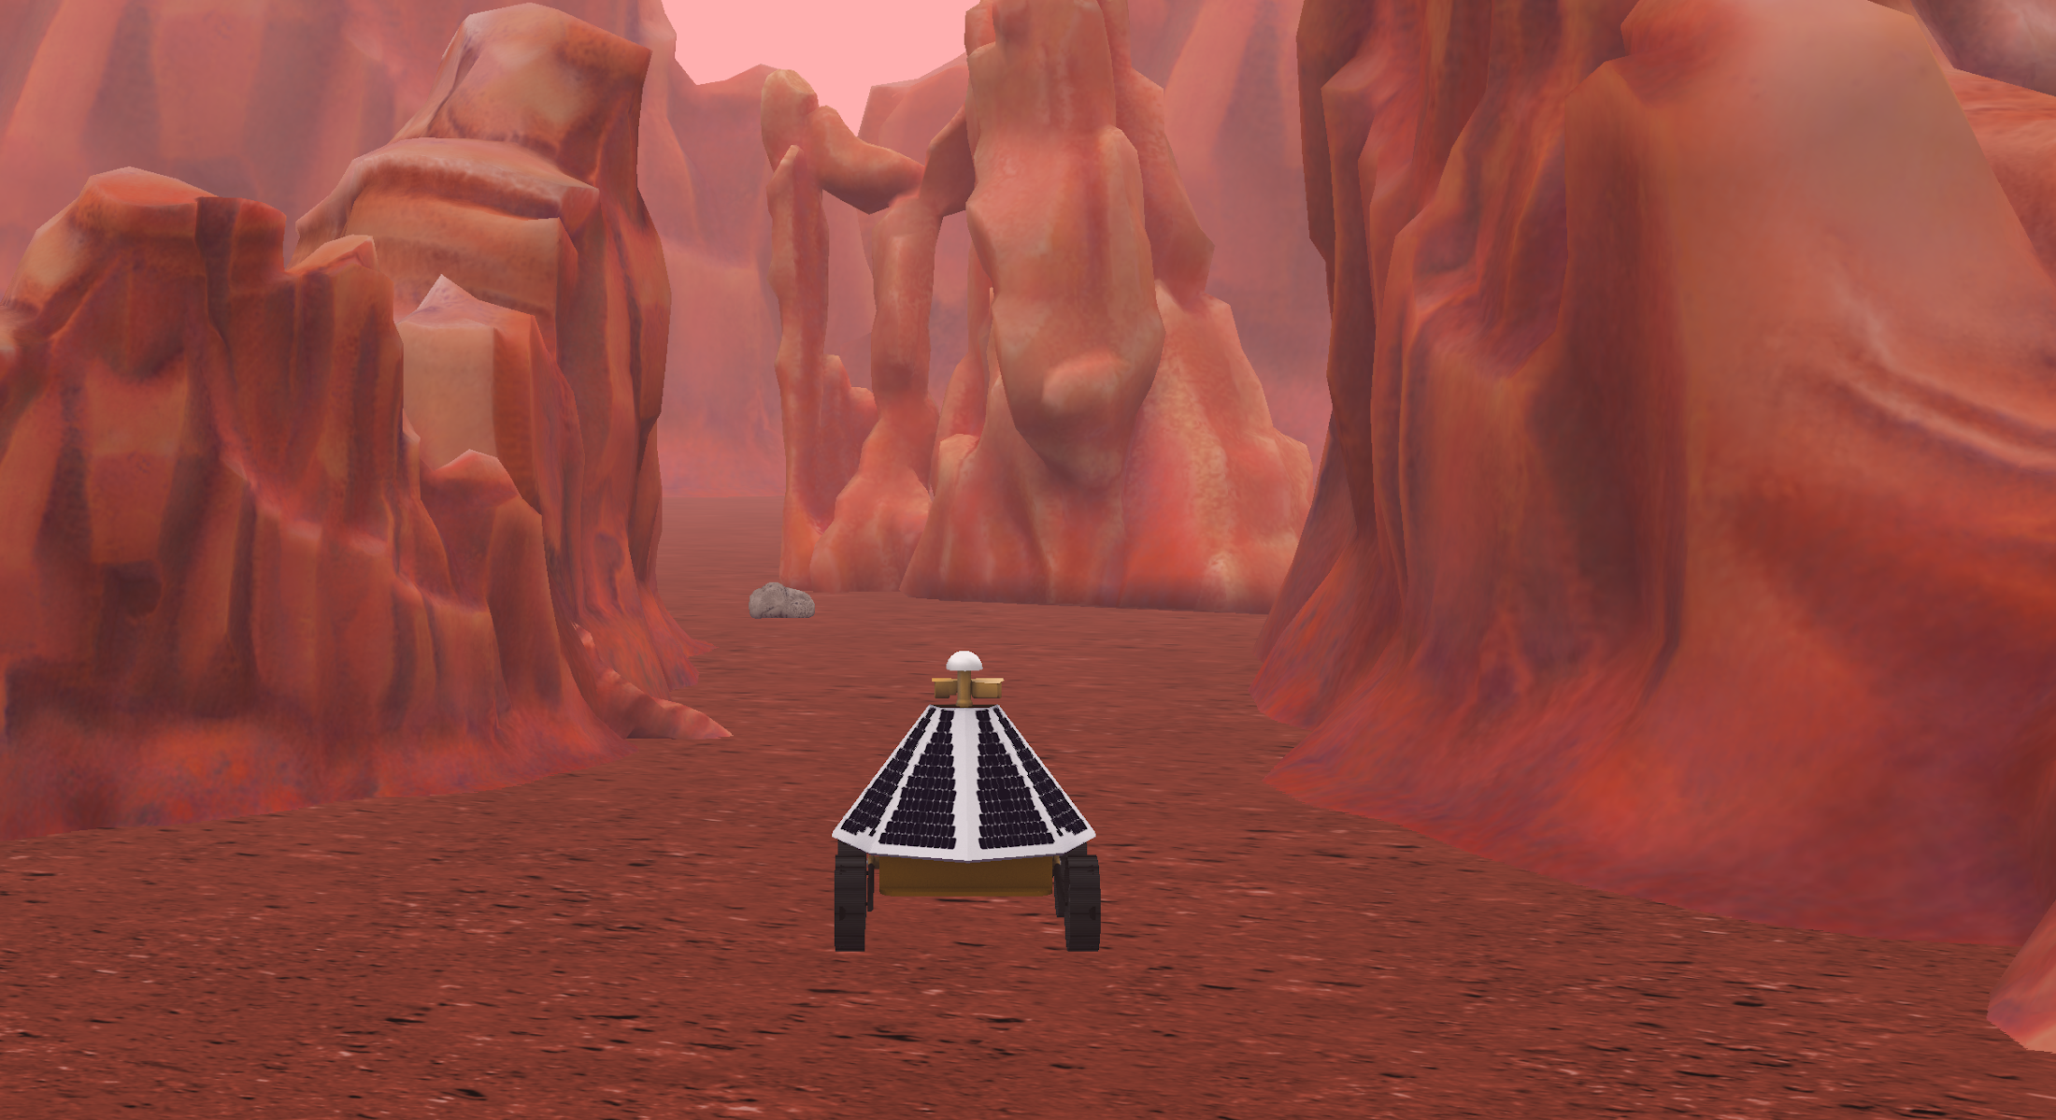
Understand the Problem
Different Needs
Story - For a linear animation you can use a script, storyboard, or straightforward flow chart to help you brainstorm and dissect your problem.
Interactive Narrative - For a branching narrative or open world you may need to create a higher level flowchart or a world map in addition to standard script and storyboard elements for each interaction.
Game - For a game you want to create a game design document that details win/lose conditions, game mechanics, and player control maps in addition to world maps and storyboards for interactions.

Slide 7
Understand the Problem
What is an Interactive Narrative
An interactive narrative is story that allows the user to engage with the story and participate through interactions or even change the outcome of the narrative. This can be achieved through things such as:
story elements that are revealed or advanced through user input
interactive elements that allow the user to choose where to advance the story
A classic example is a choose your own adventure story where the reader is confronted with decisions on where to take the story next that jumps the reader to new story elements.

Slide 8
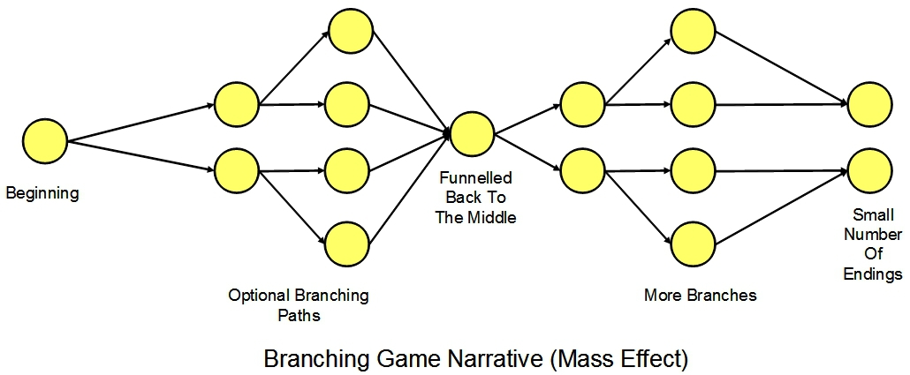
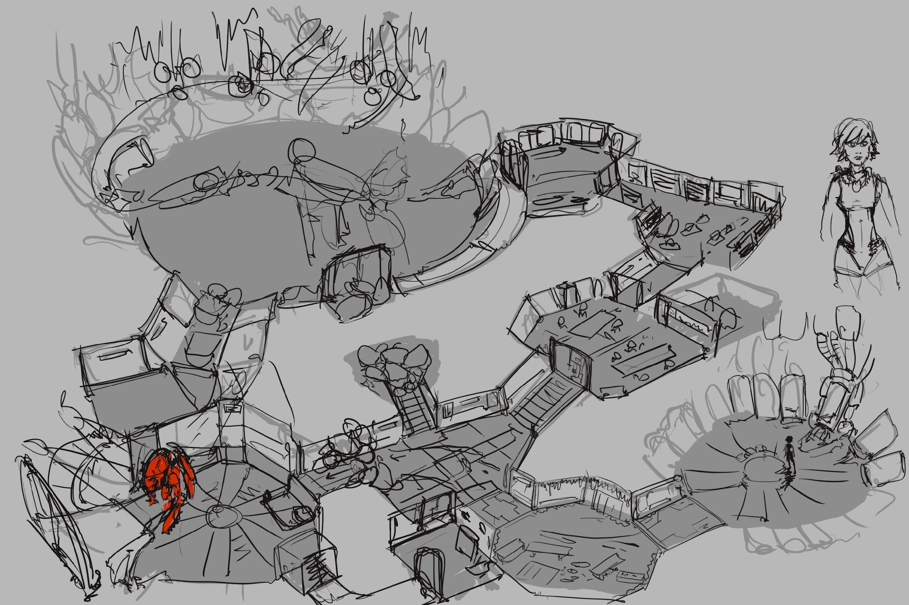
Understand the Problem
Different Approaches to Interactive Story
Guided Experience - This approach makes discreet branching points where the user is confronted with choices that take them to a new story element.
Open World - This approach lets the player engage with the world in whatever order they desire revealing the narrative through separate interactions around the scene.

Slide 9
Understand the Problem
Writing the Story
Even though you are now designing for interactivity it is still important to understand what story is being told?
Where does it take place?
Who are the Characters?
What actions are taken?
What events happen?
For an interactive story it is also important to consider
Is there an explicit order to events?
Where could the story diverge or converge?
Is there an ending? Multiple possible endings?

Slide 10
Understand the Problem
Mapping Out The Story
There are a couple options for how to brainstorm the flow of your story.
Plot mapping - this diagram allows you to make a diagram of the major story components and plan for where each branch of the story will go.
World design - this is more of a level design where you plan for the environment thinking about places where major narrative events will occur.

Slide 11
Understand the Problem
Story Map
You can use a story map to outline major story points and break down your narrative into smaller components that can then be designed individually.
Think of each node as a story chapter or interactive plot point
Each node can be a single interaction or a longer story animation or interaction
Not all plot points need to branch
All of the plot points could happen in one location ie a branching conversation

Slide 12
Understand the Problem
World Design
Creating a world map and calling out where things will happen in the story can help develop a plan for how your story will unfold.
You can think about how you would want the user to progress through the world
Remember the user will be able to move around however they would like
Different locations can be gated or revealed as the player progresses
Story Location

Slide 13
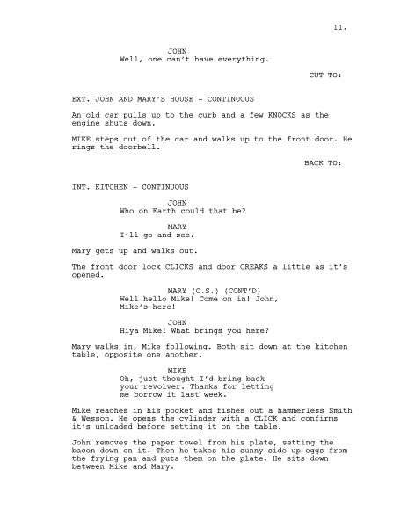
Understand the Problem
Scripting and Storyboarding
The high level story or world should still be pushed further to think through each location or plot point through the use of script or storyboards. This can help you think deeper about the characters and locations and how your story will reveal itself.

Slide 14
Design a Plan
Designing a Plan
Now that you have the main story outlined how do you plan on how you will build it?
What are the important components to consider?
How will you lay out the program?
Problem Statement
Understand
the problem
Test
Design a
Plan
Implement
Design

Slide 15
Design a Plan
Translating the Story
The major addition to the planning process between a sequential animation and an interactive is the consideration of either navigation controls in the scene planning, a decision tree in the program planning, or both.
Set Design
(Scene Setup and Navigation)
Design a Plan
Program Planning
(Algorithm/ Flow Chart)

Slide 16
Designing the World

Slide 17
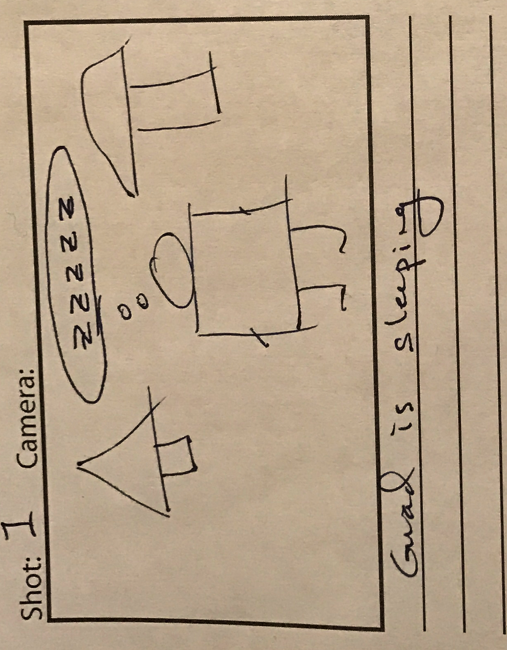
Design a Plan
Scene Design
Information for building your scene comes from:
Layouts from your level maps
Scene descriptions in a script
Scene information in your storyboards
The information to be used consists of the location information, the props, and the characters

Slide 18
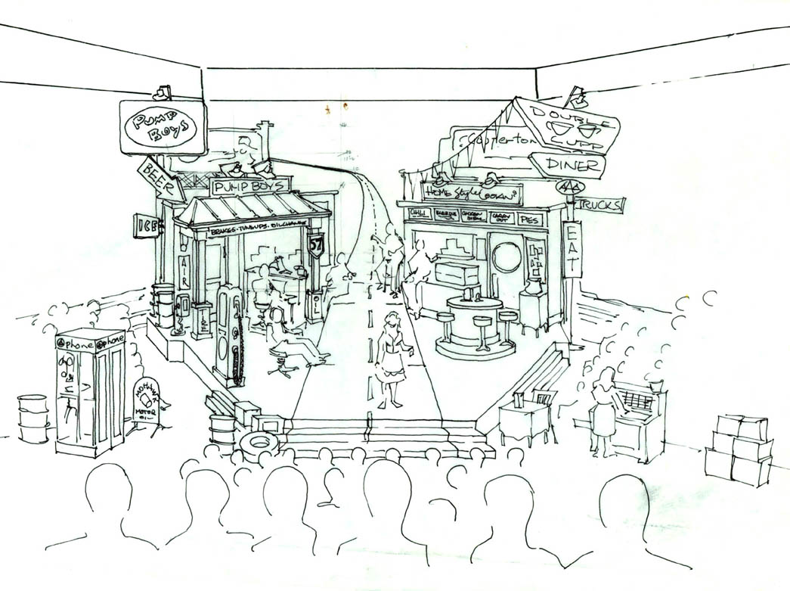
Design a Plan
Guided Navigation
If your narrative will use multiple locations but you will be controlling the movement of the character or camera you can create a set design or use the world map to plan out how the player will be guided through the scene and plan for all of the different needs of the environments and camera angles.

Slide 19
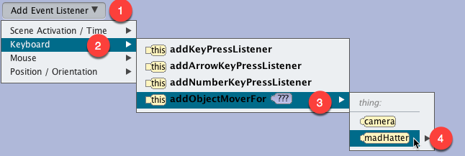
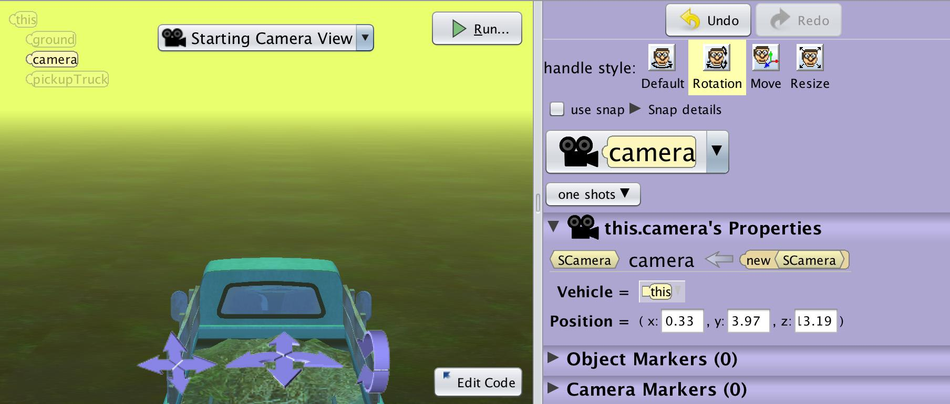
Design a Plan
Open World Navigation
For open world stories you will want to think about if it is a first person or third person experience. This will help you think about the scale of the environment and the views the player may encounter.
First Person - the camera is the eyes of the user and you move the camera around the world.
Third Person - the camera follows the avatar of the user (ie a character or vehicle) around the world.

Slide 20
Designing the Program

Slide 21
Design a Plan
What is an Algorithm
Do In Order
Step 1: Scientist One Says “Why was there thunder and lightning in the lab?”
Step 2: Lightning Flashes
Step 3: Scientist Two Says “I don’t know why?”
Step 4: Scientist One Says “The scientists were brainstorming”
A set of steps to accomplish a task:
how to get from home to school
how to sort a deck of cards
A computer science algorithm is a set of steps for a computer to accomplish a task.
An Alice Algorithm is a set of steps to tells the computer how to animate the virtual environment.

Slide 22
Design a Plan
Translating an Interactive Narrative
The first scientist says to the second scientist “Why was there thunder and lightning in the lab?”
If the hero responds “yes” the sphinx says “you are incorrect”
When the character selects the orb the user is transported to the moon.
When translating an interactive narrative you will still be looking at your script or storyboard and thinking about:
Nouns - objects that need to exist in the world
Verbs - things you will need to animate
You should also look out for conditional words such as if or when to indicate that the story might require user input or have a branching option.

Slide 23
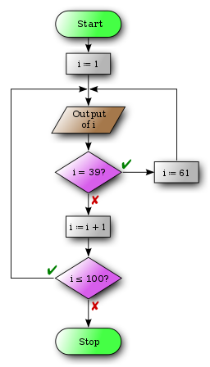
Design a Plan
Deconstructing Your World
A good way to separate and organize your program may be to:
Choose your own adventure or scripted:
Create a custom procedure for each plot point that can be constructed separately
In many cases they will end with a conditional statement or input that advances or branches the story
Open world:
Create a custom procedure for each location or interaction in your open world
In many cases they will have their own unique event listener for triggering.

Slide 24
Design a Plan
Scripted Algorithm Design
Do In Order
Scientist One Says “Why was there thunder and lightning in the lab?”
Lightning Flashes
Scientist Two Says “I don’t know why?”
Scientist One Says “The scientists were brainstorming”
For sections of the design that are scripted animations you can create short algorithm solutions to help guide the programming of individual methods.
You can easily break down each step or component of the flow chart into smaller algorithm designs until you have objects and actions that you can translate to a program.

Slide 25
Design a Plan
Using Flow Charts
Flow charts are very helpful for planning conditional and event driven animations. It is easy to indicate what will start the interaction or where conditional outcomes will link to.

Slide 26
Implement Design
Implement Design
With event driven and conditional implementations it is more important to test each component as you build them:
Start by implementing parts of your world or narrative
Test and refine small sections before moving on to new components
Revise and redesign based on what you find when implementing
Problem Statement
Understand
the problem
Test
Design a
Plan
Implement
Design

Slide 27
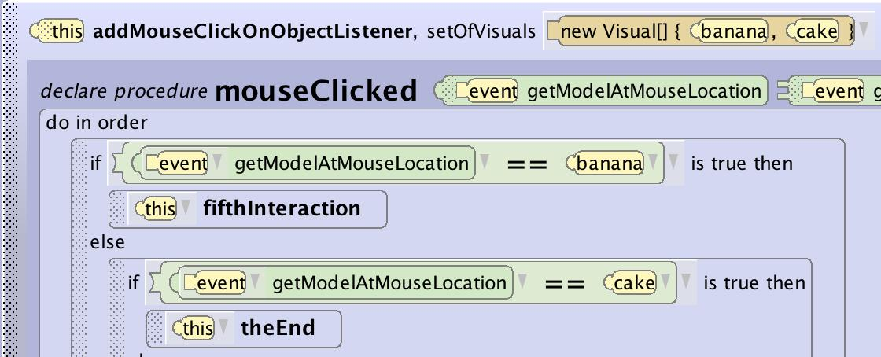
Implement Design
Common Conditional Interactions
In Alice there are couple easy mechanics you can use to set up branching or gated interactions that allow you to wait on user input to advance the story:
getBooelanFromUser, geStringFromUser, getIntegerFromUser - these functions allow you to set up a question that will wait for an answer from the user and can easily be added to a conditional block.
keyPressListener, mouseClickListener - these can be set up to be prompted in a way that allows them to gate or advance the story.

Slide 28
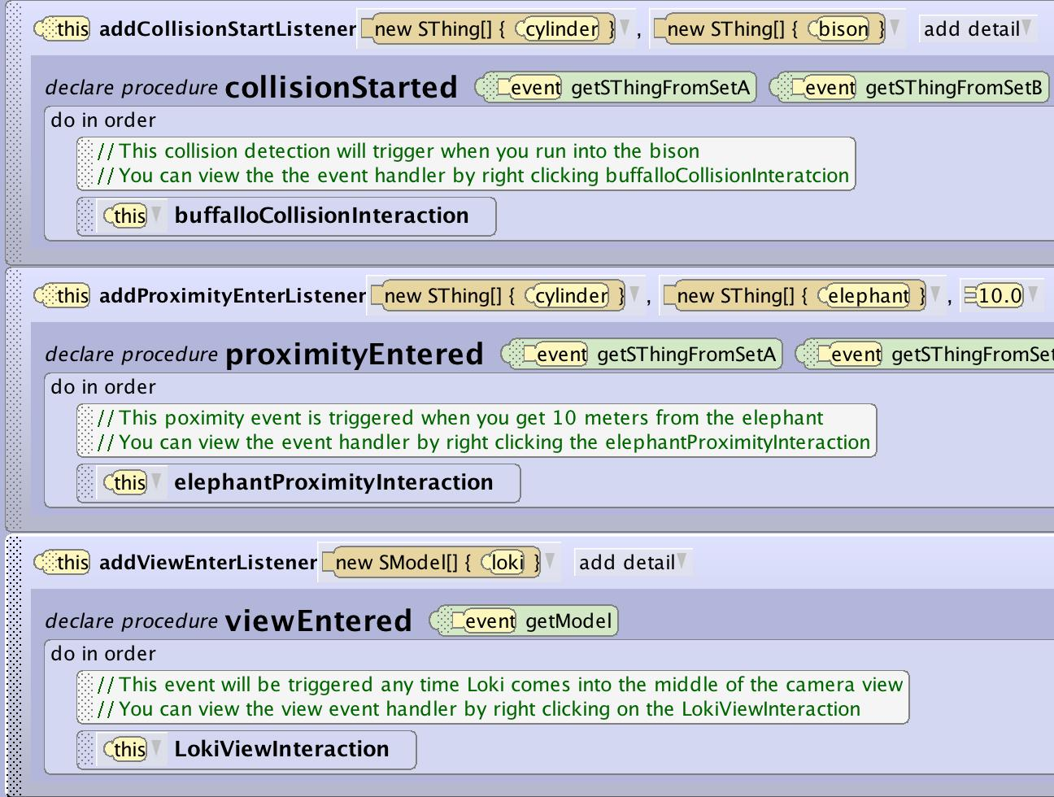
Implement Design
Common World Events
If you construct an open world you can make use of several simple interactions that are triggered when the user walks around the world.
All of these collision, proximity, and view entered triggers can then call unique story procedures that can hold story elements and can even contain further conditional interactions.

Slide 29
Testing
Testing
With event driven and conditional implementations it is more important to test each component as you build them:
Start by implementing parts of your world or narrative
Test and refine small sections before moving on to new components
Revise and redesign based on what you find when implementing
Problem Statement
Understand
the problem
Test
Design a
Plan
Implement
Design

Slide 30
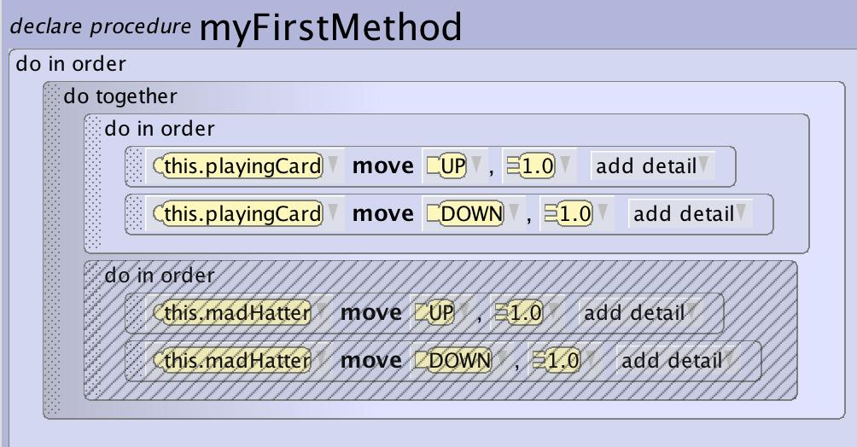
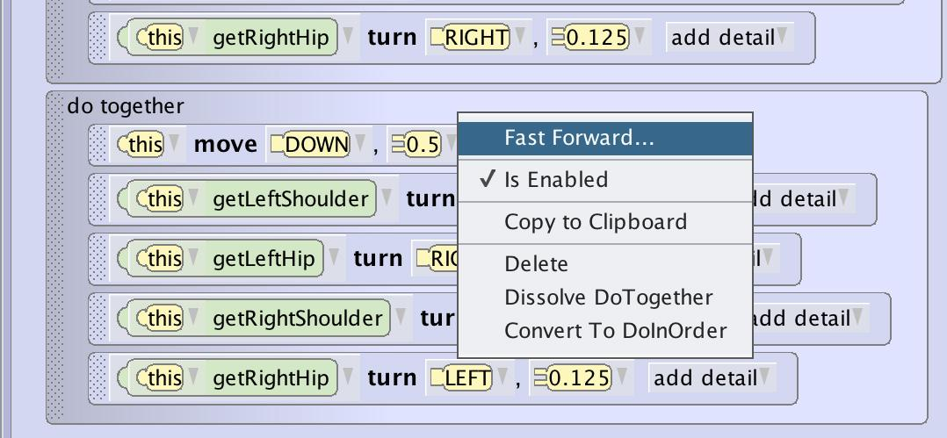
Testing
Disabling and Fast Forwarding
It is a little harder in interactive worlds to disable or fast forward because dependencies for where objects should be and the need for input can block these functions. You can still modularly test interactions.
In open worlds you can easily skip other interactions and move directly to the area to test.
In guided experiences using fast forward will still accelerate the animations and movements between interactions.

