Slide 1
Relational Expressions
http://www.alice.org/resources/lessons/relational-expressions/

Slide 2
Relational Expressions
What is a Relational Expression
A way to compare to entities that resolves to true or false.
A relational expression can be used to resolve for the boolean data type.
They are often used to inform conditional expressions such as if_else and while_
The basic equations are ==, ≠, <, ≤, >, ≥.
In Alice we have also added text comparisons for equals, starts with, contains, and ends with.

Slide 3
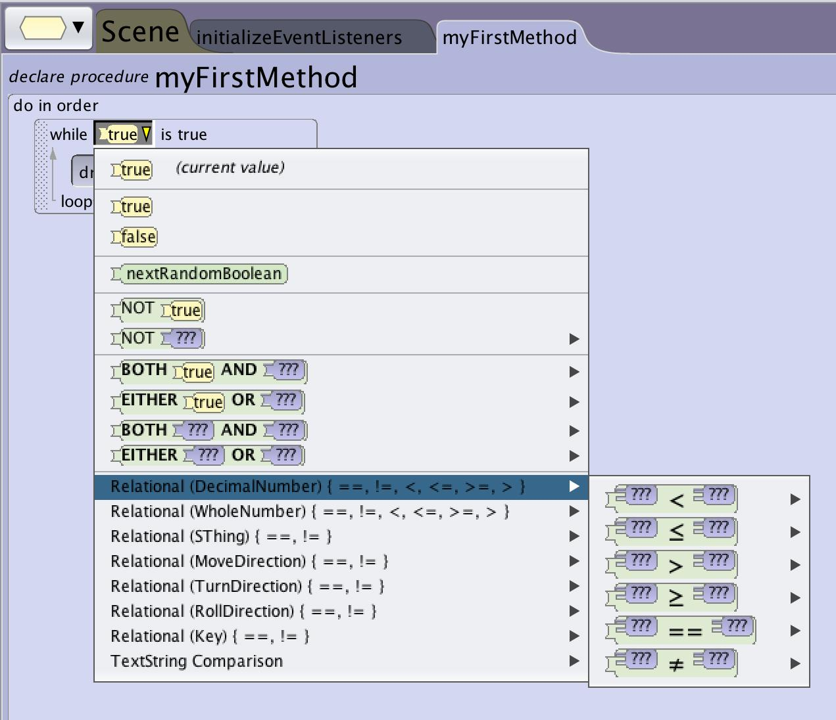
Relational Expressions
How to Construct
You can access the relational expression menu anywhere that you have a boolean data type. Traditionally the two places you will construct relational expressions is in the if_else and while_ control structures to determine which outcome to return.

Slide 4
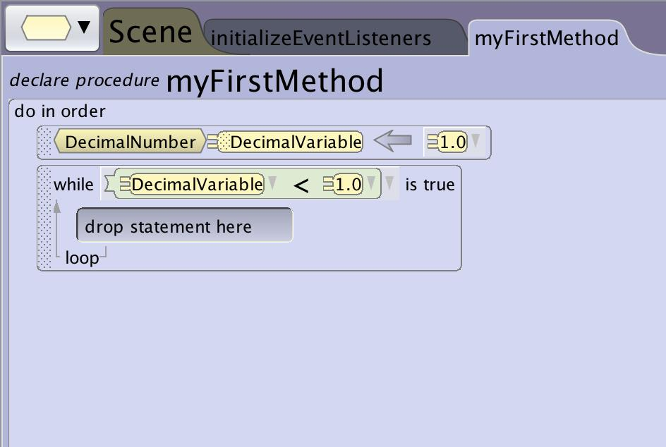
Relational Expressions
Using a Variable
A relational expression with all constants will always resolve to the same outcome.
To create a truly conditional statement you will want to add a variable to the relational expression. This could be:
A variable that is altered elsewhere in the program
A function that changes based on user input or randomization
To add a variable or function just create an expression using placeholders and drag the variable or function into the statement being sure to match data types.

Slide 5
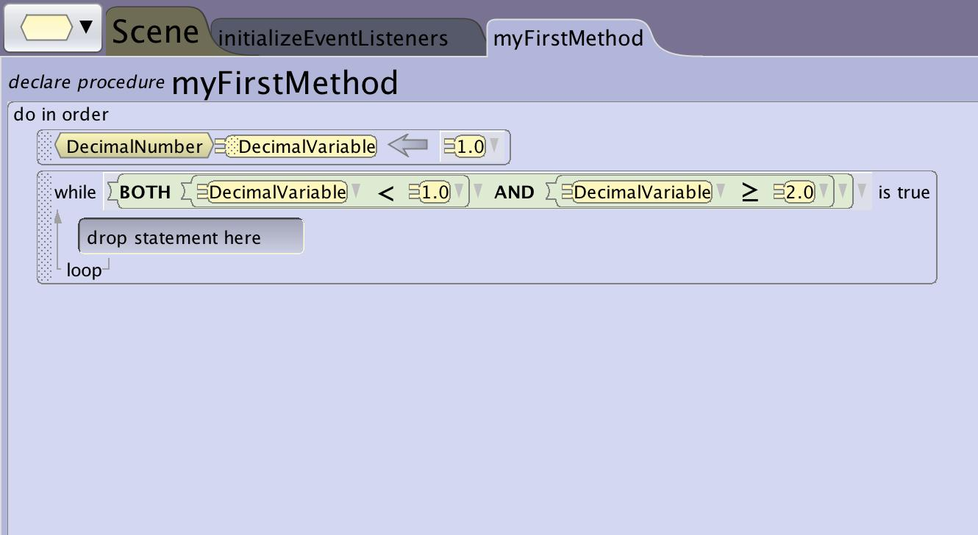
Relational Expressions
Extending an Expression
You can use the both_and or the either_or to create relational expressions that have multiple comparisons that need to be met.

Slide 6
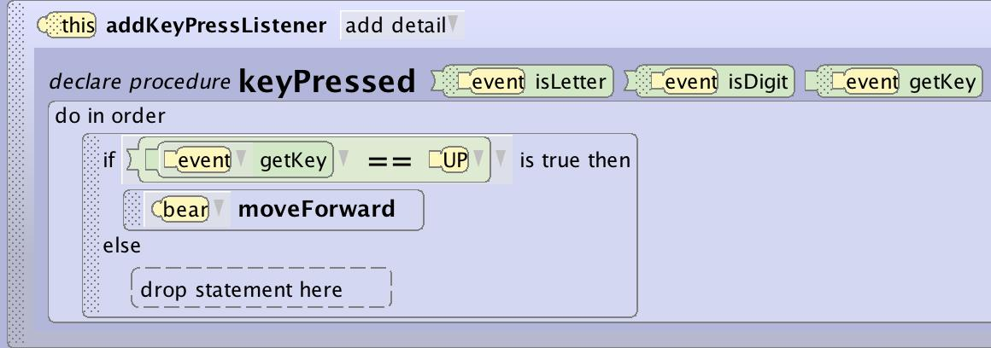
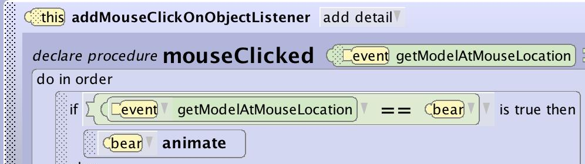
Relational Expressions
Common Uses
Some of the common uses of relational expressions in Alice are:
If score is greater than or equal to 10 win game
If textFromUser contains y then answer is correct
If keypress is up arrow move forward
If object clicked equals bear animate bear

