Slide 1
Using Parameters
http://www.alice.org/resources/lessons/using-parameters/

Slide 2
Using Parameters
What is a Parameter
A parameter is used to pass information to a procedure when the procedure is used (invoked)
Most built-in Alice statements use parameters
move parameters are: direction, distance
turn parameters are: direction, turn amount
A parameter allows you to pass information between methods including between methods of different classes

Slide 3
Using Parameters
Why Use Parameters
A parameter can be used to broaden the use of custom methods by allowing you to customize the behavior when it is used - much like our built in move and turn.
A parameter can be used to pass data between methods such as
passing outputs of events into handler methods
making methods aware of variables

Slide 4
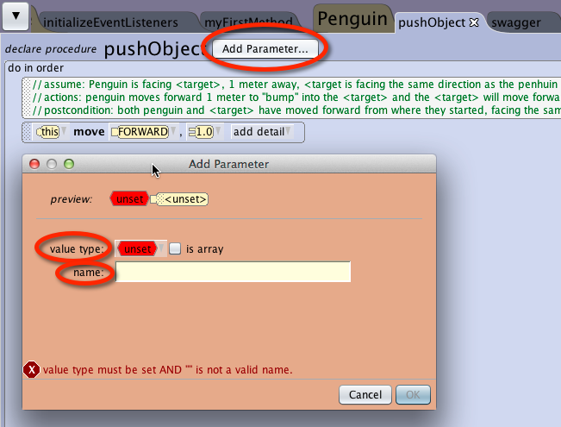
Using Parameters
Adding Parameters
To add a parameter to a method click the add parameter button found at the top of the method tab.

Slide 5
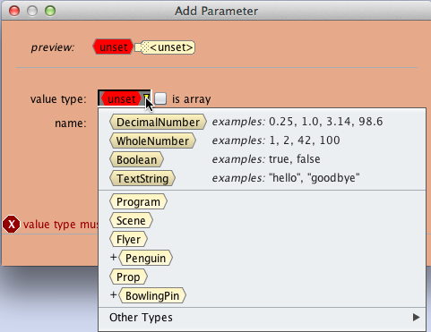
Using Parameters
Parameter Data Type
Select the type of data that you will pass through the parameter.
The available data types will vary depending on where it is being added.
When using gallery classes it is important to choose the right level of class to insure all of the classes you want to pass will be possible.

Slide 6
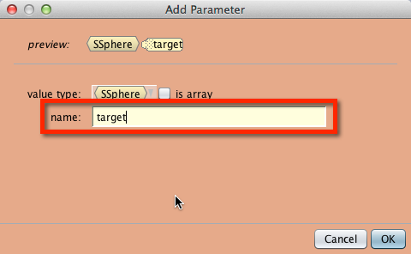
Using Parameters
Naming Your Parameter
Be sure to name your parameter in a way that you will know how the data will be used to modify the custom method such as:
textBubbleText
moveToTarget
Examples from built in procedures are:
distance
direction
target

Slide 7
Using Parameters
Parameter Declaration
A parameter declaration consists of:
<type> <parameterName>
example: <SSphere> < target>

Slide 8
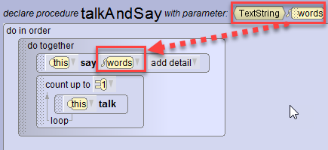
Using Parameters
Using the Parameter
The declared parameter is then used as a representational placeholder (variable) in the code developed in the method. Whatever value is given to the parameter when the method is called will replace this variable.
You can access the parameter in drop downs for parameters that match the data type or you can drag the parameter into the program where you would like the argument to be passed. The data type of the parameter will dictate where you will be able to add the parameter variable.

Slide 9
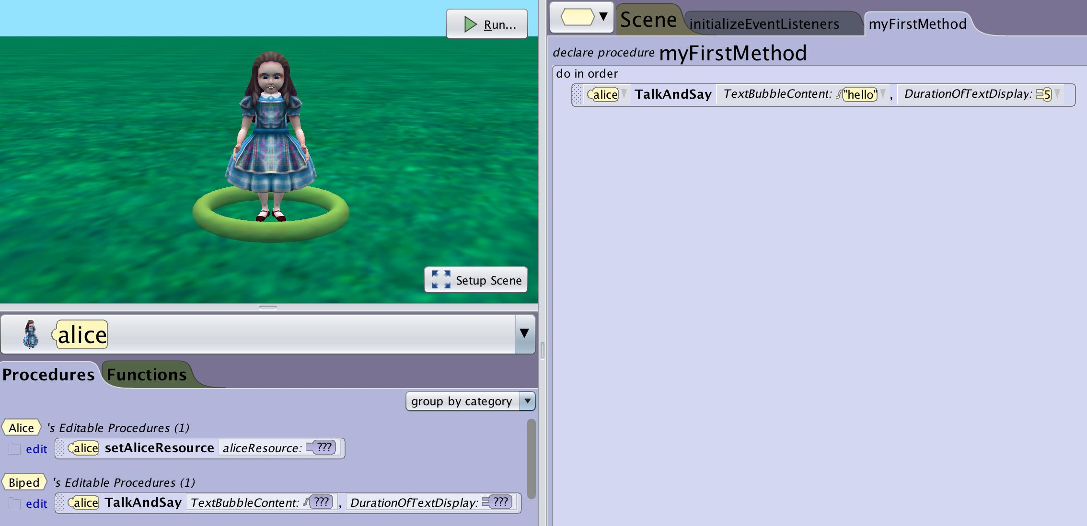
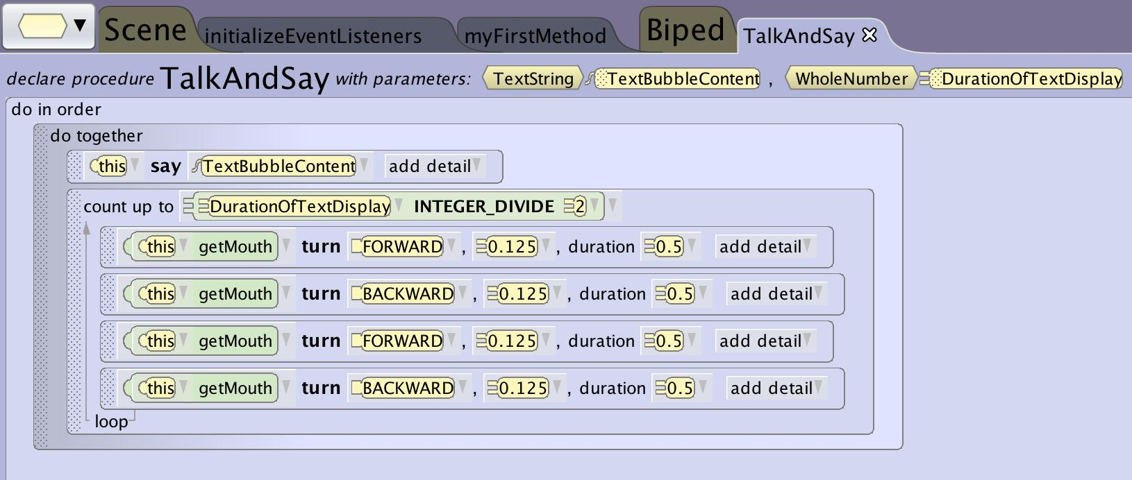
Using Parameters
Required Argument
Once you have added a parameter you will see it is now a required parameter when using the custom method.
The data given for the parameter will then be passed through the parameter into the custom method and used where it is has been added to your custom method statements.

Slide 10
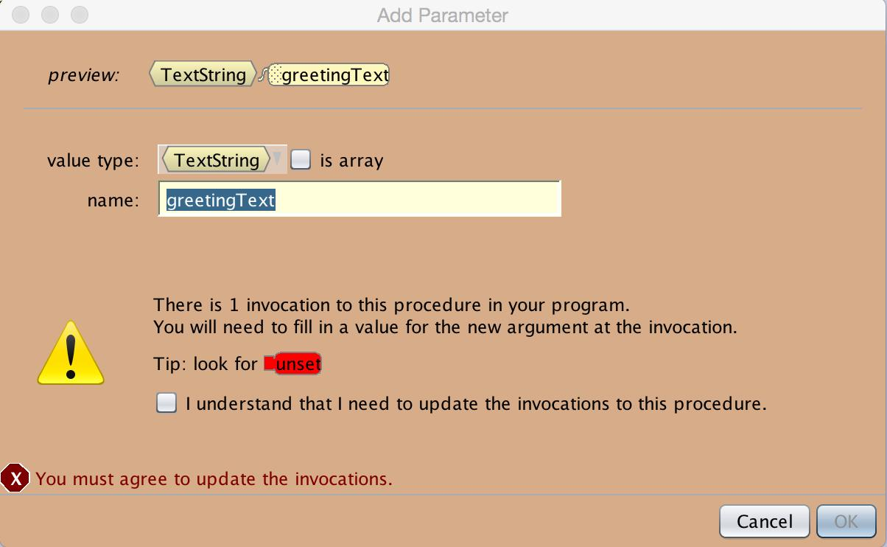
Using Parameters
Parameter Warning
If you add a parameter after you have invoked the custom method you will receive a warning that there will be procedures with unset parameters.
You can chose to ignore this warning but you should be sure to go and update the existing uses or they will create errors where the procedures don’t have the required information to successfully perform the intended action.

Slide 11
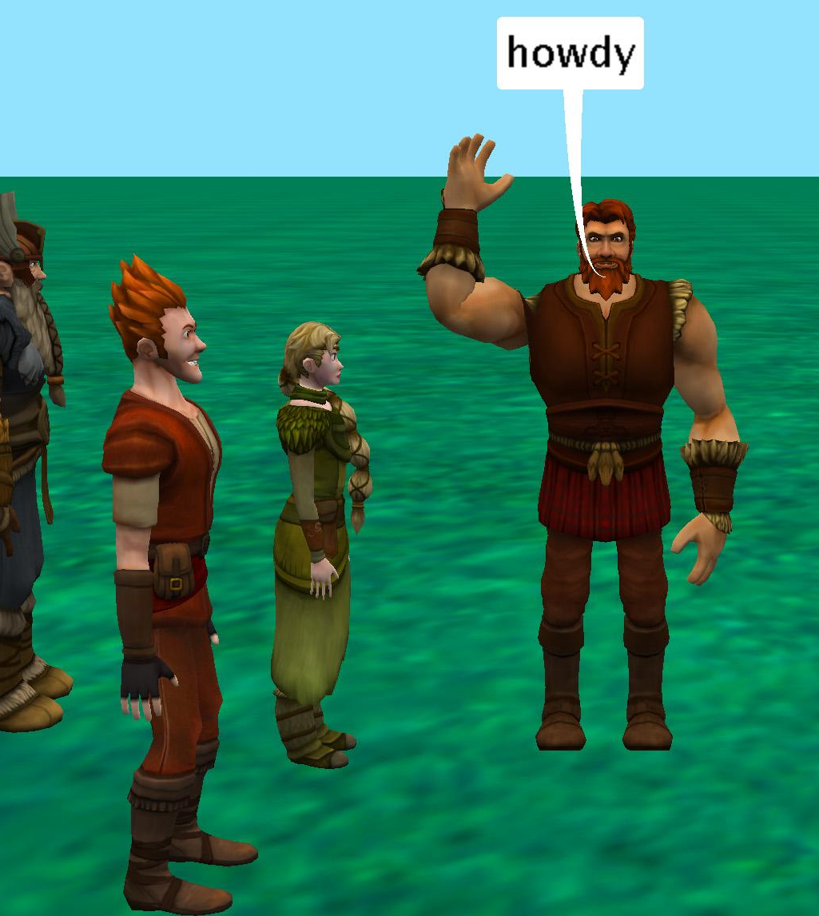
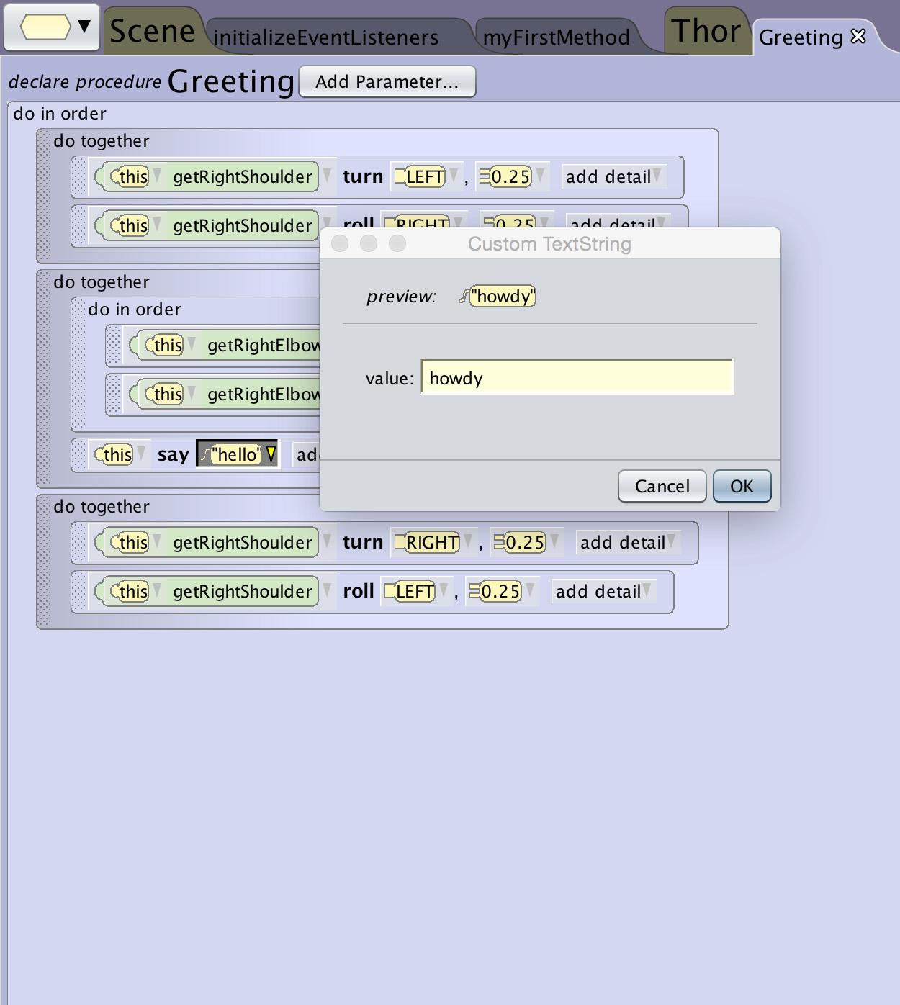
Using Parameters
Thor Greeting Guests
We created a greeting procedure to allow us to reuse the arm wave and text greeting for each guest that joined the party.
However if Thor says “howdy” to every guest as they arrive he will start to sound like a broken record.
What if we want to reuse the greeting method each time but we want to customize what he says?

Slide 12
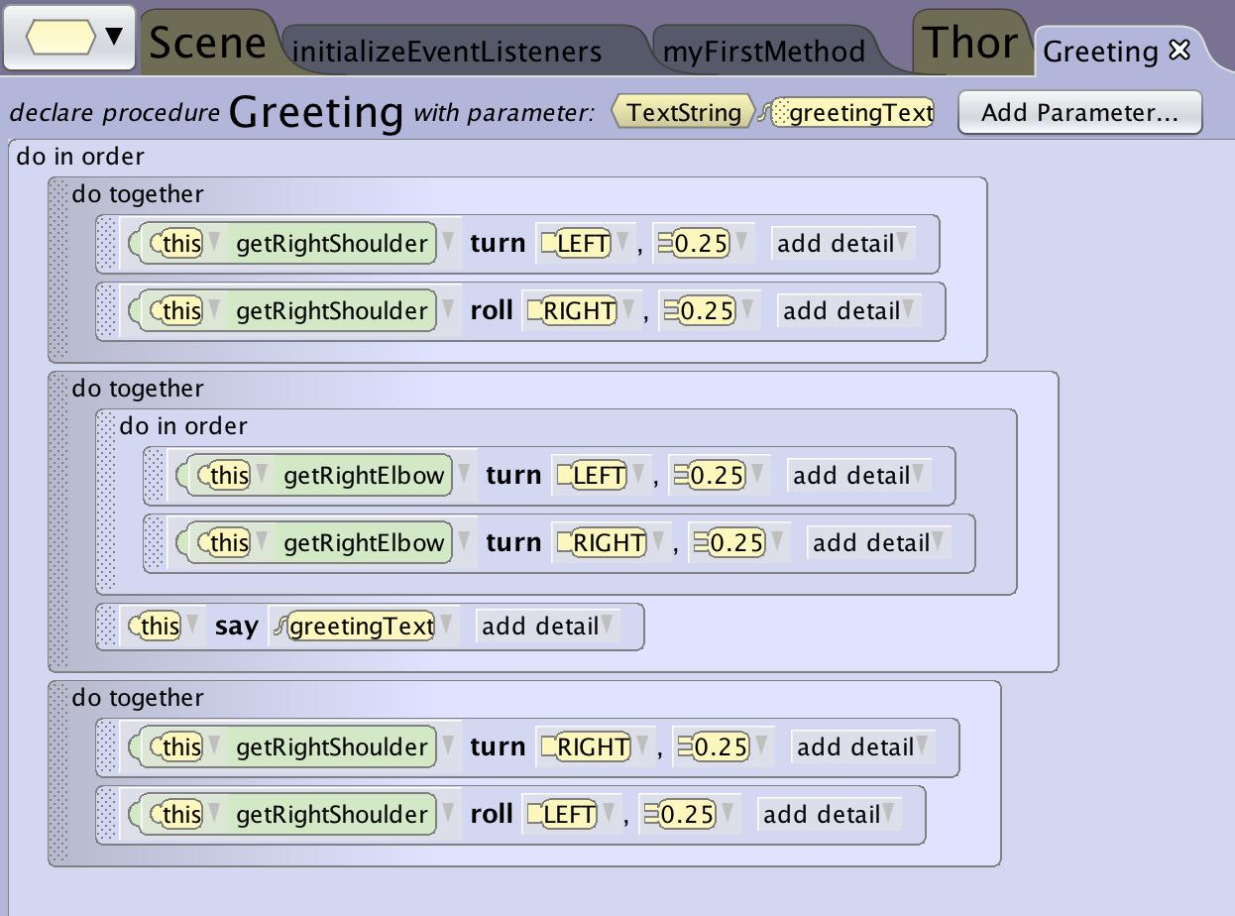
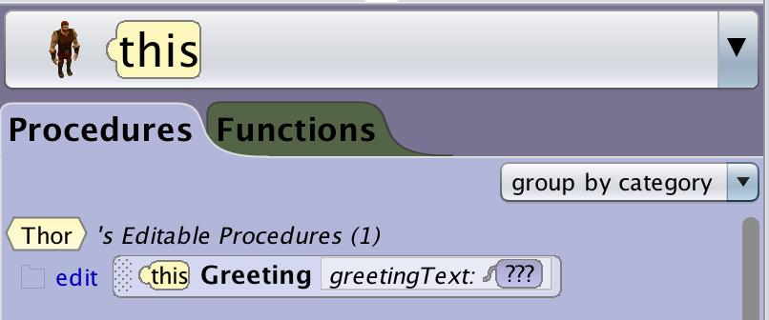
Using Parameters
Customizable Greeting
We can add a parameter for the text to allow us to change the included text each time the custom method is used.
Now each time you use the greeting procedure you will be asked to add text to fulfill the expected argument.

