Slide 1
Programming In Alice
Notes:
https://www.alice.org/resources/lessons/programming-in-alice/

Slide 2
ONE
What is a Computer Program?

Slide 3
What is a Computer Program?
Defining a Computer Program
A computer program is a set of instructions or statements that tell a device what to do.
Programmers generally write computer programs using programming languages which can then be translated into machine code that can be executed by the device.

Slide 4
What is a Computer Program?
Basic Programming Ideas
A program can be a list of instructions to follow in order (sequential processing).
A program can be a direction to do something if something else happens (conditional execution).
A program can be instructions to repeat a behavior a certain amount of times or until something happens (looping or iteration).
A program can be a a set of directions that returns an answer to a question (function).
A program can be a mixture of all of the above in differing amounts and combinations.

Slide 5
TWO
An Alice Program

Slide 6
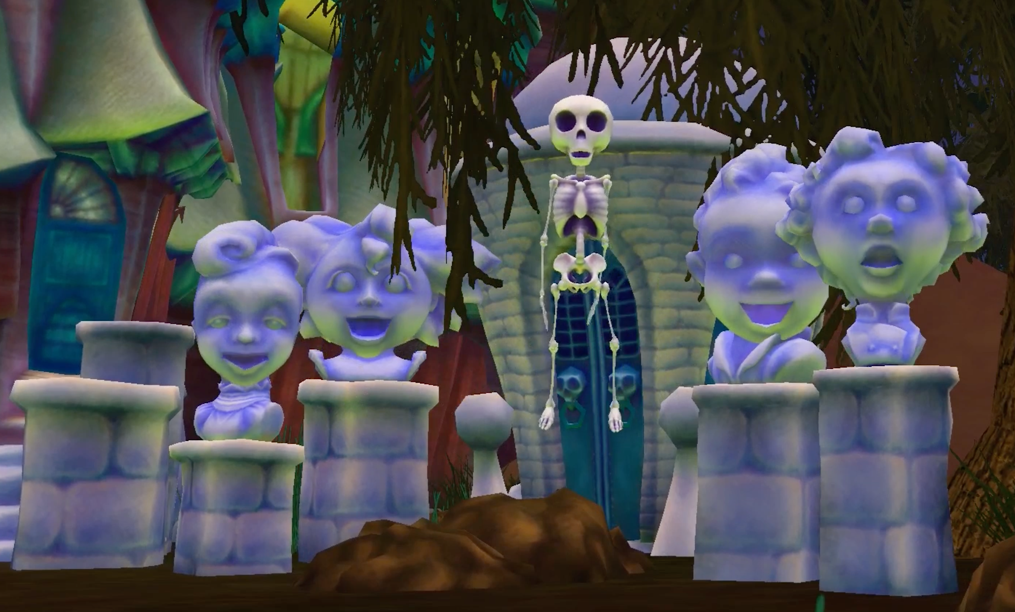
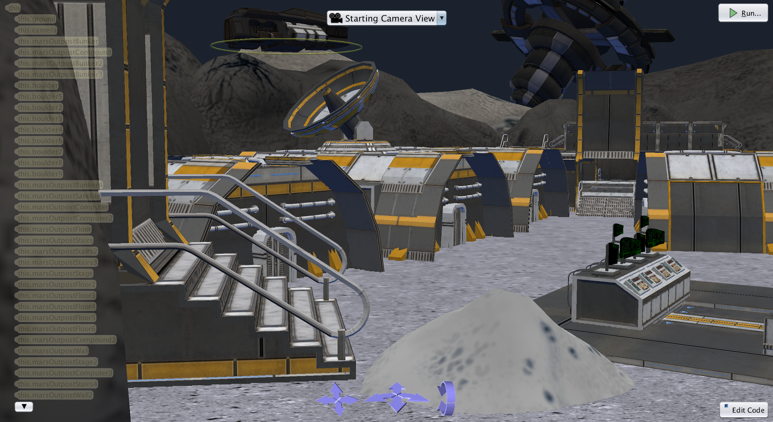
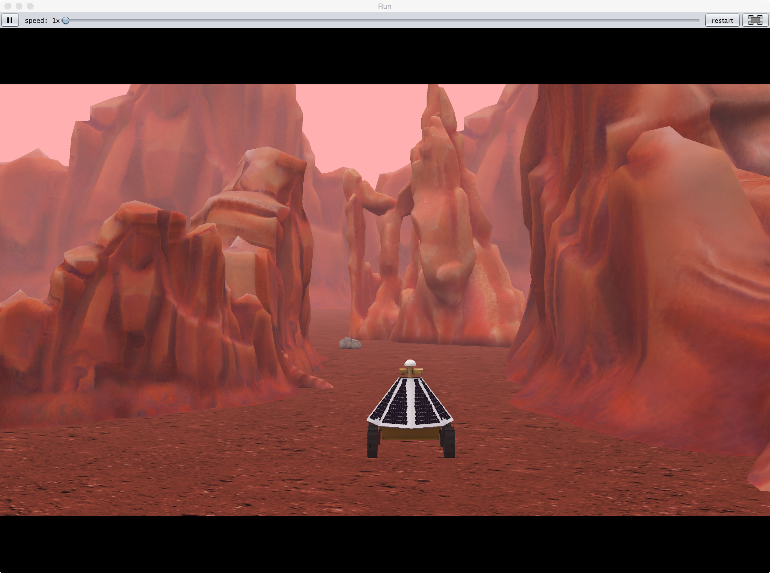
An Alice Program
What Can You Program in Alice
The Alice programming environment was created to help you program:
Scripted animations or stories
Interactive narratives or open worlds that allow you to interact with objects and the environment
Games with win and lose conditions that track and respond to interactions within the world

Slide 7
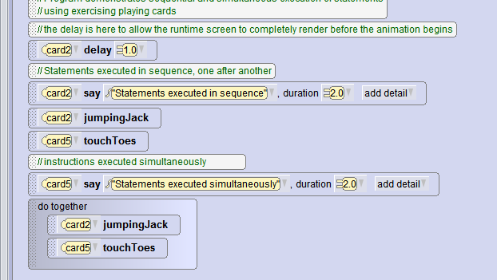
An Alice Program
What is an Alice Program?
Directions for how the computer will build and display an environment
Directions for what the happens in the world and when it happens
Directions for what the program should listen to from outside the program (key inputs, mouse interactions)

Slide 8
THREE
The Alice Code Editor

Slide 9
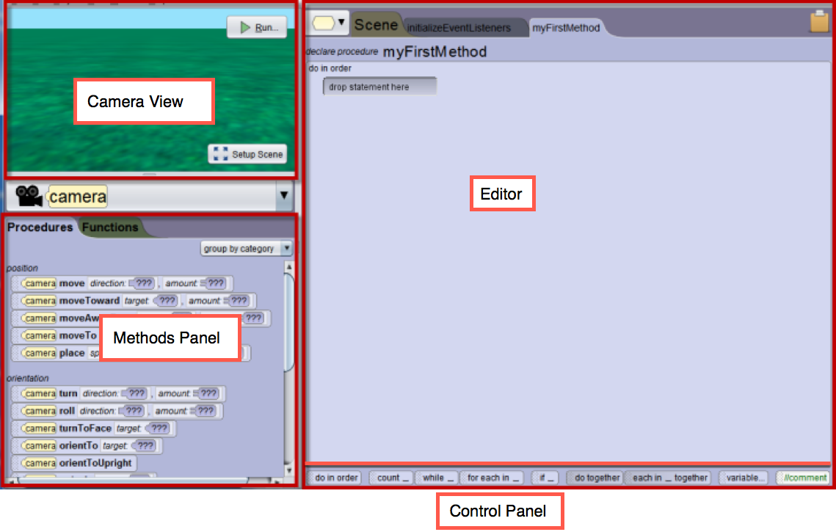
The Alice Code Editor
Code Editor Overview
The Code Editor is composed of:
Camera View
Methods Panel
Editor
Control Panel

Slide 10
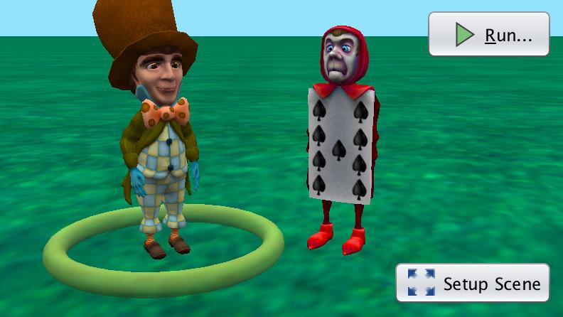
The Alice Code Editor
Camera View
Shows the scene from the starting camera view position
Allows for basic edits to the scene using mouse and hotkeys (not recommended)
Contains the Setup Scene button that navigates you to the full Scene Editor
Contains the Run button to execute your program

Slide 11
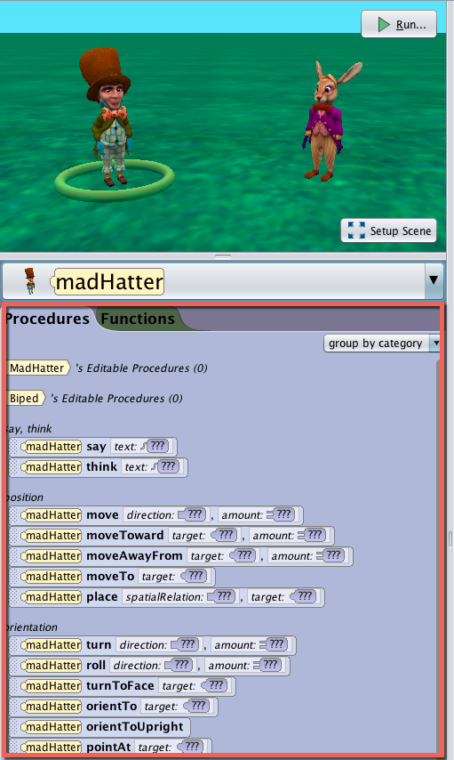
The Alice Code Editor
Methods Panel
The methods panel is where you will find code blocks that are dragged into the editor to create program statements and is composed of:
An object list drop down menu
A procedures tab (purple)
A functions tab (green)

Slide 12
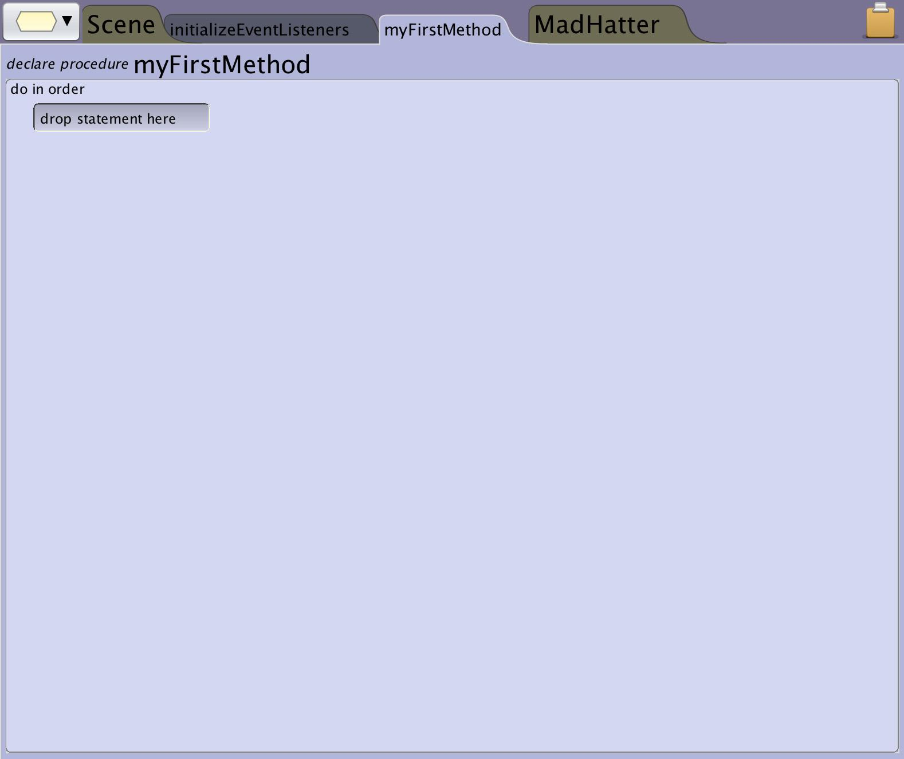
The Alice Code Editor
Code Editor
The Code Editor component is where you will build your Alice program.
The Code Editor can be navigated using two different ways:
A navigation drop down menu (the yellow hexagon)
Clicking on the pages (the tabs across the top)

Slide 13
The Alice Code Editor
Code Editor Tabs
There are 3 different types of Code Editor pages:
Methods – where you will build your program starting with the my first method tab
Event Listeners – this is a custom method tab where you will build ways for the code to handle user inputs and trigger events in your world
Classes – yellow tabs that give you a summary of all of the information for a class such as custom methods

Slide 14
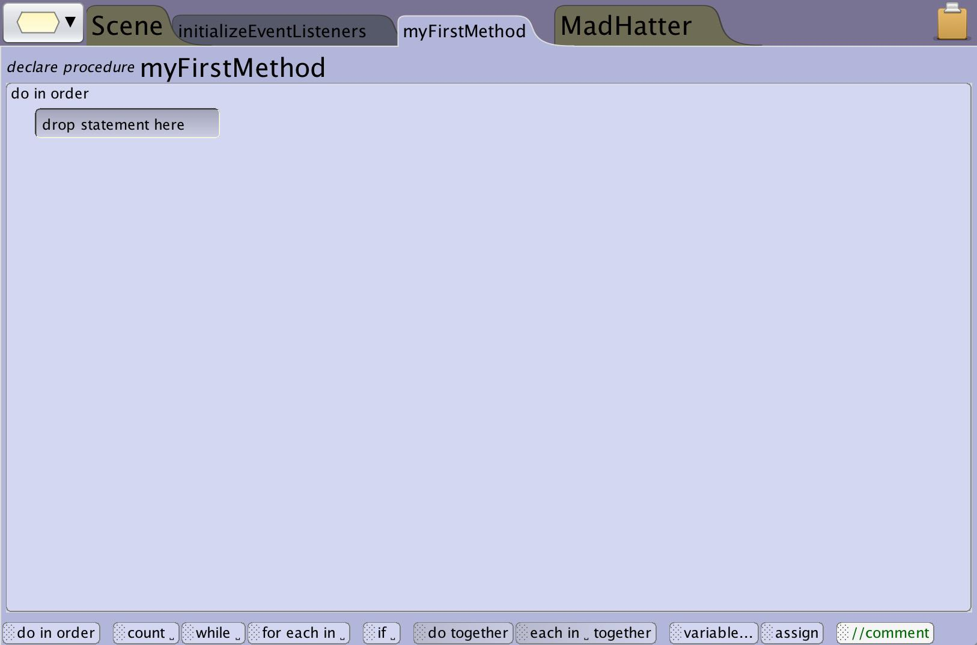
The Alice Code Editor
Control Panel
The control panel like the methods panel has blocks that you drag into the Code Editor to build your program. These elements are generally more structural elements for your program like:
Control structures for making loops and do togethers
Ways to create and manage variables
Ways to add comments to plan and explain your program

Slide 15
FOUR
Alice Methods

Slide 16
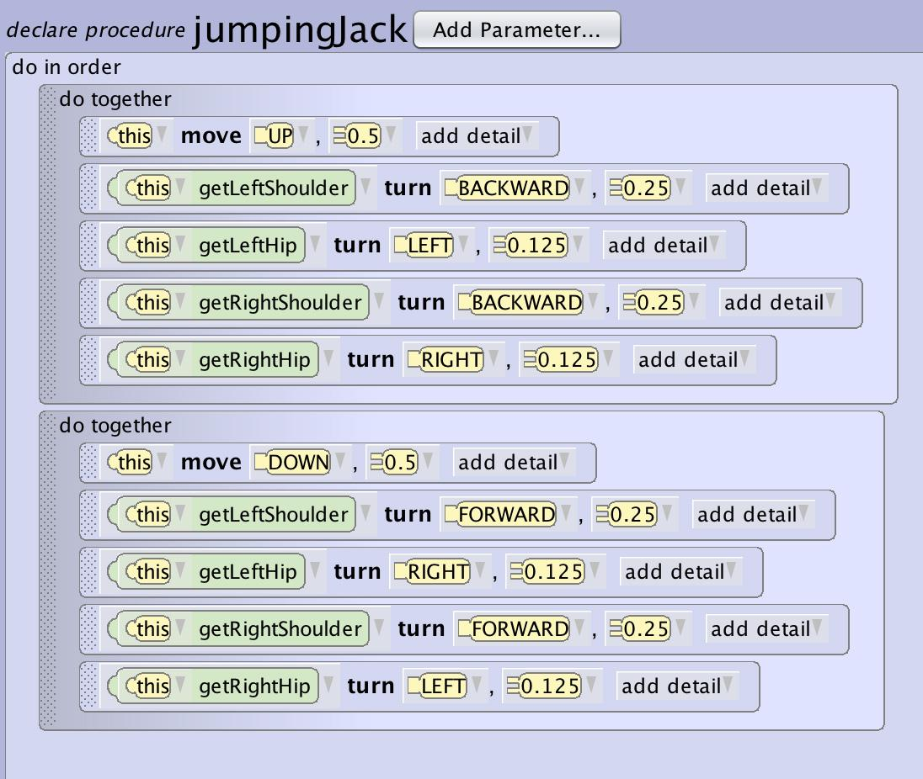
Alice Methods
What is a Method in Alice?
A method is a small defined set of code within your program that gives instructions for the program to do something.

Slide 17
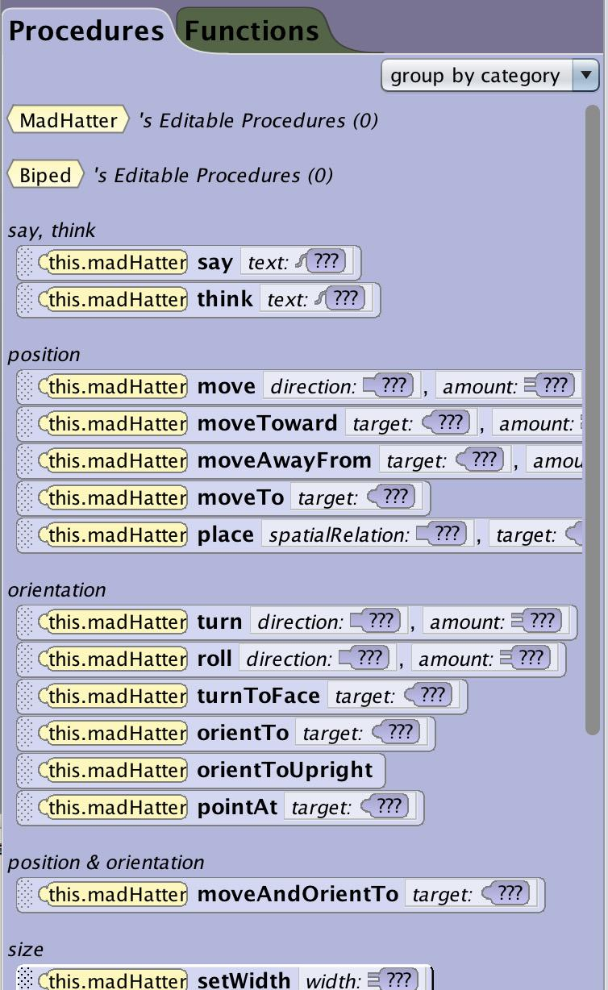
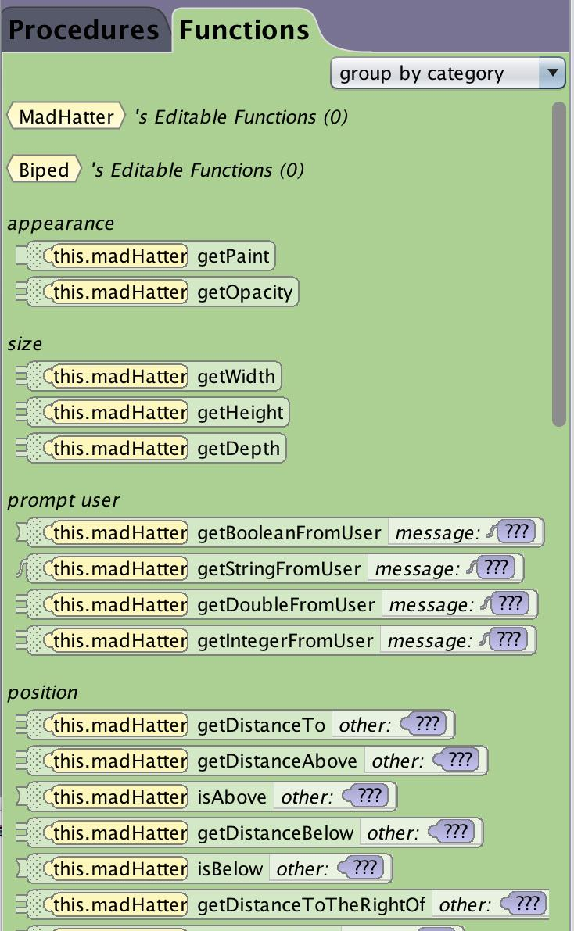
Alice Methods
Two Types of Methods
There are two types of methods in Alice:
Procedural Methods - directions for how the environment or objects in the environment should behave such as “move forward”.
Functional methods – directions for getting information from the environment or the user such as “how far is the rabbit from the carrot”.

Slide 18
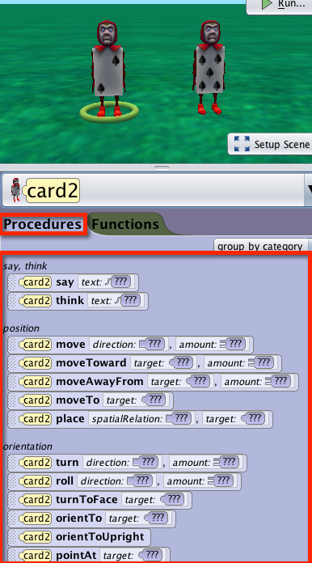
Alice Methods
Built in Procedures
Alice has a number of methods built into it that are constructed to make animation easy. The built in procedures cover the basics of:
Moving objects in all the different directions
Orienting or rolling and turning objects
Orienting objects to each other
Changing the environment (fog, sound, lighting)

Slide 19
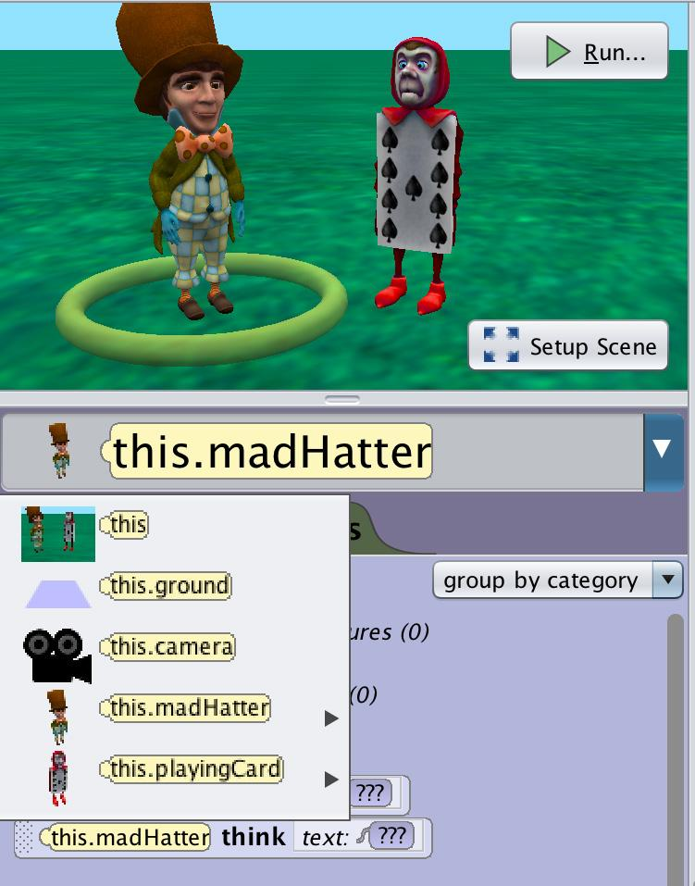
Alice Methods
Alice is Object Oriented
In Alice, procedures are attached to the object they are going to affect.
Navigate to the object you want to control to find the methods associated with that object.
Different objects can have different built in and custom procedures depending on the type.
For example, the scene object has atmospheric procedures like setting fog density while a rabbit has movement procedures like turn and roll.

Slide 20
FIVE
Alice Code Statements

Slide 21
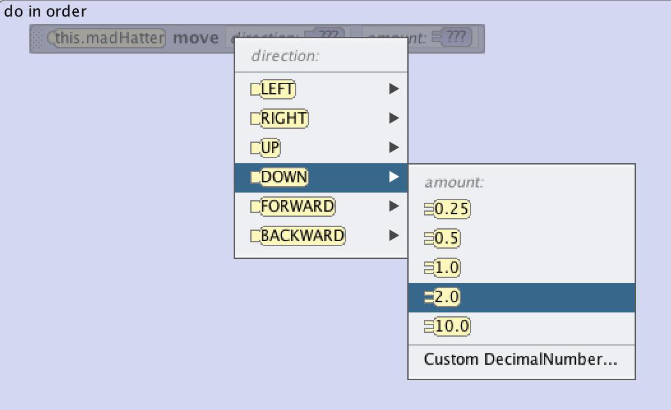
Alice Code Statements
Parameters
When using built in procedures to create an Alice code statement, parameters can be modified.
A parameter is an argument that informs what the method will do.
Telling an object to move is confusing. Which way? How far?
In this case direction and distance are parameters that provide information needed for the procedure to have all of the information it needs to execute.

Slide 22
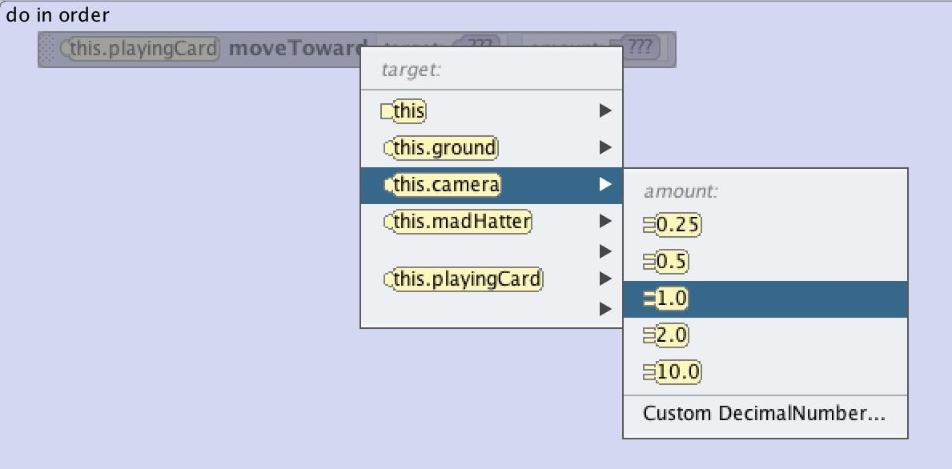
Alice Code Statements
Required Parameters
Alice doesn’t allow you to create broken code (most of the time).
When creating a statement Alice will require you to select arguments for each of the required parameters so that it can execute.
Drop down menus will guide you through selecting values for all of the required parameters.
Don’t worry you can change these later without having to rebuild the statement. In some cases, you will have to choose a place holder and replace it later on.

Slide 23
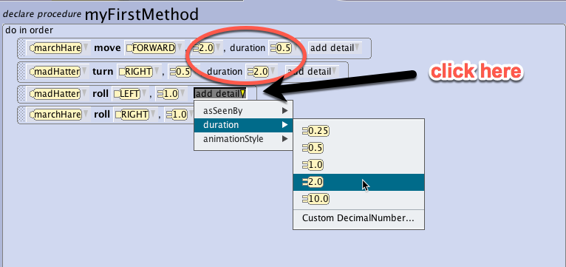
Alice Code Statements
Optional Parameters
Alice has a number of parameters that can be added to statements using the add detail dropdown. These can help create necessary variations. For move procedures these are:
Duration – This parameter controls how long something happens so you can change the default. By default, each statement takes 1 second to execute.
Animation Style – This parameter allows you to control the smoothness or abruptness something happens. By default, move commands speed up and slow down over the execution to smooth it out.
As seen by – This parameter allows you to modify the point of reference to the camera or other objects. By default, moves are relative to the object being manipulated.

Slide 24
SIX
Adding Procedures

Slide 25
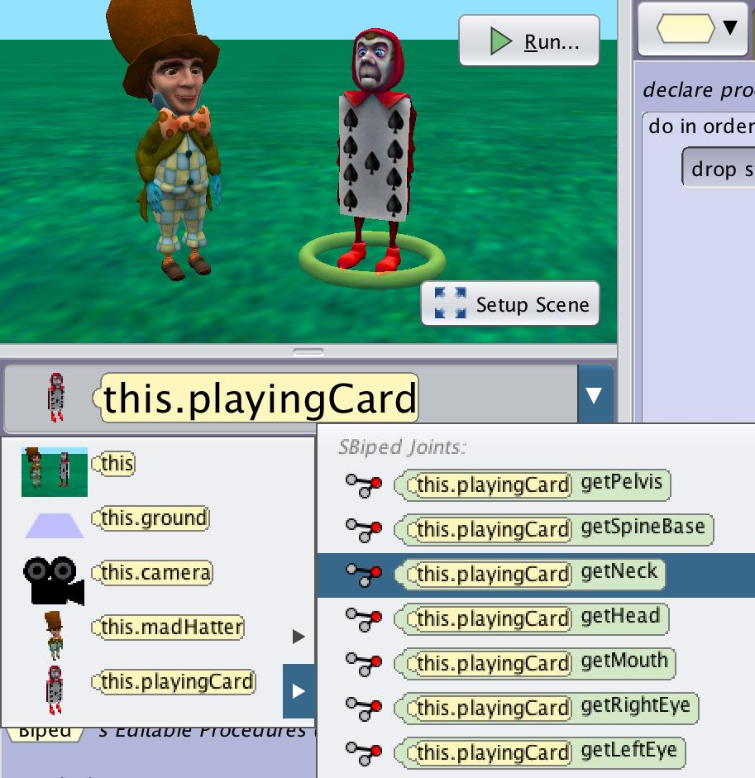
Adding Procedures
Select the Object
Remember procedures are attached to objects. Be sure to select the object you want to manipulate using the object drop down menu.
If an object has joints like the playing card, as shown in the image to the right, you can also select subJoints of the object through the nested drop down by hovering over the little arrow to the right of the object on the list.
Just like parameters, you can also change the object in a statement as long as it is able to perform the procedure. Do not worry if you accidentally chose the wrong object.

Slide 26
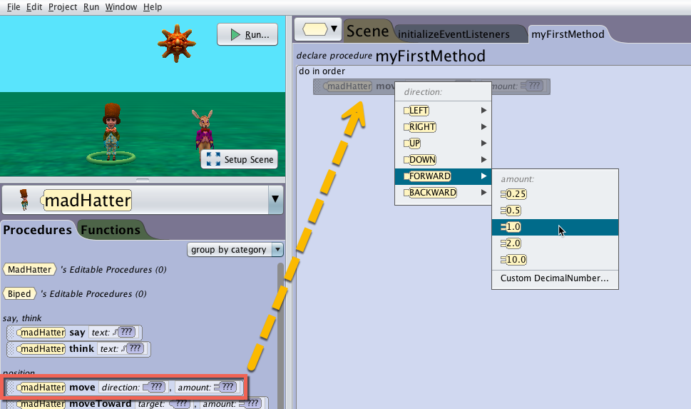
Adding Procedures
Create a Statement
Adding a statement is as easy as dragging and dropping it into the Code Editor component.
Alice will guide you through filling in the required arguments to complete the statement.

Slide 27
SEVEN
Running Your Program

Slide 28
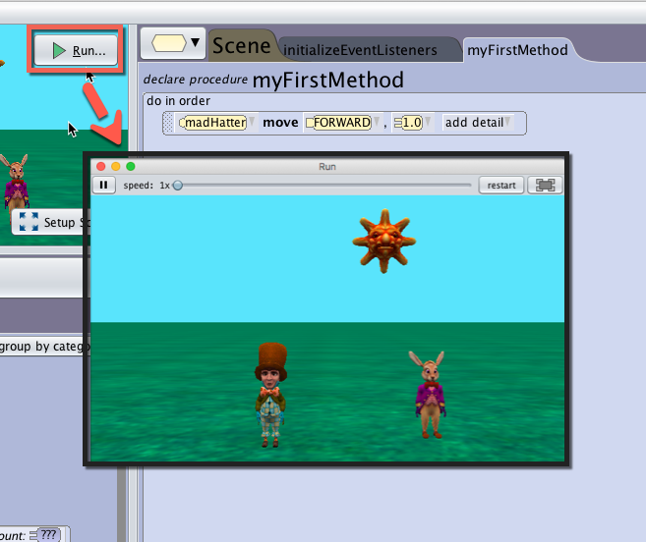
Running Your Program
The Alice Player
To execute the program press the Run button and a viewer will appear. The viewer allows you to:
Resize the window by dragging a corner or going full screen with the far right button.
Speed up, slow down, and pause playback help you navigate to different parts of the program.
Restart your program to run it again.

Slide 29
Running Your Program
Runtime Errors
Sometimes things will go wrong when you run your program and you will see the angry queen or an error screen instead of your program. Don’t worry this happens to everyone.
The error screen should tell you what is wrong with your program to help you go back and fix it. If you see red code in your program this probably means there is an issue, such as having deleted the object that is referenced.
Sometimes you can continue past the error and still run your world.
It is a good idea to save your world before running it just in case we can’t recover from the error.

Slide 30
EIGHT
Control Structures

Slide 31
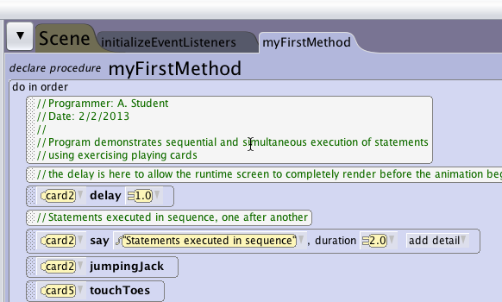
Control Structures
Do In Order
Alice will follow the list of statements you provide in the exact order you see them in your program.
Think of it like a recipe.
Do this
Then this

Slide 32
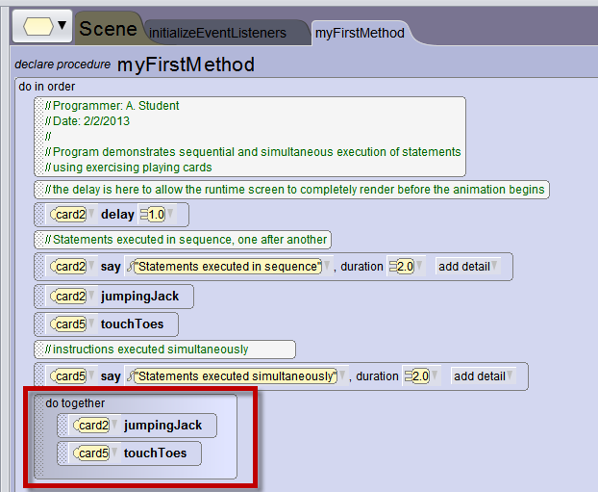
Control Structures
Do Together
Control structures allow you to change the sequence or logic that controls the order and timing of statements being run.
Often in Alice, you will want things happen at the same time. This requires the do together control block.
Drag the do together block from the control panel below the Code Editor into your program.
Add statements to the block that you want to happen at the same time.

Slide 33
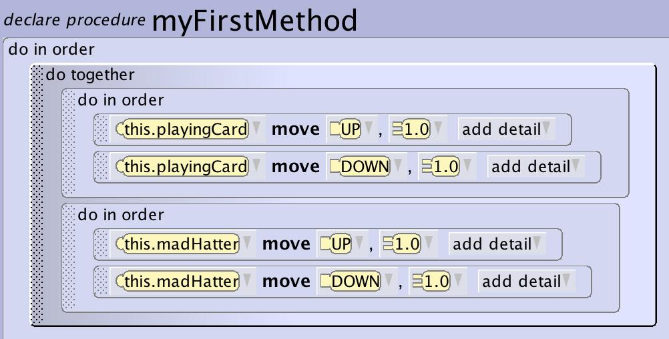
Control Structures
Nesting Control Structure
Often you will want things to happen in order for one object at the same time as another set of directions are executing in order for another object.
This requires you to place control structures inside control structures.
To have two objects jump at the same time you need the move up and down code for each jump inside do in orders that are inside the do together.
What would happen if you didn’t have the do in orders?

Slide 34
NINE
Editing Code

Slide 35
Editing Code
Undo/Redo
You can always undo or redo work to easily test to see what will happen.
Use command/Ctrl z and command y to quickly undo and redo actions.
Windows
Mac

Slide 36
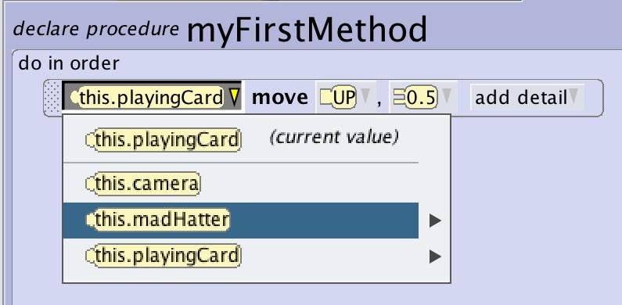
Editing Code
Modifying Existing Statements
You can always go back and modify arguments of existing statements.
Use the drop down arrows to access the options for a parameter, including the ability to change the object of the statement.

Slide 37
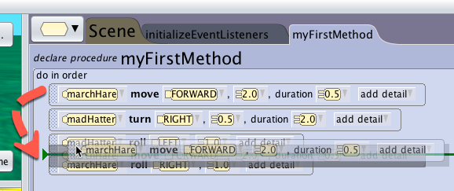
Editing Code
Reordering Statements
Changing your code can be as easy as dragging statements to a different place in the list.
You can also drag statements in and out of control structures.

Slide 38
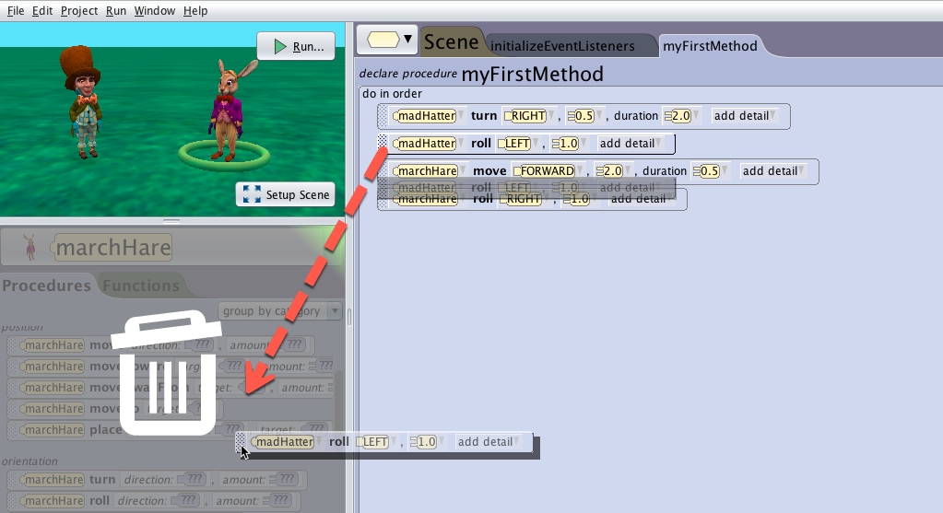
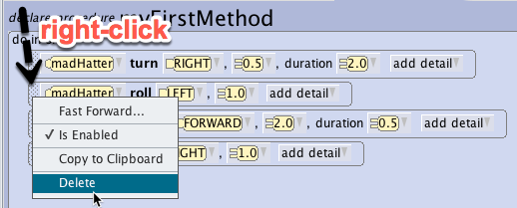
Editing Code
Deleting Statements
To delete a statement, click and drag the statement and you will see a trash can appear over the methods panel that you can drag the statement into.
You can also right click and delete a statement.

Slide 39
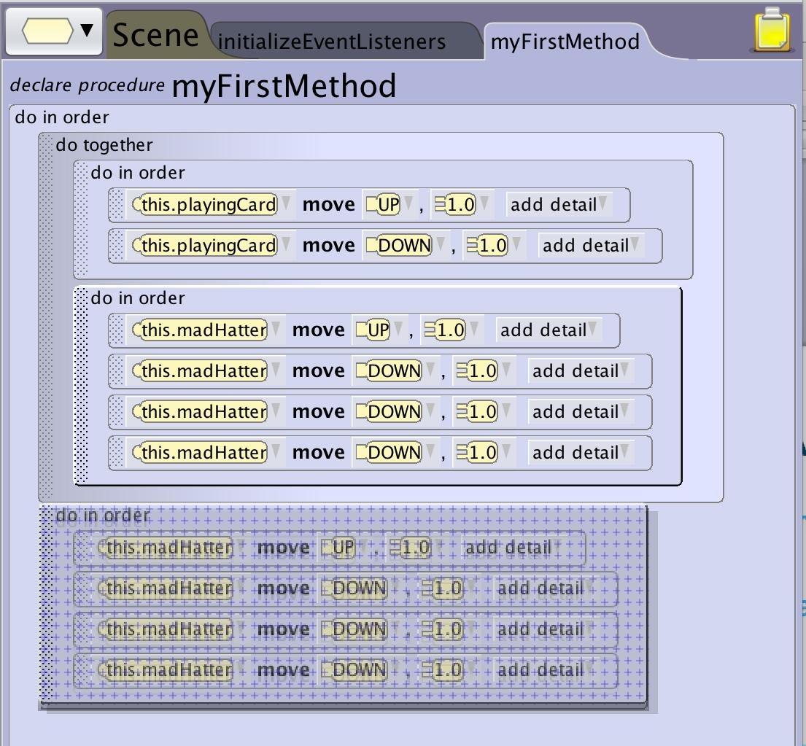
Editing Code
Copying and Duplicating Statements
Cut and Paste - You can drag statements into the clipboard and drag them out to another location.
Copying - You can option click on mac or option click on pc to drag and drop a copy of a statement or whole code block and add it to another location.
You can then go back and change arguments to quickly modify code without having to recreate similar statements.

Slide 40
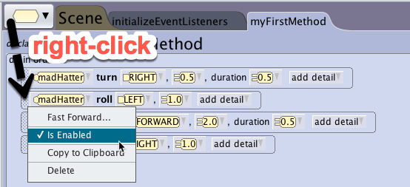
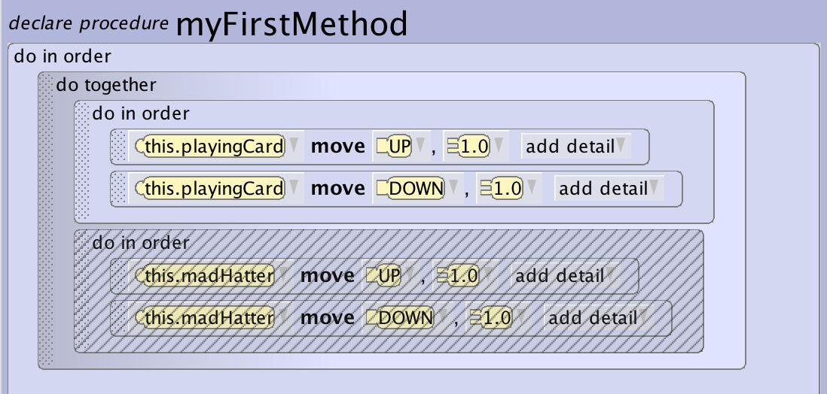
Editing Code
Disabling Code
You can enable and disable statements and code blocks to help you test or experiment with different code without having to add and remove it every time.
Right click on a statement to bring up the enable and disable toggle.
Disabled code will be ignored when the program is executed.

Slide 41
TEN
Tips and Tricks

Slide 42
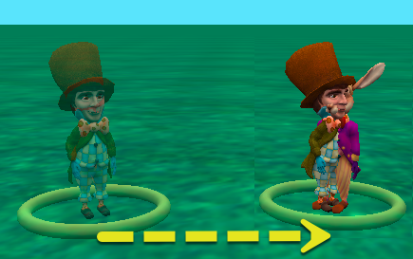
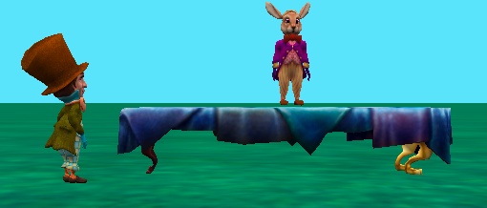
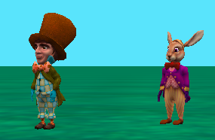
Tips and Tricks
Helpful Orientation Procedures
Alice provides a lot of helpful built-in orientation procedures that can be very useful for moving objects to and from each other.
Move To
Turn to Face
Orient To

Slide 43
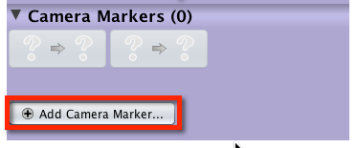
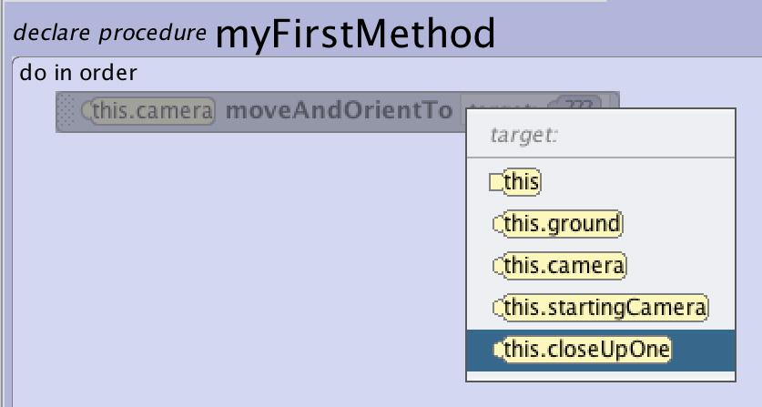
Tips and Tricks
Animating the Camera
The camera can be programmed to move just like any other object in the scene.
Use camera markers to plan for the positions and orientations of the camera. Then use the camera markers to program the camera moves, adding dynamic changes to animations.
Change the duration of the camera move to have it pan slowly or jump to the new view (use 0)
Add a camera marker in the scene editor
Use moveAndOrientTo to program camera changes

Slide 44
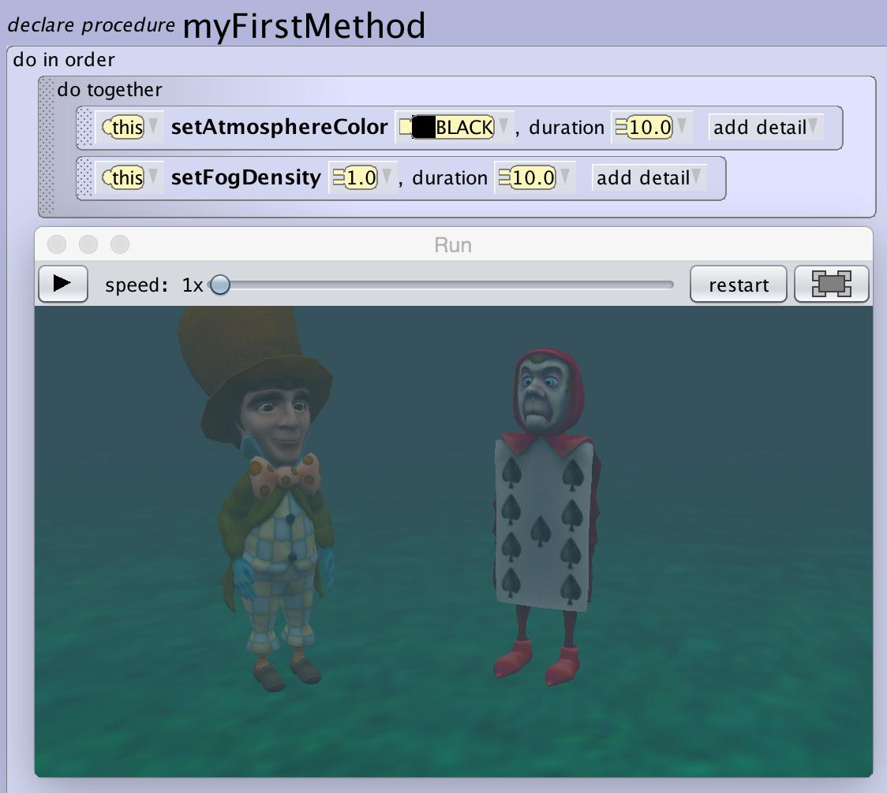
Tips and Tricks
Scene Effects
Don’t forget about the unique scene procedures. They can be used to create very cool environmental effects such as flashing lightning or rolling fog.

Slide 45
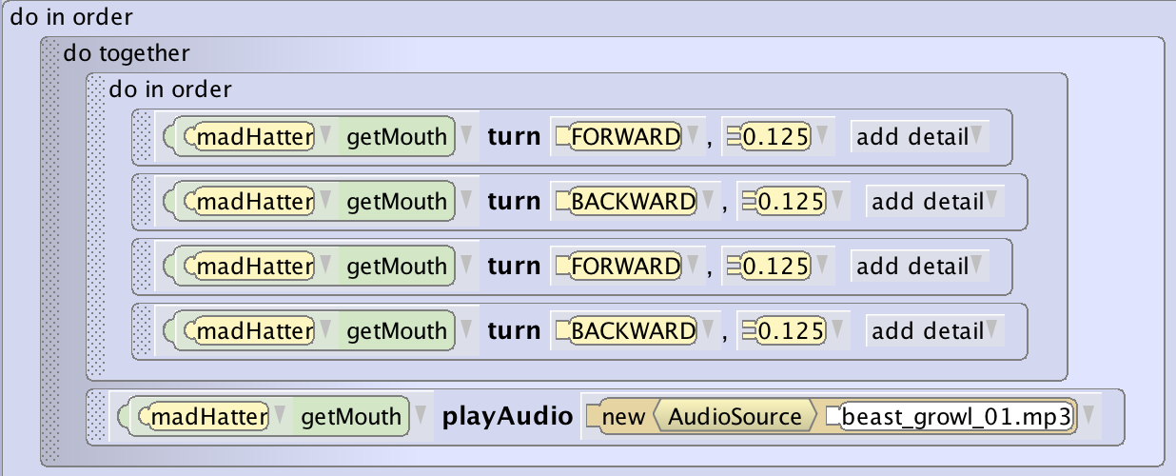
Tips and Tricks
Adding Sound
Adding sound can quickly transform an animation and bring it to life using the playAudio procedure. There are a couple different ways to easily add sound:
Add a background audio track in a sceneActivated listener to have it run during your animation
Add sound effects for movements using a do together
Add voice overs by recording your own audio and matching it to mouth movements
The Alice project supplies a number of audio files with Alice that can be explored.

Slide 46
Tips and Tricks
Incremental Development
Alice is meant to be a platform that allows you to quickly iterate your designs. Don’t be afraid to:
Write a little bit of code and test it.
Fix and and change it as needed.
Repeat above or, if you like it, move on to the next part of your project.

Slide 47
Tips and Tricks
Save Often
Save your project world often - every 10 - 20 minutes
Alice worlds can be corrupted so use a progressive naming convention for incremental backups name.a3p, name2.a3p
Later versions of Alice 3 will also have an autosave function that will save incremental backups in case of an issue

