Slide 1
Making Procedural Methods
http://www.alice.org/resources/lessons/making-procedural-methods/

Slide 2
What is a Method?

Slide 3
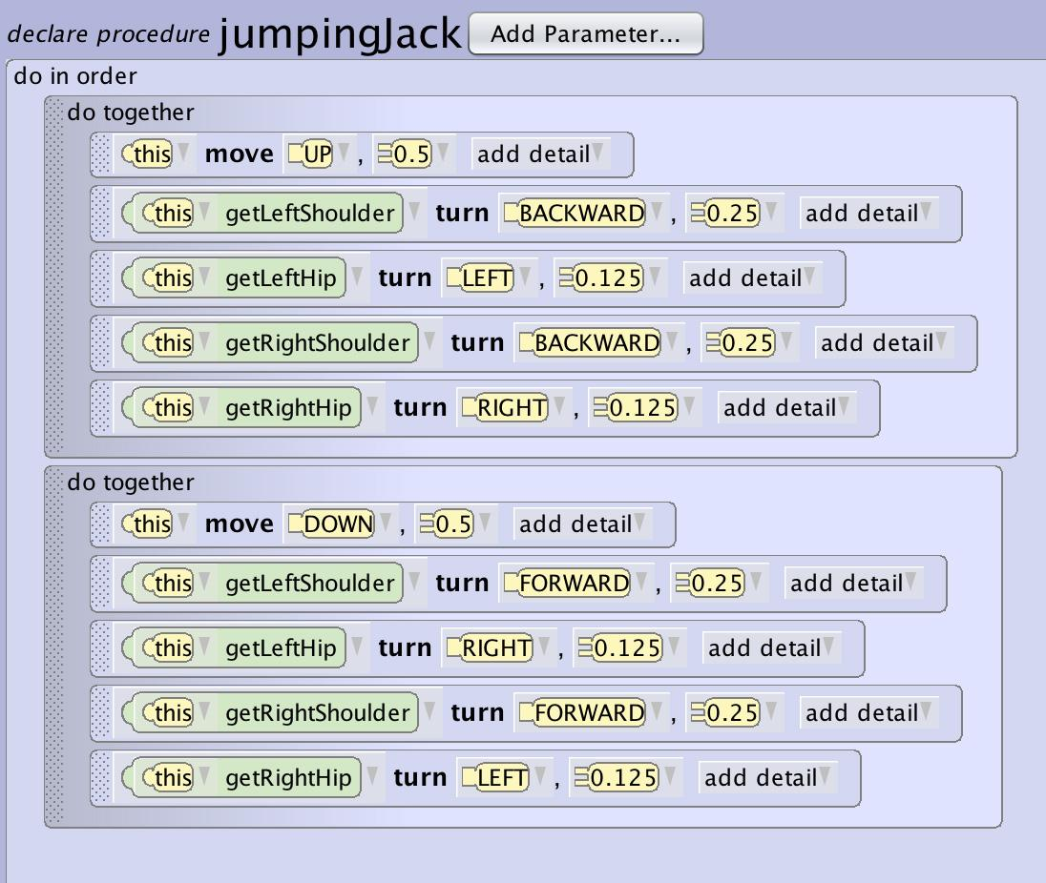
What is a Method
A method is a small defined (named) set of instructions within your program that defines a task to be performed.

Slide 4
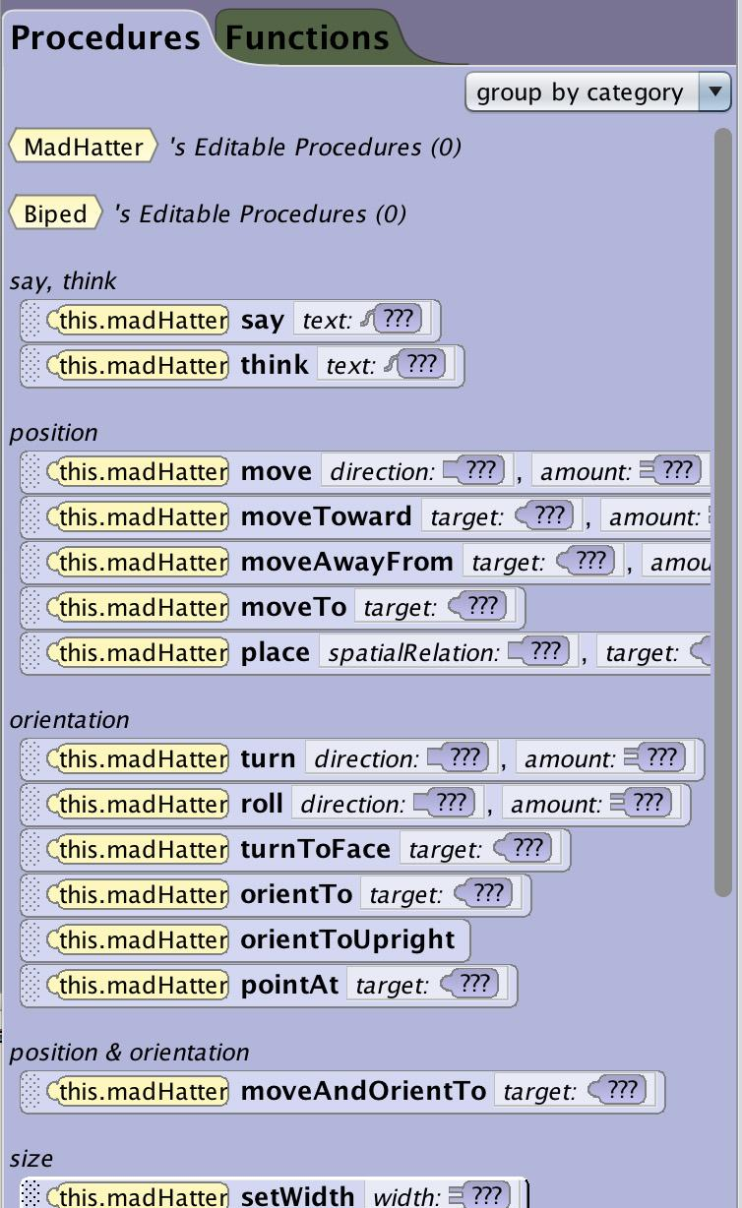
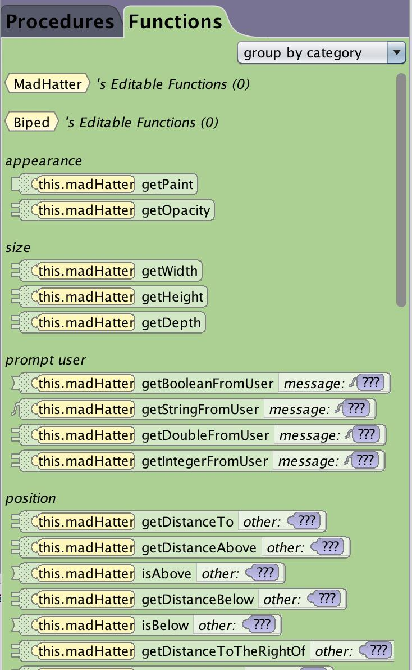
What is a Method
There are two types of methods in Alice
Procedural Methods - directions for how the environment or objects in the environment should behave such as “move forward”
Functional methods – directions for getting information from the environment, objects, or the user such as “how far is the rabbit from the carrot?”

Slide 5
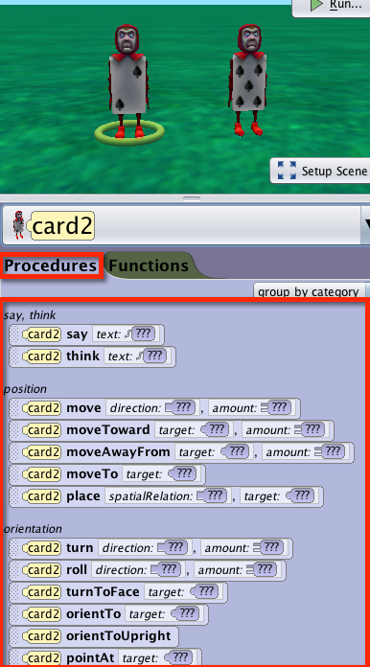
What is a Method
Built In Procedures
Alice has a number of methods built into it that are constructed to make animation easy. The built in procedures cover the basics of:
Moving objects in all the different directions
Orienting or rolling and turning objects
Orienting objects to each other
Changing the environment (fog, sound, lighting)
Notes:
‹#›

Slide 6
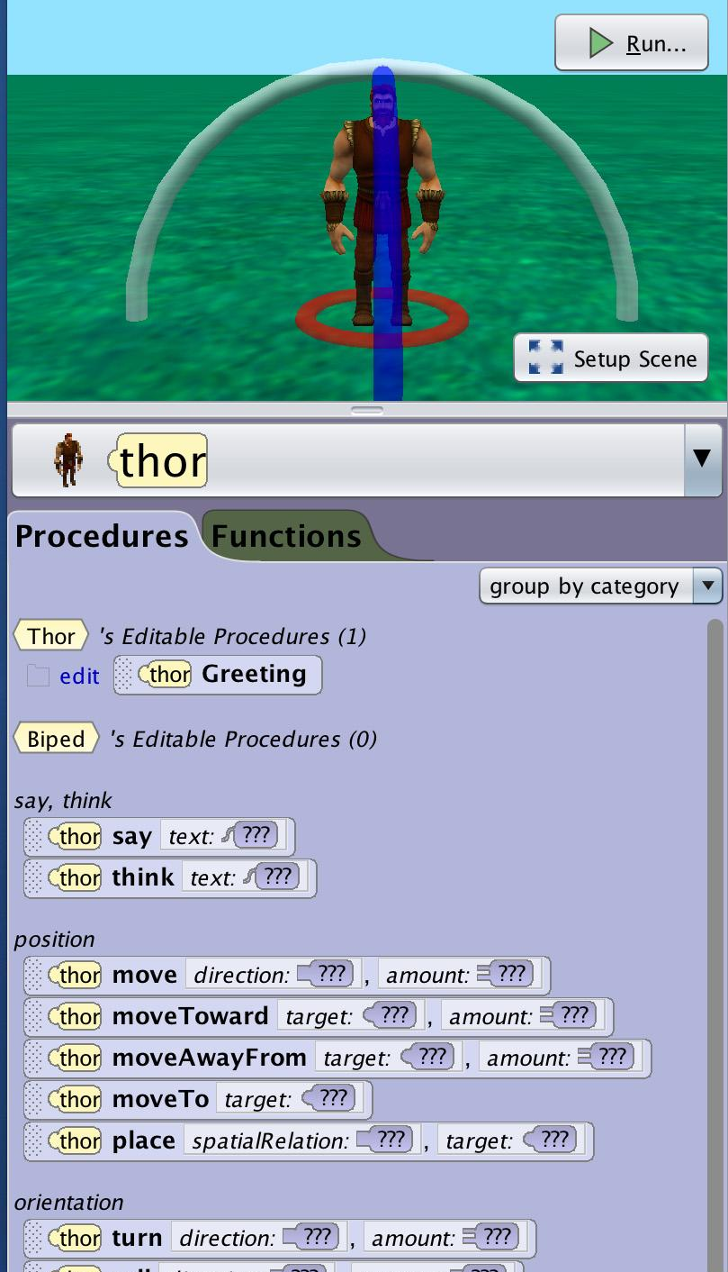
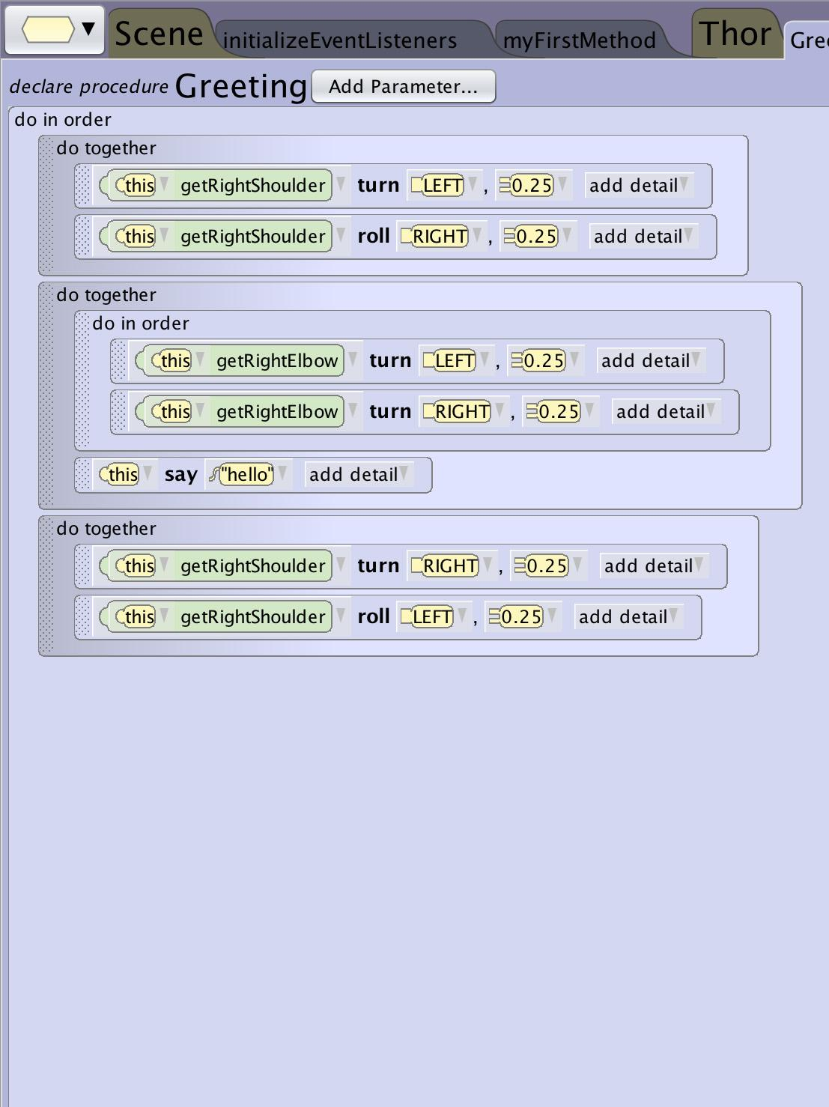
What is a Method
User Generated Procedures
Users may want to create their own to procedures to:
Create reusable animations for specific characters or classes
Simplify the level of detail to help organize and maintain their program
Share procedures between projects
Notes:
‹#›

Slide 7
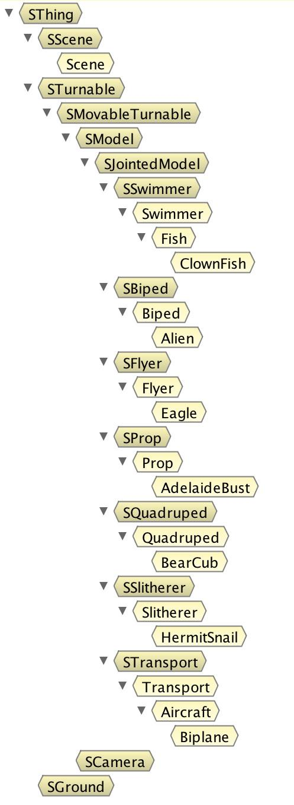
What is a Method
Hierarchy and Inheritance
Alice is object oriented so procedure are associated with objects (classes). Inheritance means that methods defined for parent classes are inherited by the child classes.
In Alice the major factor that determines the hierarchy of inheritance and the ability for methods to be used on parent and child classes is the underlying joint structure.
All of the bipeds share the same basic joint structure so teaching one biped such as Thor to walk could be shared with all bipeds, however the same method would make no sense to a clown fish or swimmer because they wouldn’t have the same joints.

Slide 8
Why Use Them?

Slide 9
Why Use Methods
Abstraction
To use an abstracted method you only need to know what it does and how to use it but not how it works. Alice built in procedures and functions are examples of abstracted methods that are designed to be helpful and very easy to use but for you to use them you don’t need to understand how they are constructed.
Abstraction also allows you to create different levels of complexity in your program. At the top level you may want to establish the larger acts of your animation or levels of your game. To keep this easier to manage and follow you may build more detail inside custom methods of the scene or within the class and object levels. This use of abstraction can help you organize the functionality and structure of your program.

Slide 10
Why Use Methods
Alice Built In Procedures
Alice built in procedures are an example of Abstraction. These methods make it easy for you to make use of functions such as say without having to see the level of detail that is needed to construct it such as:
Select Location
Select font
Select Line Weight
Input desired text
Draw on Screen
To use this method you don’t need to understand everything that is needed to make it work.

Slide 11
Why Use Methods
Reusability
Once you have constructed a method it can be used over and over again. You can invoke the same method as many times as you want in your program. This will save you lots of time when building your project.
Another aspect of reusability is that a single method can be used in several different (and separate) projects. When you need to write a new program, you can go back to your old programs, find the methods you need, and reuse those functions in your new program. You can also use methods that somebody else has written.

Slide 12
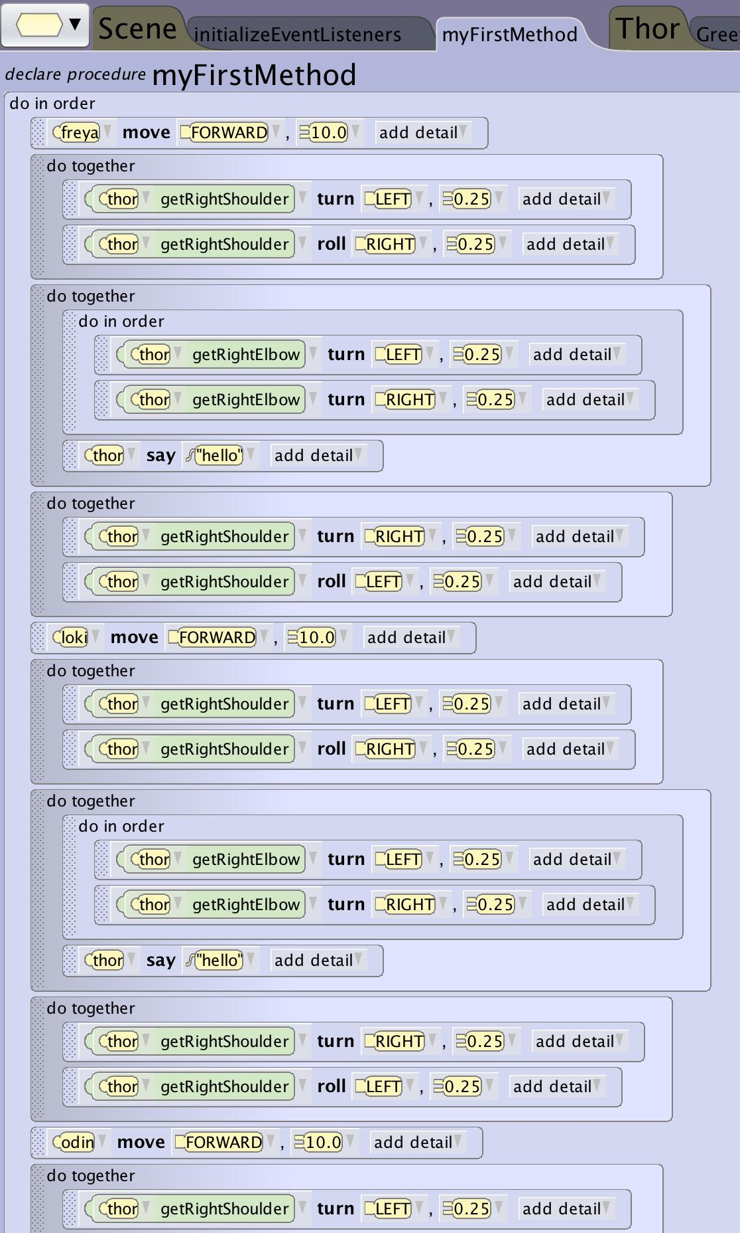
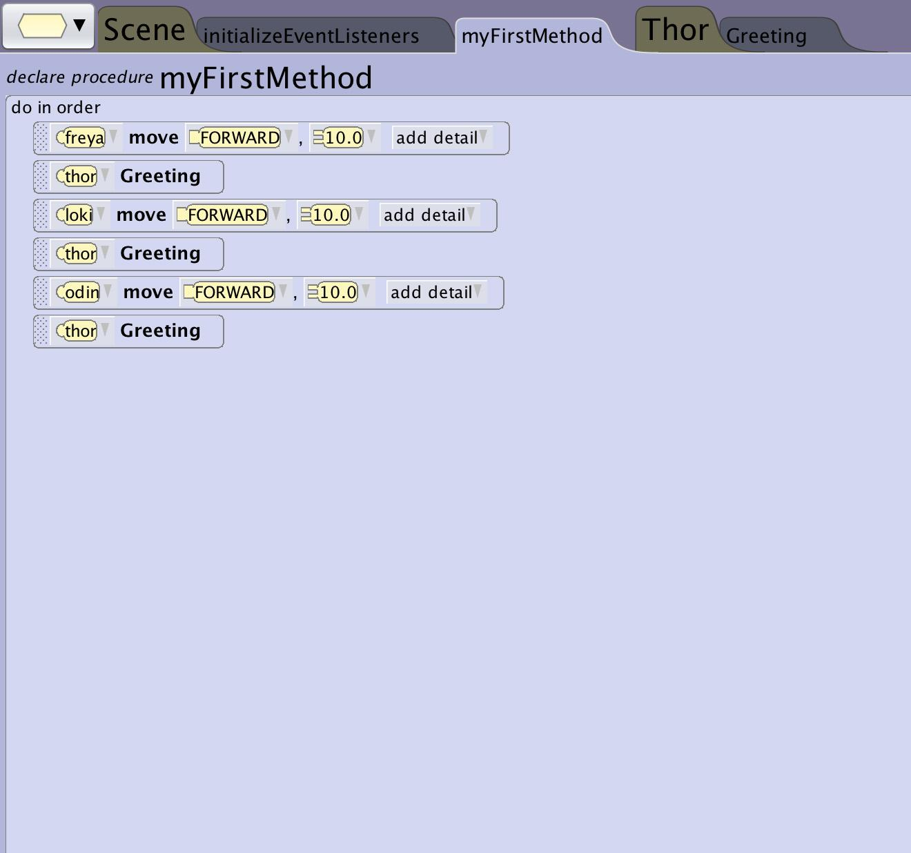
Why Use Methods
Thor Greeting His Guests

Slide 13
Why Use Methods
Debugging and Editing
Using reusable methods in multiple places makes it possible to easily maintain the original method. You can make edits to that original method and have that change reflected everywhere that your program uses that method without having to find and replace all instances of the change.
Separating your program into smaller methods also makes it easier to find partitions of your code to debug problems. Instead of reading through a long program looking for the problem code you can easily navigate to the area of code that you want to focus on.

Slide 14
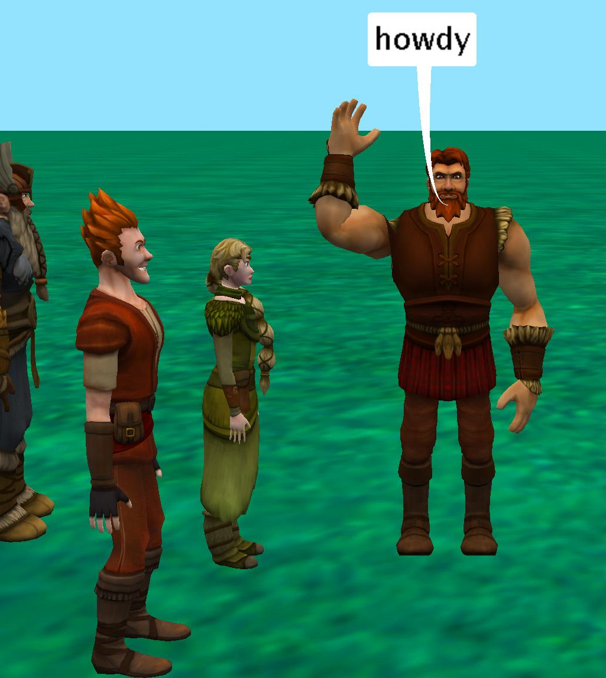
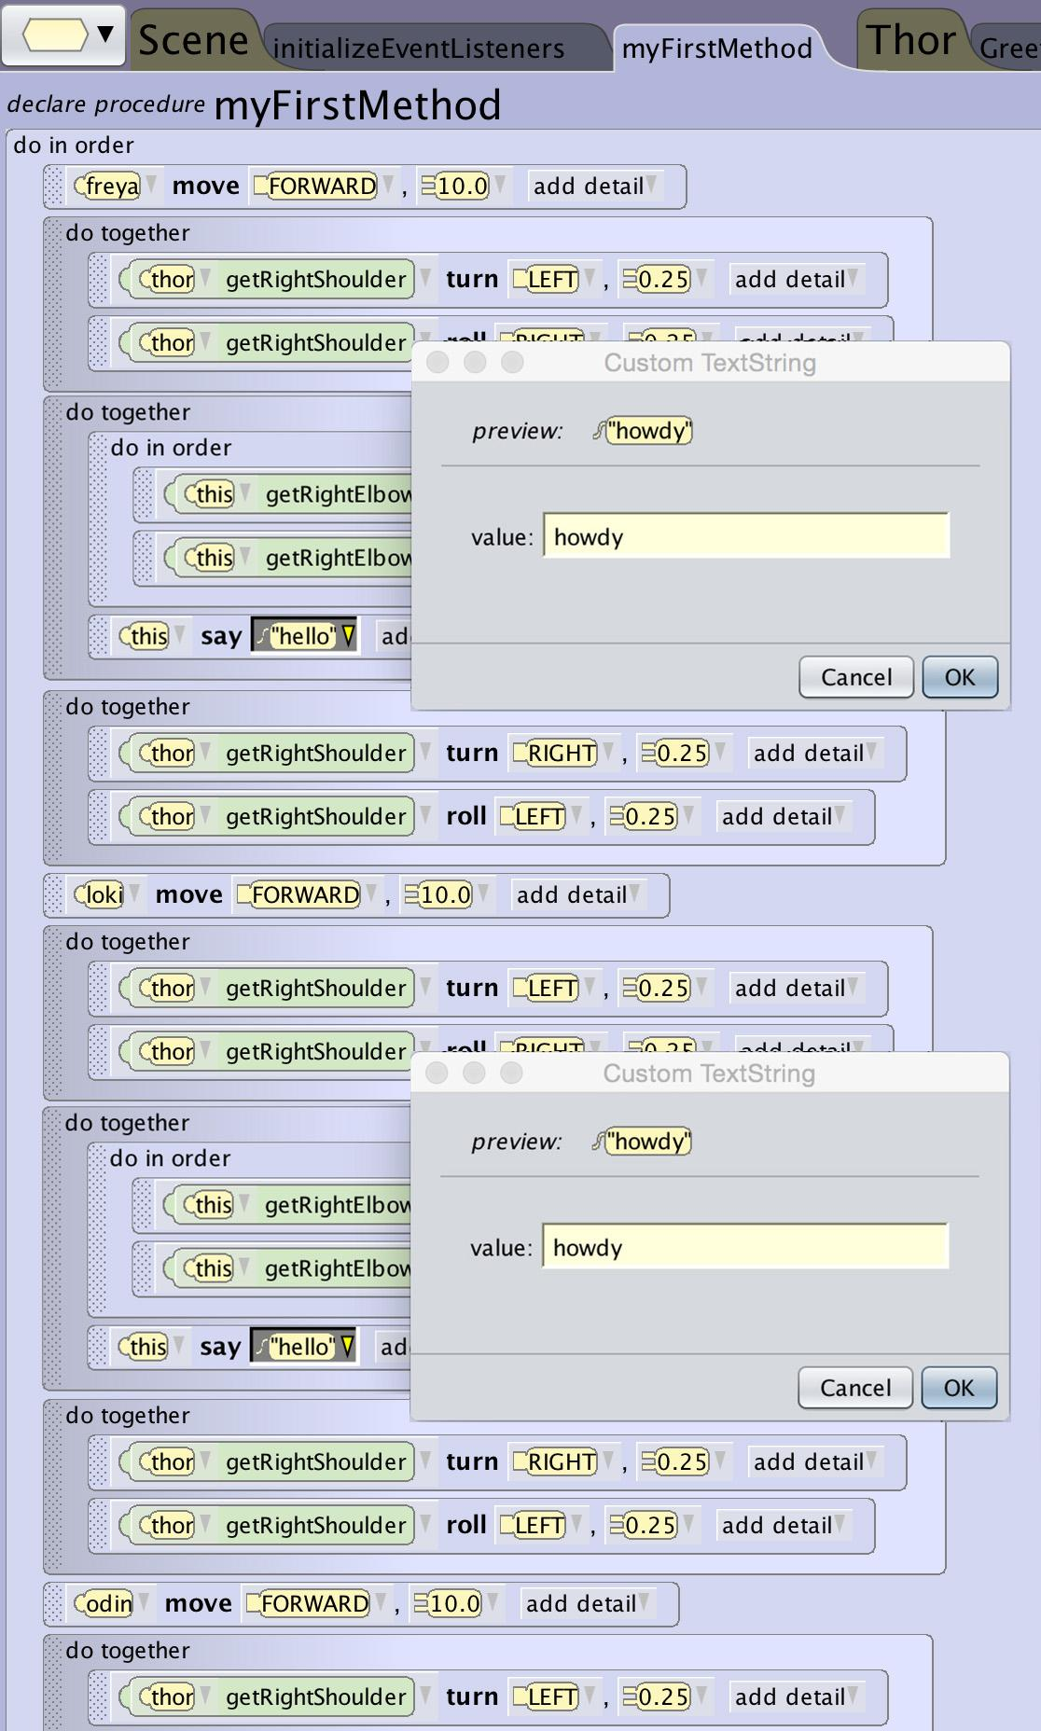
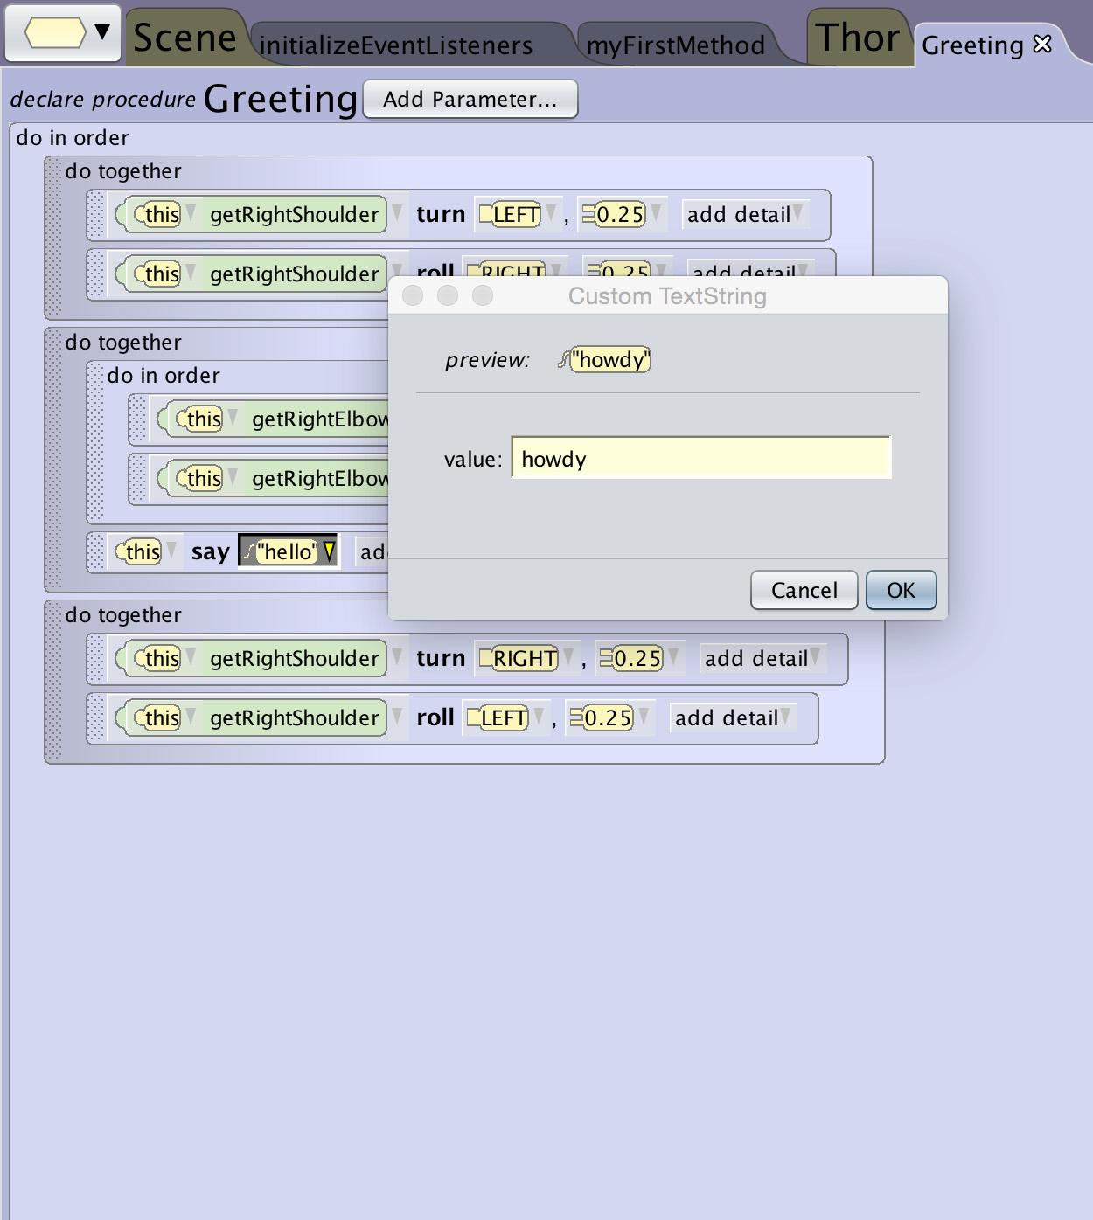
Why Use Methods
Howdy is Better

Slide 15
Creating New Procedures

Slide 16
Creating a Procedure
Adding a New Procedure
There are two places you can add a new procedure
Click on the class drop down menu and navigate to the location you want to create it and select add a procedure
Navigate to the Class summary page and select add new procedure in the procedures list

Slide 17
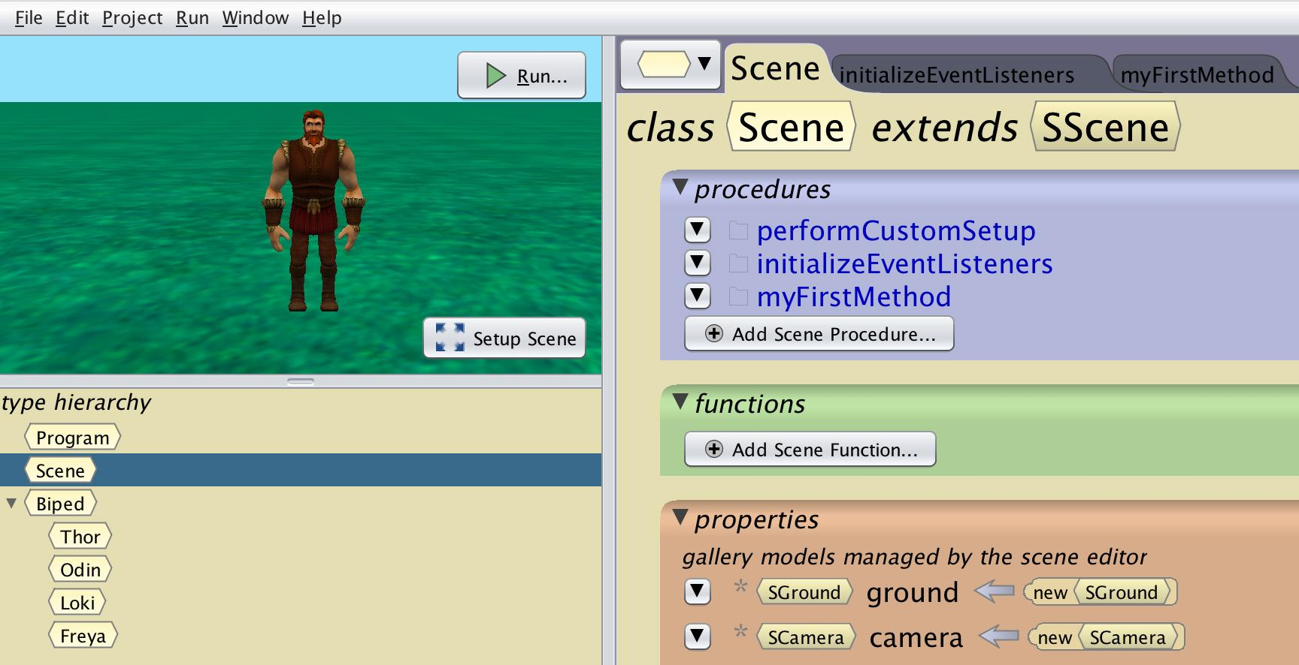
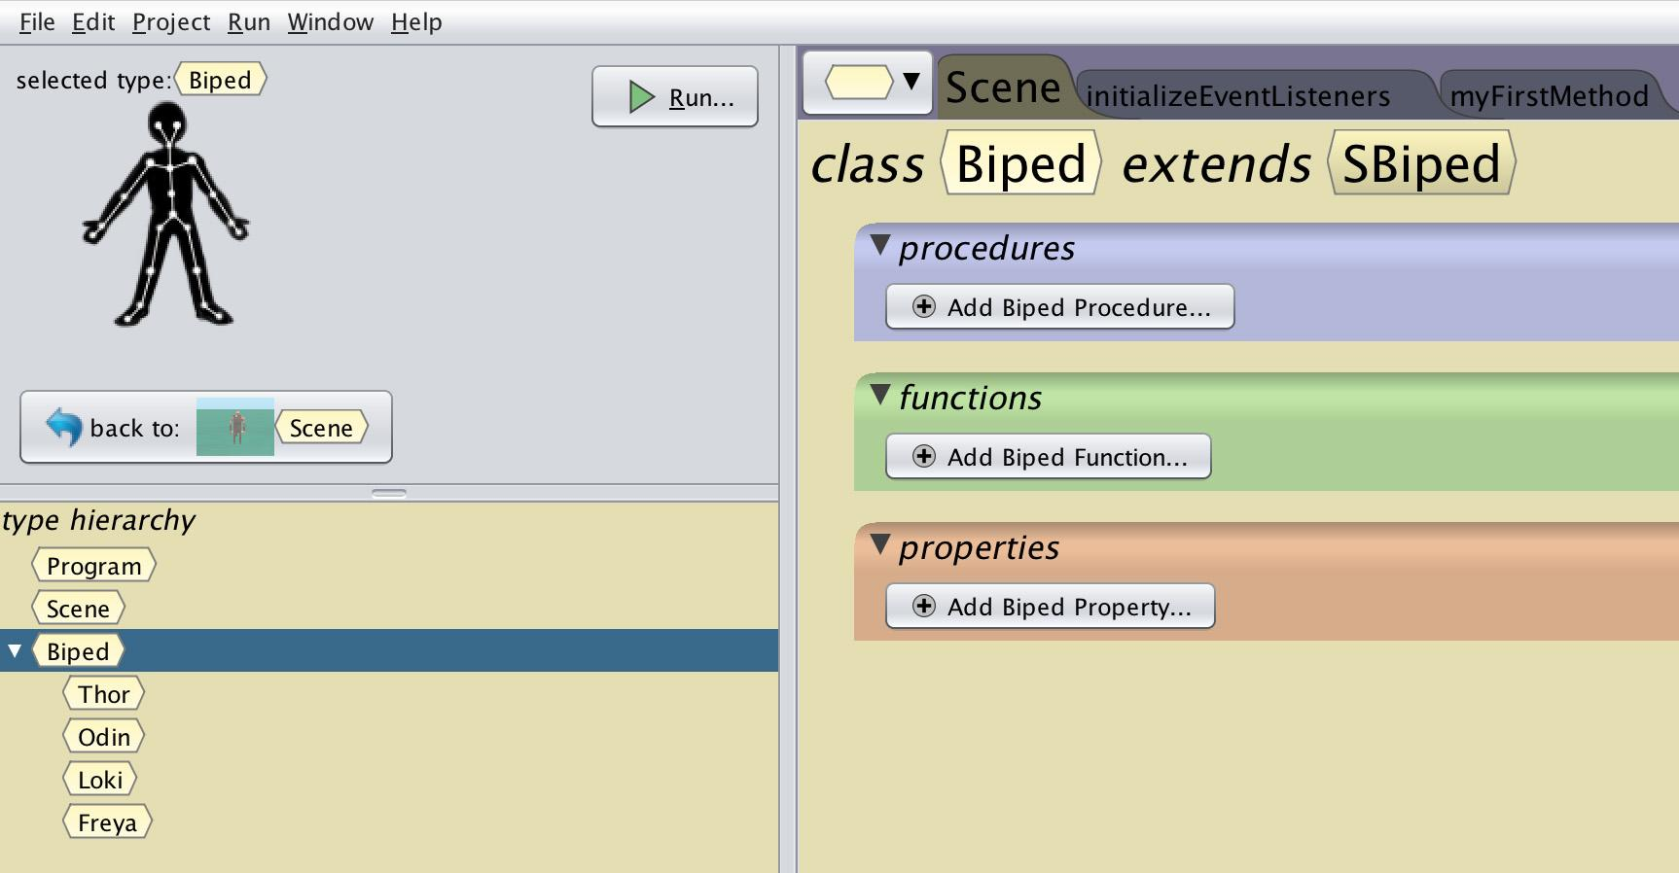
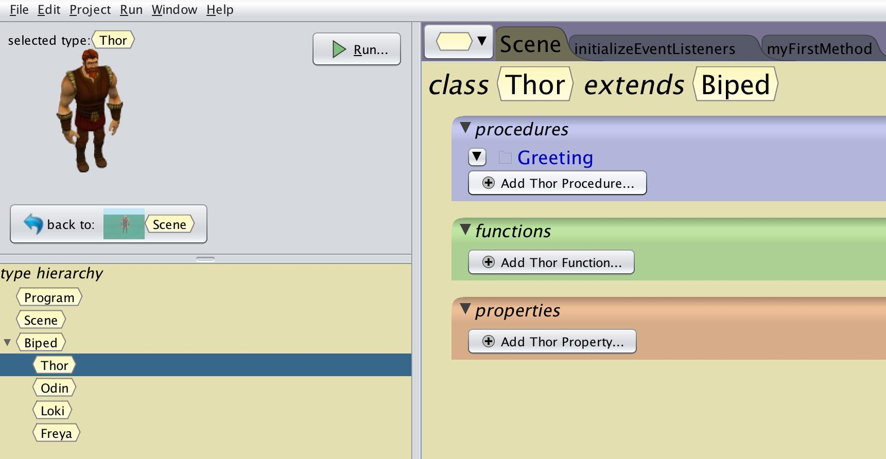
Creating a Procedure
New Procedure Hierarchy
Alice is object oriented so you can add a new procedure to different objects (classes). Things to consider when deciding where to add them:
Scene (Highest) - Will allow you to add and manipulate all objects (including scene properties)
Gallery Class (Biped) - You will be able to reuse them by all objects that share the same characteristics (joint structure)
Object Type (Thor) - You will only be able to use it with that object type but you can access all unique joints or functions associated with that object

Slide 18
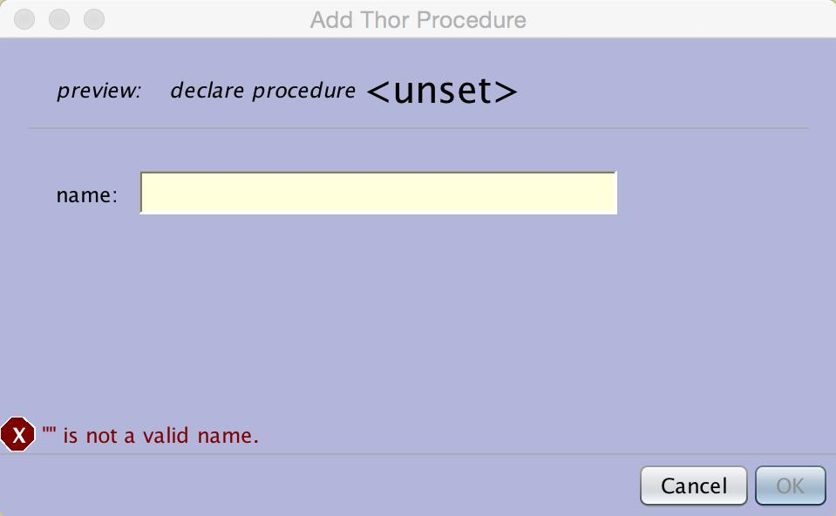
Creating a Procedure
Naming Conventions
Be sure to give it a name that easily communicates to anyone reading your code what it will do
Begin with lowercase letter of the alphabet
May include digits
No spaces, use camelCase if more than one word
No special characters such as ‘?’ or ‘#’

Slide 19
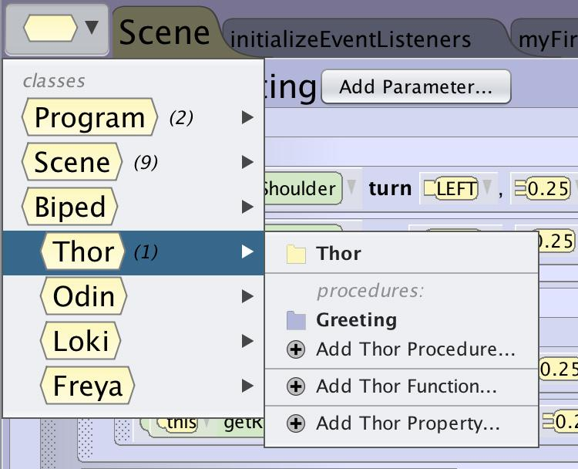
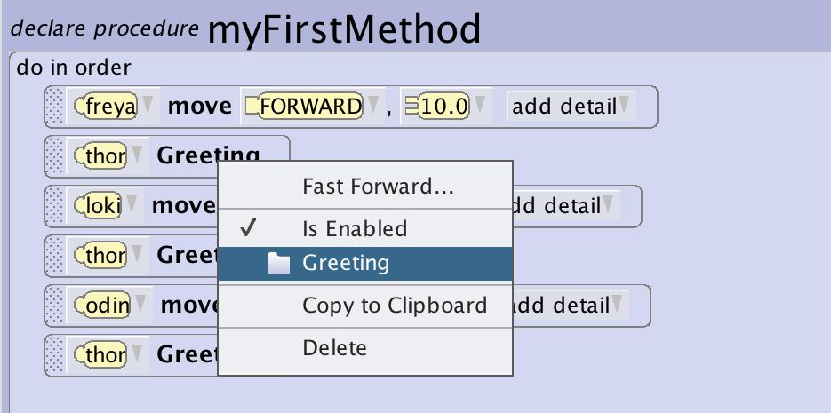
Creating a Procedure
Accessing the New Procedure
Once you have created your new procedure there are multiple ways to access it to edit
Select it from the drop down class menu
Select it from the list of procedures on the class summary page
Select edit next to the procedure on the method pane
Right click on the procedure in the code editor and select the procedure folder

Slide 20
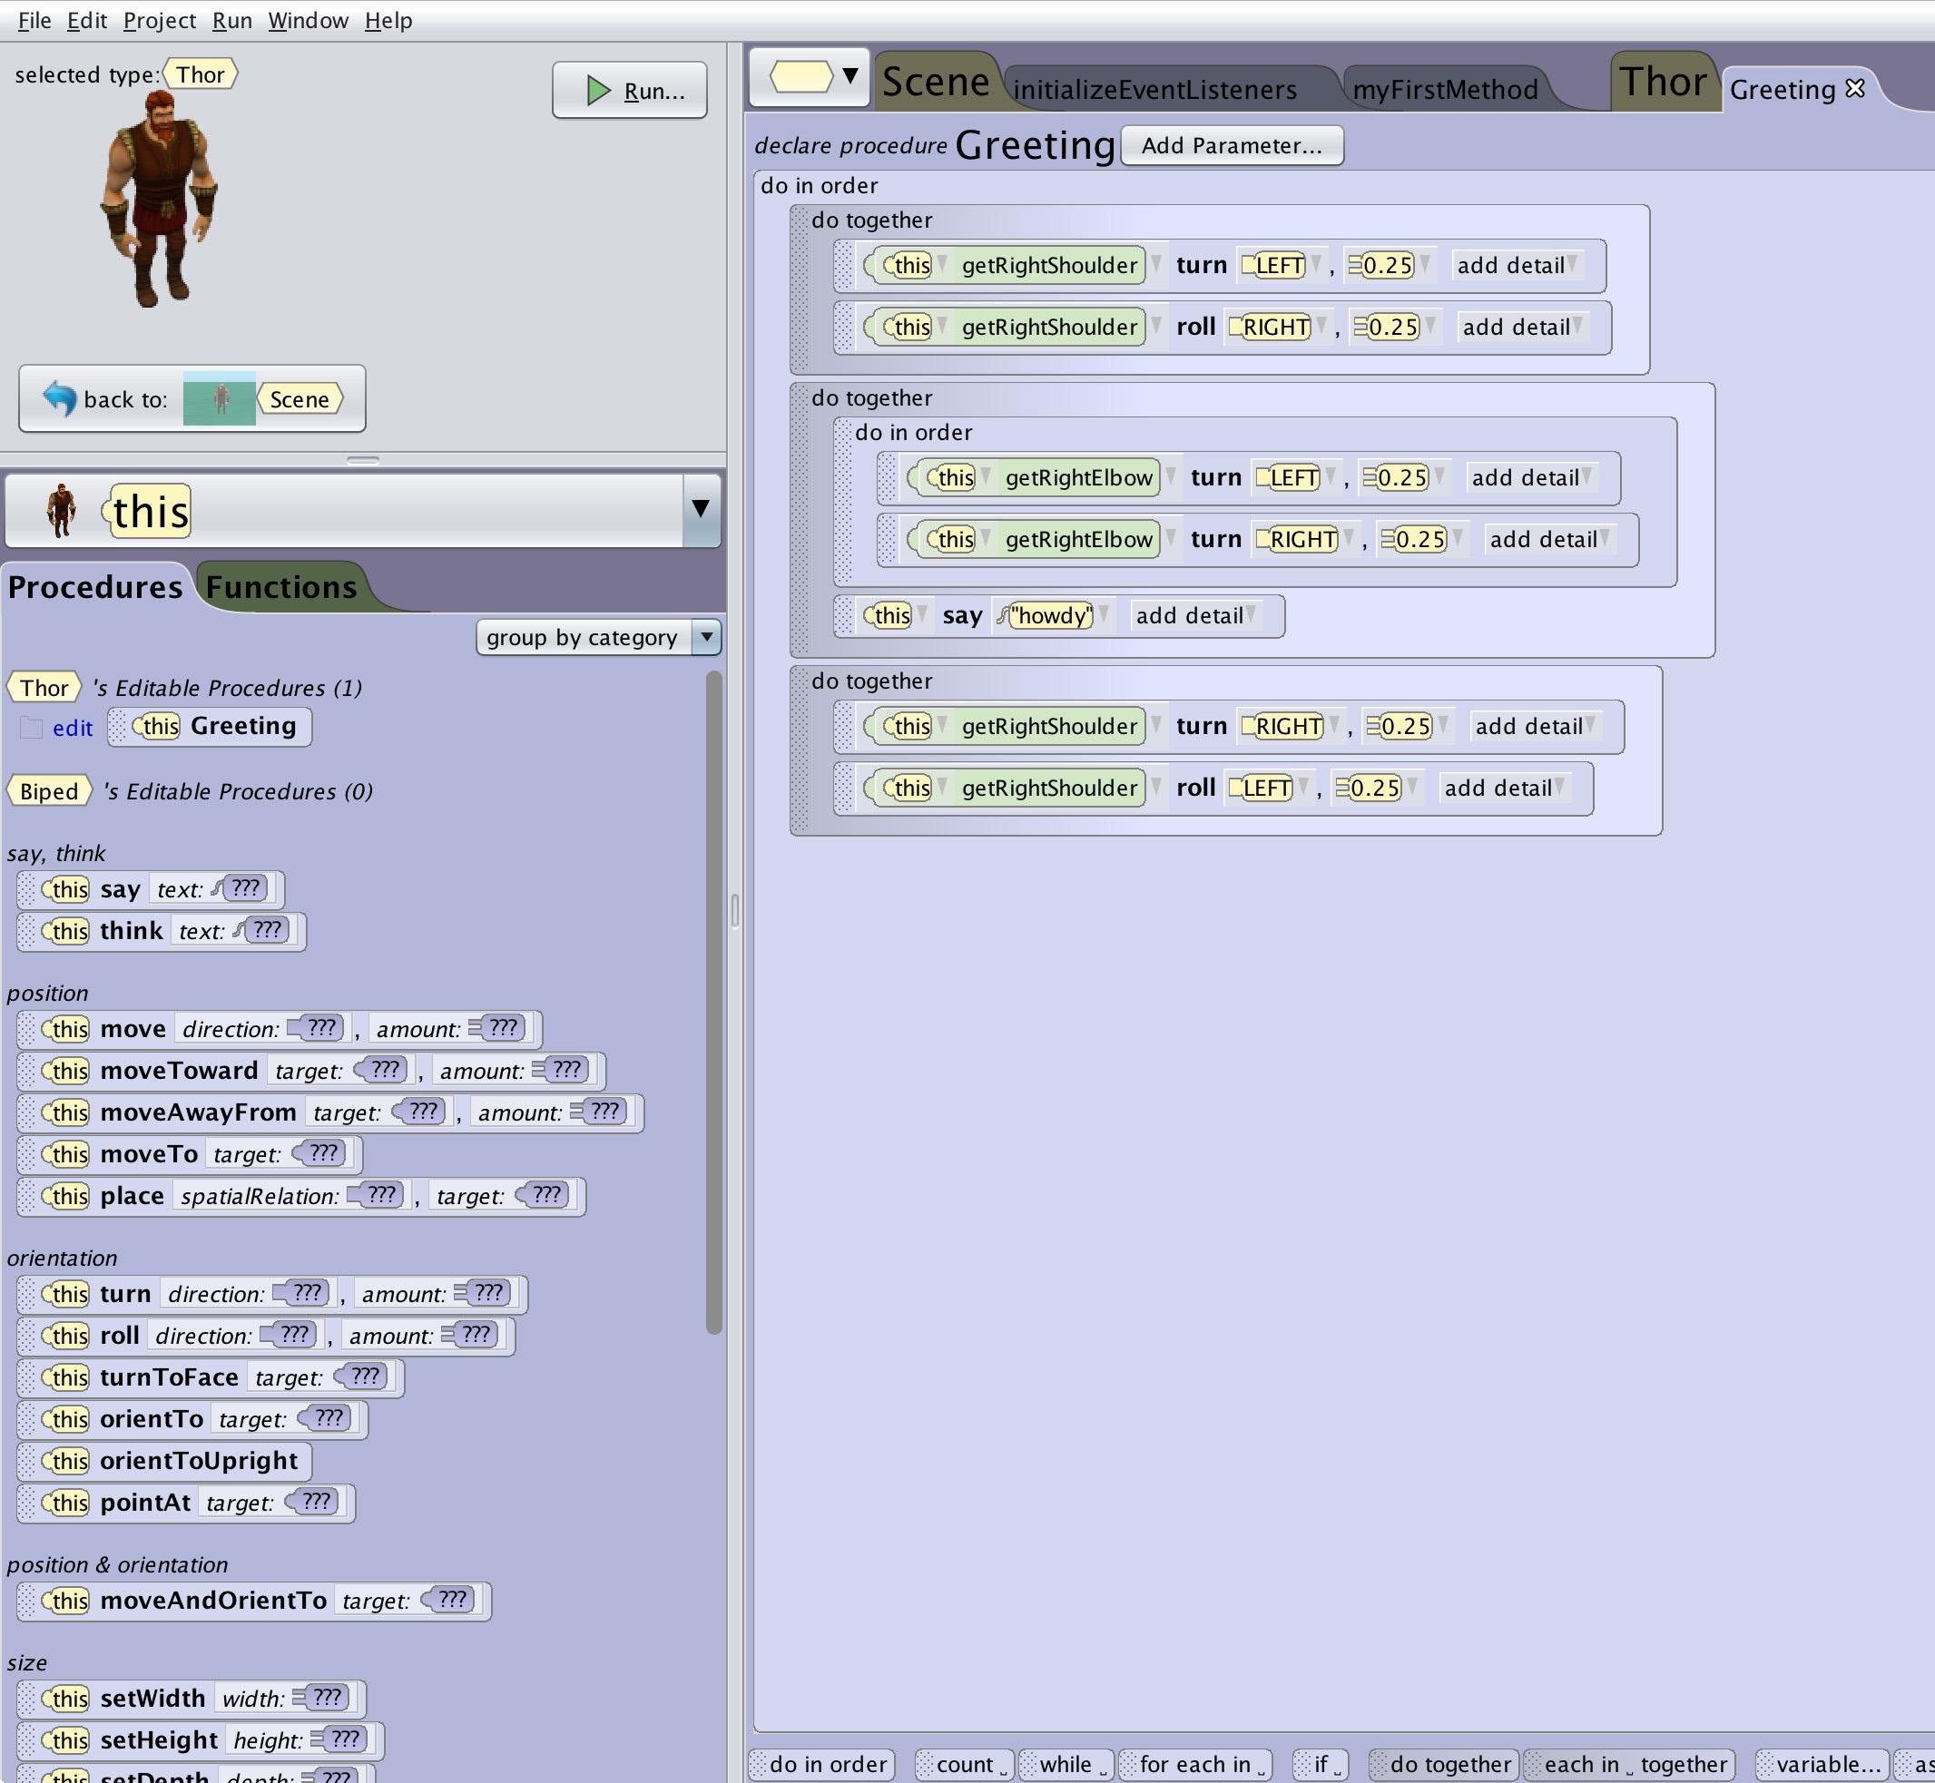
Creating a Procedure
“This” is a Placeholder
Don’t be confused by the use of “This”. When viewing the procedure remember that the procedure you are writing could be used by any number of objects depending on where you put it.
At the biped level “this” could be any object of the biped type that you add such as Loki or Odin
At the Thor level “this” could be any number of Thor characters - remember that you could have a whole army of Thors running around

Slide 21
Creating a Procedure
Build Your Procedure
You can now make your procedure using all of the different functionalities available in Alice.

Slide 22
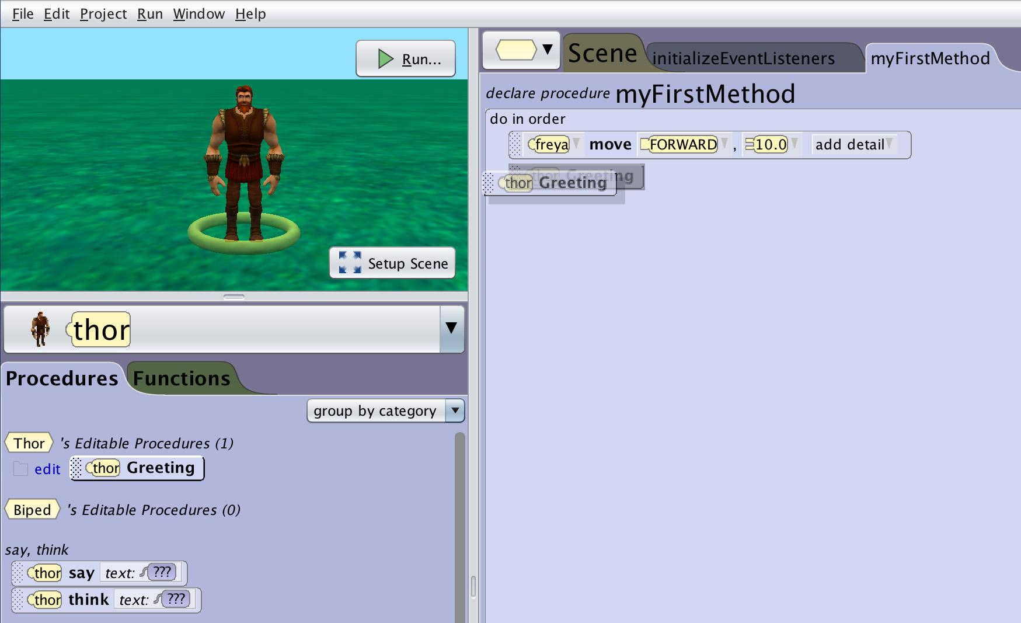
Creating a Procedure
Procedure is Ready to Use
Your procedure is now ready to be used. You will see it in the procedures tab of the code editor when the appropriate objects are selected. Remember you can use it as often as you like and make edits that will automatically propagate to all uses of that method.

Slide 23
Sharing Custom Procedures

Slide 24
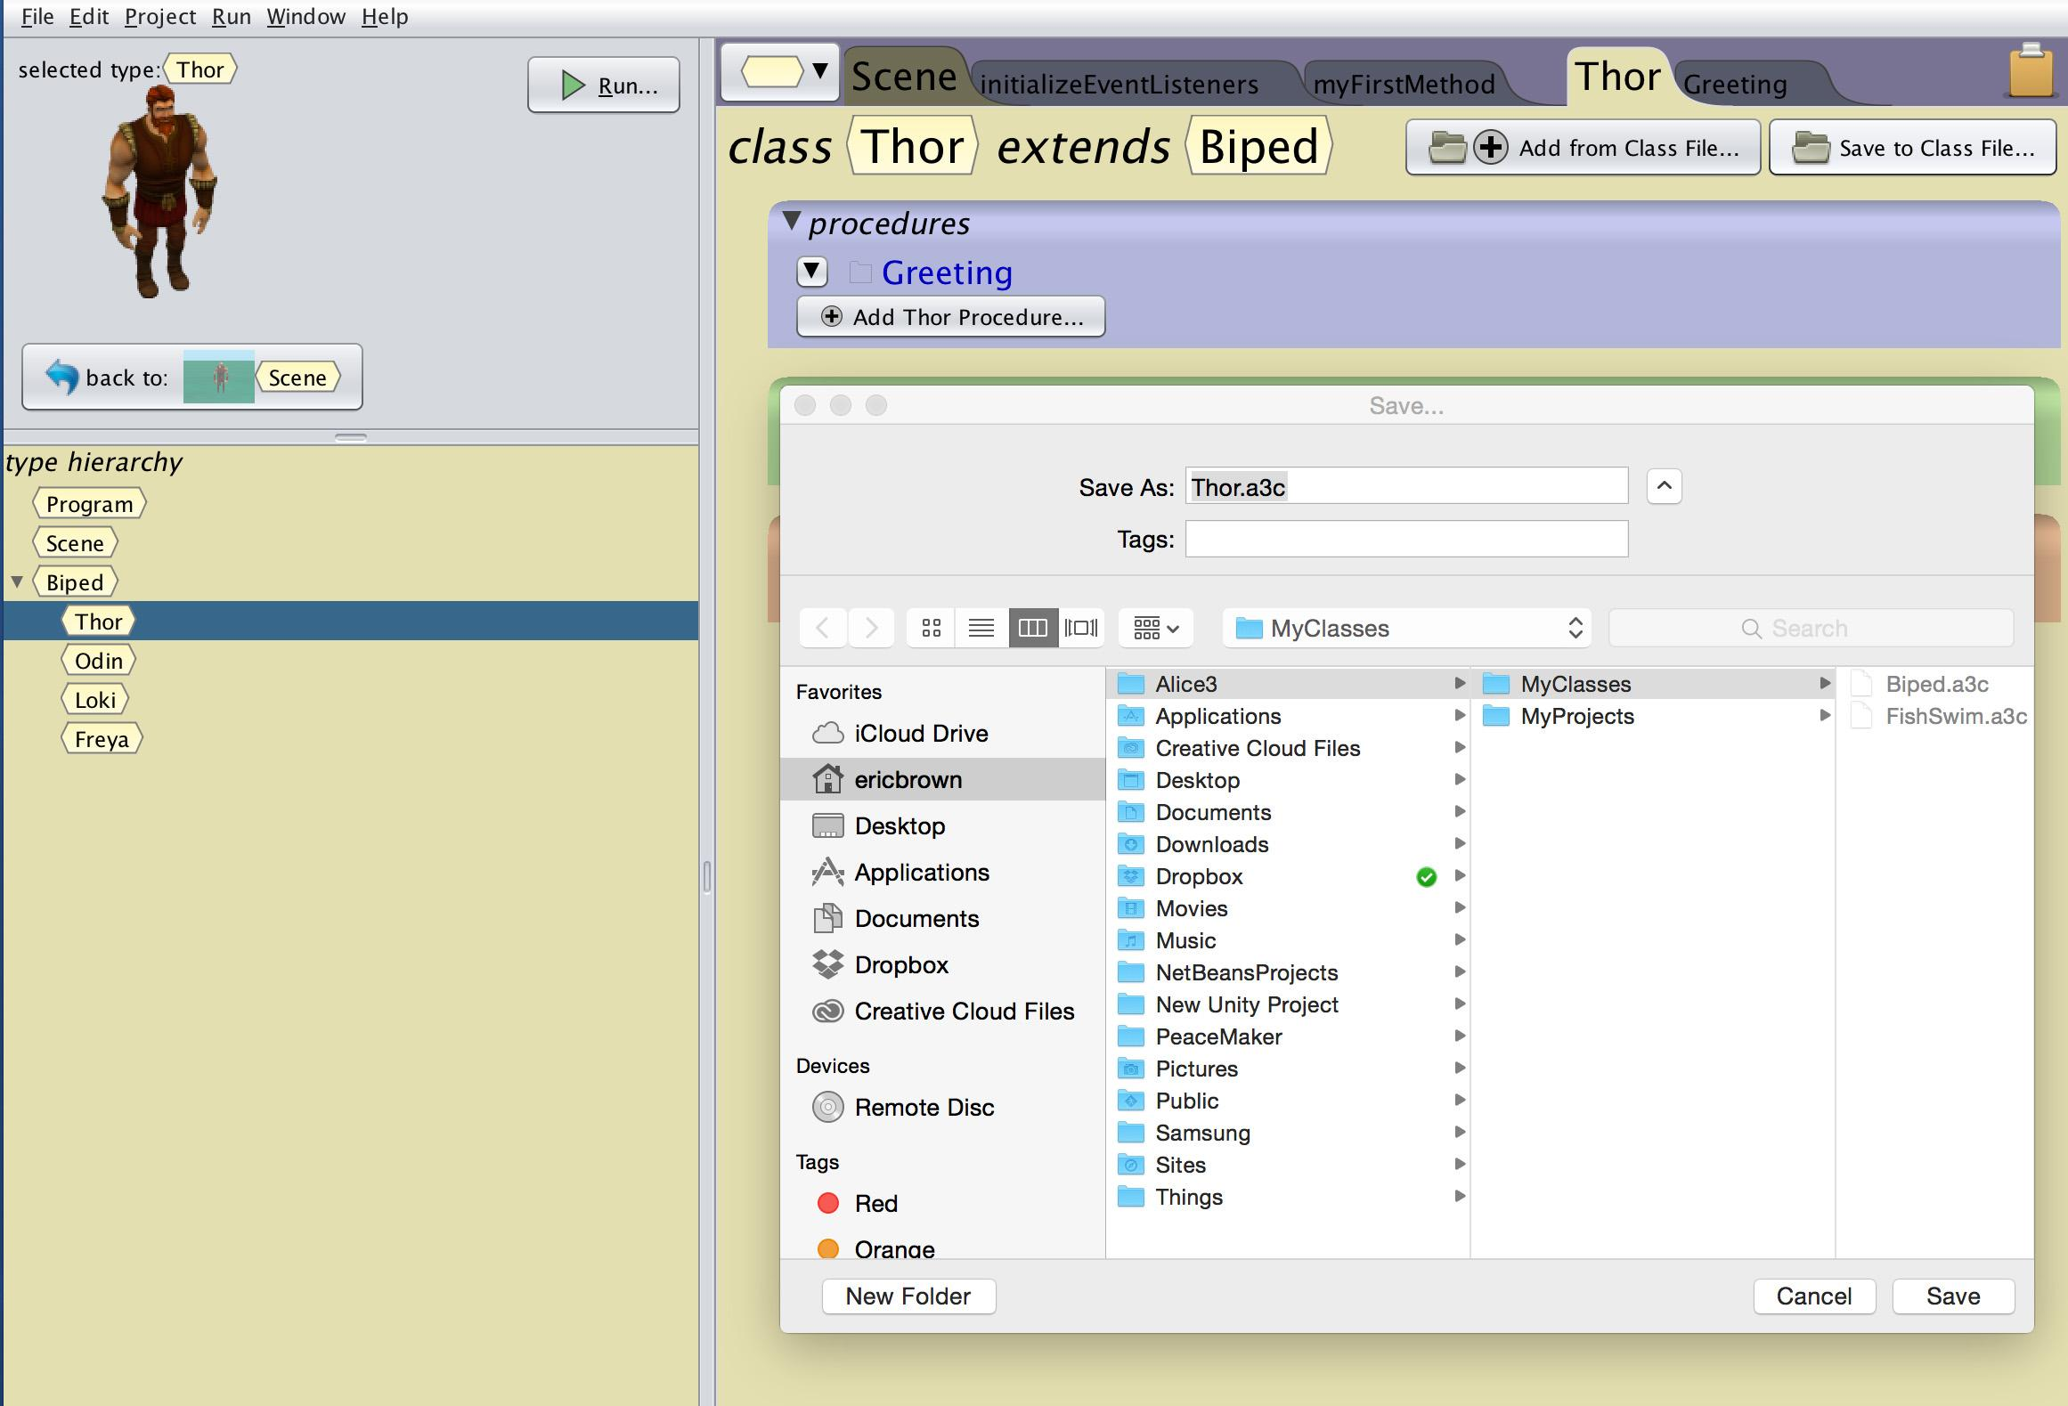
Sharing Custom Procedures
Exporting and Importing Class Files
You can share procedures between projects by saving out and then importing the whole class file.
Navigate to the class summary tab that contains the methods you desire to share
Select Save to Class File
The default will name the file the class name and save to your MyClasses folder

Slide 25
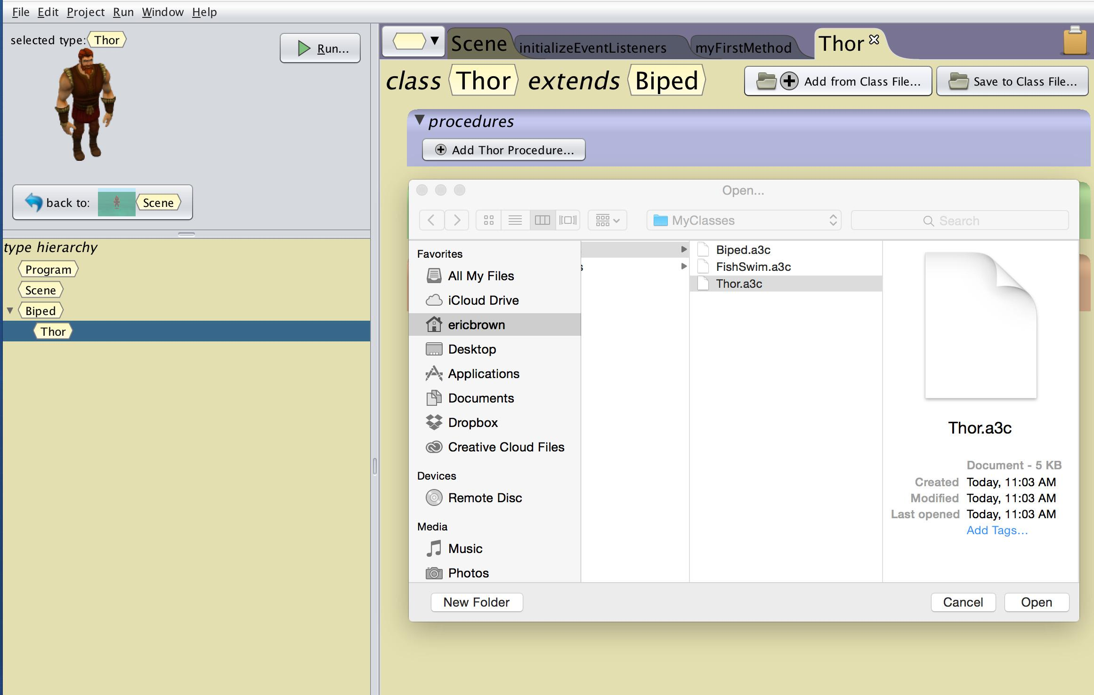
Sharing Custom Procedures
Importing Class Files
To import the class file you will need to first add an object of the class type to your scene
Navigate to the class summary tab that you wish to import class information for
Select add from class file
Select the class file that you want to add to your project

Slide 26
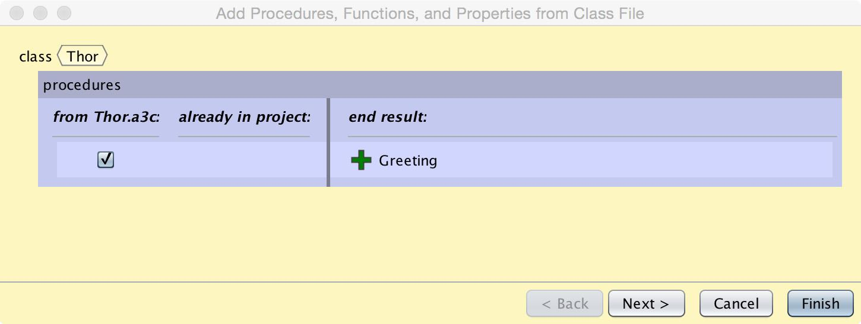
Sharing Custom Procedures
Merging Class Files
You can decide what methods you want to import from the merge dialogue box
Check and Uncheck your desired imports
Select Finish and you will see the desired methods populated in your new project

Slide 27
Tips and Tricks

Slide 28
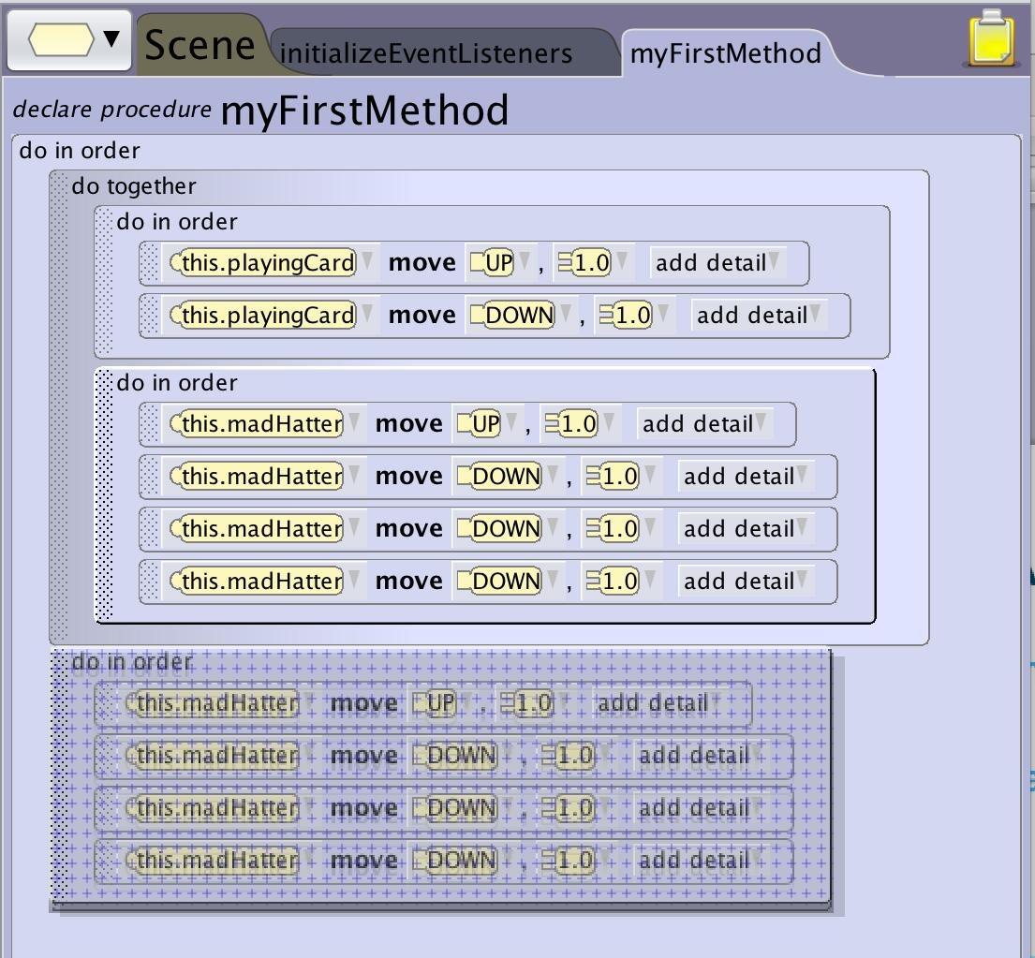
Tips and Tricks
Using the Clipboard
Many times you may realize after you have made something that you will want to use it over and over again. If this happens to you:
Create your new custom method
Drag the code you want to move to the clipboard
Navigate to your new method and drag the code out of the clipboard
The clipboard doesn’t make a copy so if you want the code to remain in the original location make a copy first then drag to the clipboard

