Slide 1
Control Structures
http://www.alice.org/resources/lessons/control-structures-overview/

Slide 2
Control Structures
What is a Control Structure?
A control structure is a programming element that controls which statements in a program are executed and in what order. Types of control structures in Alice are:
Sequential: Do in Order
Concurrent: Do Together and Each In_Together
Conditional: If_
Repetition: Count_ For Each In_ and While_

Slide 3
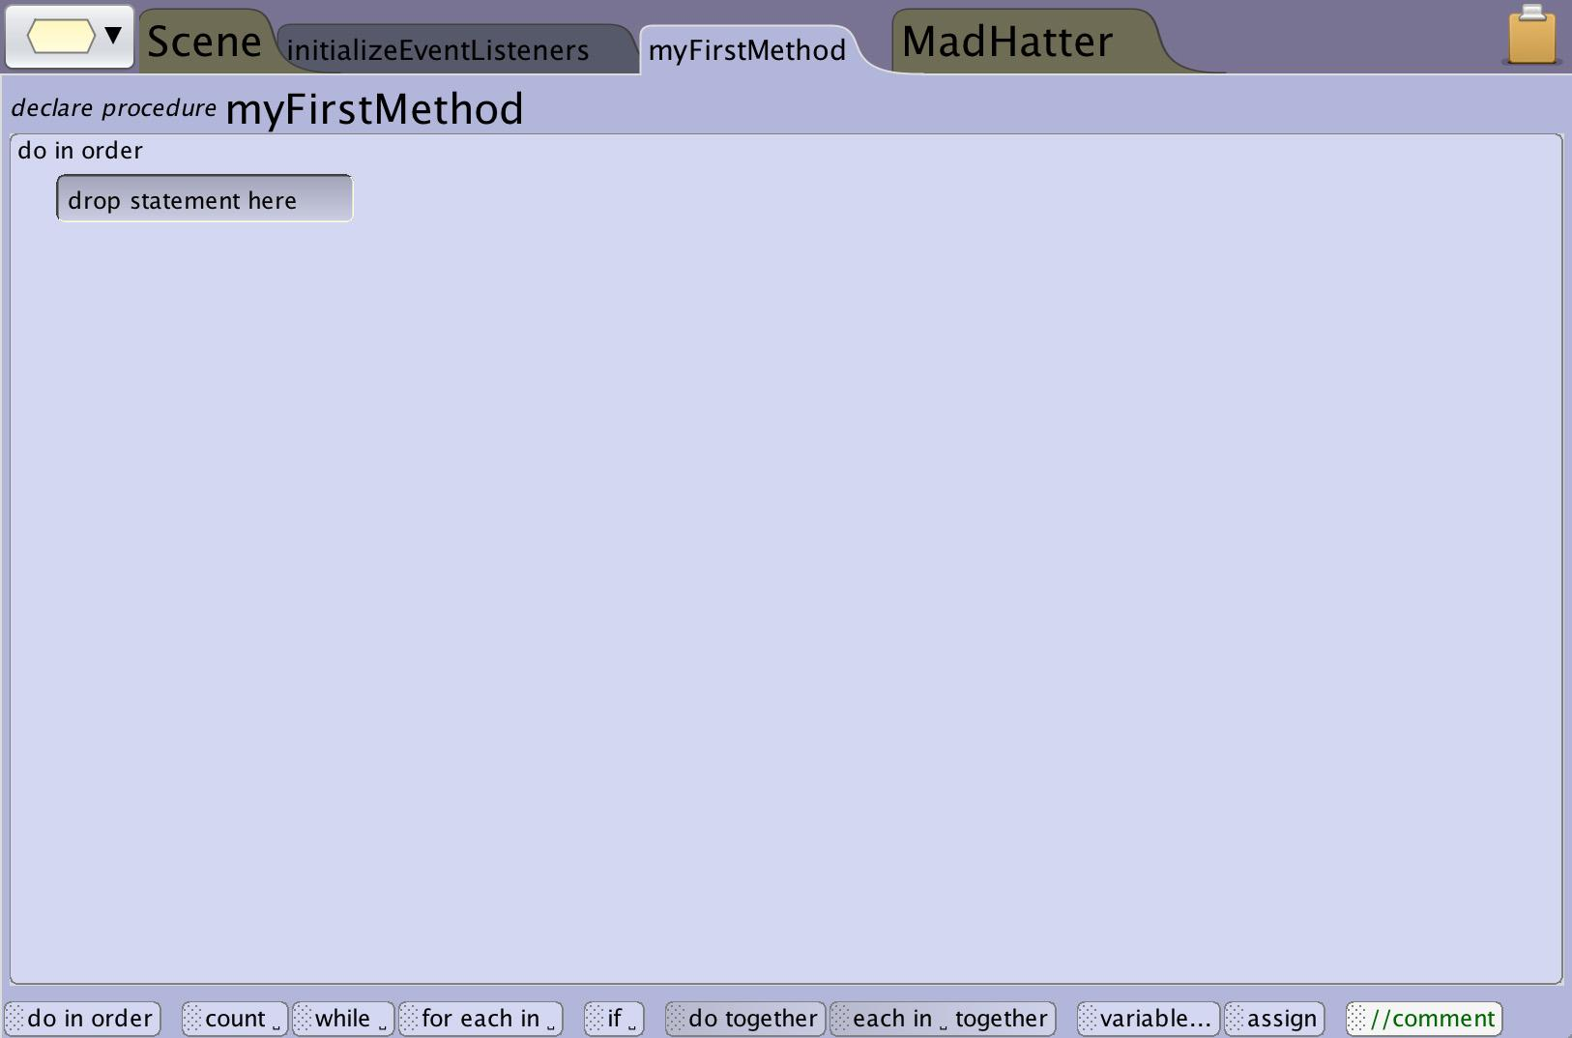
Control Structures
Control Panel
The control panel is where you find the control structure elements that you can use in your Alice programs.

Slide 4
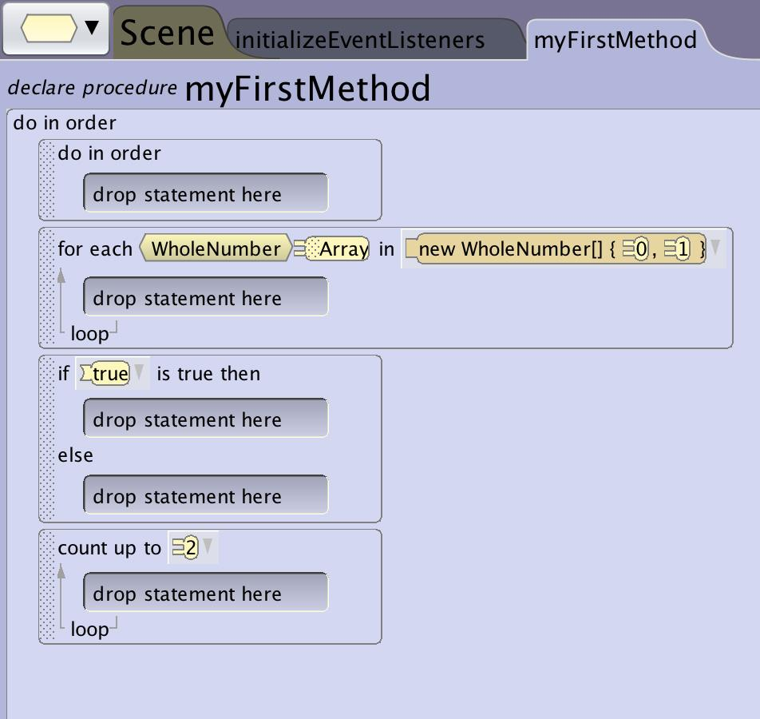
Control Structures
Code Blocks
When you drag a control structure into your program they create code blocks that have empty areas that allow you to add statements into the block.
Each type of code block will have different required fields and formats based on how they will function.

Slide 5
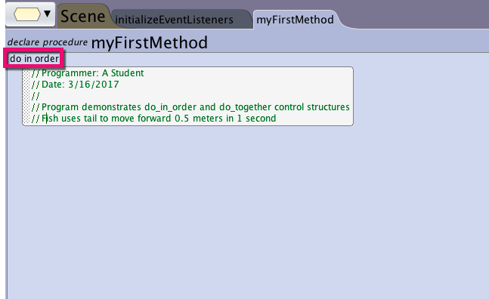
Control Structures
Do In Order
The most basic control structure in Alice is a do in order block. A do in order block will tell the program to execute the enclosed statements in sequence (one after another).
All methods in Alice start with a do in order control structure as the default behavior.

Slide 6
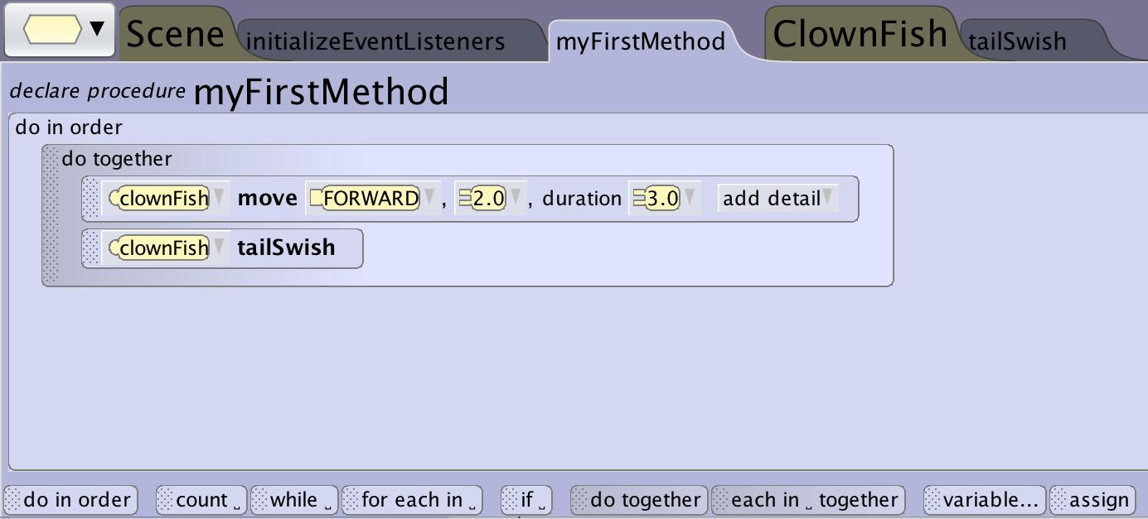
Control Structures
Do Together
A do together code block can be used to execute all of the statements in the block at the same time. Do together is very helpful for things like:
complex movement such having a fish move forward while having it’s tail swish at the same time.
having multiple characters animating at the same time.

Slide 7
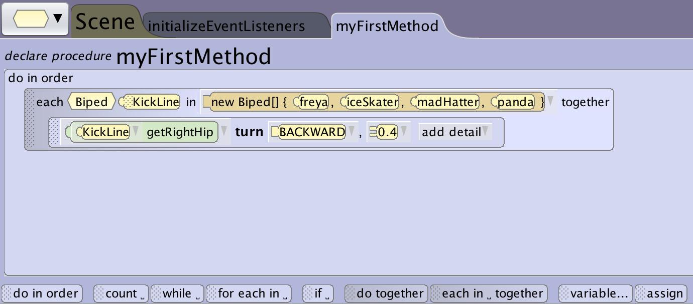
Control Structures
Each In Together
An each in_ together block in Alice is a do together control structure that includes the use of an array. It will execute the statements in the block at the same time for all of the elements in the array.
An each in_together can be used to have a whole group of characters perform the same action simultaneously such as having a row of characters dancing at the same time.

Slide 8
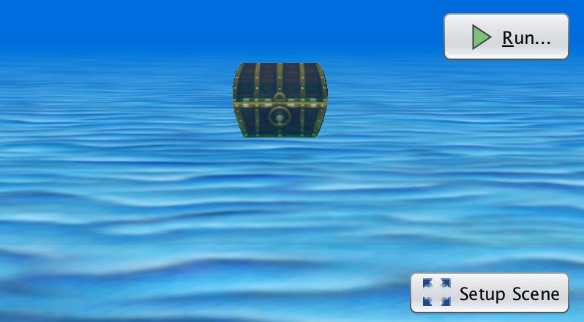
Control Structures
If Else
Many times in a program you want something to execute only under certain circumstances. In many programs this is expressed using an If_ else statement. This means that when this part of the program is being executed if_ a certain condition is true or false such as “the timer has run out” do this set of directions otherwise (else) do this other set of directions such as “keep playing”.
This structure is often paired with other patterns that allow it to be checked multiple times or after an event has changed conditions in the world.

Slide 9
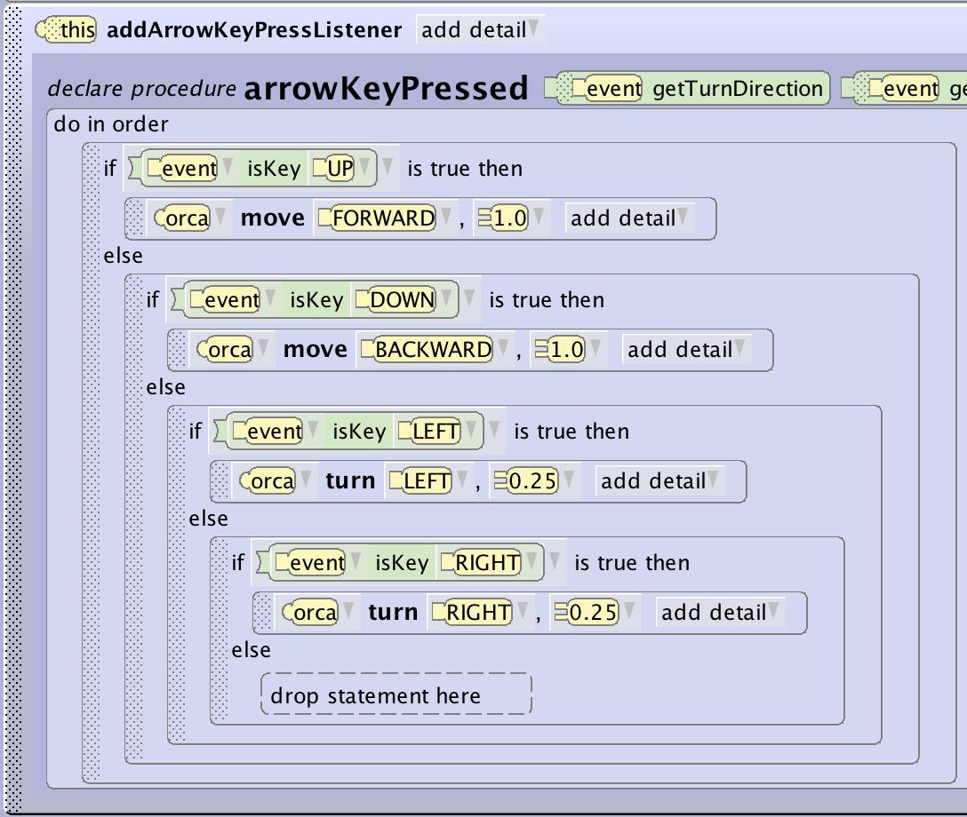
Control Structures
Conditional Constructions
In Alice you will use conditionals in conjunction with event listeners for things like if a key is pressed or if the mouse is clicked.
You may also use a conditional with a loop to continuously check to see if a score has been reached or a timer has run out
In order to use conditionals you may need to use functions, variables, and/or events

Slide 10
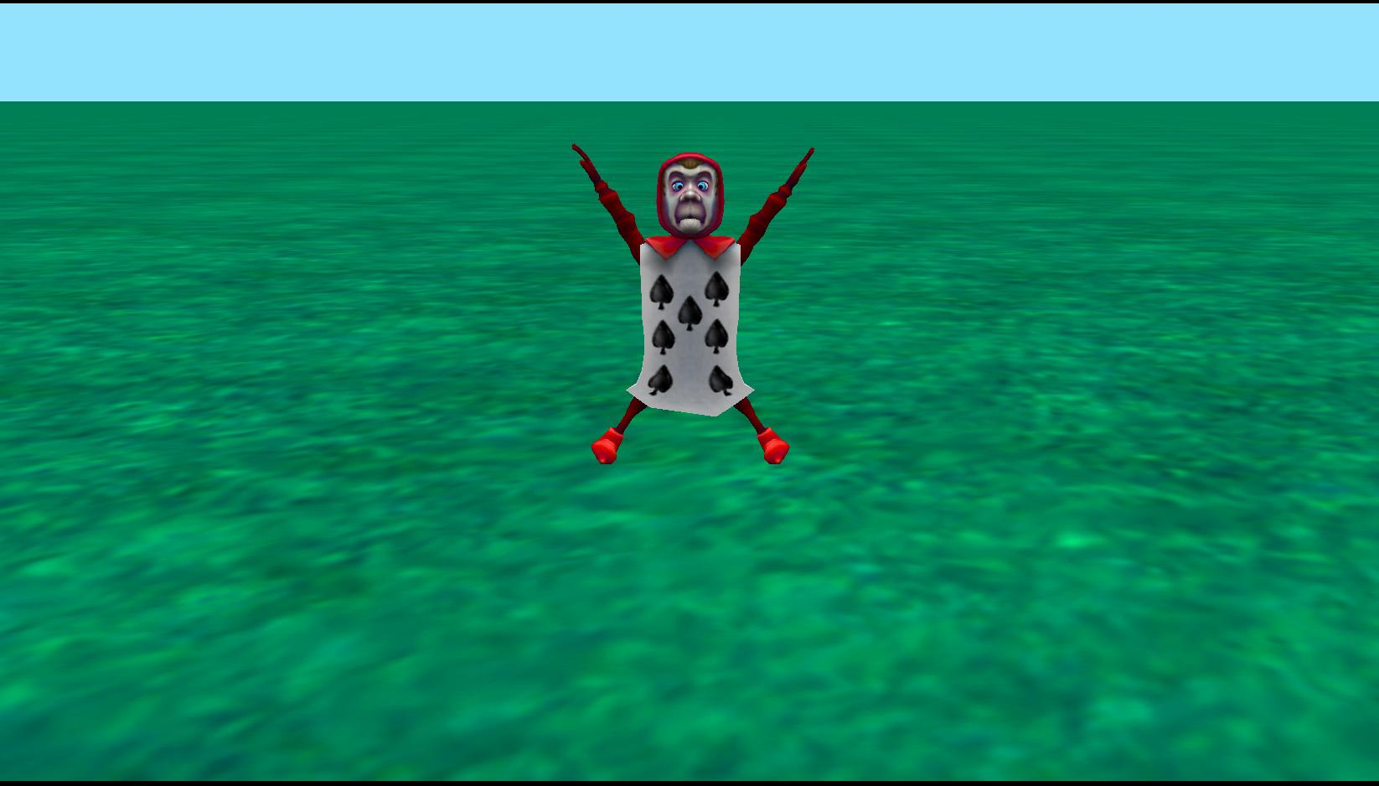
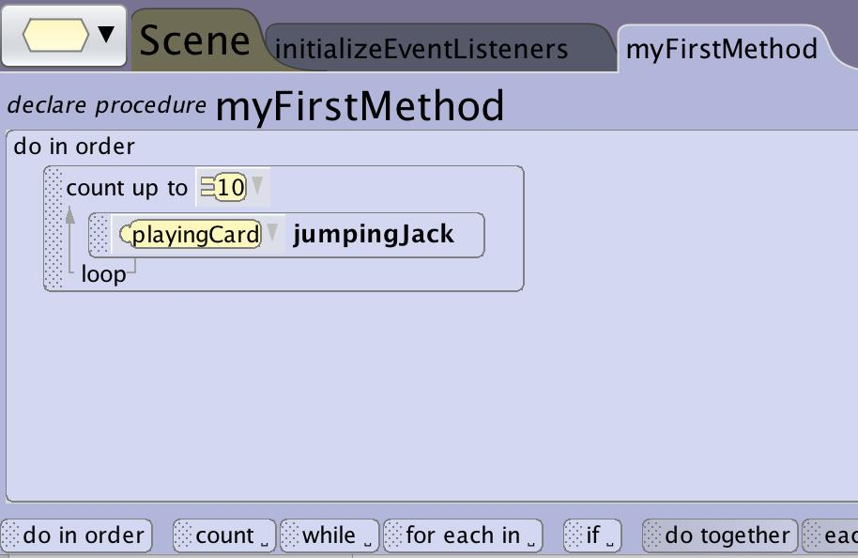
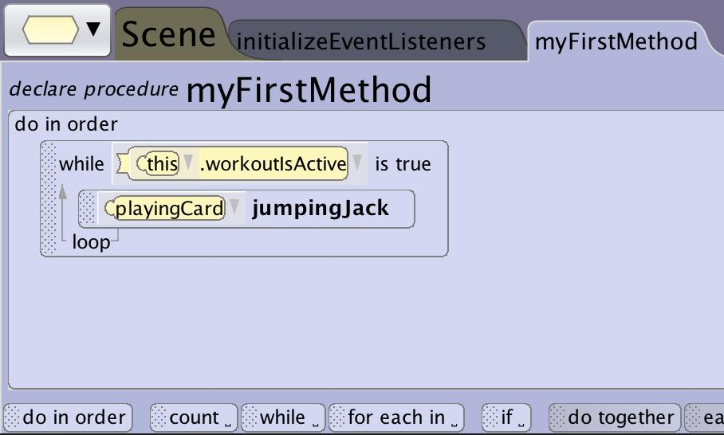
Control Structures
Looping
Computers don’t get bored or tired and are happy to do the same thing over and over again. Lots of time you may want the same action to be repeated a number of times. There are 3 ways in Alice you can achieve this.
A count loop defines how many times you want the program to execute the contained code.
A for each in loop defines how many times and how you want the program to execute the contained code based on elements in an array.
A while loop tells the program to continue to do the contained code until the defined condition is no longer accurate.

Slide 11
Control Structures
Count Loop
A count_ block in Alice will execute a method the number of times that you define.
This is a great way to have your animation run the same animation multiple times without having to write the same code lots of times such as having a character do jumping jacks.
The computer is not even breaking a sweat after 10.

Slide 12
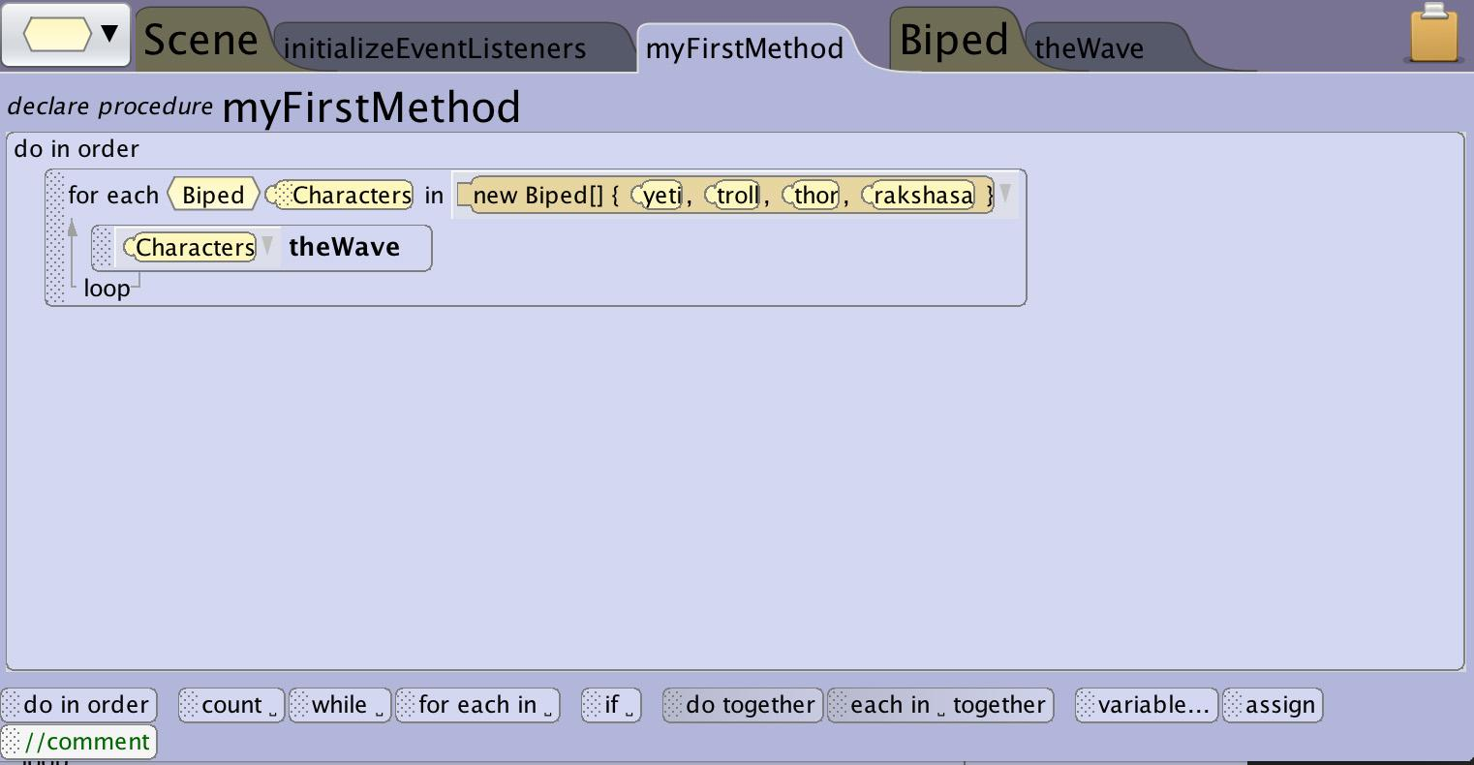
Control Structures
For each In Loop
A for each in_ block in Alice will execute the statements inside the block repeatedly for each element in an array.
Additionally you can substitute the element from the array in each time the statements are executed to easily create complex animations.
Using an array of characters you can repeat the same statements multiple times replacing it each time with a different character from the array to have a row of characters raise their arms in order and do the wave.

Slide 13
Control Structures
While Loop
A while_ code block can be used to have your program execute the same instructions for an undefined amount of times based on conditions in the program.
A while_ can be used to make an animation repeat for the duration of your program using a “while program is active” condition such as having clouds move across the sky.
A while_ can be used to have an animation play only when a character is close enough to an object or looking at it such as having a dog jump up and down when the character is close to it.

Slide 14
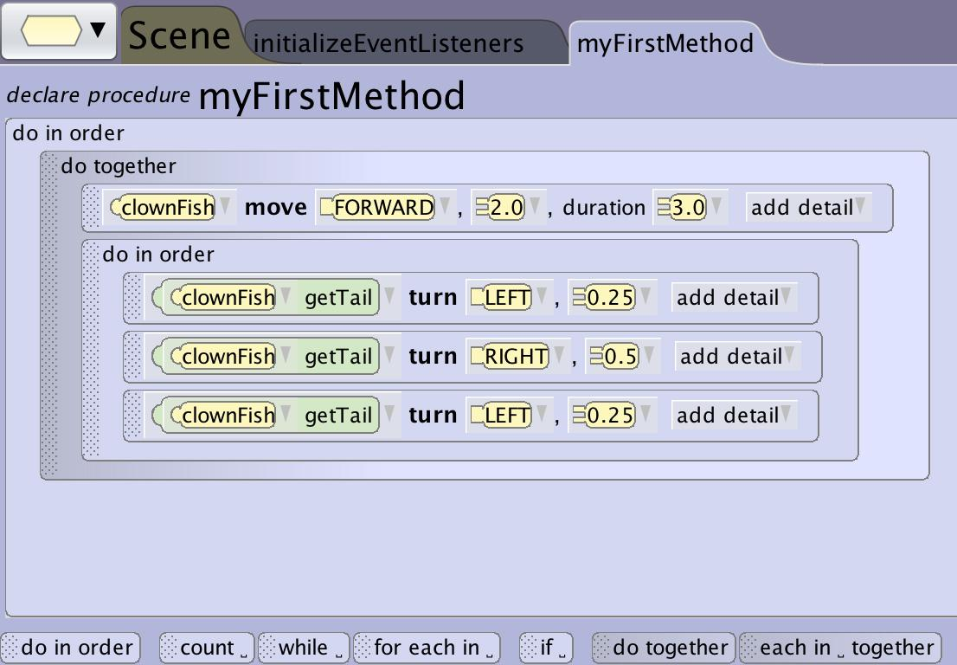
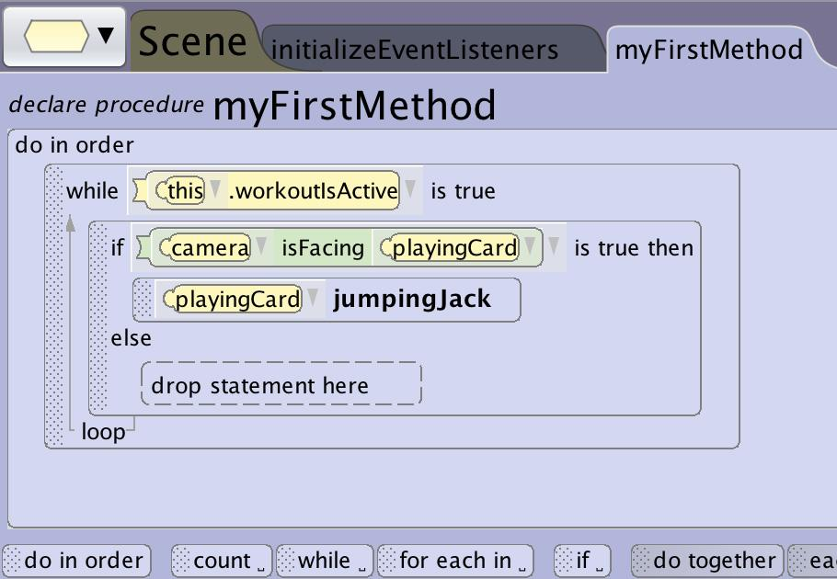
Control Structures
Nested Code Blocks
You can put control structures inside of other control structures. This will come in very handy when trying to synchronize when events happen.
In Alice you will often want to have multiple do in orders nested inside a do together to enable multiple different characters to simultaneously do a string of different actions.

Slide 15
Tips and Tricks

Slide 16
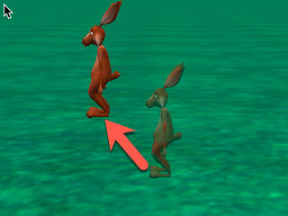
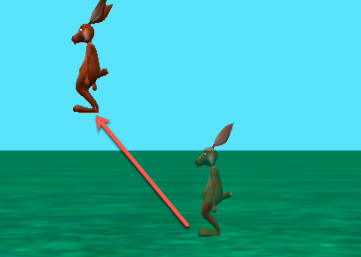
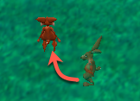
Tips and Tricks
Achieving Different Movements
Diagonal move
Do together
Move forward 1 meter
Move left 1 meter
Move on a slope
Do together
Move forward 1 meter
Move up1 meter
Move on an arc
Do together
Move forward 2 meter
Turn right .5 rotations

Slide 17
Tips and Tricks
Synchronization
Remember that each Alice statement defaults to a duration of 1 second
When using a do together you will need to change a single statement duration detail to 3 seconds if you want it to take the same amount of time of another animation that is comprised of 3 separate statements.

Slide 18
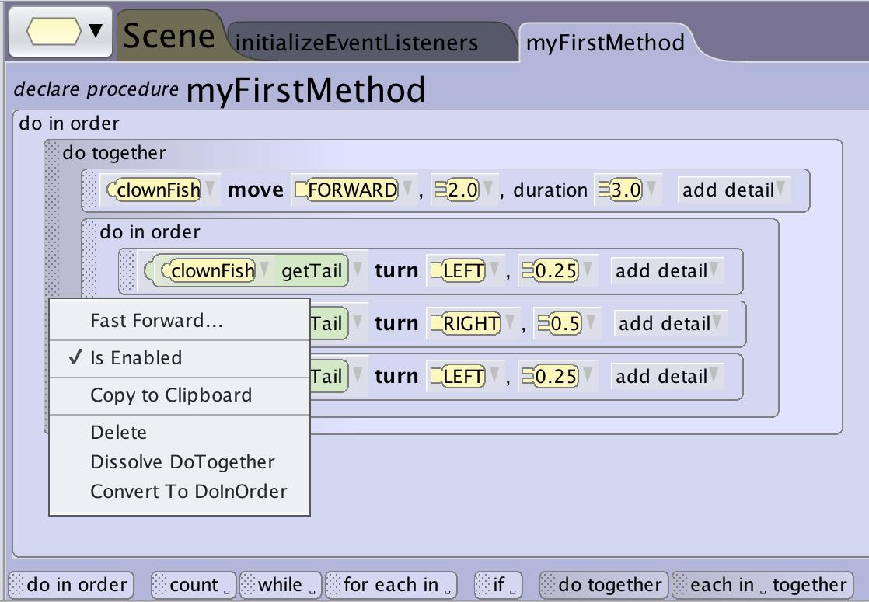
Tips and Tricks
Dissolving and Converting
Right clicking on a control structure will allow you to:
dissolve constructed control structures
change a do together into a do in order or vice versa

