Slide 1
Events: Collision and Proximity
http://www.alice.org/resources/lessons/events-collision-and-proximity/

Slide 2
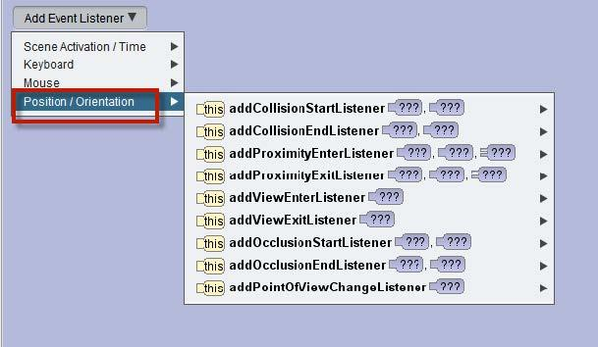
Events Position/ Orientation
Position / Orientation Events
Position and orientation events trigger based on events inside your world. These events are based on tracking the position and orientation of objects. Collision and Proximity are based on events that happen when two objects positions relative to each other fulfill the parameters of the event.

Slide 3
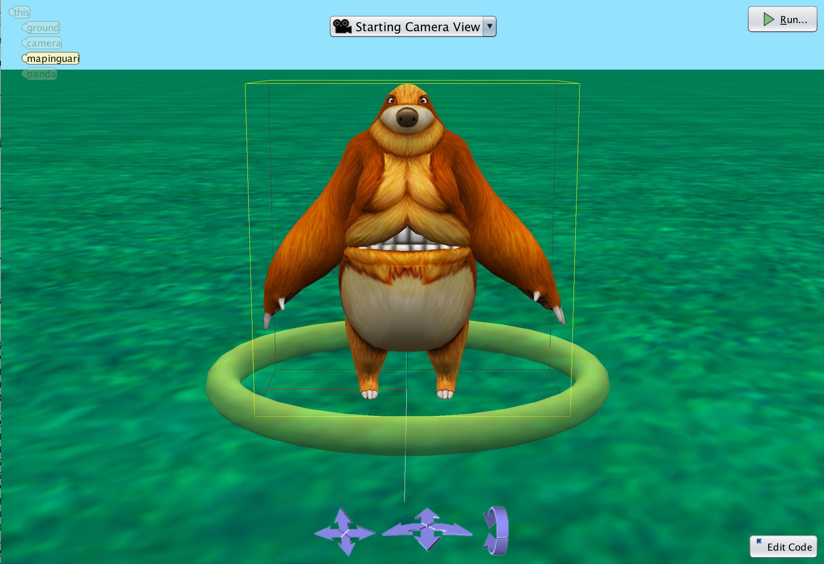
Collision Detection
Collision Detection
Objects in Alice have what we call bounding boxes around the objects that surround all of the outermost parts of the model.
The collision detection triggers when the bounding boxes surrounding two objects intersect.
There are 2 options for when you want the event to trigger:
Collision Start - this will trigger the moment the two objects intersect.
Collision End - this will trigger after two objects that have intersected are no longer intersecting.

Slide 4
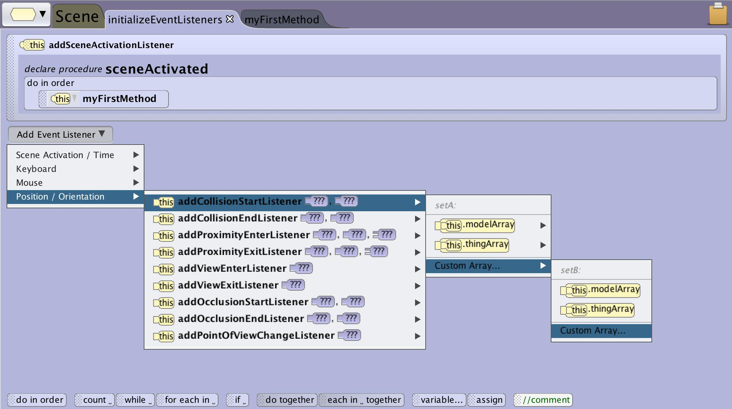
Collision Detection
Collision Required Parameters
In Alice, the listeners for collision detection use two arrays that hold the objects that will be tracked for collision events. The object arrays are required parameters when adding a new collision event listener.
Each array can be made custom when creating the listener or you can access an existing array.
Remember that the initializeEventListeners is a scene class method so to access existing arrays you will want to create them at the scene property level.

Slide 5
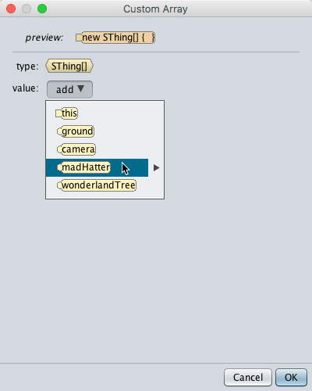
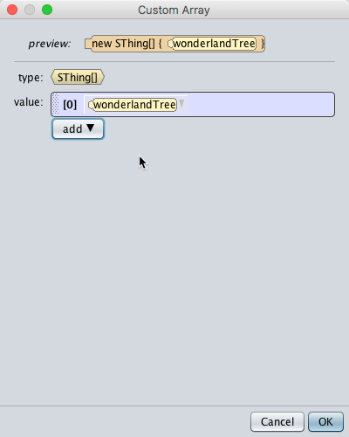
Collision Detection Arrays
One way to construct your arrays are:
First Array: Add all of the objects that will be moving around and initiating the collision.
Second Array: Add all of the objects that the moving objects will collide with.
This is only a suggestion for readability. As long as the two colliding object are in different arrays the event will work.
Also note than an Array can have only one object it in.

Slide 6
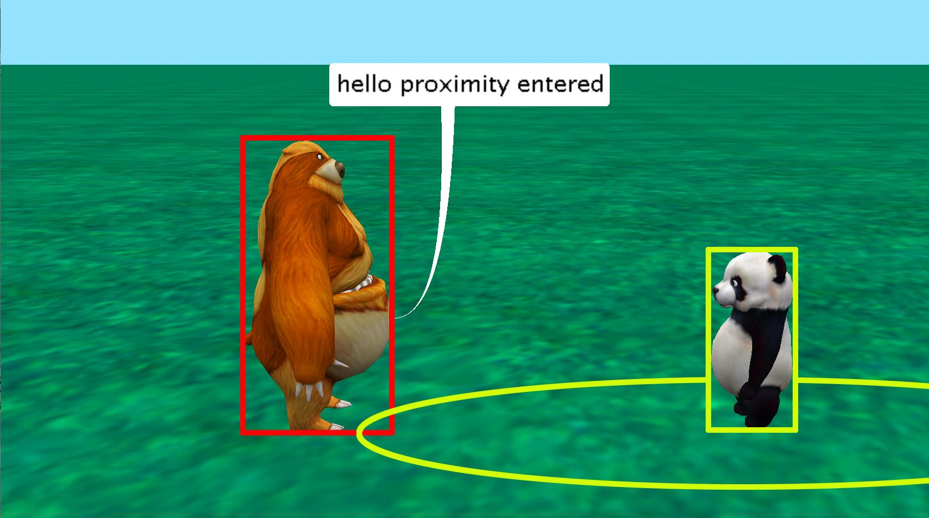
Proximity Detection
Proximity Detection
The proximity detection works very similar to the collision detection except it triggers when the bounding box plus the distance indicated in the distance parameter intersect.
Proximity is a good alternative to collision when you don’t want the objects to be right on top of each other to trigger the event.
In this example the mapinguari is triggering the proximity event when it’s bounding box is crossing the distance threshold that is represented by the circle.
The same 2 options exist for when you want the event to trigger: Proximity Start and Proximity End.

Slide 7
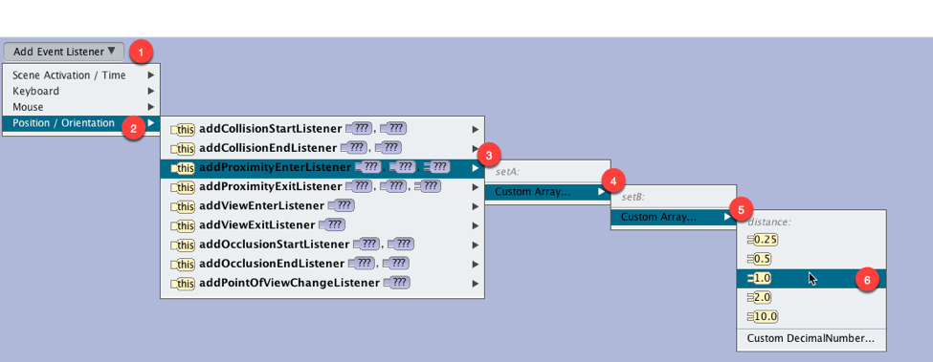
Proximity Detection
Proximity Required Parameters
The proximity detection uses the same required two arrays as the collision detection.
The proximity event listener also adds a required parameter for distance to set how close the objects need to be to each other in order for the event to trigger.

Slide 8
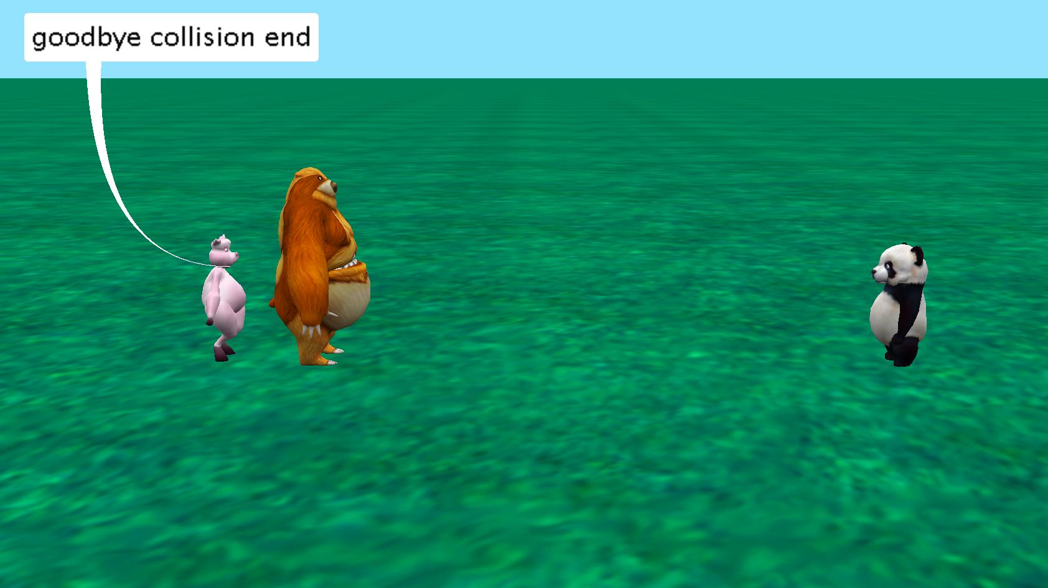
Event Built in Fucntions
Built In Event Functions
When constructed the collision and proximity events will trigger when any of the objects in one array collide or come within the proximity of any object from the other array. In some cases you may want to differentiate which of the objects has collided so you can set up different outcomes.
Collision and proximity events have built in functions for returning the objects that triggered the event getSThingFromSetA and getSThingFromSetB. These can be used to inform the outcome.
In the example a conditional block using a relational expressions is being used to set up different outcomes depending on which object the mapinguari collides with.

Slide 9
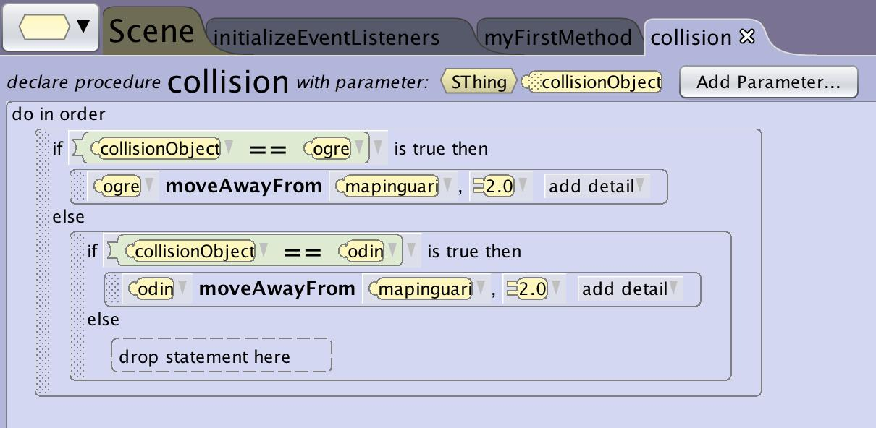
Events and Handlers
Recommended Structure
It is recommended that you limit the amount of programming you do in the event listener.
When possible you should create custom procedures for the event handler (what happens when the event occurs) and pass information such as which objects collided through as a parameter.
This allows for easier reading of the program, debugging and editing.

Slide 10
Functions Return SThing
The built in event functions return an sThing data type. This is done to allow for the ground to be used in a collision.
You will need to pass it as an SThing parameter and then translate them into logic or variables to be able to directly manipulate the object.
When using them in a procedure you can’t substitute the function for objects statements such as move and turn because those procedures are only available to object classes. You will need to set up relational expressions to trigger handlers for different objects if you want to use object procedures.

Slide 11
Tips and Tricks

Slide 12
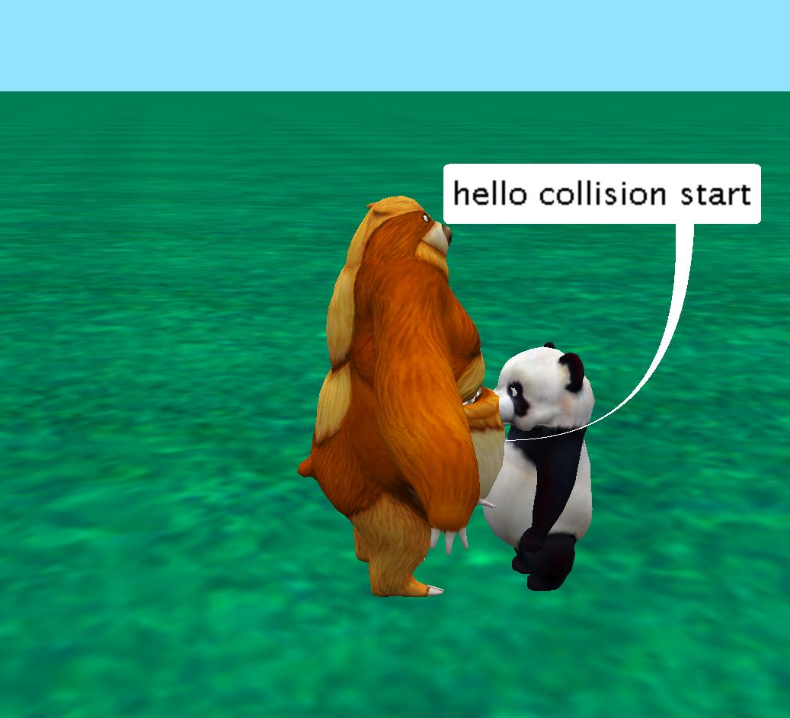
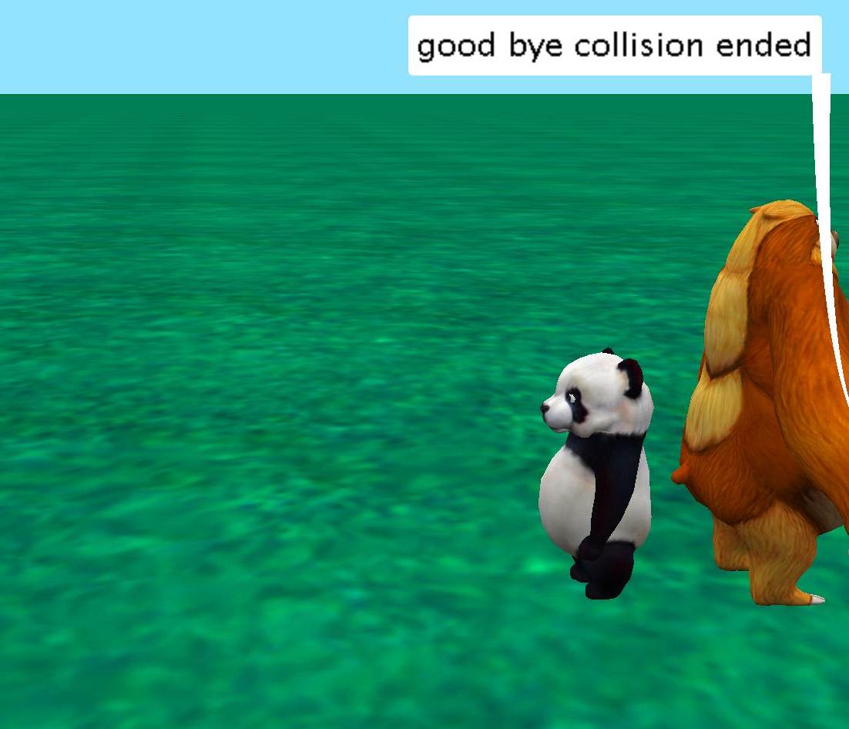
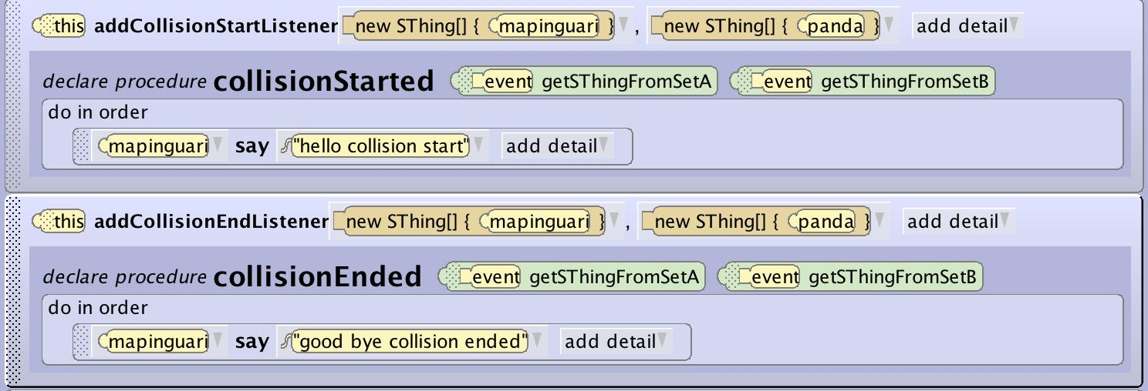
Collision Detection
Collision Detection Testing
To test code that wouldn’t otherwise have a visible outcome in your program a good trick is to trigger say statements when events occur so that you can easily see if it is successfully executing.
In this case we have set it up so when the collision start or end is triggered the mapinguari will say “hello collision started” and “goodbye collision ended”

Slide 13
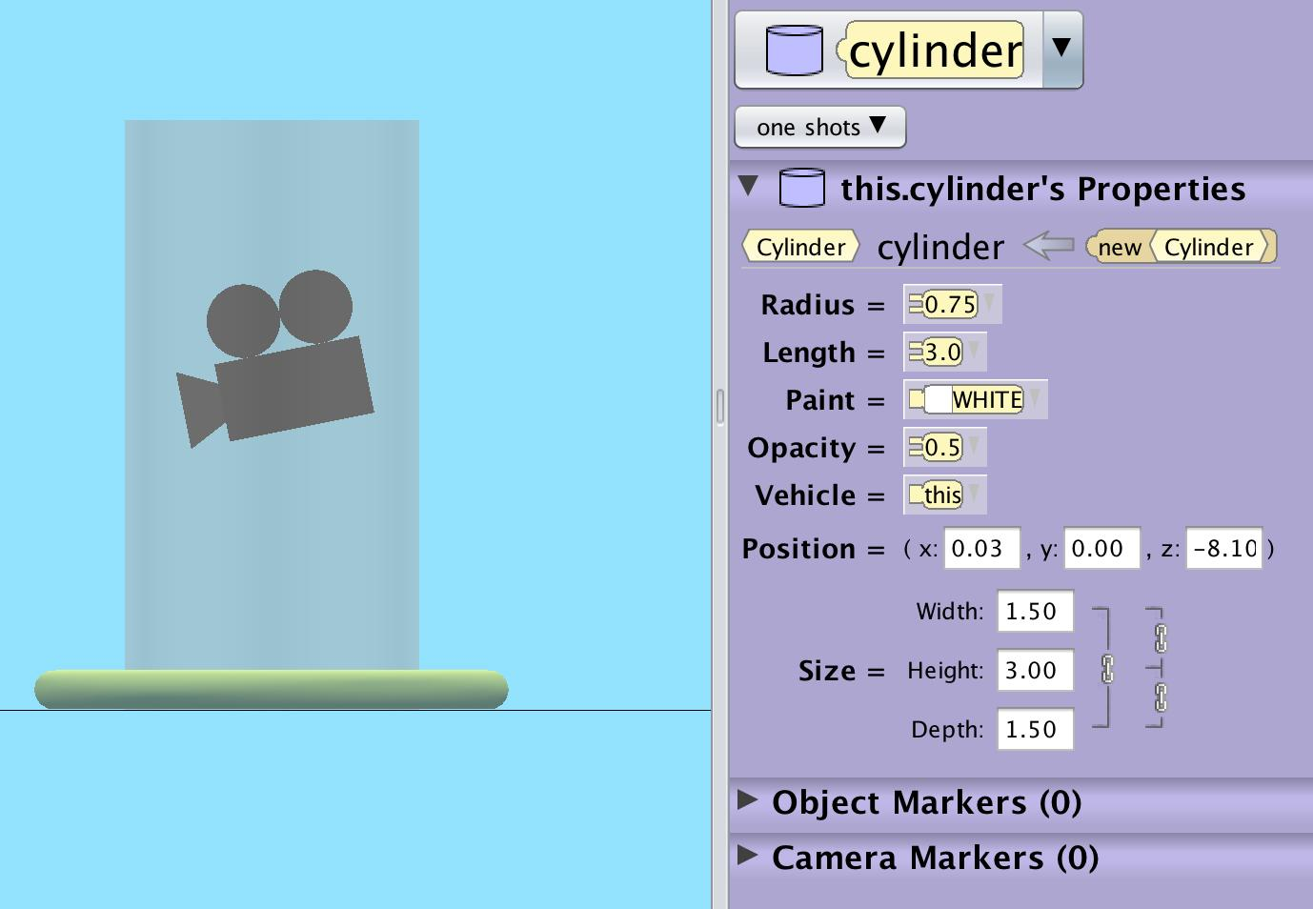
Tips and Tricks
Camera Collision and Proximity
The camera doesn’t have a bounding box so can’t be programmed for collision and proximity (as of version 3.4 added in later versions)
If you are going to make a first person world you will need to add an object that can be programmed for these interactions and either hide it from the camera or set it’s opacity to 0:
Center camera in cylinder
Vehicle Camera to cylinder
Set key move for object cylinder
Remember that though you can’t see it the object will be there for possible interference with other interactions.

Slide 14
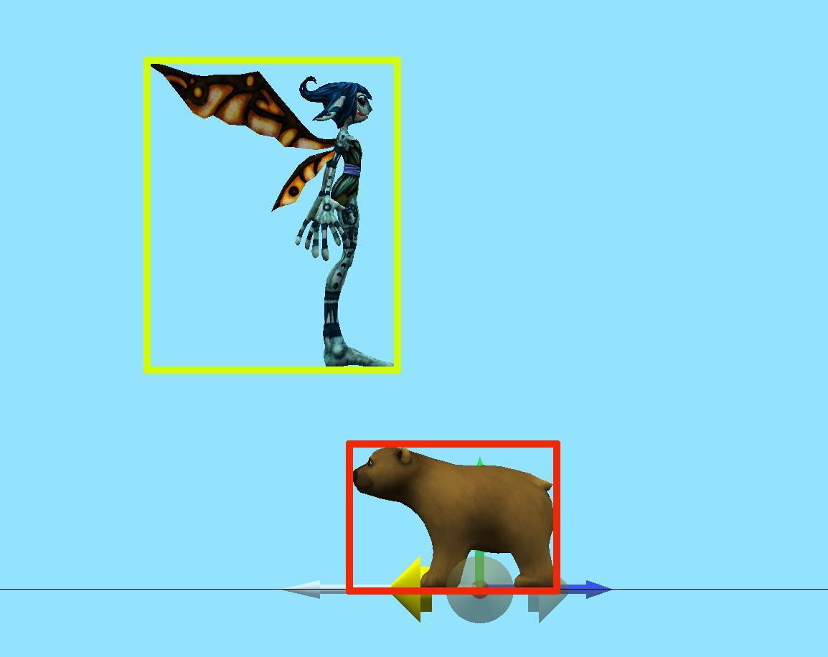
Tips and Tricks
Height Matters
Many times the reason a collision event isn’t triggering is based on the height of the objects to miss each other.
Remember to check in the scene set up that the objects will in fact intersect.
You can also use a proximity set to a short distance to emulate the collision with more margin for error.

Slide 15
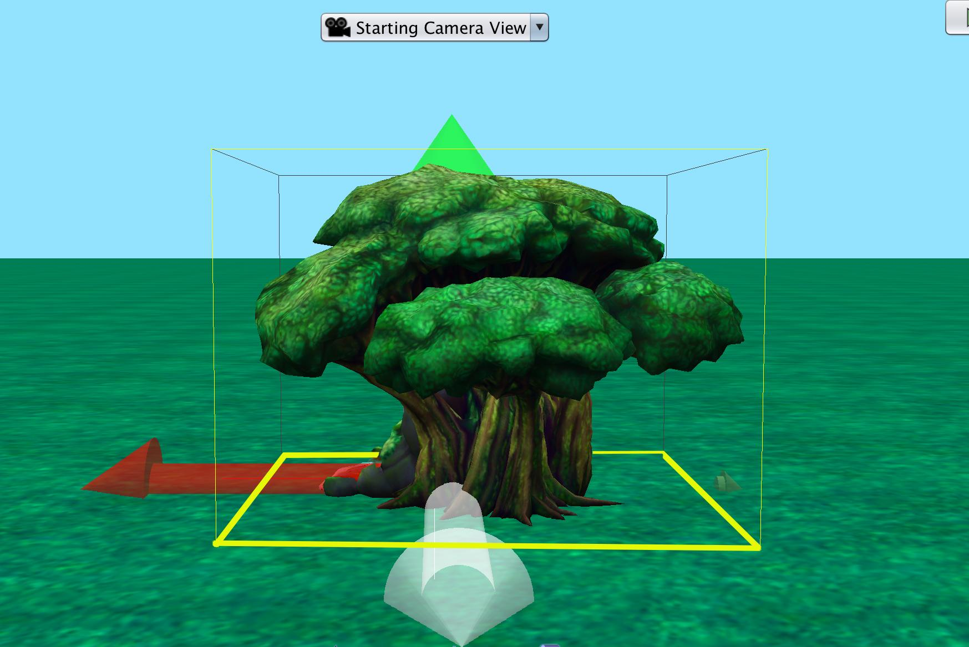
Tips and Tricks
The Bounding Box
The bounding box contains the full object at its outermost parts.
For objects like a tree this means the box is as far out as the furthest branch. This might mean that collision with the trunk would actually be far inside the full box.
You can use hidden objects to create the effect you want by pacing a hidden cylinder around the trunk and using that instead of the tree itself.

Slide 16
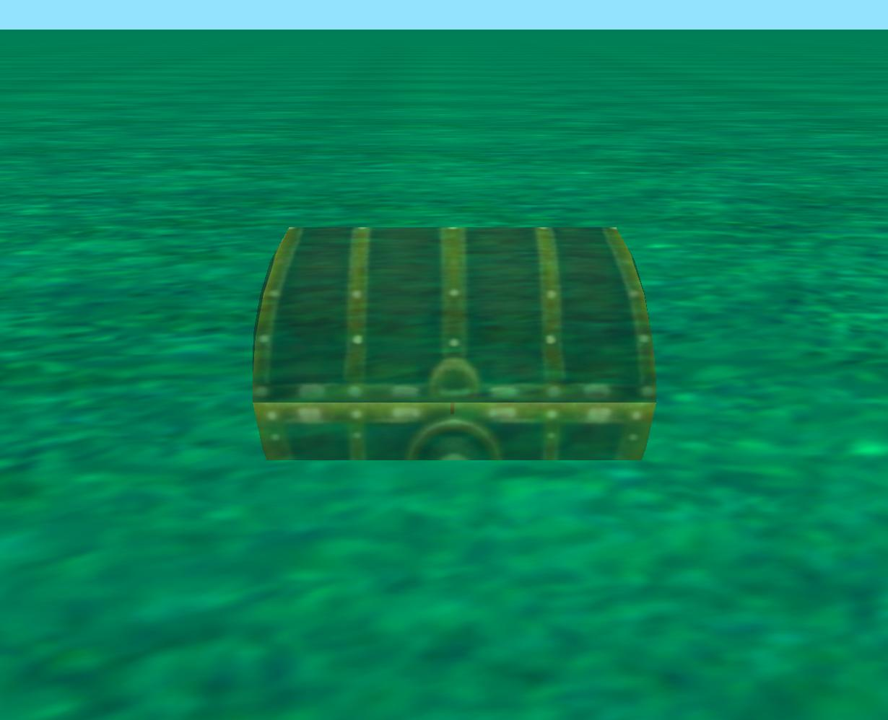
Tips and Tricks
Hidden Objects Still Trigger
When using collision or proximity to collect objects the obvious option is to set the opacity to 0.
This will work but the object will still be there to continue to trigger collision and proximity events.
You can make the treasure disappear quickly when collected by changing opacity but it could still be collected again so instead move it through the floor and out of play

