Slide 1
Using Comments
http://www.alice.org/resources/lessons/using-comments/

Slide 2
Using Comments
What is a Comment?
A comment is text is used to document code. It is for other programmers to read but is ignored by a compiler or interpreter.
Generally you can find comments stylized using variations of the following:
/* the comment lives here and can be multiple lines */
or what Alice uses
// for individual lines you use this format // however, you can put multiple of these in a row

Slide 3
Using Comments
Why Comment
To layout and outline your program before coding to help guide your development.
To help others understand what your program does when reviewing or collaborating on a project.
To help you navigate and debug your code base

Slide 4
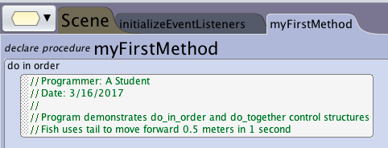
Using Comments
Documenting Your Program
A Header comment is put at the beginning of your program file and can include:
Authors - who wrote it
Date - when it was written or last modified
Description - a summary of what the program does

Slide 5
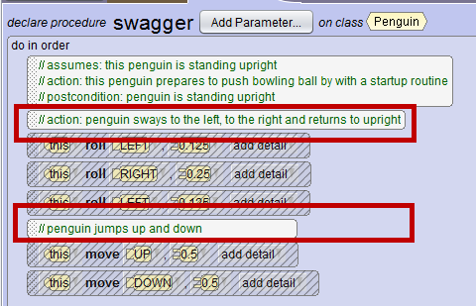
Using Comments
In Line Commenting
Comments can be added in line with your program code to summarize a specific task or problem the code addresses This can be helpful to:
Quickly navigate to components for debugging
help other programmers understand what the code is intended to do

Slide 6
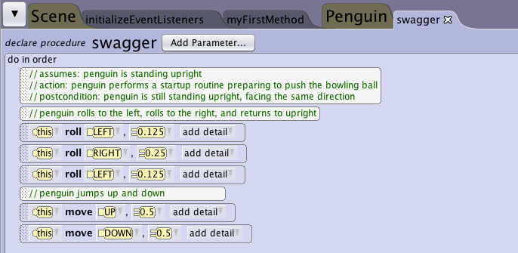
Using Comments
Describe Custom Methods
When creating custom methods and functions it is a good idea to add comments to them. Good information to include are:
Preconditions: What assumptions are being made for the method to behave correctly (i.e. A hop method may assume that the object is standing upright)
Action: A summary of what the procedure does
Postconditions: What can be assumed about the state of the object after the method has executed. (i.e. after a hop, the object is standing upright)

Slide 7
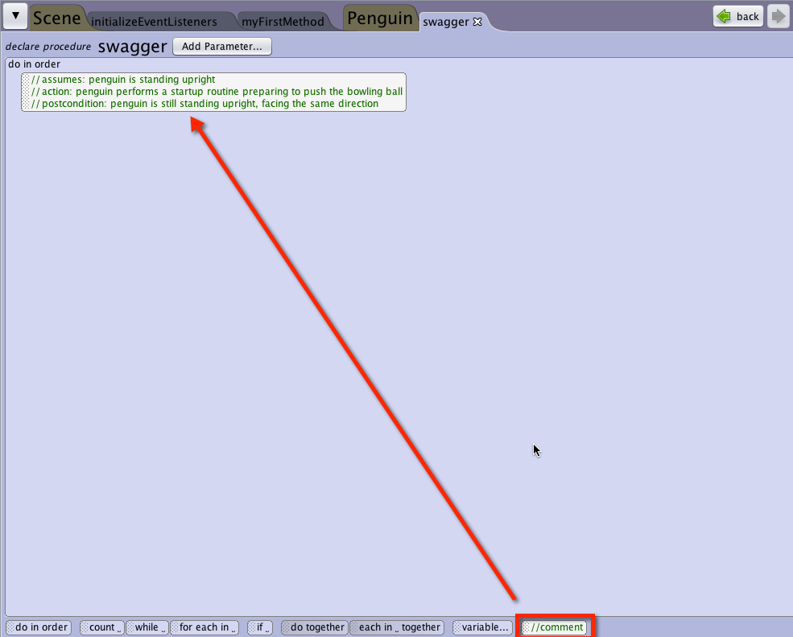
Using Comments
Adding Comments
Drag it in from the control structures menu.
Edit the text by clicking into the tile.
Drag to trash or right click to delete.

Slide 8
Using Comments
Converting Code to Comments
Using commenting syntax is a way to disable code so that the code statements are ignored by compilers. This is commonly used to disable code for testing or debugging purposes.
Right click on code statements and select disable or enable to toggle the state
This is then displayed with backslashes and grayed out to show that it has been commented out.
Be sure that the conditions resulting from the code are not needed for later code to perform as expected

