Slide 1
Using Functions
http://www.alice.org/resources/lessons/using-functions/

Slide 2
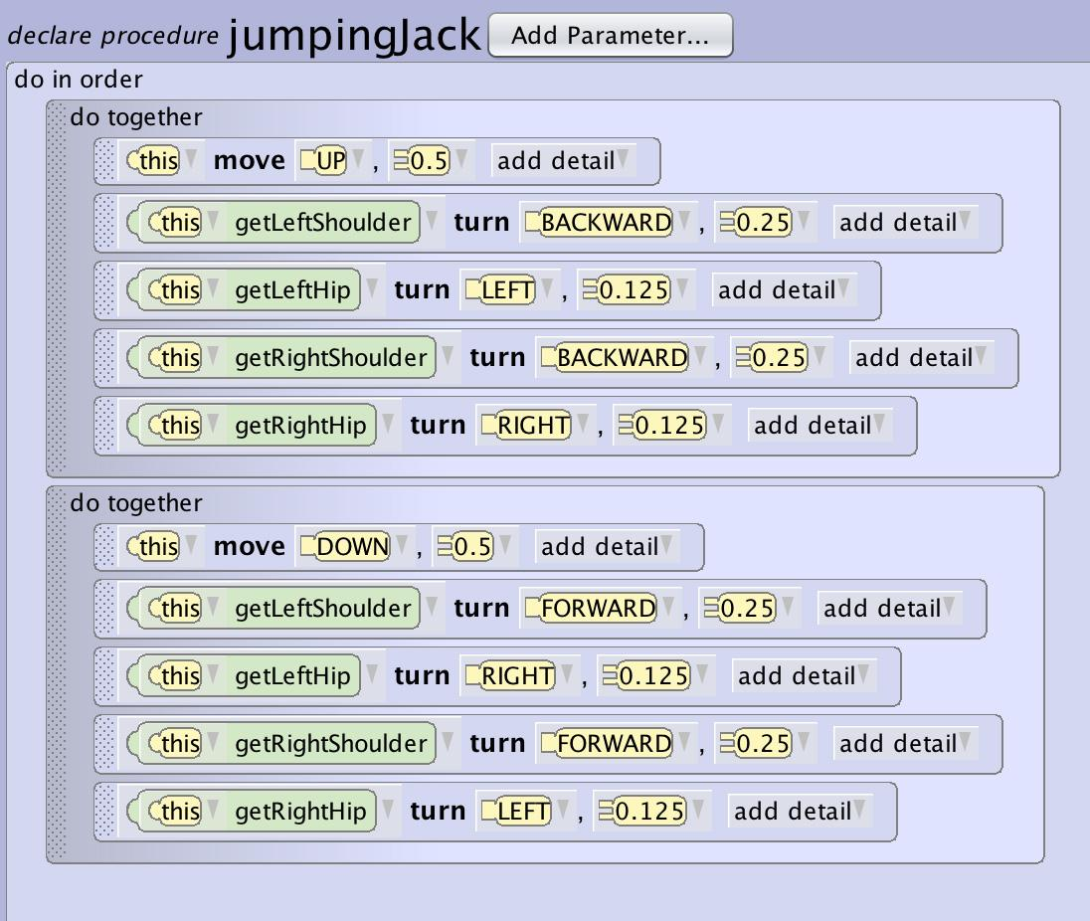
What is a Method
A method is set of instructions that is named, may have parameters and / or return a value, which defines a task to be performed.
Methods are defined with a class, and are used by objects of that class

Slide 3
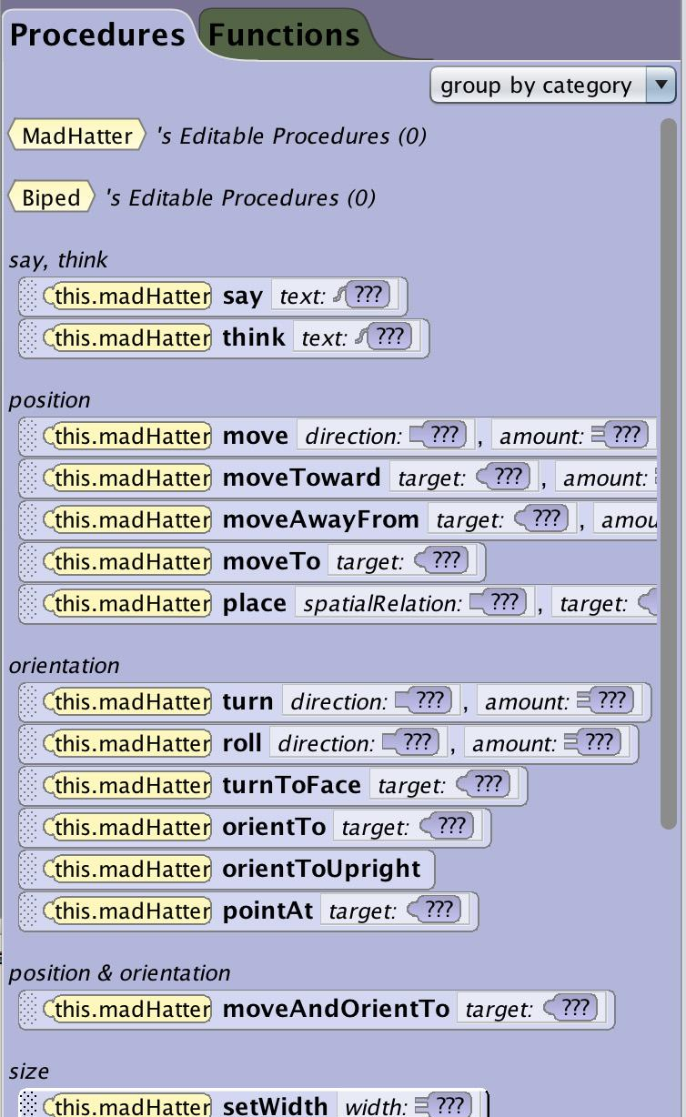
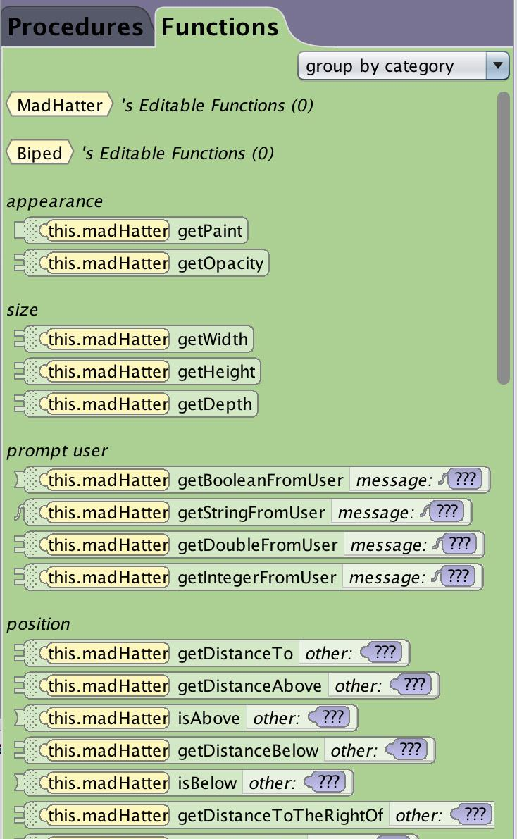
What is a Method
There are two types of methods in Alice
Procedural Methods - directions for how the environment or objects in the environment should behave
i.e“move forward”
Functional methods – directions for getting information from the environment, objects, or the user
i.e. “how far is the rabbit from the carrot?”

Slide 4
What is a Function
What is a Function?
A function asks a question (to check a condition or compute a value).
In Alice, a function is used to get the information we need concerning:
Information from Alice Find out the properties of an object Find out the relationship of one object to another
Information from outside of Alice Ask for information from the user or return data from inputs Get information from the computer

Slide 5
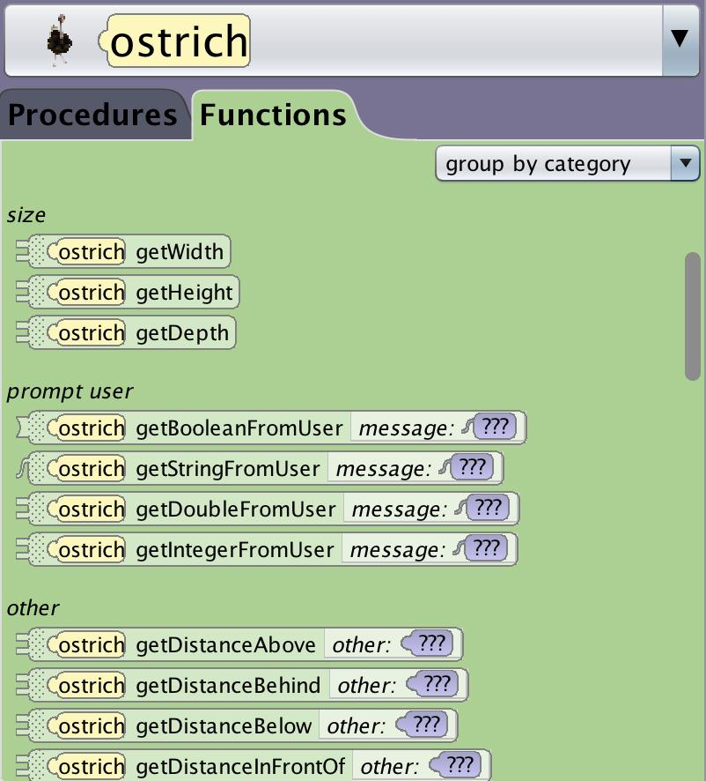
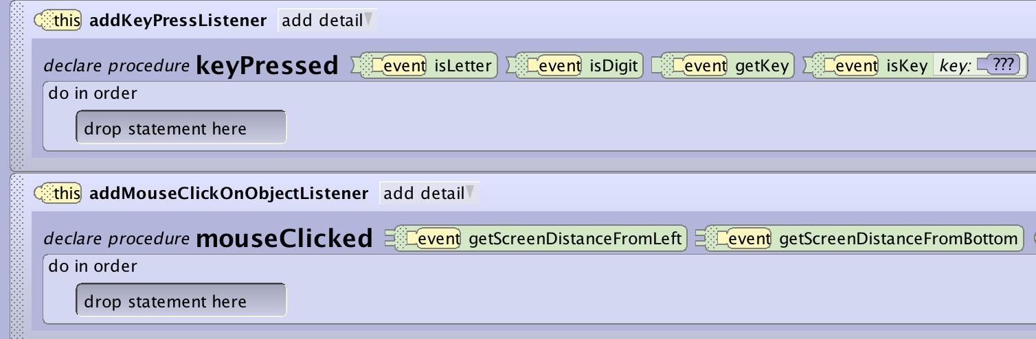
What is a Function
Built In Functions
There are two places you can find built in functions in Alice.
Class Methods Panel - Similar to the procedures tab you will find different functions depending on the class type you have select.
Event Listeners Header - Many of the event listeners have functions that are built into them that allow you to request specific information about the event.

Slide 6
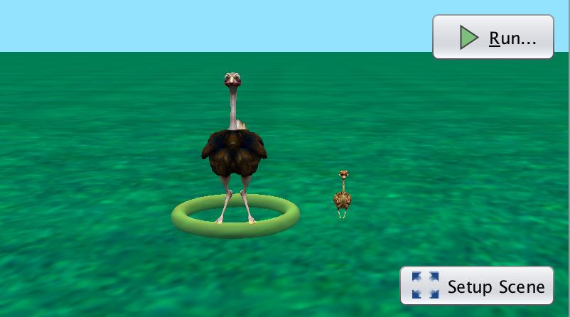
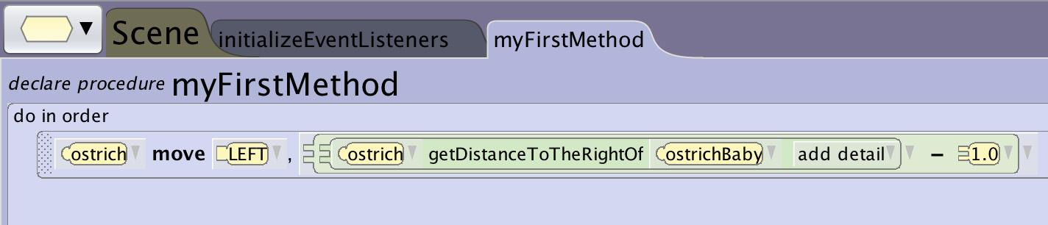
What is a Function
Information From Inside Alice
Functions can be used to find out information from within an Alice virtual world. They can be used to find out:
Object Properties: What color an object is How tall an object is
Relational Properties: How far is the ostrich from the baby ostrich Is the ostrich to the right of the baby ostrich

Slide 7
What is a Function
Information From Users
Information from users can be returned using built in functional methods that are found in the methods panel or by using functions that extend specific event listeners to get information like:
A text string A number What key was pressed What object the mouse clicked

Slide 8
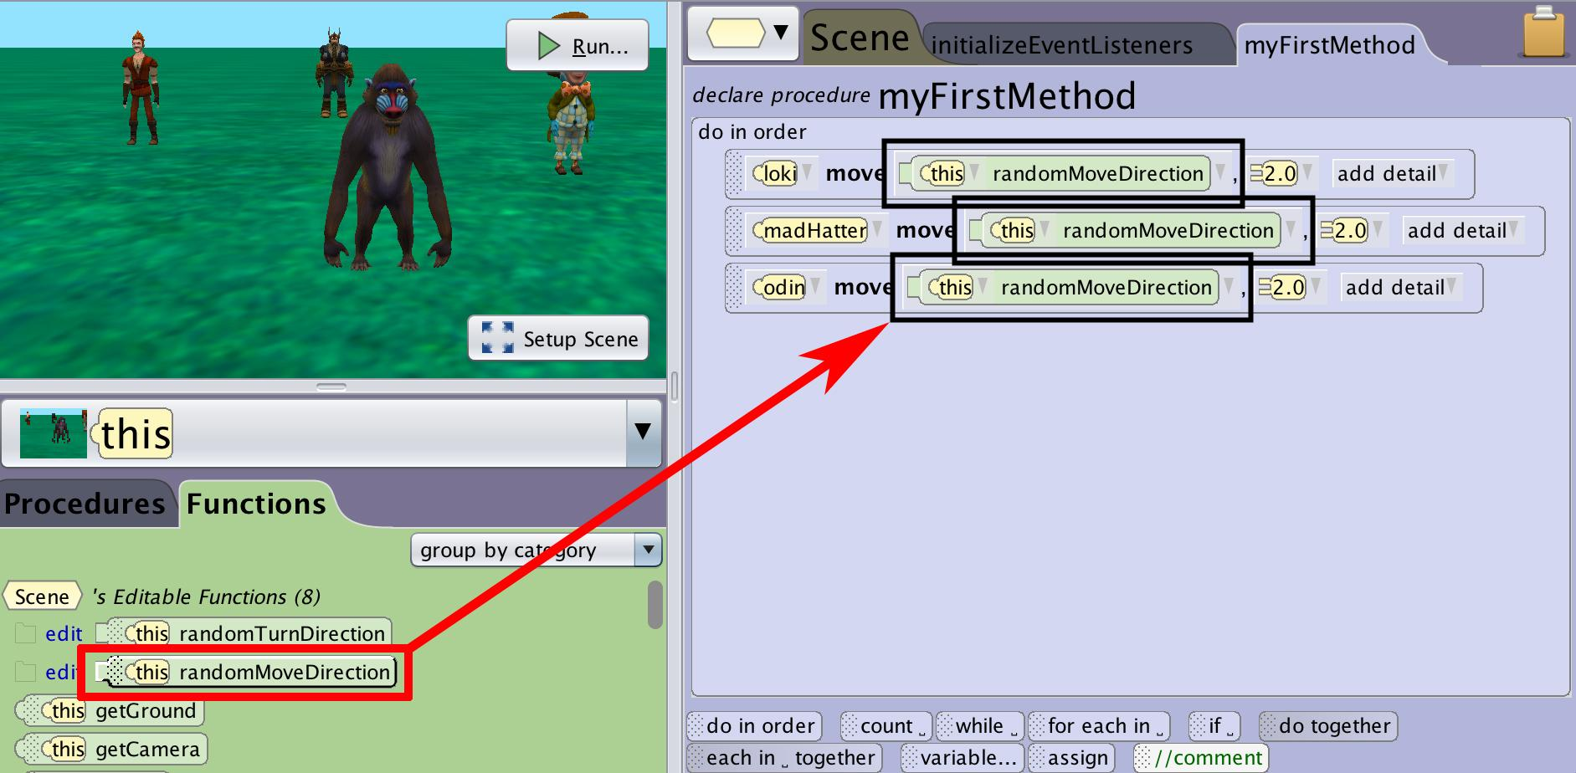
Using a Function
Using a Function
A function can’t be added to your program simply by dragging them to the appropriate locations.
Unlike procedures Functions need to be used to replace parts of statements that you have already added to your program.

Slide 9
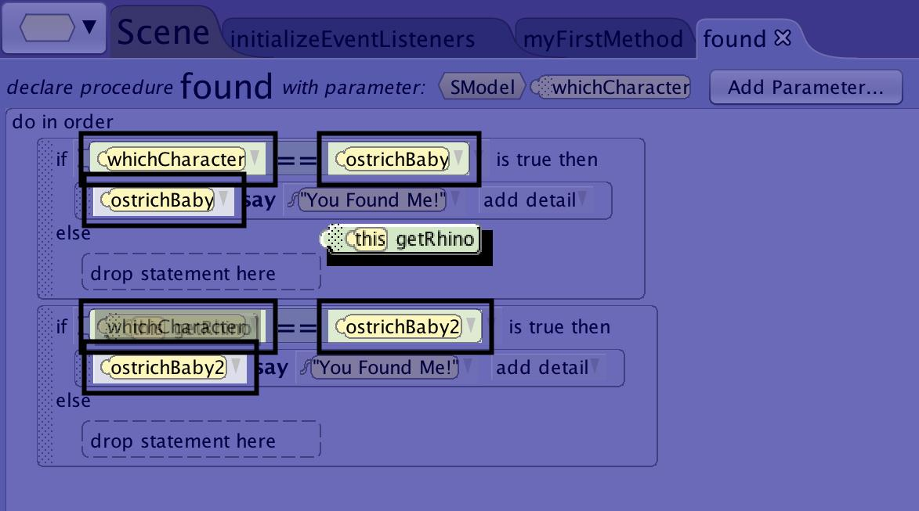
Using a Function
Where They Go?
Alice will only let you drag a function into your program in a place where:
The statement can include a function
The data type that the function will return will match the expected data type
When you grab a function Alice will obscure the interface everywhere that is off limits and highlight and put a box around areas that will accept the inclusion of the selected function.
Sometimes you will need to implement an arithmetic or relational expression to get the correct data type.

Slide 10
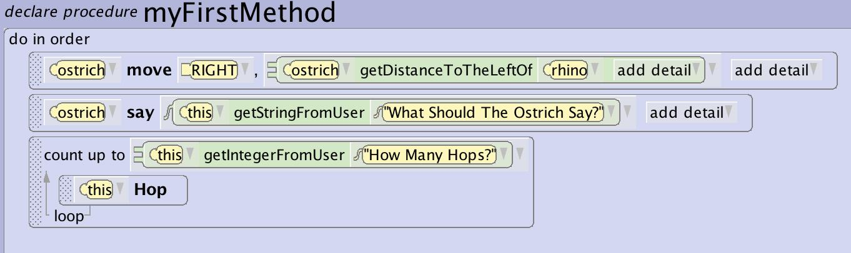
Using a Function
Replacing a Parameters
A useful way to use functions is to replace parameters in simple procedures to make them more dynamic:
To move a character an unknown distance between objects
To allow the user to input dialogue for a text bubble
To allow the user to decide the number of times an animation will loop

Slide 11
Using a Function
As a Conditional Expression
Functions are very useful for setting up conditional outcomes based on user input or world relationships.
Using a function allows you to request information that may be user defined or that can be different depending on when the procedure is called.

Slide 12
Using a Function
Using an Expression
You can use a function together with a mathematical expression to modify the information that is returned by the function.
In this example you want the mom to move to the baby but not to move on top of her.
If I use getDistance to to replace the move distance they will end up on top of each other.
If I use the same function but add an arithmetical expression to subtract 1 from that return value I can have her stop just short.

Slide 13
Tips and Tricks

Slide 14
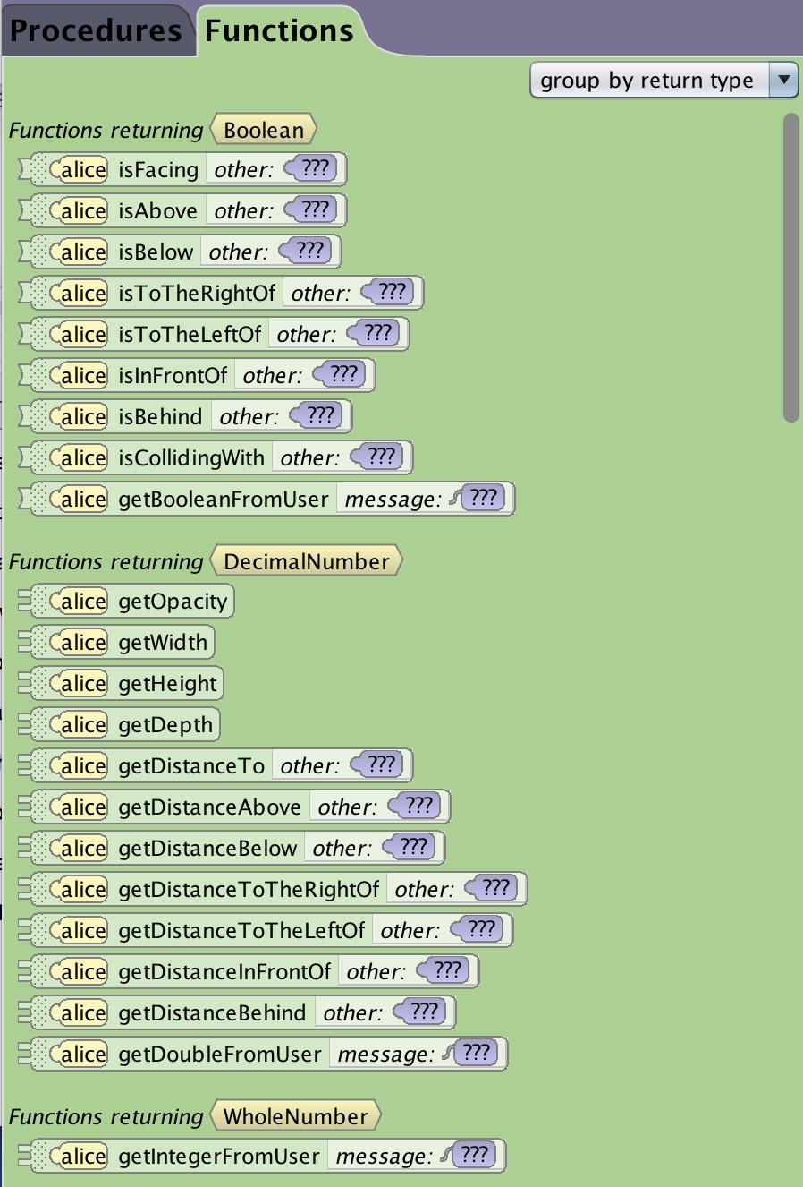
Tips and Tricks
Sort Function By Return Type
One great way to easily see what type of data the functions will return is to group the function list by return type using the top right drop down.

Slide 15
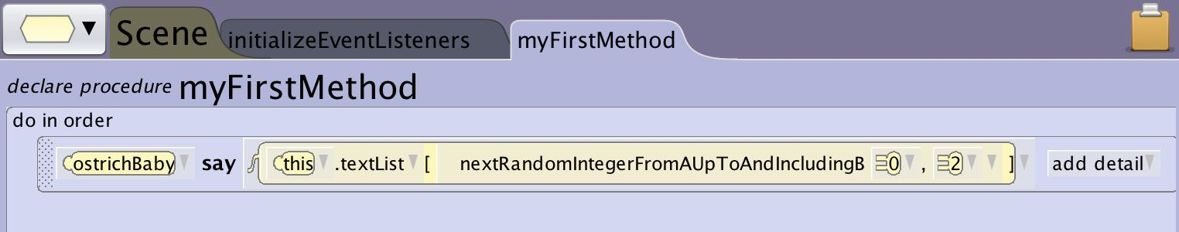
Tips and Tricks
Using Random Number Function
The getRandom functions use the computer to randomly create a number or value within the range you specify.
The random number generation function is an extremely useful tool in Alice. It allows you to create variety in behavior and outcomes that can help add complex dimensions to animations and interactions.
In these examples the random function will:
Randomly determine how far the ostrich will run
Select from a list of statements to determine what the ostrich will say

Slide 16
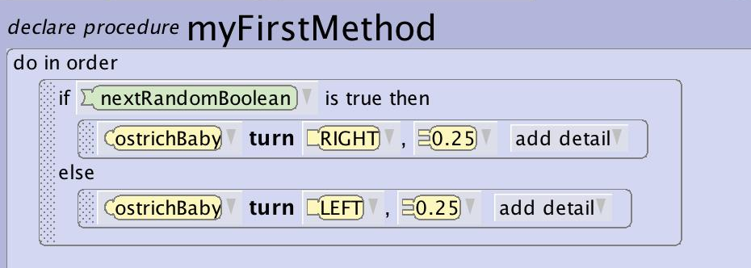
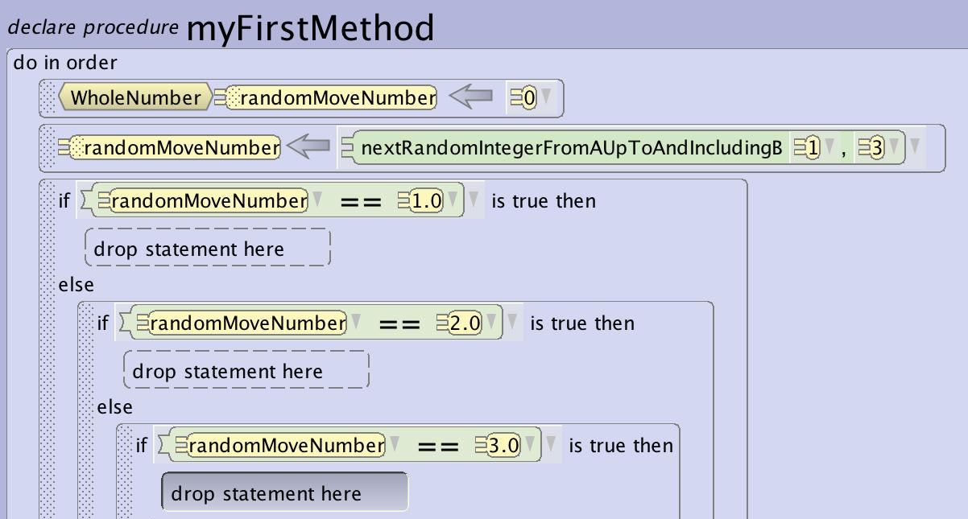
Tips and Tricks
Random Number in a Conditional
Random functions can be used to set up multiple different possible outcomes.
By using a random boolean or number function with the if_else control structure you can create variations in behavior over time or on separate program runs.
By not having to script every change in direction or behavior you can save a lot of time and create the illusion that objects or characters are naturally moving around of their own free will..

