Slide 1
Design: Games
http://www.alice.org/resources/lessons/design-process-games/

Slide 2
Where do I start?

Slide 3
Problem Statement
Design Thinking and Problem Solving
Problem Statement
Define the Problem
Understand the Problem
Design a Plan
Implement the Design
Test the Design
Repeat as Necessary
Understand
the problem
Test
Design a
Plan
Implement
Design

Slide 4
Problem Statement
What is my Problem?
When thinking about creating a game we will focus on a combination of all three of these problems:
I want to create a story where ….
I want to build a world where….
I want to build a game where…..
Notes:
what is the fantasy

Slide 5
Understand the Problem
What is a Game?
A game can be many things and the debate over its definition is ongoing. For the purposes of this lesson we will define a game as:
A system that presents the player(s) with a goal and provides a set of rules and mechanics for achieving the goal.

Slide 6
Understand the Problem
The Fantasy of a Game?
Beyond just the systems of the game or objectives there is the fantasy that the game creates. This includes:
What is the overall theme of the game?
What world does the game live in?
What is the motivation of the player in the game?
What is the adventure the player gets to control?
These can all influence the description of the problem.
I want to create a world where the player gets to...

Slide 7
Example Game
A Driving Game Example
I want to create a driving game where a delivery driver needs to deliver a birthday cake to a party before it starts or be fired!
(This may not be the kind of fantasy world everyone dreams of experiencing but what a challenge and the tension :0 )

Slide 8
Designing a Game

Slide 9
Understand the Problem
Understand the Problem
What tools can I use to help define the problem?
What are the important components to consider?
Problem Statement
Understand
the problem
Test
Design a
Plan
Implement
Design

Slide 10
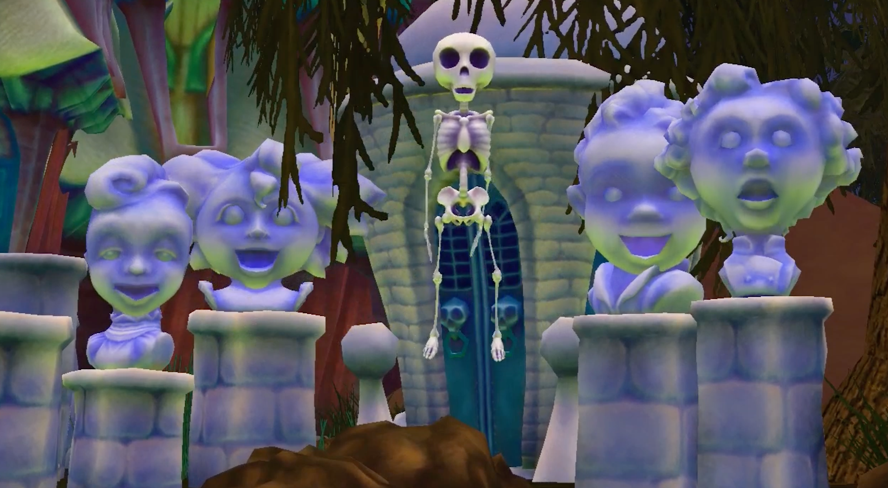
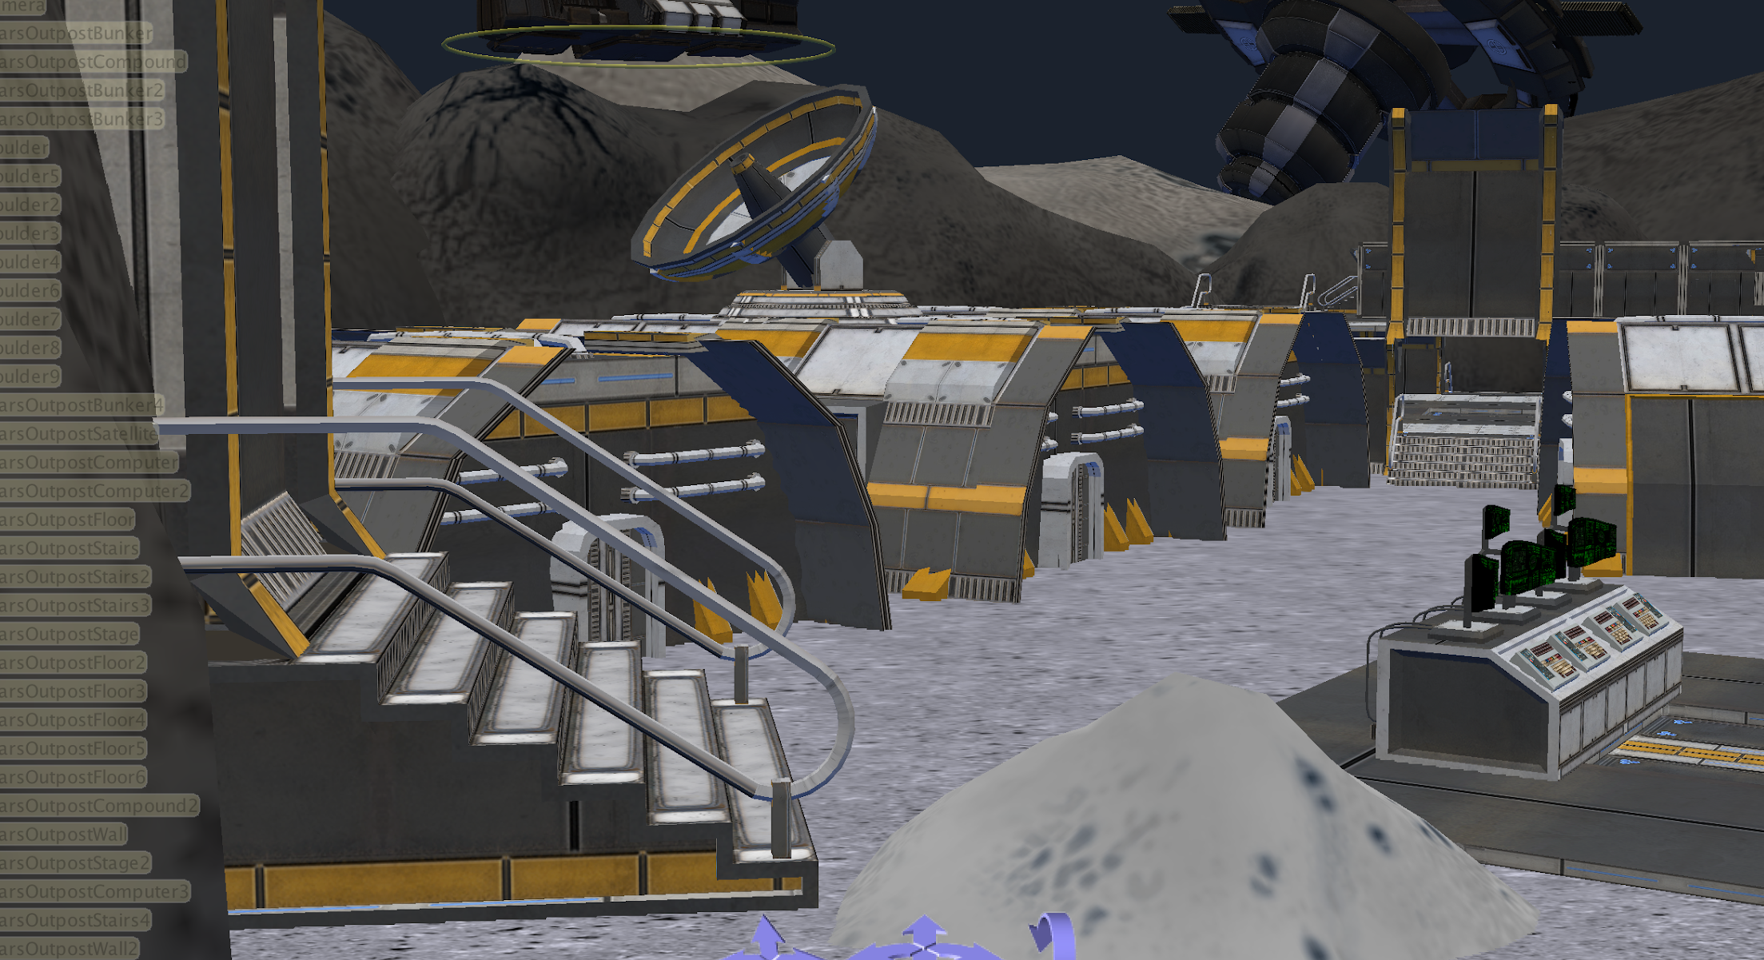
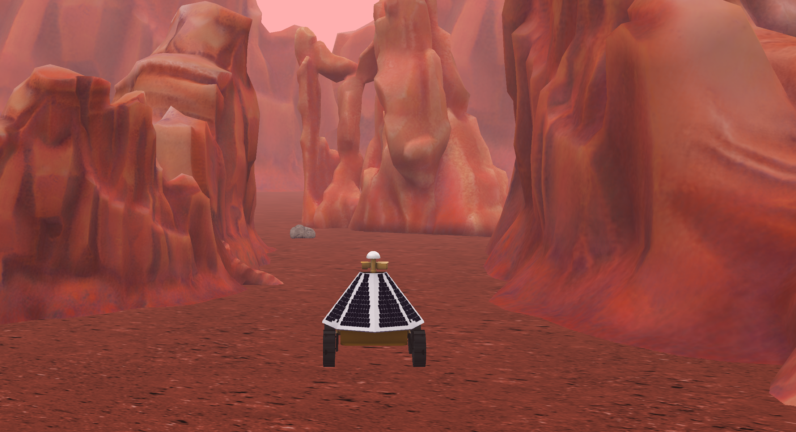
Understand the Problem
Different Needs
Story - For a linear animation you can use a script, storyboard, or straightforward flow chart to help you brainstorm and dissect your problem.
Interactive Narrative - For a branching narrative or open world you may need to create a higher level flowchart or a world map in addition to standard script and storyboard elements for each interaction.
Game - For a game you want to create a game design document that details win/lose conditions, game mechanics, and player control maps in addition to world maps and storyboards for interactions.

Slide 11
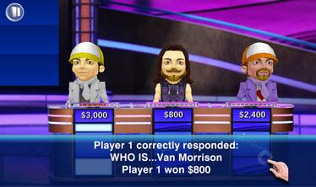
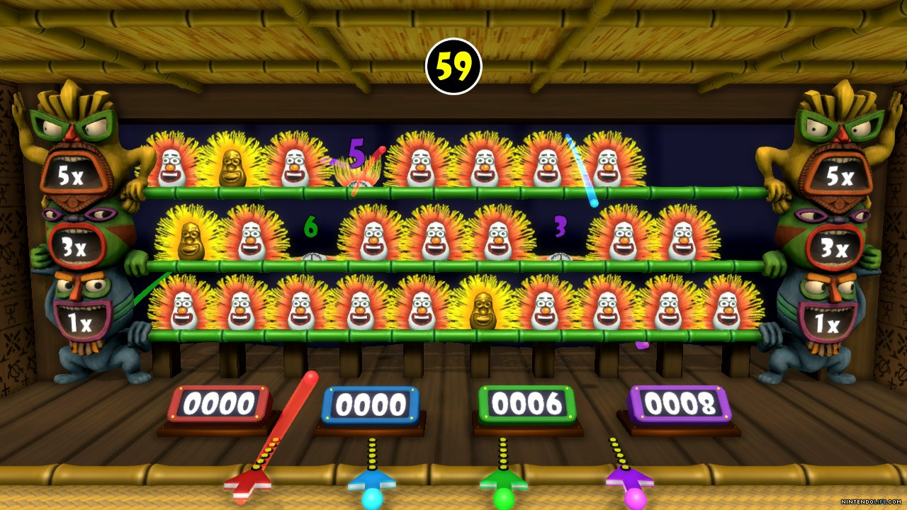
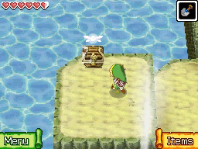
Understand the Problem
Different Approaches for Different Games
Games can be many things within many different genres:
Quiz Shows Adventure Games Racing Games Skill Games There are lots of writings out there describing different game genres and game definitions

Slide 12
Understand the Problem
Building a Rich Game World
Even though you are now designing a game it is still important to understand what story is being told?
Where does it take place?
Who are the Characters?
What is the players motivation?
What events happen?
Is there an explicit order to events?
Where could the game diverge or converge?
Is there an ending? Multiple possible endings?

Slide 13
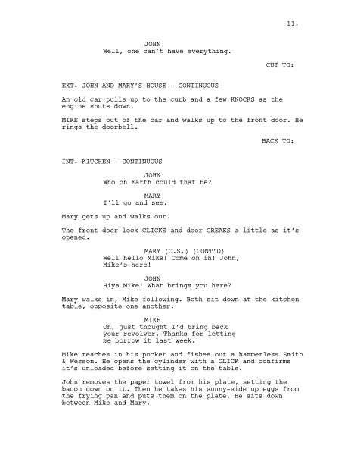
Understand the Problem
Using a Script
A script is a story written as a set of directions that is intended to be used to direct a play, a movie, or similar. In games there are lots of story elements that enrich the experience: cut scenes, player interactions, win and lose scenes and more.
What are the important parts of your game that a script could help you understand
Descriptions of the set and environment
Non player character interactions
Game directions and introduction

Slide 14
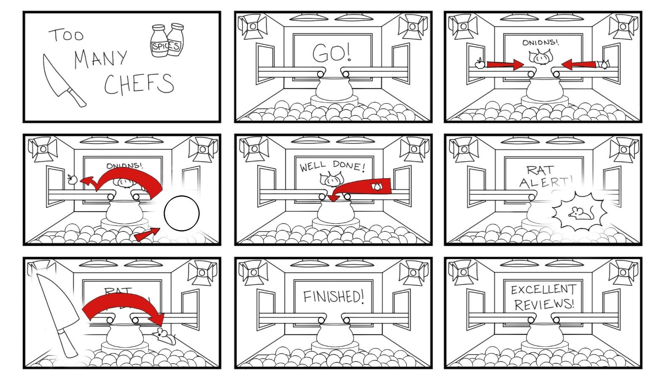
Understand the Problem
Using a Storyboard
A storyboard is a visual representation of a story used for planning animations, films, or even games. Each frame captures a moment in the game and conveys important information about:
What is in the scene
What is happening
Key game interactions and events
https://www.artstation.com/artwork/nxzXr

Slide 15
Understand the Problem
What is the Goal of the Game?
A good way to understand the game you are trying to make is to state the goal of the player in the game. I am making a game where the player…..
Needs to reach the finish line before time runs out (racing game)
Needs to find their friend (adventure or role playing game)
Score as many points as possible by… answering questions, collecting items, smashing items (quiz game, first person shooter, scavenger hunt)
While there are countless games out there you will find that many games have a very similar underlying goal structures. What is the goal of some of your favorite games?

Slide 16
Understand the Problem
What are the Rules of the Game?
The key mechanics of the game can sometimes be thought of as the rules of the game.
The player has to stay on the road
You lose a point by running into a barrier
You score points by collecting gems
While there are countless games out there you will find that many games have a very similar underlying rule structures. What are the rules of some of your favorite games?

Slide 17
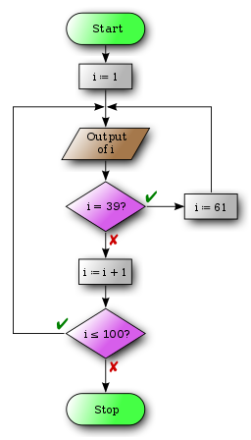
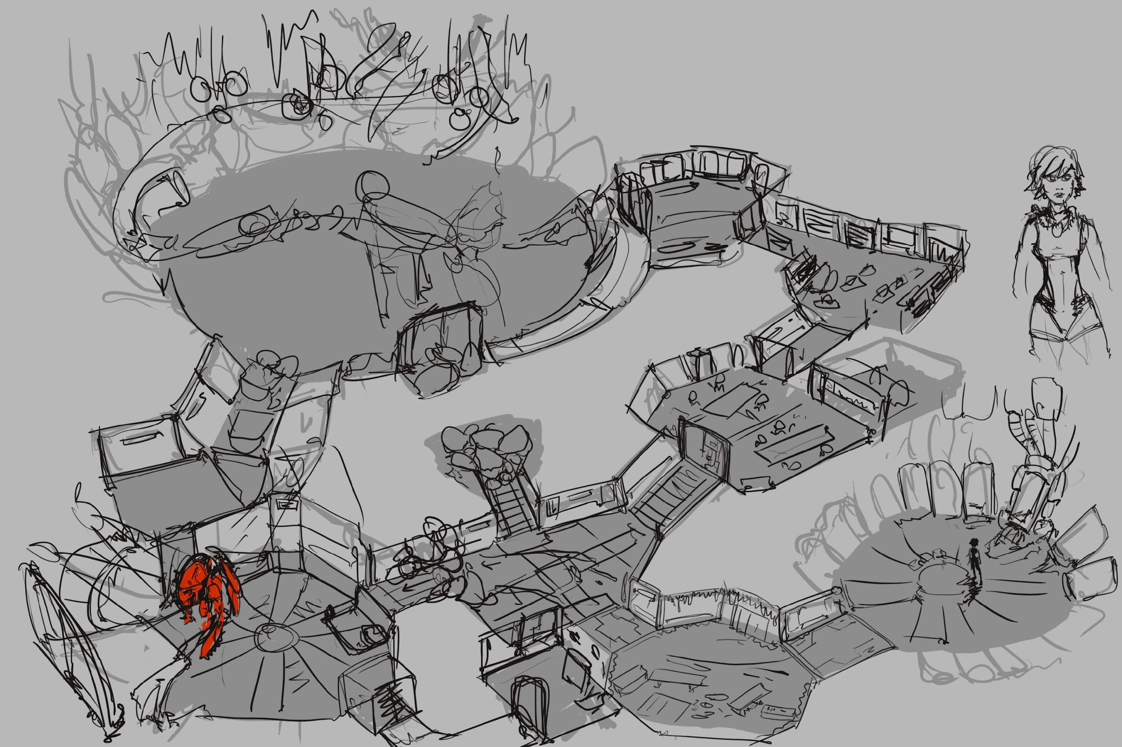
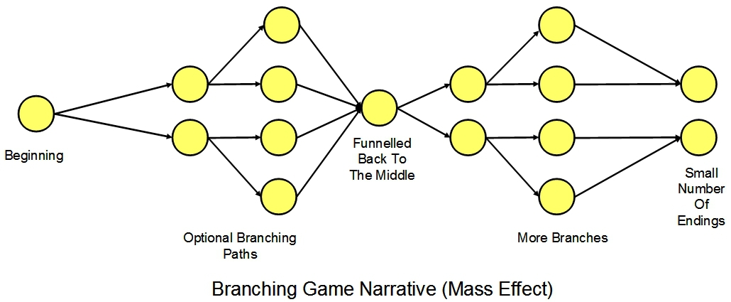
Understand the Problem
Mapping Out The Game
There are a couple options for how to brainstorm the flow of your game (goal and rules/mechanics).
Game Flow - a flow chart can help you map out conditional flows of the game such as the win and lose conditions, puzzle objectives, and game mechanics.
Level Design - using a level or world design you can map out where the player interactions occur and understand the navigation of the game.
Objective mapping - this diagram allows you layout the major game events and interactions and how they advance the player towards the final goal.

Slide 18
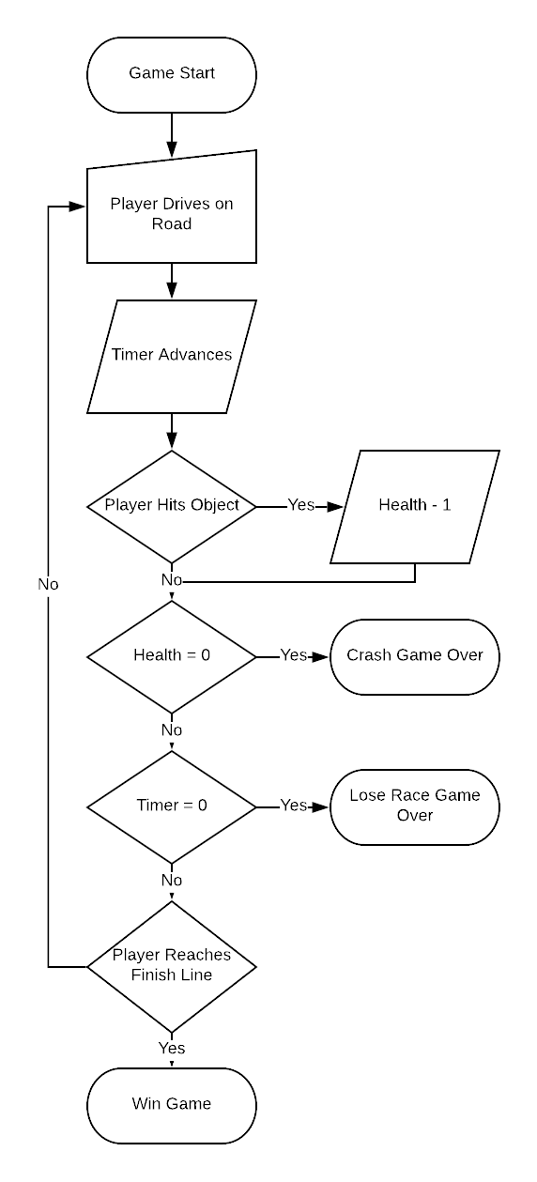
Understand the Problem
Game Flowchart
Creating a flowchart of the game mechanics can help map out the high level conditions of the game. It can help you visualize:
The broader conditional wrapper that controls the win condition of the game
Different event outcomes can represent lose conditions (not required of a game)
Each node can represent a mechanic or game interaction

Slide 19
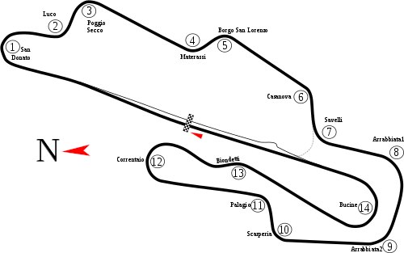
Understand the Problem
Level Design
Creating a world map and calling out where things will happen can also help you think through the components of the game.
You can think about where the player will start
What are the key interactions they will have in the world
Call out where the game ends (if a specific location)
1 - 14 = Barriers for collision Checkered line is start and finish

Slide 20
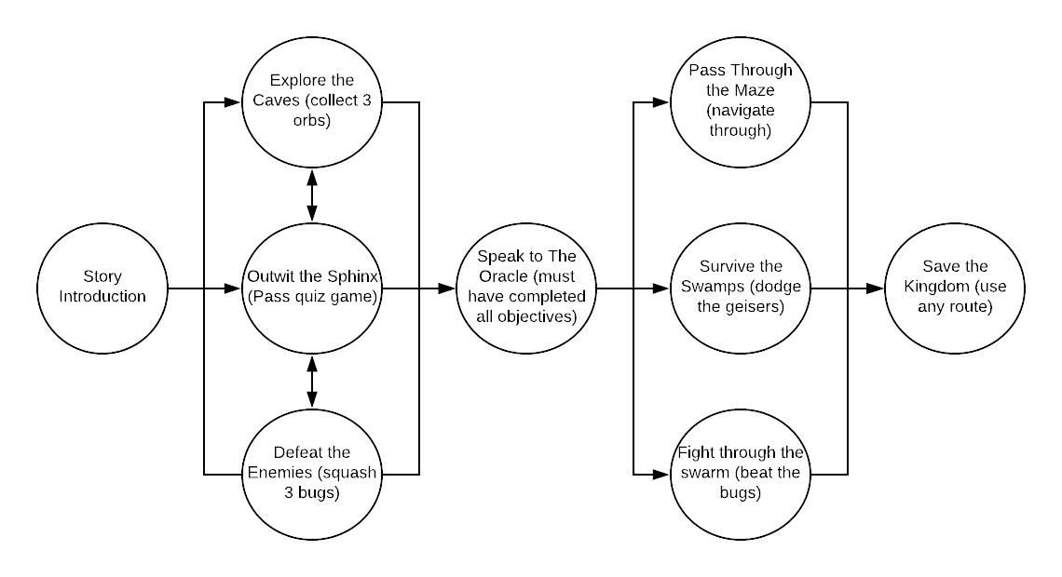
Understand the Problem
Objective Mapping
You can use an objective map to outline major events or gated game points to help you break down your game into smaller components that can then be designed individually.
Think of each node as a game interaction, mission objective, or puzzle
You can map multiple paths through the game or one
A level increase can be represented where a number of objectives need to be met before advancing

Slide 21
Understand the Problem
Game Design Document
The game design documents takes all of the different components and puts it together into a cohesive description of the whole experience:
The narrative of the game - backstory, location, character and story development
game goal (win/lose conditions)
interface description (player controls)
game mechanics (what are the core things that impact the games difficulty or progression).
This document can follow this basic outline and include the diagrams described previously and/or other sketches or information as needed.

Slide 22
The Driving Game Example cont’d
The Narrative (Make scripts or storyboards for these):
The main theme of the game is a forest world where animals talk and drive.
The main characters are a monkey delivery driver that can’t afford to lose his job, his boss (a grumpy mandril), and the Mapinguari (birthday animal) who lives on the other side of the forest and is very sensitive.
Deliver the birthday cake before the party starts to celebrate or fail and be fired.
The goal of the game (make flow chart of win and lose states and a map showing the course):
Deliver the cake to the birthday location before time runs out without wrecking your car
Player Controls (outline how the car should perform):
Use the arrow keys to drive the car
Game Mechanics (flow chart for how the timer and collision will work):
A Timer - The timer will affect how difficult it is to navigate to the end in time
Car Health - The amount and complexity of things the player can run into will affect how difficult it is to survive till the final location

Slide 23
Planning Your Program

Slide 24
Design a Plan
Designing a Plan
Now that you have the main game components outlined how do you plan on how you will build it?
What are the important components to consider?
How will you lay out the program?
Problem Statement
Understand
the problem
Test
Design a
Plan
Implement
Design

Slide 25
Design a Plan
Translating the Design Document
The major addition to the planning process between a sequential animation and a game is the consideration of either navigation controls in the scene planning, a decision tree or conditional tree in the program planning, or both.
World Design
(Scene Setup and Navigation)
Design a Plan
Program Planning
(Algorithm/ Flow Chart)

Slide 26
Designing the World

Slide 27
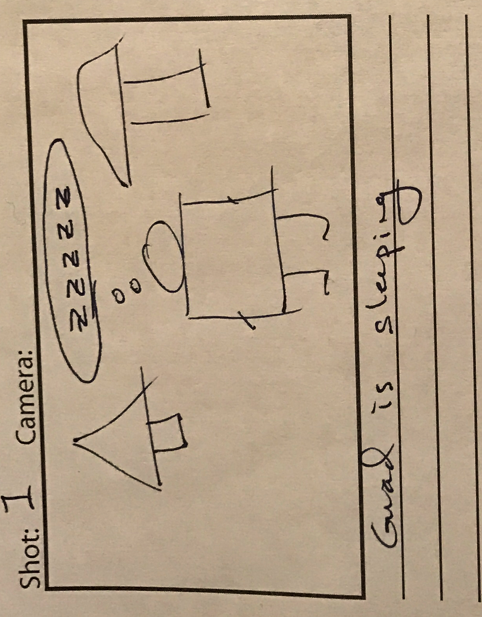
Design a Plan
Scene Design
Information for building your scene comes from:
Layouts from your level maps
Scene descriptions in a script
Scene information in your storyboards
The information to be used consists of the location information, the props, and the characters

Slide 28
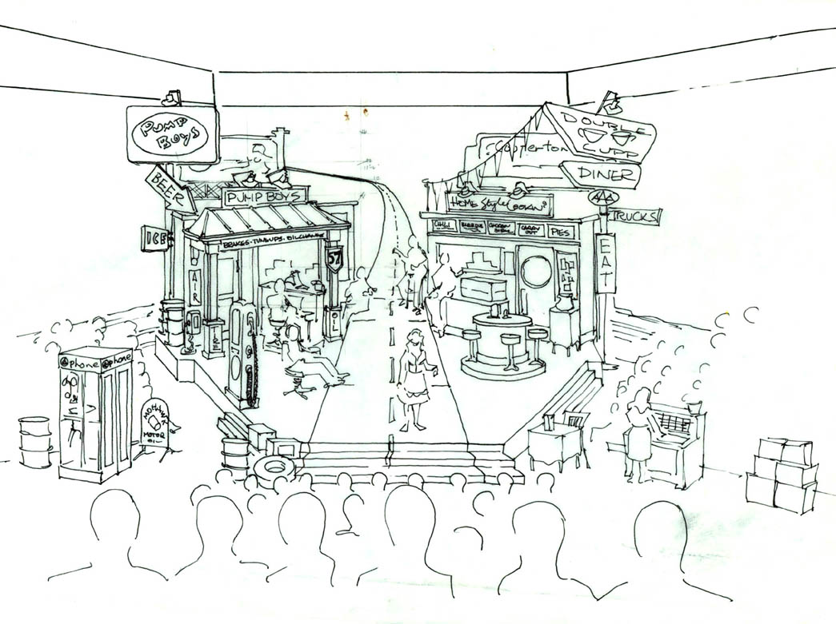
Design a Plan
Guided Navigation
If your game will use multiple locations but the program will be controlling the movement of the player or camera you can create a set design or use the world map to plan out how the player will be guided through the scene and plan for all of the different needs of the environments and camera angles.

Slide 29
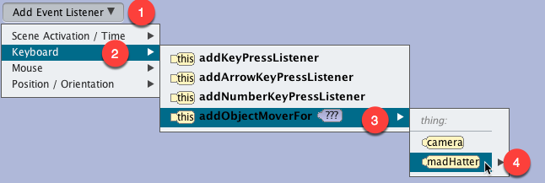
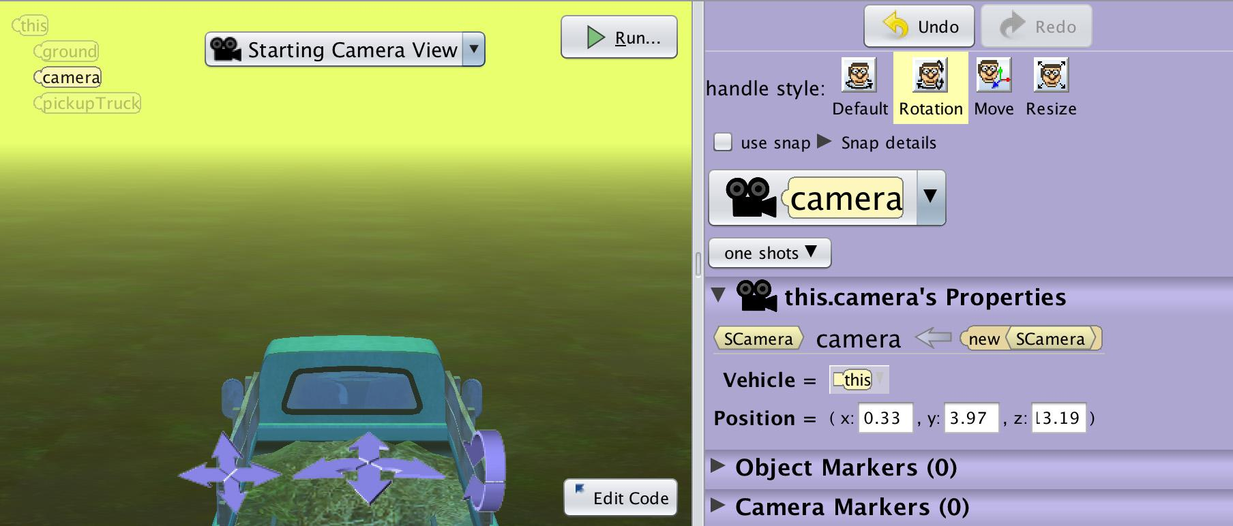
Design a Plan
Open World Navigation
For open world games you will want to think about if it is a first person or third person experience. This will help you think about the scale of the environment and the views the player may encounter.
First Person - the camera is the eyes of the user and you move the camera around the world.
Third Person - the camera follows the avatar of the user (ie a character or vehicle) around the world.

Slide 30
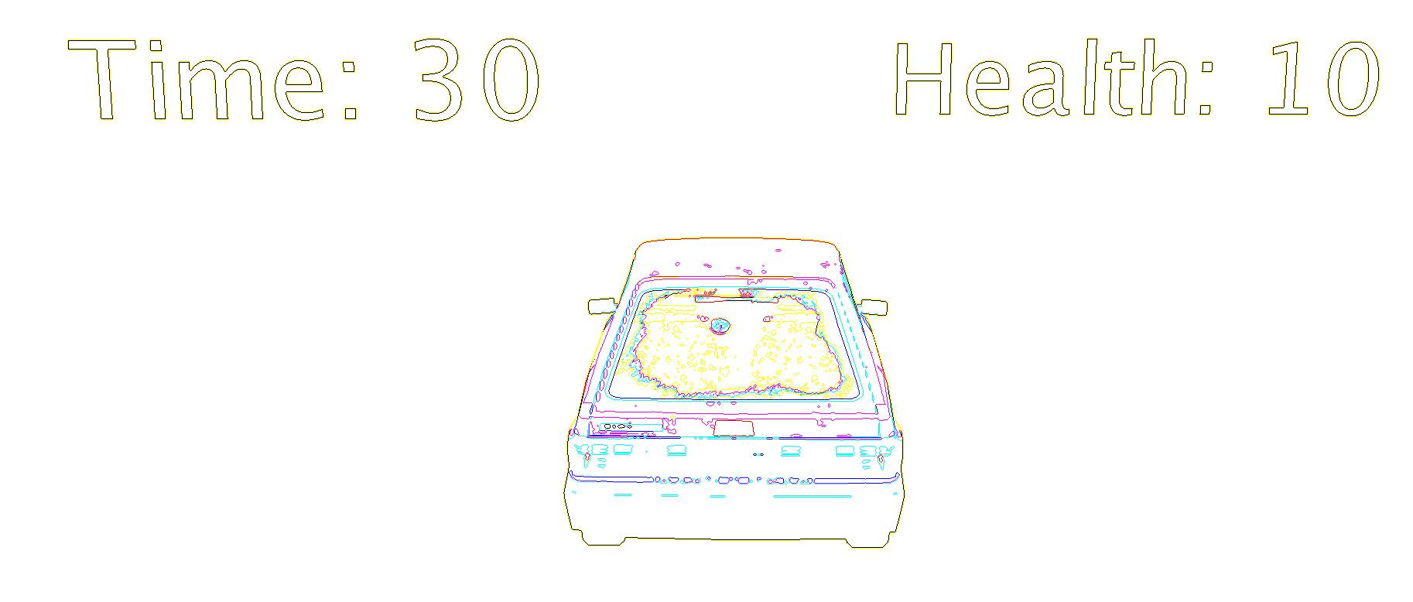
Driving Game Example cnt’d
For this game it makes sense to draw a world map and mark where the game will start, mark the location of the beginning animation, note important parts of the road, mark the ending, show where the final animations will happen, and note what objects are required for each area.
For planning the navigation you might make a description of the how the driving controls would work ie what camera angle. You might even want to sketch quickly the screen with any heads up displays you want such as text for the timer and health.

Slide 31
Designing the Program

Slide 32
Design a Plan
Translating a Game
The first racer says to the player “I challenge you to a drag race for the future of mankind. Do you accept?”
If the player responds “yes” the timer counts down.
If the player wins the first racer says “You have saved mankind… for now”.
When translating a game you will still be looking at your script, storyboard, or flow charts and be thinking about:
Nouns - objects that need to exist in the world (tree) or as variables (time)
Verbs - things you will need to program or implement as player controls
Conditional words - (if or when) to indicate game conditionals

Slide 33
Design a Plan
Deconstructing Your World
Depending on the type of game you are creating you may want to separate your planning into scripted segments for introduction, cut scenes, directions, game play, and win and lose scenes where the design may be more linear.
For the conditional elements you can script them out in text but it may be easier to use a flow chart. You may also want to separate out each mechanic into its own plan to help you think about how to implement each component. Win lose flow, Timer, Health, Score and more.

Slide 34
Design a Plan
Scripted Algorithm Design
Do In Order
Scientist One Says “Why was there thunder and lightning in the lab?”
Lightning Flashes
Scientist Two Says “I don’t know why?”
Scientist One Says “The scientists were brainstorming”
For sections of the design that are scripted animations you can create short text based algorithm solutions to help guide the programming of individual animation methods.
You can easily break down each step or component of a flow chart or world design into smaller algorithm designs until you have objects and actions that you can translate to a program.

Slide 35
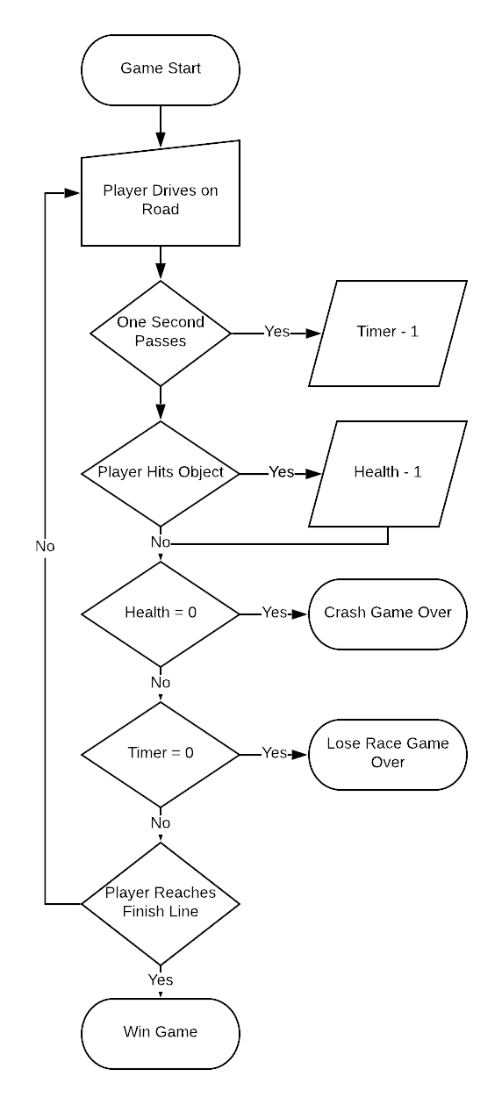
Design a Plan
Using Flow Charts
Flow charts are very helpful for planning conditional and event driven mechanics of your game. It is easy to indicate what will start the interaction or where conditional outcomes will link to.
Flow charts for a game can also be broken down into smaller elements or separate flow charts for different components of the game ie one for the win/lose level advancement logic, others for individual game mechanics. This can help you think about the function of each component separately.

Slide 36
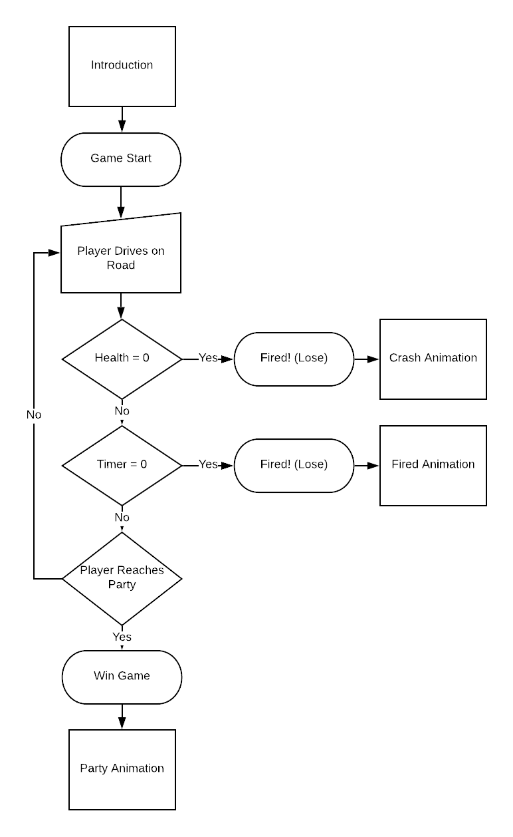
Driving Game cont’d
The mandril says to the player “You better get this cake to the party on time or you’re fired!”
For this world it makes sense to do the following:
Make scripted algorithms for the introduction and the win lose animations.
Make flow charts for the overall game and program flow.
Make separate flow charts scripts for each of the game mechanics: timer, health, navigation
If the time is 0 then the player loses

Slide 37
Building Your Game

Slide 38
Implement Design
Implement Design
With event driven and conditional implementations it is more important to test each component as you build them:
Start by implementing parts of your world or narrative
Test and refine small sections before moving on to new components
Revise and redesign based on what you find when implementing
Problem Statement
Understand
the problem
Test
Design a
Plan
Implement
Design

Slide 39
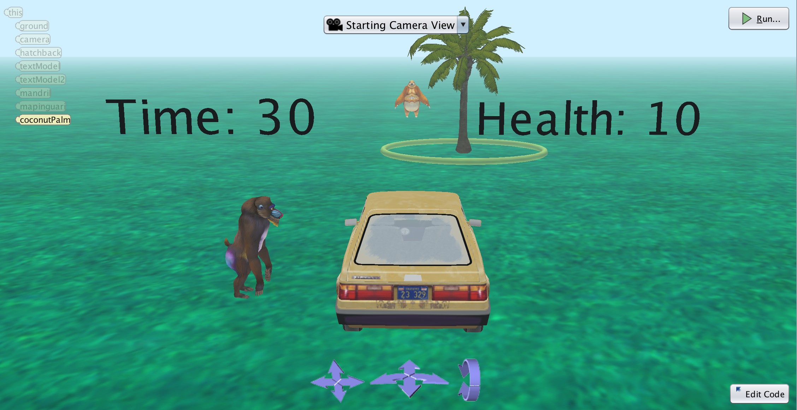
Build Your Scene
Use all of your materials (scripts, storyboards, maps) to build your scene.
Early it may be easier to include just the required or minimal components for your game to build out the functionality. Once tested and functional you can add more elements and scenic detail.
In games you will often have things come and go from the scene so remember to think about where you will position objects off set (hidden below or to the sides of the active area) and their locations to be able to program bringing them into the scene when needed.

Slide 40
Build Your Program
Remember you can iterate through your program addressing smaller parts and testing along the way. A good way to approach games (not all) is to start from the end and work backwards:
Implement navigation and controls
Implement your win/lose/level conditions
Implement each mechanic
Implement story components
*You can use simple placeholder methods and animations,debug placeholders, use cheat keys to advance

Slide 41
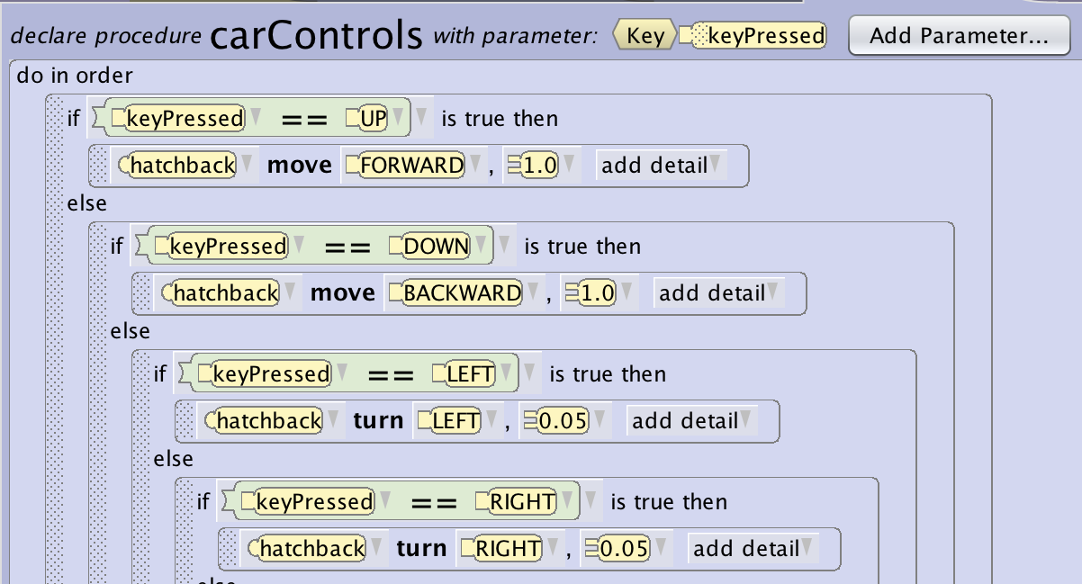
Set Up Navigation/Controls
To be able to test your game it may be important to set up the payer navigation/controls early.
(Optional) Some games may have navigation built in with the game mechanics so will be added during programming. Some game types may not have any navigation.
Some common navigation systems:
Use arrow keys to move around the scene
Click on an object to move to an area
When an objective is completed move the player to a new area

Slide 42
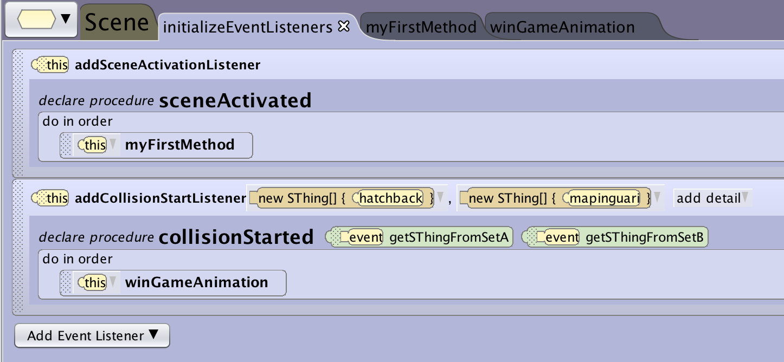
Win/Lose Conditions
One approach is to first address implementing your broad win/lose level conditions. Putting the broader items in place and the items needed to manage them will allow you to fill in the details as you go and test them.
There are different ways your game may trigger the win/loss or end of the game:
Reaching and interacting with a character or location (event driven)
Answering a question correct (input driven)
Fulfilling a number of requirements (variable driven)
Reaching the win can trigger a win method that can play an animation, change game states and more.

Slide 43
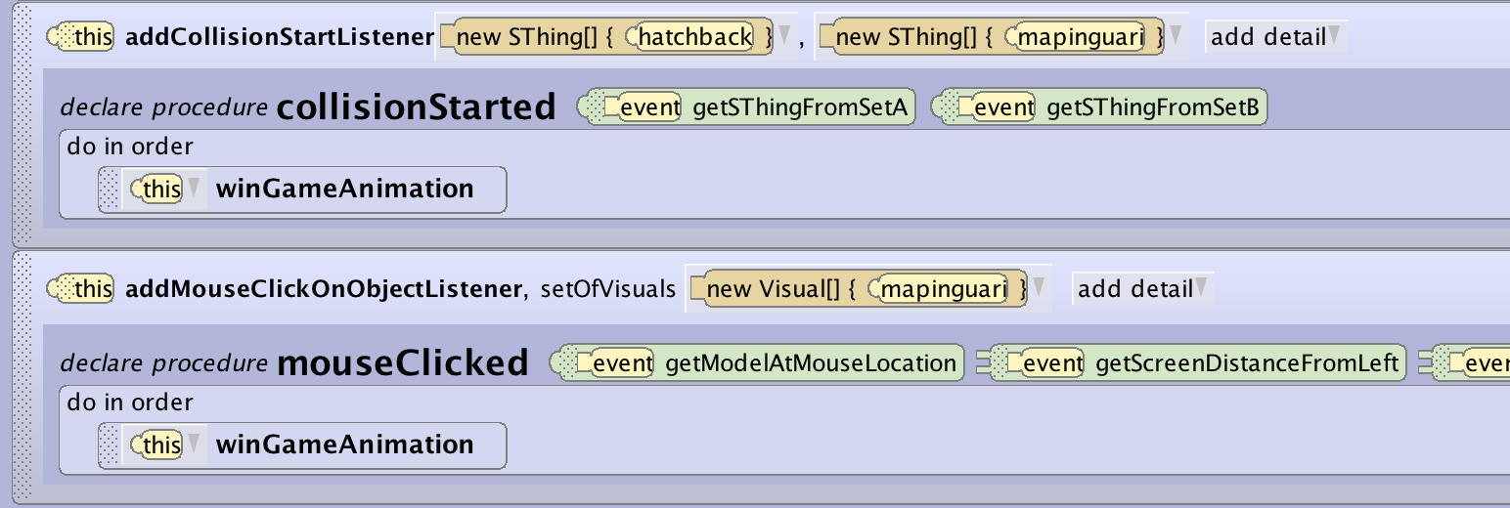
Implement Design
Common Game Mechanics (Win/Lose)
In certain game designs you may trigger the win condition by answering a question, reaching a location, or some other predefined event.
This can be constructed by having that event or input call your win or lose method.

Slide 44
Implement Design
Common Game Mechanics (Win/Lose)
In other game designs you may have a variable that will trigger a win or lose. A single event may not trigger the condition but may lead to it.
This pattern may include a conditional check when an event is triggered to see if it causes a condition to be met.
In this example a collision triggers a health decrease, when updating the health variable you check to see if the health has reached 0 in which case you lose.

Slide 45
Implement Design
Common Game Mechanics (Win/Lose)
In other game designs you may have a list of conditions that need to be met in order to win.
In this case a common pattern is to use a timer event to continuously check to see if the required parameters have been met. Often this will be achieved by setting up variables to track progress and then check for successful completion.

Slide 46
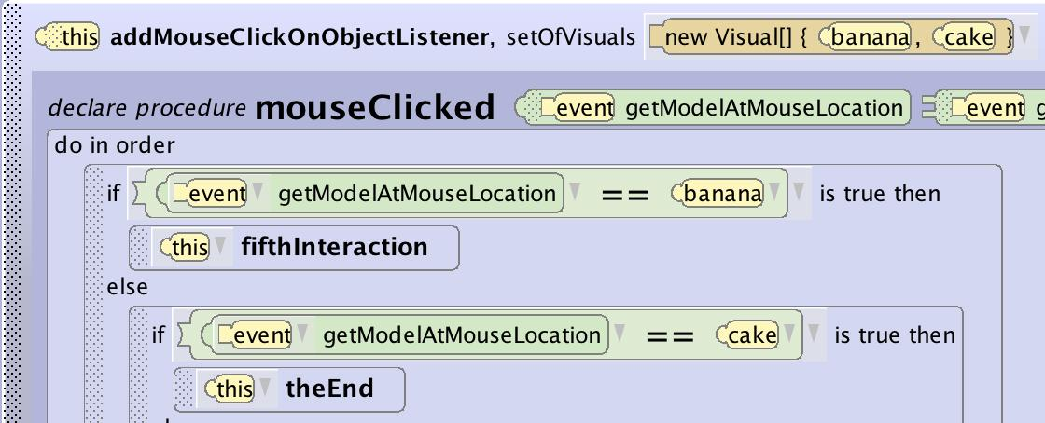
Implement Design
Common Game Interactions
In Alice there are couple easy mechanics you can use to set up conditional player inputs such as text inputs for quiz games, to collect objects, and many more:
getBooelanFromUser, getStringFromUser, getIntegerFromUser - these functions allow you to set up a question that will wait for an answer from the user and can easily be added to a conditional block.
keyPressListener, mouseClickListener - these can be set up to be prompted in a way that allows them to gate or advance the game such as collecting items or interacting with objects.

Slide 47
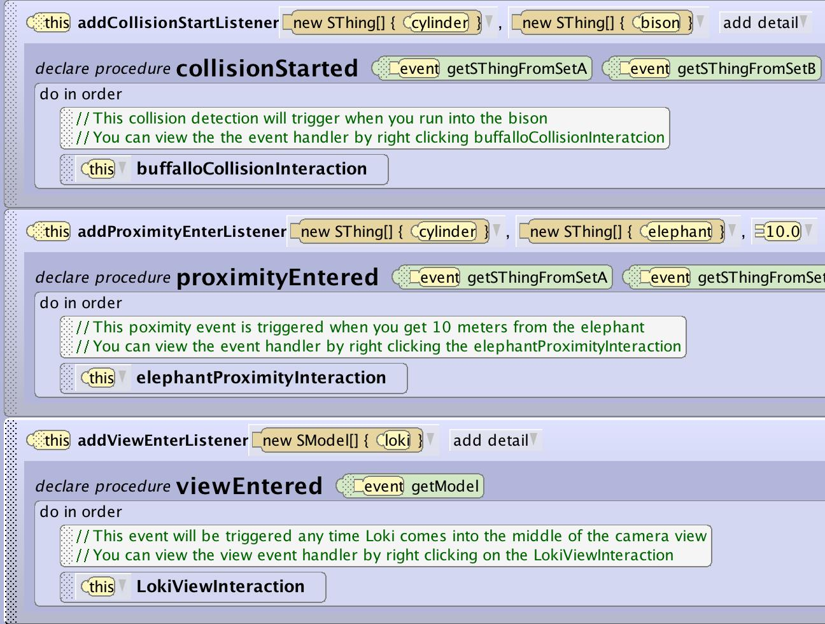
Implement Design
Common Game Interactions Cont’d
If you construct an open world game you can make use of several simple interactions that are triggered when the player moves around the world.
All of these collision, proximity, and view entered triggers can be used to trigger events and drive game mechanics that can impact the game outcome or state.

Slide 48
Implement Design
Common Game Mechanics (Score/Health)
Lots of games want to keep track of things like health, score, collected items and many more. This very useful mechanics has a fairly simple pattern for setting up:
Create a variable (whole/Decimal number)
Create an event that triggers the variable change (collision, question answer and more)
Create a method that manages that variable or updates it as part of the outcome
(optional) implement a display that shows the current value of the variable
(optional) create an outcome that is triggered when the variable becomes a certain value

Slide 49
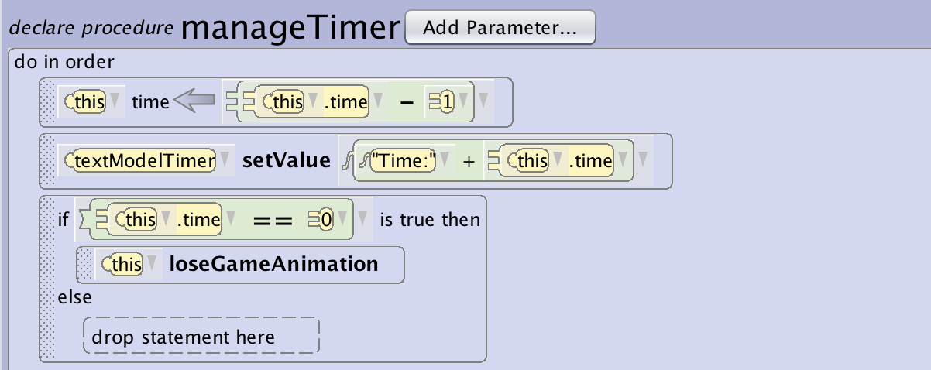
Implement Design
Common Game Mechanics (Timer)
Lots of games want to keep track of time. This can be used to end a level, lose a game, or keep track of fastest times. This very useful mechanics has a fairly simple pattern for setting up:
Create a time variable (whole/Decimal number)
Create an event that triggers every second (or your desired time scale)
Create a method that manages the time variable every time it is triggered
(optional) implement a display that shows the current value of the variable
(optional) create an outcome that is triggered when the variable = 0 (or another value)

Slide 50
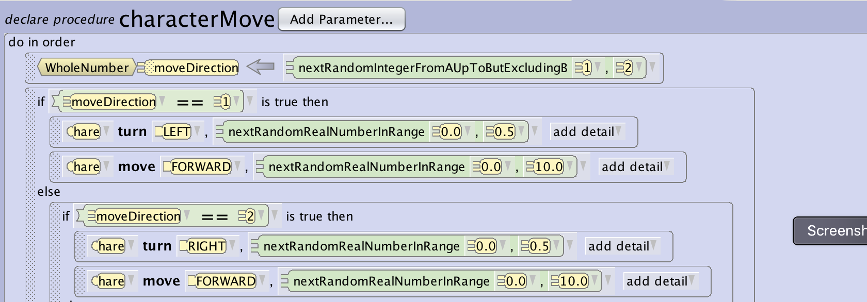
Implement Design
Common Game Mechanics (Randomization)
Using the random number generation function can allow you to make your games far more replayable. This can be used to do things like:
Randomize the starting location of objects in your world
Have the world feel more dynamic by having characters move randomly around the scene
Have interactions with characters give different dialogue from a randomized set of responses
Mix up the order of quiz elements

Slide 51
Driving Game Example Cont’d
In the driving game we have made use of the following game mechanics:
Arrow Key Navigation - the car is moved using keyboard events
Collision Win - the game is won if a collision with the final location is achieved and the following have not happened:
Timer - counts down and game is lost if the timer equals 0
Health - collisions decrease health and game is lost if health equals 0
What else could you imagine? Fuel to add more time? Wrench for more health? Objects that move into the road when the car approaches?

Slide 52
Game Testing

Slide 53
Testing
Testing
With event driven and conditional implementations it is more important to test each component as you build them:
Start by implementing parts of your game
Test and refine small sections before moving on to new components
Revise and redesign based on what you find when implementing
Problem Statement
Understand
the problem
Test
Design a
Plan
Implement
Design

Slide 54
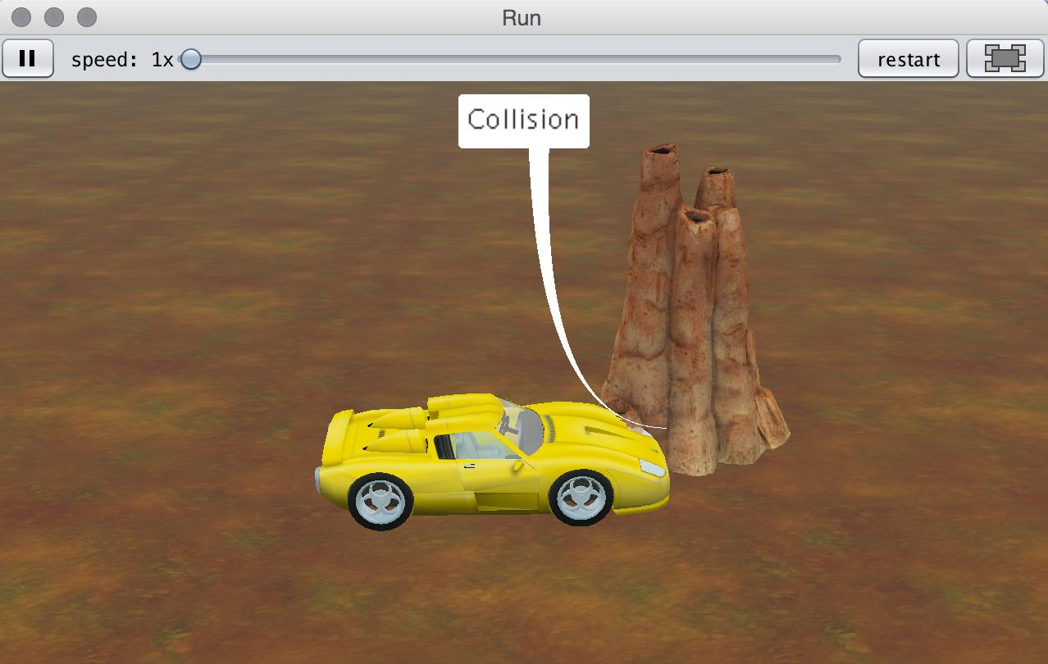
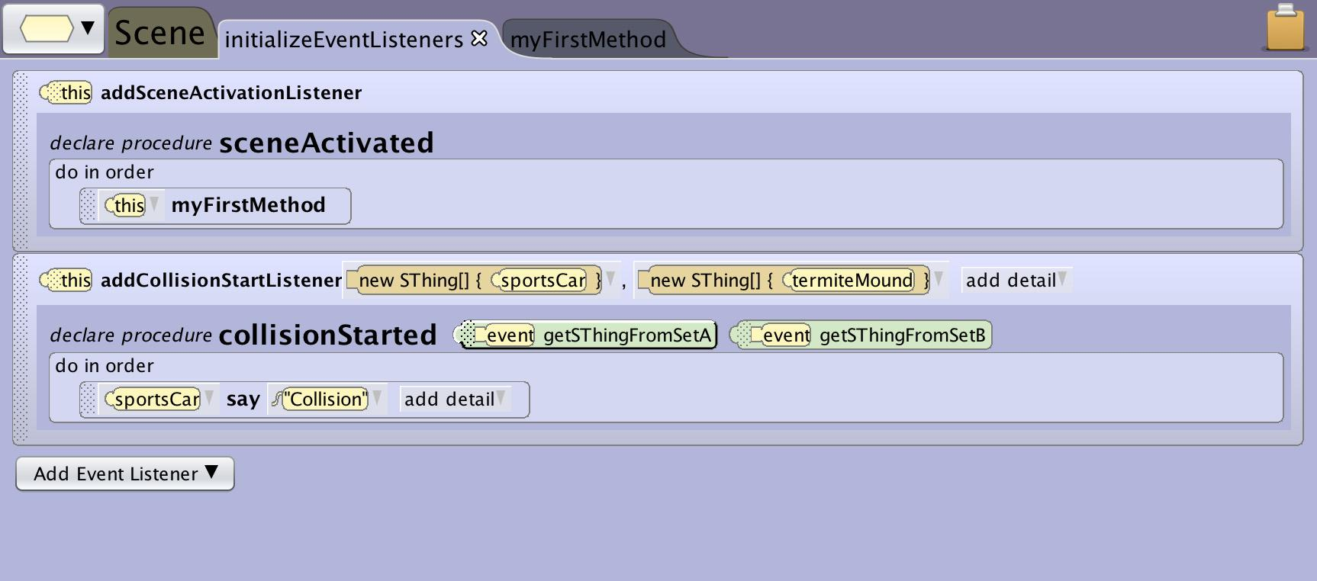
Debugging Mechanics
When you are managing variables and events in Alice it is sometimes helpful to use a couple tricks to debug what is working. A common trick is to have objects in the scene use say commands to expose underlying events and variable states that would otherwise be invisible.
To test a collision is firing have the first step of the event outcome have the object say “collision”
To see if a timer or health variable is being changed you can have an object say the value of the variable when it is triggered

Slide 55
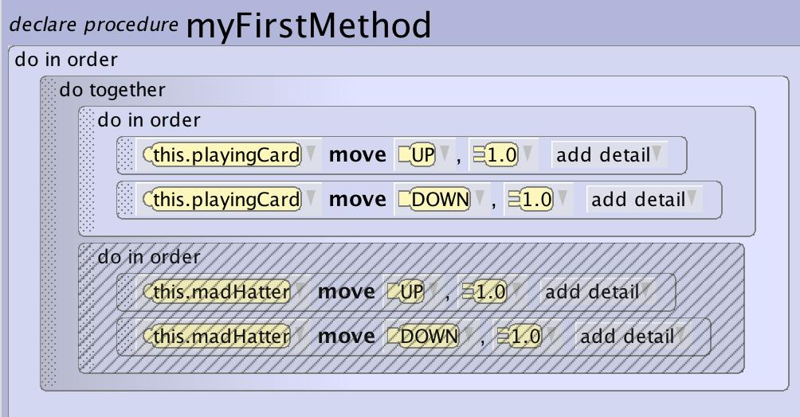
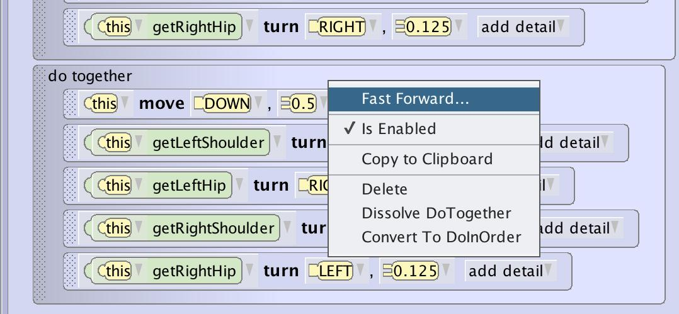
Testing
Disabling and Fast Forwarding
It is a little harder in interactive worlds to disable or fast forward because dependencies for where objects should be and the need for input can block these functions. You can still modularly test interactions.
In open worlds you can easily skip other interactions and move directly to the area to test.
In guided experiences using fast forward will still accelerate the animations and movements between interactions.

Slide 56
Tips and Tricks

Slide 57
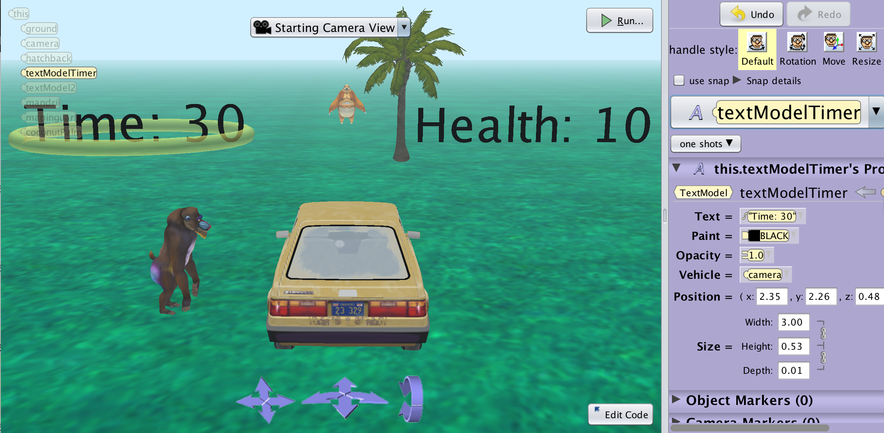
Game Heads Up Display
To have display elements remain in front of the camera when the character or camera moves such as time, health or other information for the player you can set it where you want it and then vehicle it to the camera to lock it’s relative position.
In this scene the camera is vehicled to the hatchback to follow the car and the variable displays are vehicled to the camera to stay in position when the camera moves.

Slide 58
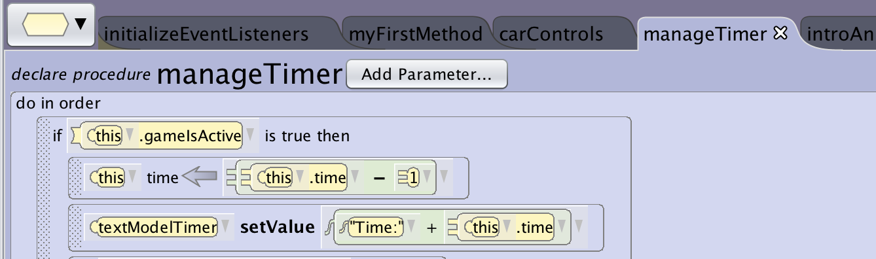
Using Game States
Many times you will want to restrict game inputs till the game starts. You can use a game state variable like gameIsActive to restrict when the player can start to control things.
This pattern can also be used to change which controls are active between levels or scenes.
You can add this on the event handler or in the control method.

Slide 59
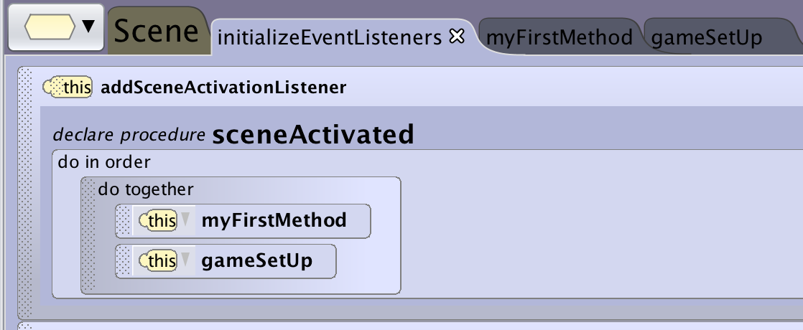
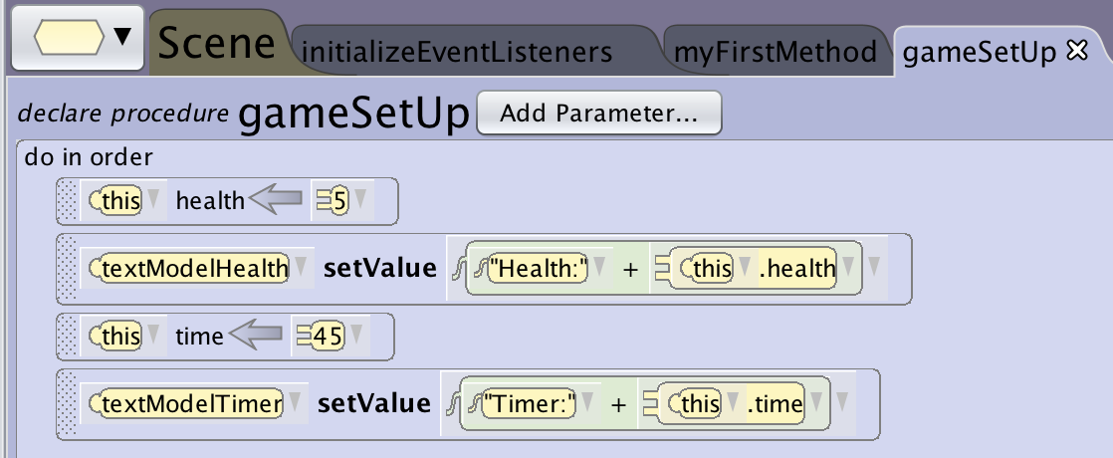
Using Game Setup
When you create a variable or text object among other things you need to set a value. While you can go in and change those in the Scene properties it can be helpful to make a separate game setup method that includes all of your game variables and key starting information to make it easier for you to change them when testing and tweaking your game.
This can also be used to reset the game if you want it to be replayable or have different settings between levels or difficulties.

Slide 60
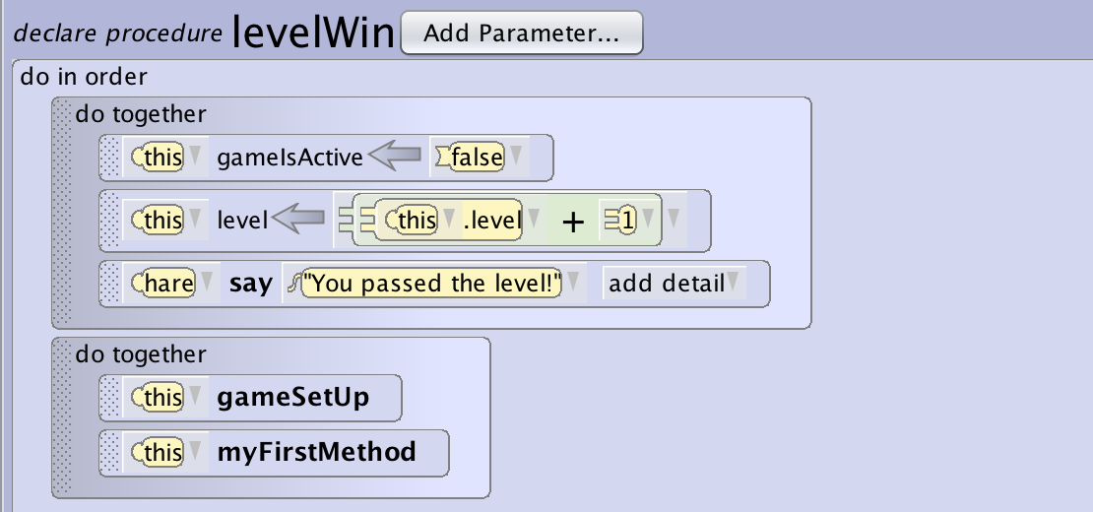
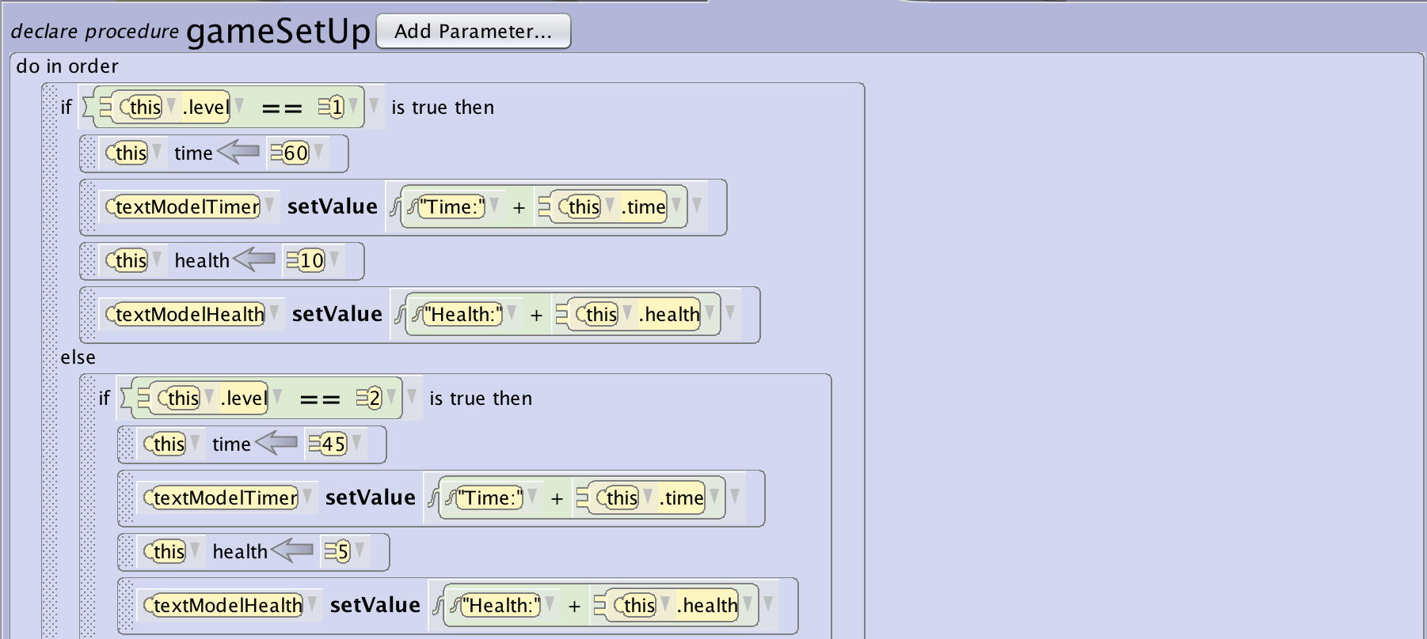
Using Game Setup Cont’d
You can also use game setup for enabling replay or for creating multiple levels or levels of difficulty.

