Slide 1



With
and
The Sims are a registered trademark of Electronic Arts, Inc
The 'Hour of Code™' is a nationwide initiative by Computer Science Education Week and Code.org to introduce millions of students to one hour of computer science and computer programming.”

Slide 2
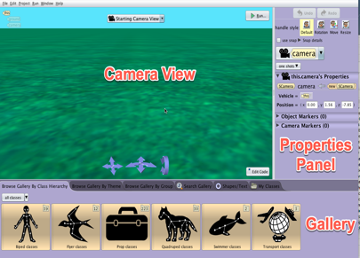
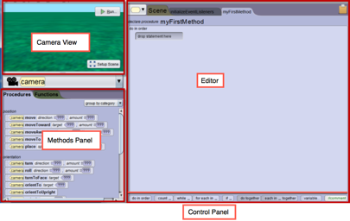
Introduction
What is Alice?
Alice is an easy to use programming environment that allows you to to create 3D animations and interactive 3D worlds. It is made up of:
The scene editor that allows you to build worlds using a gallery of characters and props.
The code editor that allows you to drag and drop code blocks to build a program that will generate your animation.

Slide 3
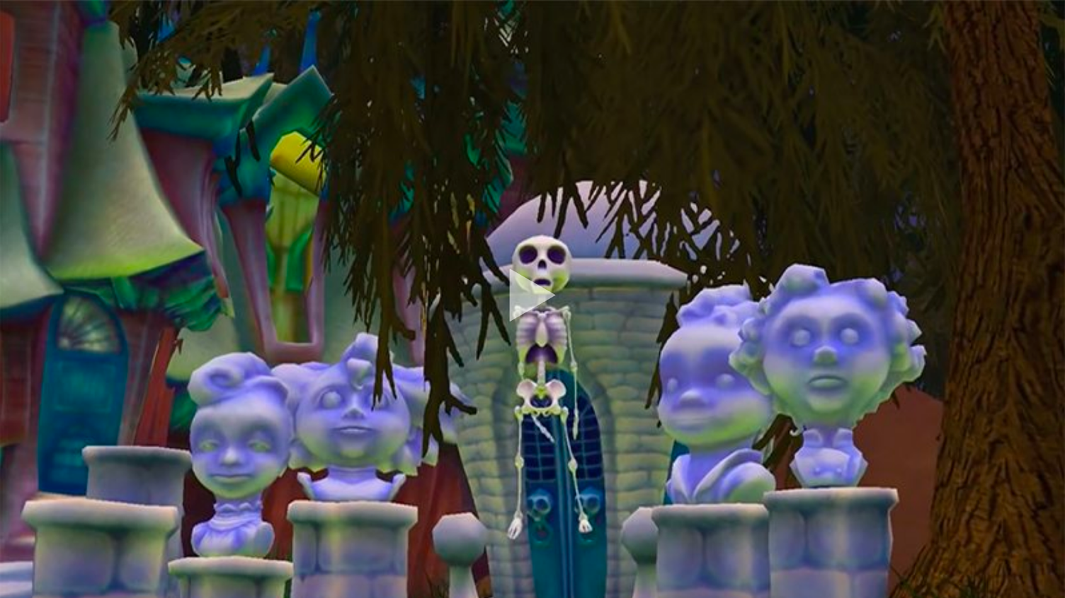
Notes:
You can use any Alice world video you like. The one from the image above can be found here: http://www.alice.org/featured-projects/
I have not embedded the video due to file size nor linked to the youtube video due to ppt video embed compatibility concerns. You can deifinitely download and embed or link as needed.

Slide 4
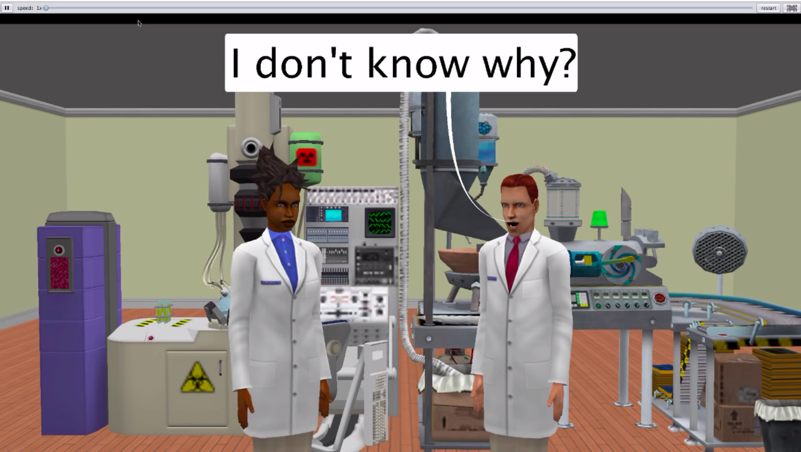
Notes:
This video can be played and download from the page associated with this lesson here: http://www.alice.org/resources/lessons/hour-of-code/

Slide 5
Overview
Creating an Animation
In this Hour of Code you will create an animation of a dialogue or a simple interaction between characters.
Ideas for your animation could be characters singing your favorite song, an animation of your favorite internet meme, a funny comedy skit or joke you know, or even a serious conversation.

Slide 6
Overview
Schedule of Activities
Step One: Building A Scene
Step Two: Create A Storyboard
Step Three: Plan Your Program
Step Four: Program Your Animation
Step Five: Share And Discuss

Slide 7
Activity One
Building a Scene

Slide 8

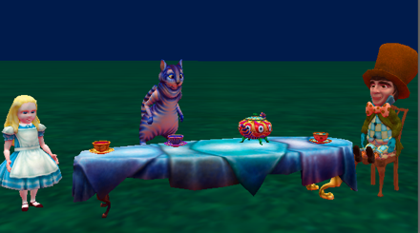
Building a Scene
A 3D Virtual Environment
An Alice world is a virtual environment created in 3 dimensions (3D).
The 3D world is a representation of a place (environment) and the objects in that place that have height, width, and depth
A 2D image of a tea party
A tea party in the Alice virtual environment

Slide 9
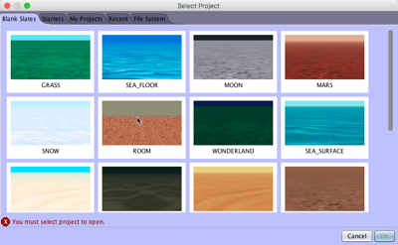
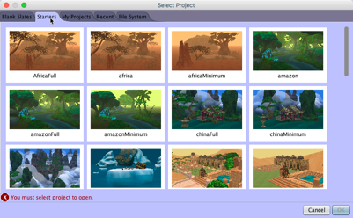
Building a Scene
Scene Templates
Blank Slates: Empty worlds with pre set ground textures, sky colors and fog settings to mimic different settings
Starter World: Environment containing a range of prop objects pre built to a specific theme

Slide 10

Building a Scene
Scene Editor Overview
The scene editor is composed of:
Camera View
Properties Panel
Gallery

Slide 11
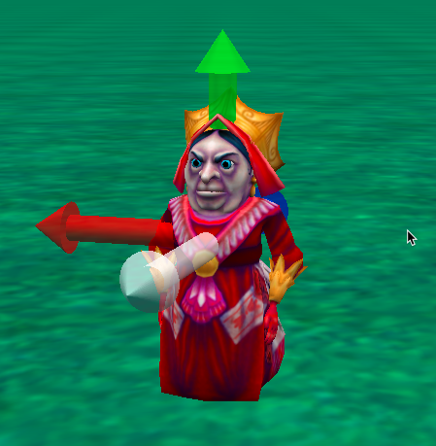
Building a Scene
Move, Turn, and Roll
The white axis points forward, the red arrow to the right, green up, and blue backward
Objects can move in 6 directions
Up / Down
Left / Right
Forward / Backward
Objects can turn in 2 Directions
Left / Right
Forward / Backward
Objects can roll in 2 directions
Left / Right

Slide 12
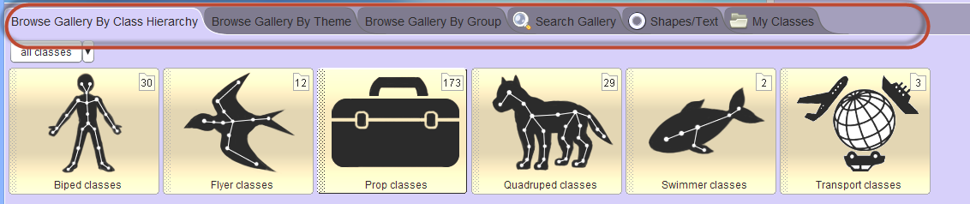
Building a Scene
The Gallery
The Gallery contains the definitions of 3D models for adding objects to a scene.
Each tab displays a different organizational scheme for finding classes in the gallery.

Slide 13
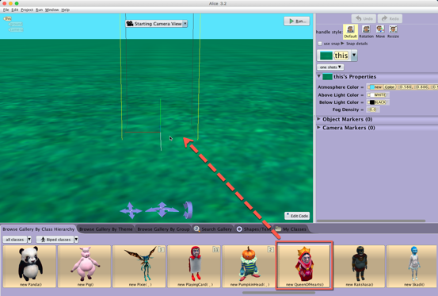
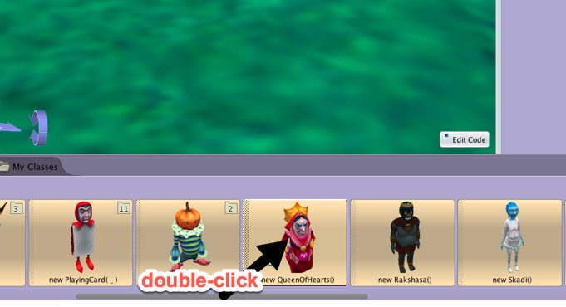
Building a Scene
Adding Objects
You can drag and drop or/ double click
Bounding boxes show you where the object will be positioned when dragged in to the scene
Double clicked objects will be added at the very center of the world (0,0,0)

Slide 14
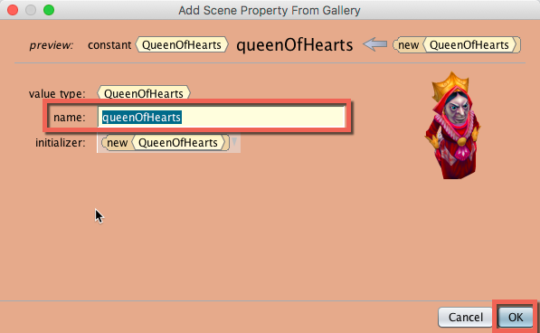
Building a Scene
Naming Objects
Alice will provide a default name based on the class name selected but you can enter a different name when you add a new instance of that class. You will need to adhere to the following rules:
Names must be one continuous word with no spaces
For names with multiple words try using camelCase
The first space has to be a letter and not a number
No special characters such as a ?

Slide 15
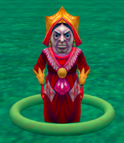
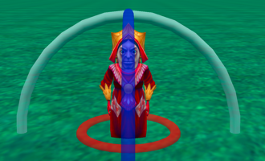
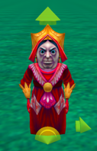
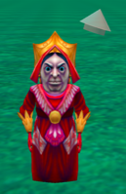

Building a Scene
Positioning With Mouse
By default clicking on an object and dragging the mouse around will move the object on the ground plane. It will also highlight a ring around the object that can be used to rotate the object.
You can use the handle style buttons to change the mouse behavior:
Rotation - displays circular handles for manipulating turn and roll relative to the object's orientation
Translation - displays handles for moving the object along the major axis relative to the object
Resize - displays a handle for uniformly scaling the object

Slide 16
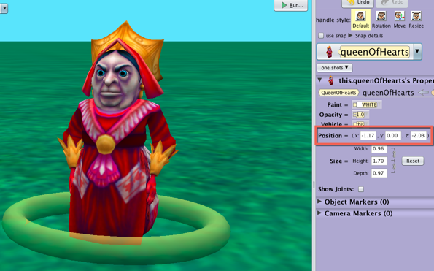
Building a Scene
Position With Coordinates
For more precise positioning of objects you can use the properties panel to adjust the absolute position of the objects in the world.
Select the desired object from the object tree or the object drop down
Modify the x,y,z coordinates for the object
The properties panel can be used for position but not orientation

Slide 17
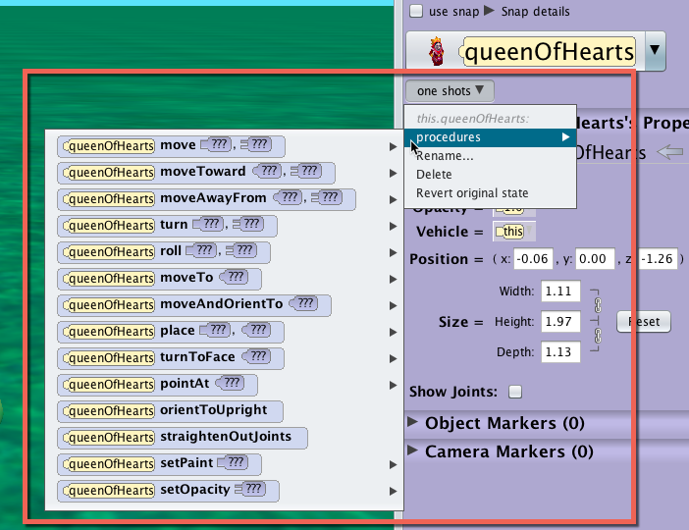
Building a Scene
Positioning With One Shots
For more precise and relative positioning of objects, use the one shot menu:
Select the object’s name from the object menu
In the properties panel select a move command from the one shots sub menu
Note: you can also right click on an object in the scene to access the menu

Slide 18
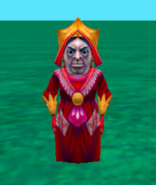
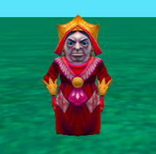
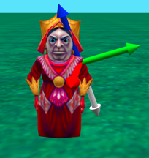
Building a Scene
Internal Joints
Objects usually (not always) have internal joints or skeletons that control subparts of the model.
A joint connects the subparts of the body to the rest of the body.
Joints have a different orientation than the whole object. This orientation determines how turn and roll will control them.
The white arrow points forward, the red points right, the green points up, and the blue axis points backwards.

Slide 19
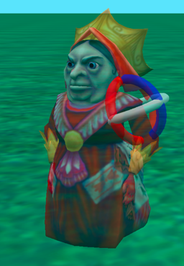
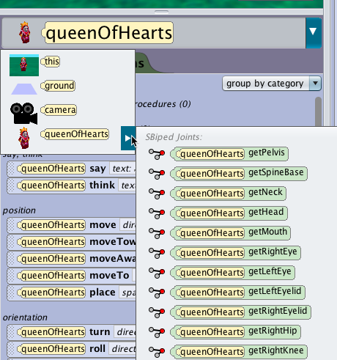
Building a Scene
Manipulating Object Subparts
To Access a joint click on the arrow next to the object’s name in the object list
The joint acts as the pivot point for the subparts of the object extending from that joint to its extremities
Turning and rotating joints may also move other joints and subparts
Ex. Turning the left elbow joint will also move the wrist, and finger joints and move the forearm and hand subparts.

Slide 20
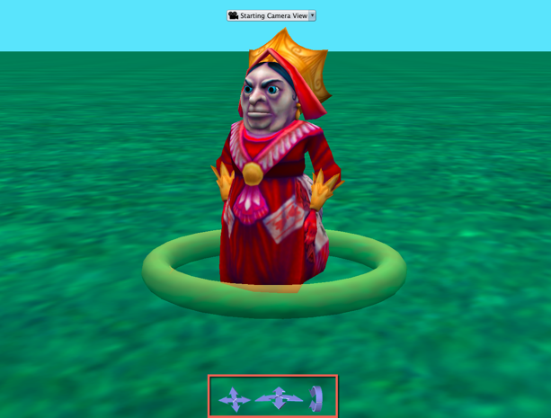
Building a Scene
Camera Controls
In Alice there is only one camera that can be moved around the scene
Changes in the scene view are achieved by moving the camera not by switching to different cameras
The basic camera controls on the bottom of the scene view allow you to reposition the camera view in the scene editor

Slide 21
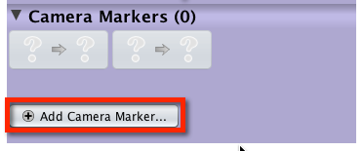
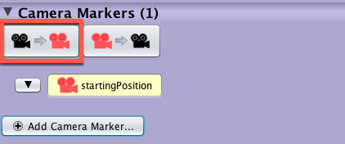
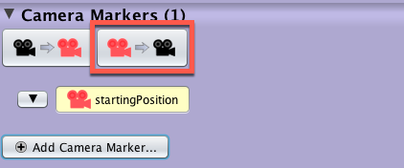
Building a Scene
What is a Camera Marker?
A camera marker is an invisible object that allows you to mark a location and orientation in the world so that you can quickly move the camera to a saved place.
It is highly recommended to create a camera marker when you start a new scene so that you can return to the starting place in case you accidentally move the camera.
Add a camera marker in the properties menu
Use the left button to move the camera to the selected marker
Use the right button to move the selected marker to the current camera position

Slide 22
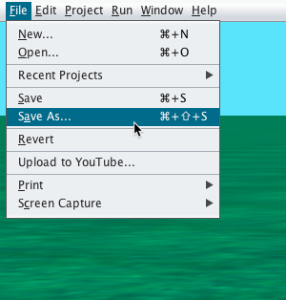
Building a Scene
Save Often
Save your world when you first start a new project
Later versions of Alice 3 have an autosave function that will save incremental backups in case of an issue
Save your project world often - every 10 - 20 minutes
Alice worlds can be corrupted so use a progressive naming convention for incremental backups name.a3p, name2.a3p

Slide 23
Building a Scene
Undo / Redo
You can always use undo and redo to test things things
In addition to the interface buttons you can use command z and command y

Slide 24
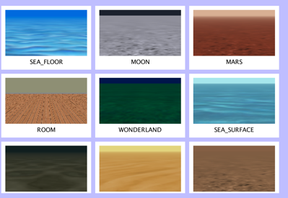
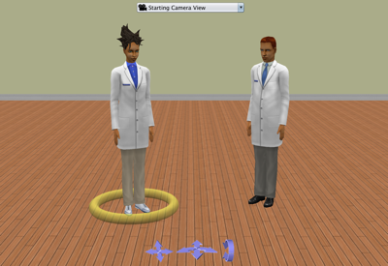
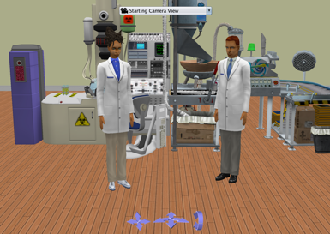
Building a Scene
Creating a Scene
You will first explore the Alice gallery to determine the environment, characters and props you want to use for your animation.
Think about where you want the animation to take place?
Who are your main characters?
What scenery or props will help build the environment for your animation

Slide 25
Activity Two
Crafting A Story

Slide 26
Crafting A Story
Story Components
Whether you are writing your own story or dissecting an existing story, it is important to understand what story is being told?
Where does it take place?
Who are the characters?
What actions are taken?
What events happen?

Slide 27
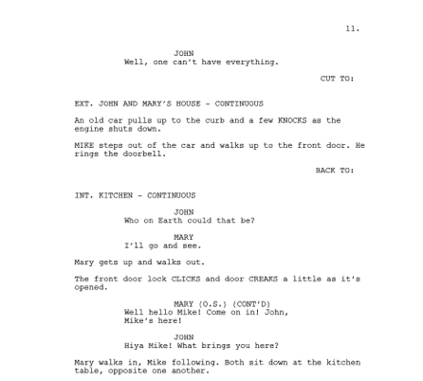
Crafting A Story
Using a Script
A script is a story written as a set of directions that is intended to be used to direct a play, a movie, or a similar. production.
What are the key parts of a script that help you understand your story?
Descriptions of the set and environment
Directions for movements around the space
Specific dialogue

Slide 28
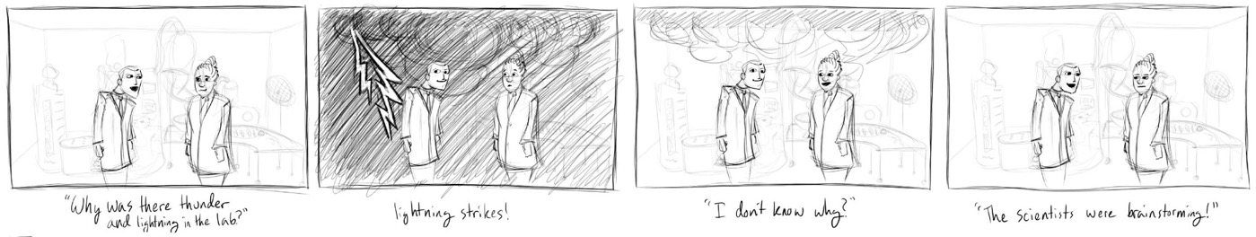
Crafting A Story
Using a Storyboard
A storyboard is a visual representation of a story that is used for planning animations or films. Each frame captures a moment in the story and conveys important information about:
Where the story is taking place
Who is in the scene
What is happening

Slide 29
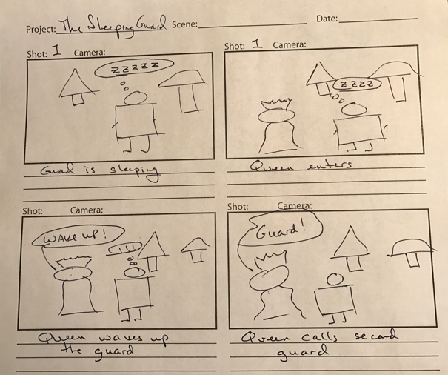
Crafting A Story
Making a Storyboard
The drawings are not expected to be beautiful artwork. Use stick figures and simple shapes.
Use text comments to give more information when needed.
Add audio notes for intended sounds.

Slide 30
Crafting A Story
Story Ideas
First focus on a simple conversation between the characters like:
Telling a joke (knock knock)
Internet Memes
eCards
Song Lyrics
Existing comics strips and cartoons
For more challenging animations add
A character entering or leaving the scene
Characters using simple gestures such as waving or shaking their head
Have different camera angles such as a wide shot followed by close ups of the characters

Slide 31
Activity Three
Planning A Program

Slide 32
Planning a Program
What is an Algorithm
Do In Order
Step 1: Scientist One Says “Why was there thunder and lightning in the lab?”
Step 2: Lightning Flashes
Step 3: Scientist Two Says “I don’t know why?”
Step 4: Scientist One Says “The scientists were brainstorming.”
A set of steps to accomplish a task.
Ex: How to get from home to school or how to sort a deck of cards.
A computer science algorithm is a set of steps for a computer to accomplish a task.
An Alice Algorithm is a set of steps that tells the computer how to animate the virtual environment.

Slide 33
Planning a Program
Translating a Story
  The scene opens and we see the first guard sleeping in the queen’s garden that has a tree and a giant mushroom. The queen enters the scene and sees the sleeping guard. The queen attempts to wake the sleeping guard. The guard awakes, and is frightened. The queen turns and calls for a second guard. The second guard enters the scene. The queen angrily points at the first guard and says “Off with his head”. The first guard runs and hides behind the mushroom.
Alice is based on setting up scenes and animating objects.
To translate your story to an animation it is important to define:
What are the nouns (objects)
What are the verbs (actions)

Slide 34
Planning a Program
Translating a Storyboard
In a storyboard a lot of the time the objects or characters (nouns) are easy to determine because they are there for you to see.
It is important to remember that many times in a storyboard the action (verbs) takes place in between the frames (ie the clouds appear).

Slide 35
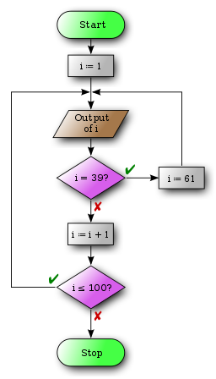
Planning a Program
What is a Flowchart
Flowcharts are used to visually design and document processes or programs. There are several different formats.
Shapes that depict actions, inputs, or processes
Allow visual representations of simultaneous actions and conditional actions
Easily map out decision points and repetitions

Slide 36

Planning a Program
Benefits of a Flowchart
A flowchart allows you to easily show program flows that include more complex scripts.
The activity diagram format of solid bars allows you to show things happening at the same time and helps figure out timing.
You can also use a mixture of flowcharts and text based design to write out individual nodes of the chart.

Slide 37
Activity Four
Coding An Animation

Slide 38
Coding An Animation
Defining a Computer Program
A computer program is a set of instructions or statements that tell a computer what to do.
Programmers generally write computer programs using programming languages which can then be translated into machine code that can be executed by the computer.

Slide 39

Coding An Animation
Code Editor Overview
The Code Editor is composed of:
Camera View
Methods Panel
Editor
Control Panel

Slide 40
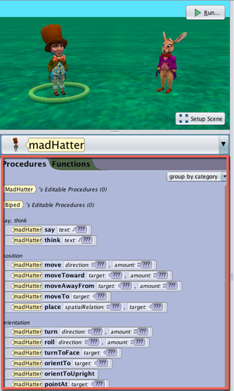
Coding An Animation
Methods Panel
The methods panel is where you will find code blocks that are dragged into the editor to create program statements and is composed of:
An object list drop down menu
A procedures tab (purple)
A functions tab (green)

Slide 41
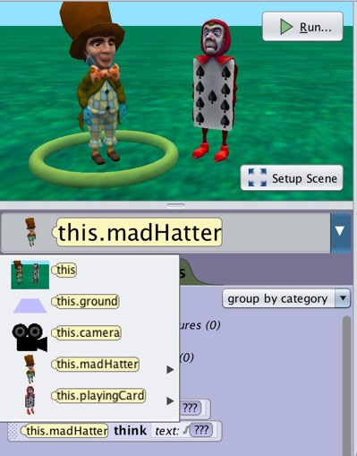
Coding An Animation
Alice is Object Oriented
In Alice, procedures are attached to the object they are going to affect.
Navigate to the object you want to control to find the methods associated with that object.
Different objects can have different built in and custom procedures depending on the type.
For example, the scene object has atmospheric procedures like setting fog density while a rabbit has movement procedures like turn and roll.

Slide 42
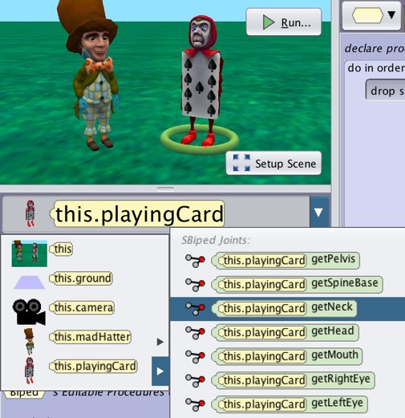
Coding An Animation
Select the Object
Remember procedures are attached to objects. Be sure to select the object you want to manipulate using the object drop down menu.
If an object has joints like the playing card, as shown in the image to the right, you can also select subJoints of the object through the nested drop down by hovering over the little arrow to the right of the object on the list.
Just like parameters, you can also change the object in a statement as long as it is able to perform the procedure. Do not worry if you accidentally chose the wrong object.

Slide 43
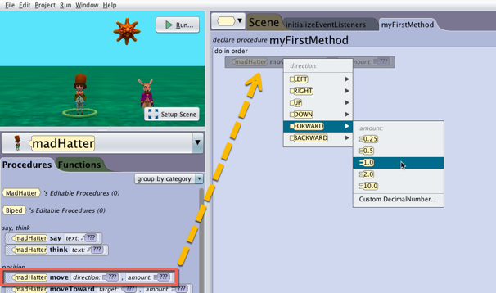
Coding An Animation
Create a Statement
Adding a statement is as easy as dragging and dropping it into the Code Editor component.
Alice will guide you through filling in the required arguments to complete the statement.

Slide 44
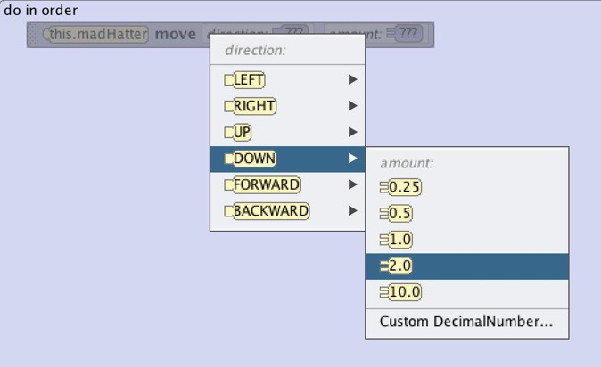
Coding An Animation
Parameters
When using built in procedures to create an Alice code statement, parameters can be modified.
A parameter is an argument that informs what the method will do.
Telling an object to move is confusing. Which way? How far?
In this case direction and distance are parameters that provide information needed for the procedure to have all of the information it needs to execute.

Slide 45
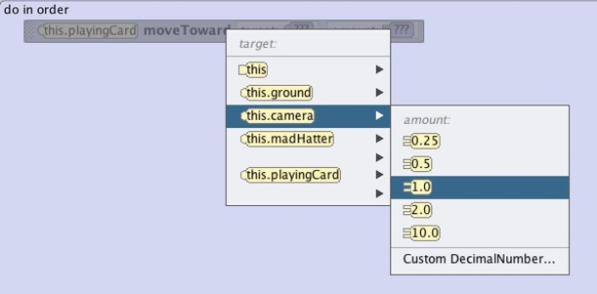
Coding An Animation
Required Parameters
Alice doesn’t allow you to create broken code (most of the time).
When creating a statement Alice will require you to select arguments for each of the required parameters so that it can execute.
Drop down menus will guide you through selecting values for all of the required parameters.
Don’t worry you can change these later without having to rebuild the statement. In some cases, you will have to choose a place holder and replace it later on.

Slide 46
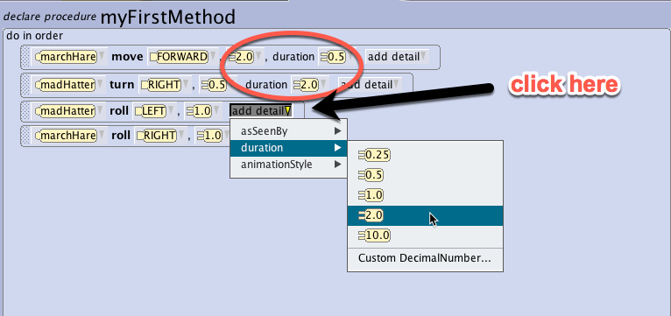
Coding An Animation
Optional Parameters
Alice has a number of parameters that can be added to statements using the add detail dropdown. These can help create necessary variations. For move procedures these are:
Duration – This parameter controls how long something happens so you can change the default. By default, each statement takes 1 second to execute.
Animation Style – This parameter allows you to control the smoothness or abruptness something happens. By default, move commands speed up and slow down over the execution to smooth it out.
As seen by – This parameter allows you to modify the point of reference to the camera or other objects. By default, moves are relative to the object being manipulated.

Slide 47
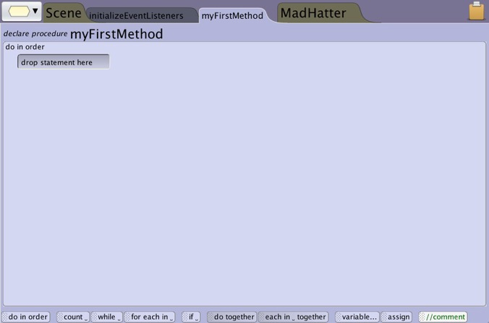
Coding An Animation
Control Panel
The control panel like the methods panel has blocks that you drag into the Code Editor to build your program. These elements are generally more structural elements for your program like:
Control structures for making loops and do togethers
Ways to create and manage variables
Ways to add comments to plan and explain your program

Slide 48
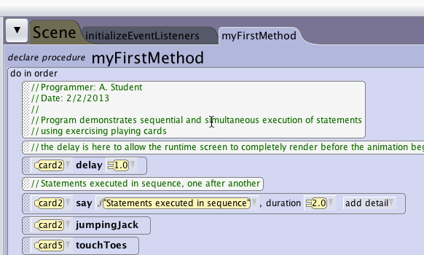
Coding An Animation
Do In Order
Alice will follow the list of statements you provide in the exact order you see them in your program.
Think of it like a recipe.
Do this
Then this

Slide 49
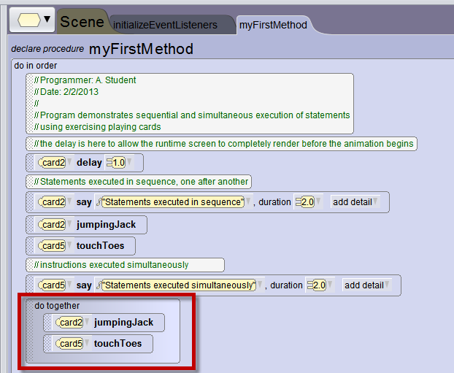
Coding An Animation
Do Together
Control structures allow you to change the sequence or logic that controls the order and timing of statements being run.
Often in Alice, you will want things happen at the same time. This requires the do together control block.
Drag the do together block from the control panel below the Code Editor into your program.
Add statements to the block that you want to happen at the same time.

Slide 50
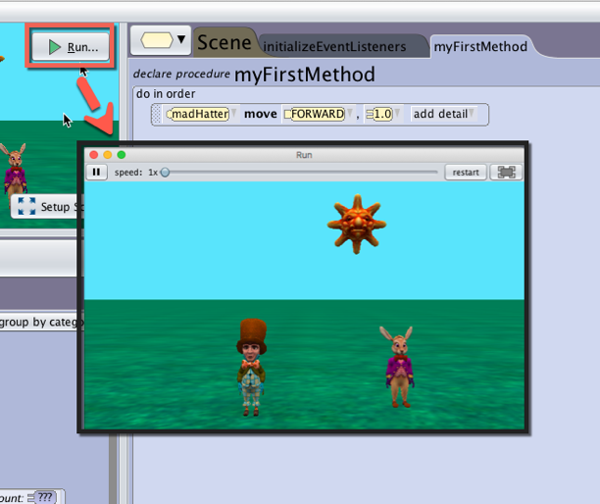
Running Your Program
The Alice Player
To execute the program press the Run button and a viewer will appear. The viewer allows you to:
Resize the window by dragging a corner or going full screen with the far right button.
Speed up, slow down, and pause playback help you navigate to different parts of the program.
Restart your program to run it again.

Slide 51
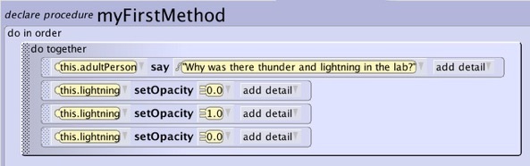
Implementing Design
Incremental Design
Alice is intended to allow you to easily iterate and test your program as often as you would like.
Start by implementing parts of your animation
Test and refine small sections before moving on to new components
Revise and redesign based on what you find when implementing
Do Together
Step 1: Scientist One Says “Why was there thunder and lightning in the lab?”
Step 2: Lightning Flashes
Do In Order
Step 3: Scientist Two Says “I don’t know why?”
Do After Step 1-3
Step 4: Scientist One Says “The scientists were brainstorming”

Slide 52
Advanced Topics
If Time Permits

Slide 53
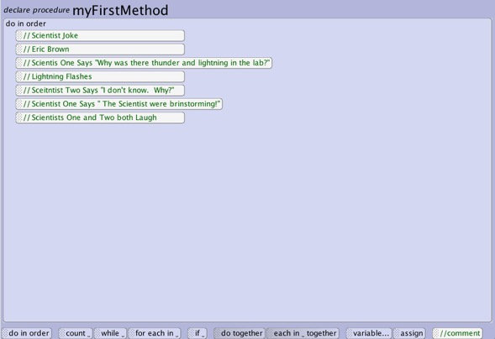
Implement Design
Commenting
Comments are used to display information that the computer will ignore when running your program and are used to:
Give attribution to the author of the code
Help you layout and plan your program
Help other people understand what your program does
Planning out your program with comments first can be a good first step when implementing your design.

Slide 54
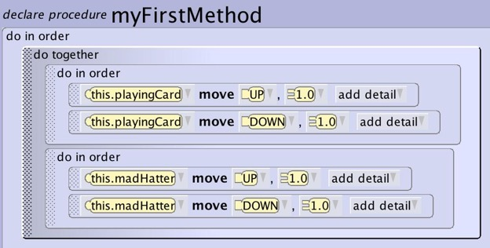
Advanced Topics
Nesting Control Structure
Often you will want things to happen in order for one object at the same time as another set of directions are executing in order for another object.
This requires you to place control structures inside control structures.
To have two objects jump at the same time you need the move up and down code for each jump inside do in orders that are inside the do together.
What would happen if you didn’t have the do in orders?

Slide 55
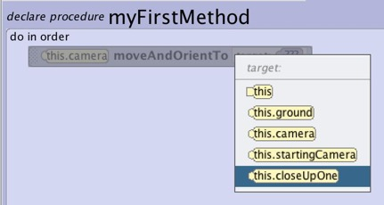
Advanced Topics
Animating the Camera
The camera can be programmed to move just like any other object in the scene.
Use camera markers to plan for the positions and orientations of the camera. Then use the camera markers to program the camera moves, adding dynamic changes to animations.
Change the duration of the camera move to have it pan slowly or jump to the new view (use 0)
Add a camera marker in the scene editor
Use moveAndOrientTo to program camera changes

Slide 56

Advanced Topics
Scene Effects
Don’t forget about the unique scene procedures. They can be used to create very cool environmental effects such as flashing lightning or rolling fog.

Slide 57
Advanced Topics
“Off Set” Objects and Characters
Some stories require you to have characters enter and leave the scene. There are two ways to do this:
Build your scene with the characters off set and have them naturally enter and leave.
Set objects and characters to 0 transparency (hidden) and bring them to 1 (visible). Be careful that these objects will still be there for collision and mouse click events.
Off Screen
Camera
Transparent

Slide 58


Advanced Topics
Adding Sound
Adding sound can quickly transform an animation and bring it to life using the playAudio procedure. There are a couple different ways to easily add sound:
Add a background audio track in a sceneActivated listener to have it run during your animation
Add sound effects for movements using a do together
Add voice overs by recording your own audio and matching it to mouth movements
The Alice project supplies a number of audio files with Alice that can be explored.

Slide 59
Activity Five
Wrap up and Discussion

Slide 60
Wrap Up
Share and Discuss
Show your project to your group or someone close to you
Show them your storyboard and script
Show them your animation and explain how you implemented it
Discuss as a group your experience coding an animation
What did you think of the project?
What did you use to inspire your animation?
What was it like to “code”?

