Slide 1
Using Variables
http://www.alice.org/resources/lessons/using-variables/

Slide 2
Variables
What is a Variable
A variable is a named location in the computer’s memory where a value may be stored.
The type of data stored in the variable is defined by the data type. This helps the program:
allot the right amount of space for the data to be stored
allow the program to check that the type of data will match the type of data requested
inform the computer the operations that are allowed to be performed with that variable
The value of a variable can be changed during the execution of a program.

Slide 3
Variables
What are they used for?
Short Term Storage - Some things in Alice, such as arithmetic expressions, will store the result in a variable for immediate usage. Some control structures will have you set up variables to be able to process individual actions such as an individual object of an array for use in a for each in loop.
Long Term Storage - In other cases you may want to create use a variable to keep track of information for later use. These variables can have the data stored in them changed as needed to track things like items collected, time passed, or if a game state has changed.

Slide 4
Variables
Where to Declare (Create) them?
There are a couple different places you can declare variables in Alice. Where you declare the variable will affect the type of data that can be used as well as where you will be able to access and use the variable.
As a parameter - Declaring a variable as a parameter of a method allows you to pass data between methods.
Object Properties - Declare a property variable that is a part of the class definition. These variables will be accessible in all methods for all instances of that class.
Using a code statement - You can declare a variable using code inside of a method. Variables declared using code statements will only be accessible in that method and after it has been declared.
Inside a Control Structure - You can declare a variable inside of a control structure. For some control structures Alice will force you declare a local variable in order to service the control structure. A locally declared variable will only be accessible within that control structure for use.

Slide 5
Declaring (creating) a Variable

Slide 6
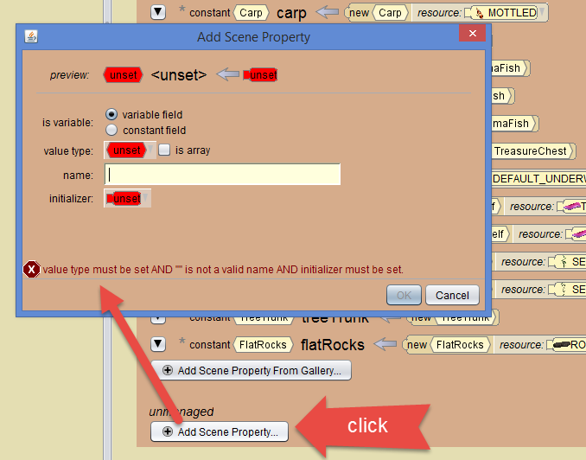
Variables
Adding a Variable to a Class
You can declare variables on the class page (yellow tab) for each type of class.
On the scene class tab you declare variables in the unmanaged properties section. Click add scene property to declare a new variable.
Only the scene class tab will have a managed (the list of objects added to the scene) and unmanaged properties sections.

Slide 7
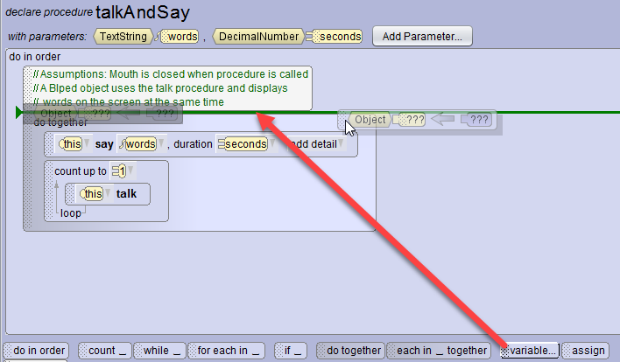
Variables
Declaring a Variable in Code
To declare a variable in line you simply drag the variable block from the control structure bar and add it to your code.
The placement of it within the method will determine if the value will be recognized when called, so be sure it is placed before code that needs to use the variable.

Slide 8
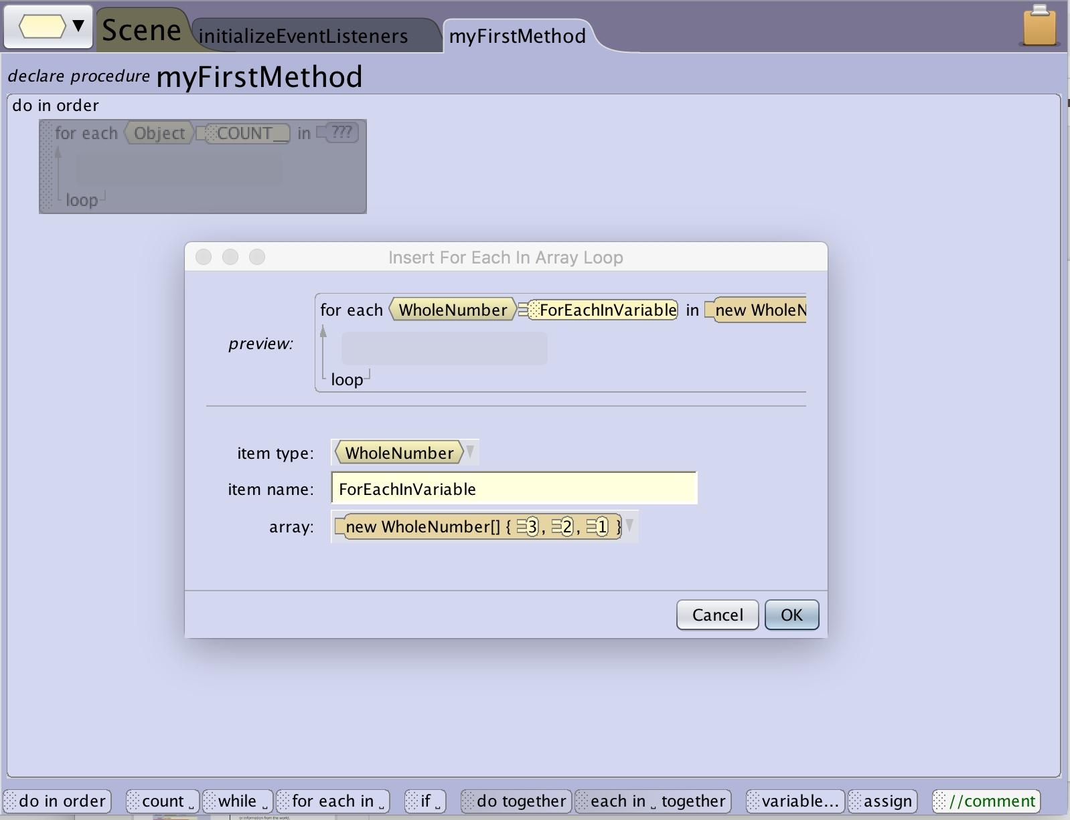
Control Structure Variable
Control structures that make use of arrays will require you to declare a variable to store an element of the array for use in the statements you construct inside the control structure. (for each in_ and each in_ together)
The variable is used to replace the parameter. This variable will be replaced by an element from the array on each iteration of the code block.

Slide 9
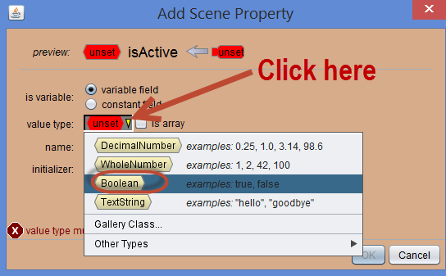
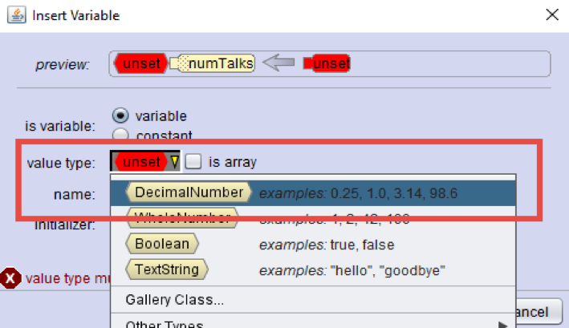
Variables
Selecting the Data Type
Enter a value type (data type).
Depending on where you declare the variable some data types may not be available.
A gallery class object will not be available as a data type for a variable being added to a specific object class such as a Biped.
A joint data type will not be available for a non jointed object such as a box or even the scene.

Slide 10
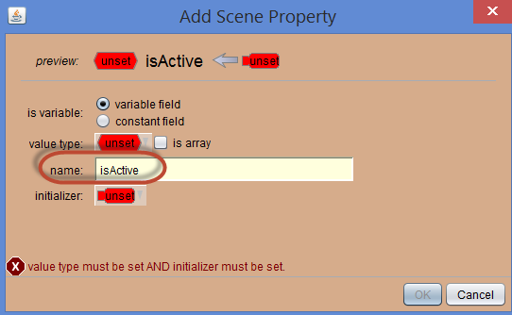
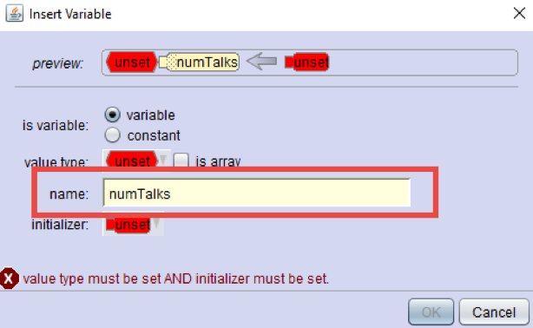
Variables
Naming a Variable
Be sure to name your variable in a way that makes it easy for you and others to understand what the variable is being used for.
You will need to follow the same naming conventions as objects and other inputs in Alice:
Names must be one continuous word with no spaces
For names with multiple words try using camelCase
The first space has to be a letter and not a number
No special characters such as a ?

Slide 11
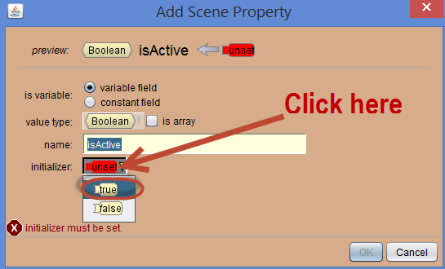
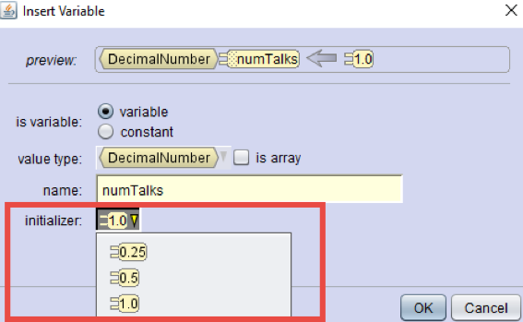
Variables
Initializing a Variable
Most variables has to have a value when you set it up (initializer). You will need to define the initial value when you set it up.
Similar to other procedures in Alice that require a value, you can use a placeholder when first creating the variable. This value can then be replaced by adding a function or other logic that will set the value of the variable based on user input or information from the world.

Slide 12
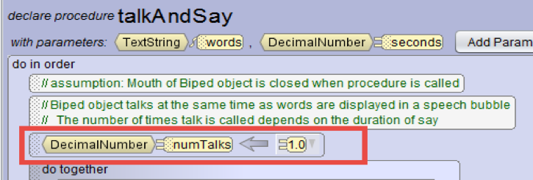
Variables
Resulting Variable
When added to the properties of a class you will see the Data type, variable name, and initial value listed on the properties of the class. This indicates that any object created for that class will be created with that variable set to that value.
When declared in code you will see the resulting declarative statement with the data type, variable name, and initial value.

Slide 13
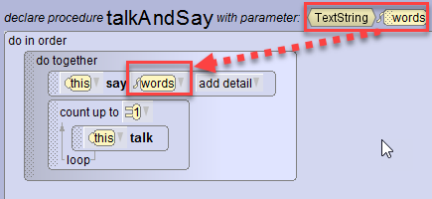
Using Parameters
Parameters are Variables
When adding a parameter to a method you create a variable. Unlike the other variables you do not need to initialize (define) the initial value of the variable when you create it. Whatever value is given to the parameter when the method is called will replace this variable.

Slide 14
Using a Variable

Slide 15
Variables
Using a Variable
To access a variable that has been created in the current method or as a property of the class that the method belongs to:
Find the variable in the parameter drop down menu. It will only show in the drop down of parameters of matching data types
If there is an instance of the variable visible in the code you can drag the variable to a parameter of the same data type. The acceptable locations will highlight with a box around them.

Slide 16
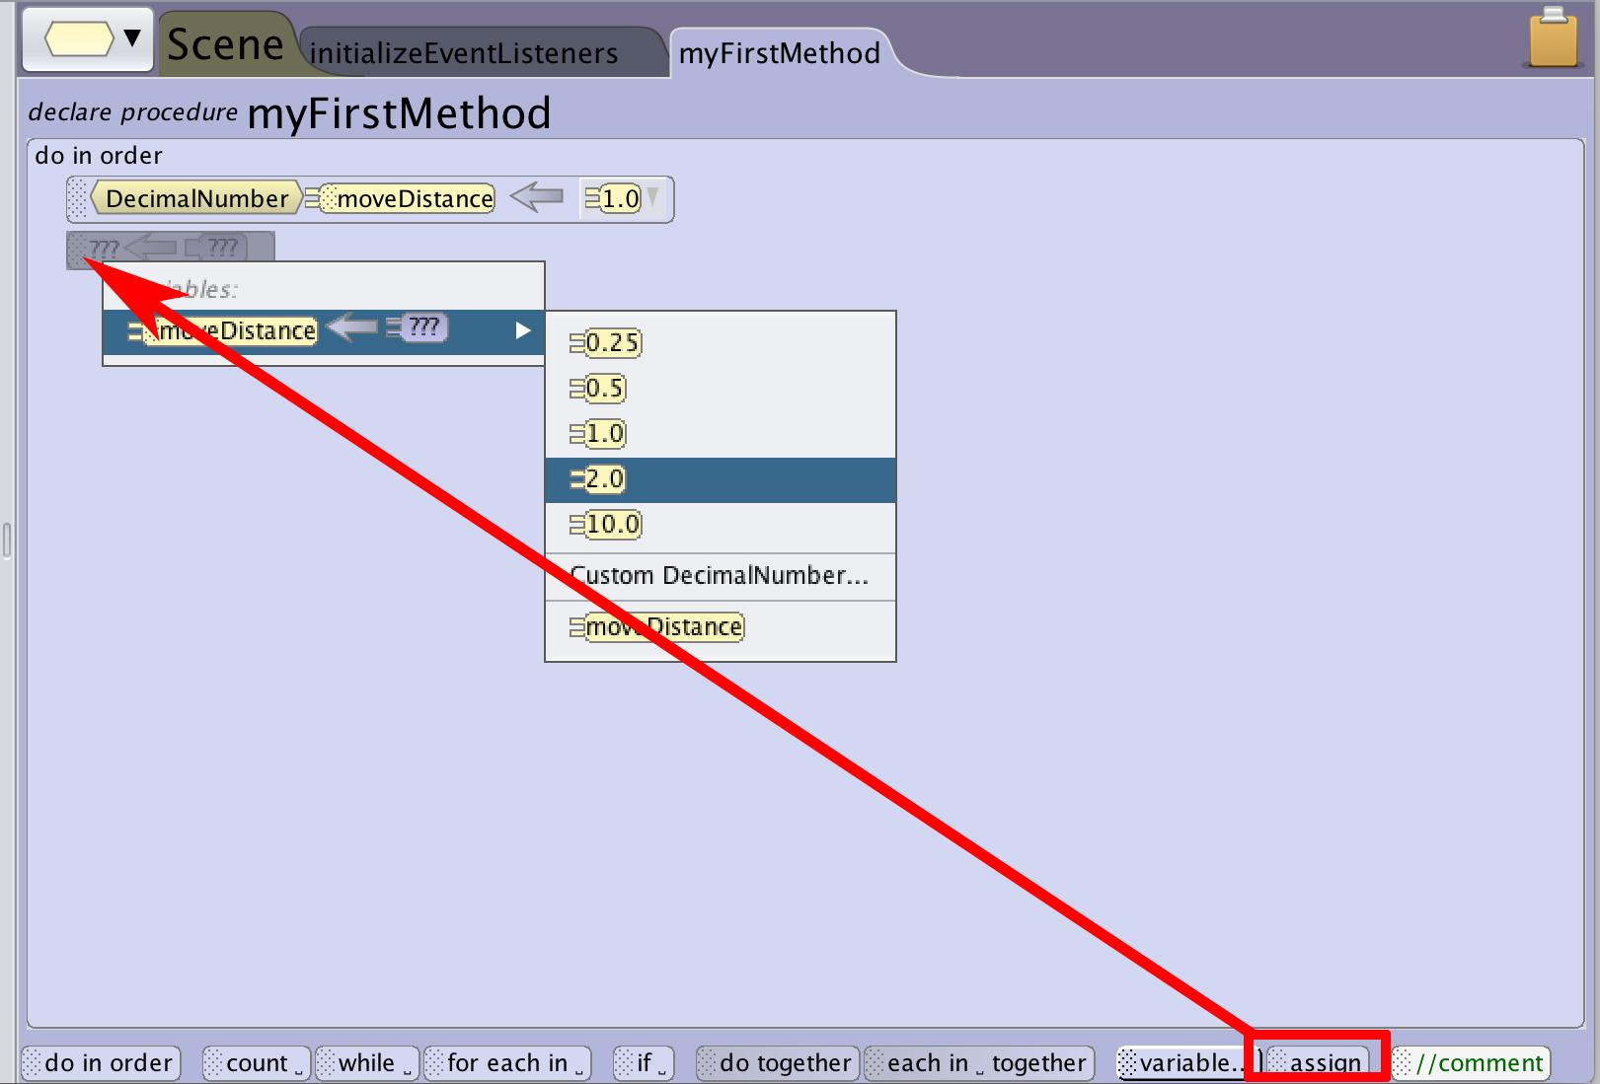
Variables
Changing the Value of a Variable
You can change the data stored in a variable that is within the current method or a property of the current class using the assign control block.
To assign a math or relational strings or set the variable with a function set a default value from the drop down. Use the edit drop down to access the full options list or drag a function into place.

Slide 17
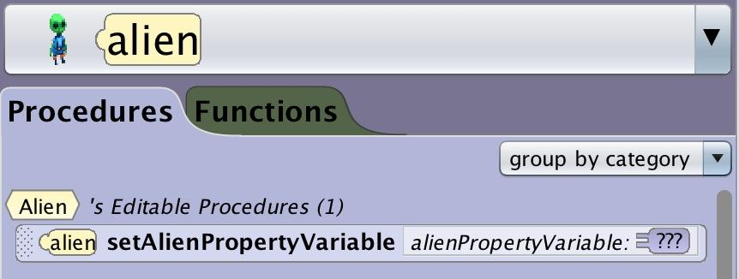
Using set and get Methods
When a property variable is declared Alice automatically creates a procedure and a function for the variable.
set procedure - For setting the variable to a new value
get function - for returning the current value of the variable
These methods will be found in the objects procedure and function tabs.
In scene methods you can access these variables for all of the managed classes (objects in the scene).

Slide 18
The Location of the Variable
Scene Variables - The scene is the parent object that manages all of the other objects. This relationship allows the scene to manage (set and get) other objects’ variables. However, this is a one way relationship so variables that are a property of the scene can’t be accessed directly by other objects using set or get methods. For other classes to access variables of the scene you will need to pass them as a parameter into a method or create an instance variable for that object and set that variable to the scene variable. To pass a new value back out to the scene you would use a custom function or the get function.
Gallery Class (Biped, Flyer, Etc) - Gallery class property variables can be accessed and managed by the parent scene class. These variables will also be inherited by any subclasses. Each instance of that gallery class will have its own unique version of the variable.
Object Class - (ex Cheshire Cat) - Object class property variables will be accessible to the specific object class and the scene class but not the gallery class. Each instance of the object will have its own unique version of the variable that can be managed separately.

Slide 19
Examples in Alice

Slide 20
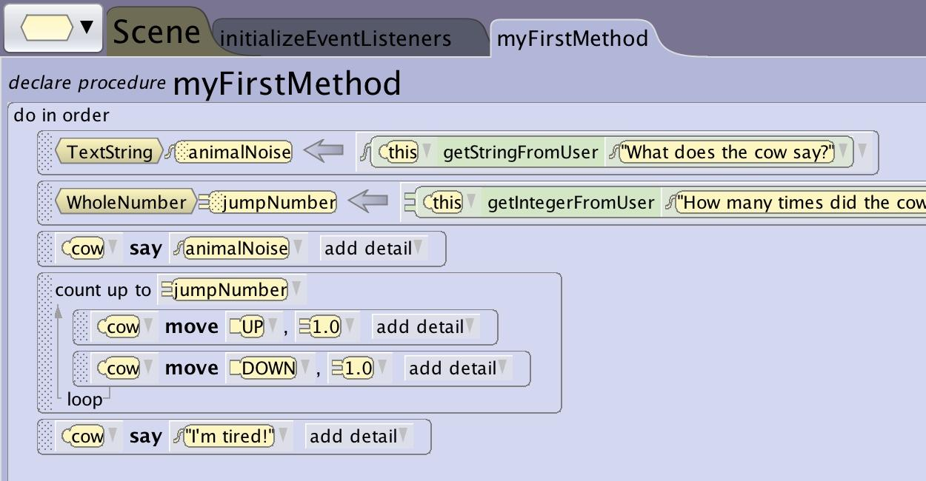
A Mad Libs™ Example
Declare a list of variables that are replaced by user inputs to create a user driven dialogue (madlib) replacing parameters from your animation with user created inputs.
In this example you are using the variable to store the user inputs so that you can use them later to be able to play the whole animation straight through.
If you build the whole animation in one method you can create the variables locally to the animation procedures.

Slide 21
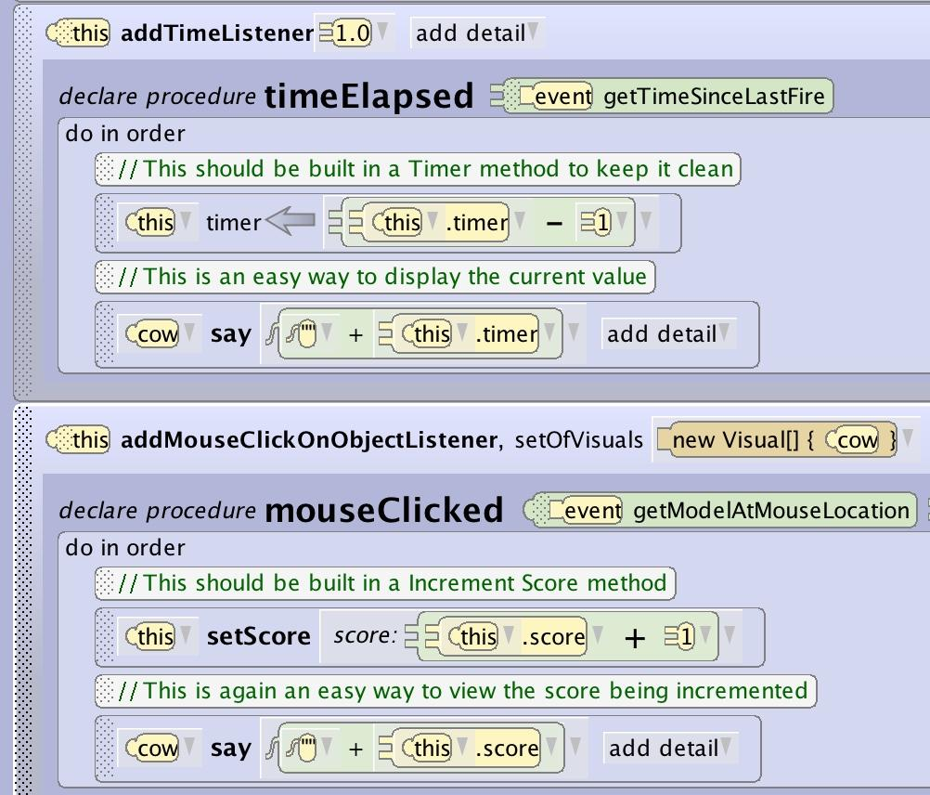
Timer and Score Variables
Some examples of global variables that you might want to create at the scene level and increment are timers and score keepers.
A timer is a variable that you would want to decrement each time a certain amount of time has passed. This variable can then be used for a number of interactions.
A score variable is an example of a variable that you might want to increment when things happen.
This same pattern can be attached to collecting objects, collision events, correct answers to questions and much more.

Slide 22
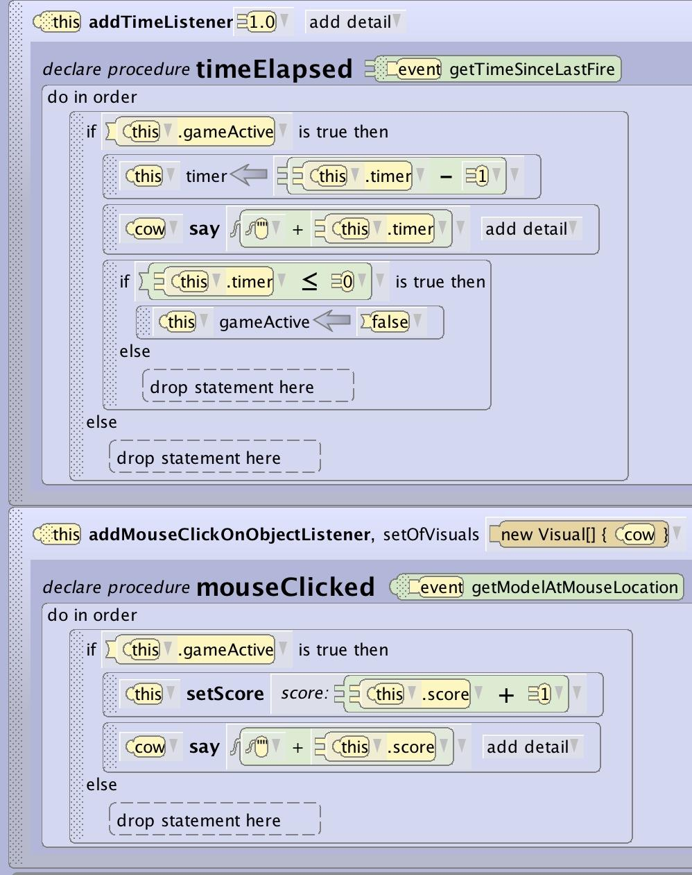
World States
You can use variables that change based on other variables in order to activate or deactivate elements of an interactive world or game.
A boolean variable that impacts a conditional statement that can be switched on and off can be used for managing things like game is active or over, or for door interactions to be locked or unlocked and much more.

Slide 23
Variable
Tips and Tricks

Slide 24
Variables
Data Type Mismatch
A variable will not be able to be applied to a parameter if the data type doesn’t match the expected data type. Some mismatched data types can be used when the data type inherits from the specified data type.
An sThing parameter can accept a biped, quadruped, or other data types that are more specific types of things
A decimal parameter can accept a whole number variable because a whole number will not include data not expected by a decimal
The reverse of these will not work because the value could be something other than what information would be expected.
A biped parameter can’t accept an sThing variable because the value of that variable could be an object other than a biped.
A whole number parameter can’t accept a decimal variable because the parameter may not be able to handle decimal values.

Slide 25
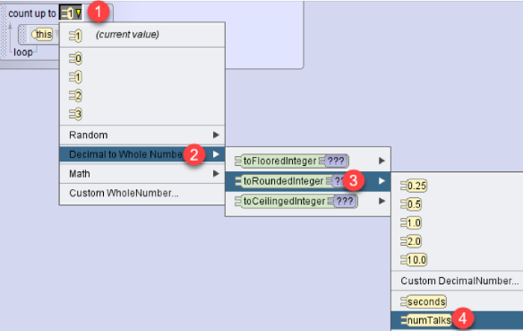
Variables
Using Rounding
You can use the rounding function to translate a variable or function that might return a decimal number into a whole number to be able to use it where a whole number is required such as a count loop.

