Slide 1

Building A Scene
Notes:
http://www.alice.org/resources/lessons/building-a-scene/

Slide 2
ONE
The Alice Virtual World

Slide 3

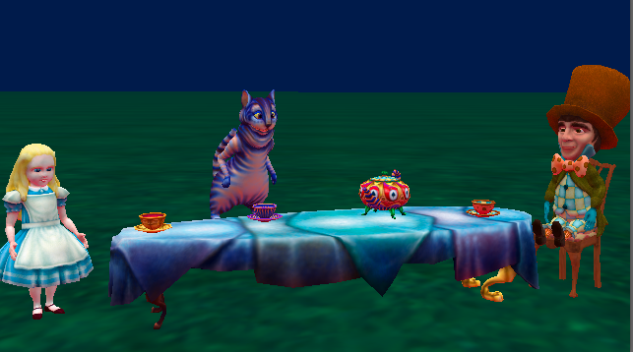
The Alice Virtual World
A 3D Virtual Environment
An Alice world is a virtual environment created in 3 dimensions (3D).
The 3D world is a representation of a place (environment) and the objects in that place that have height, width, and depth
A 2D image of a tea party
A tea party in the Alice virtual environment

Slide 4
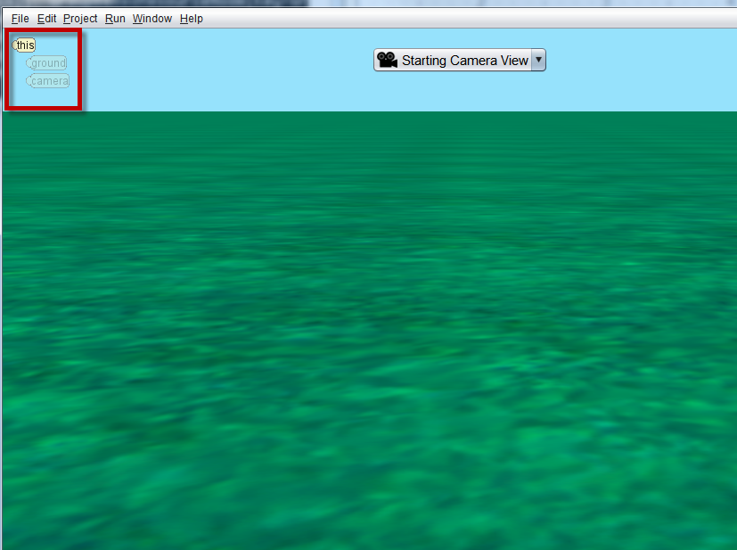
The Alice Virtual World
Core Components of an Alice Scene
Alice Virtual Environments or Scenes will always contain:
  Sky and fog settings
  A ground surface (grass, sand, rocks, water)
  A range of objects (characters, props, scenery)
  A camera that can be moved around the scene

Slide 5
TWO
The Alice Scene Editor

Slide 6
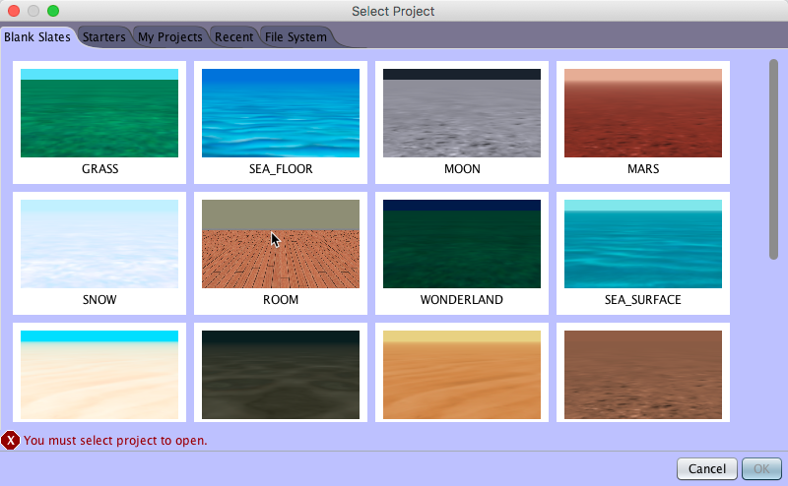
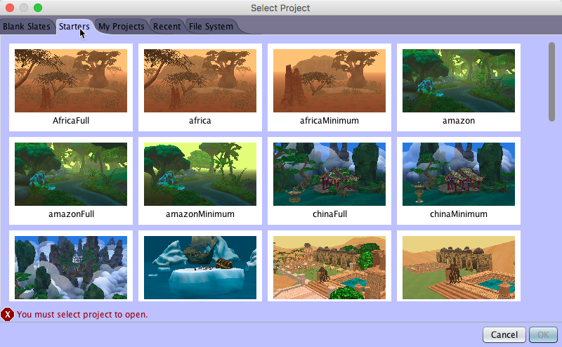
The Alice Scene Editor
Scene Templates
Blank Slates: Empty worlds with pre set ground textures, sky colors and fog settings to mimic different settings
Starter Worlds: Environments containing a range of prop objects pre-built to a specific theme

Slide 7
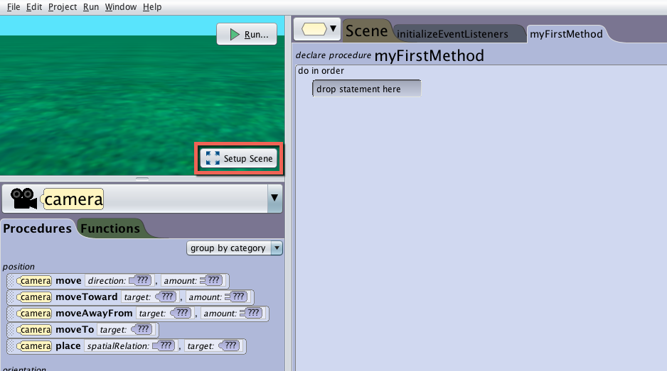
The Alice Scene Editor
Scene Editor Access
The scene is visible in the Camera View in the top left of the code editor
Flip from Code Editor to Scene Editor by clicking the Setup Scene button

Slide 8
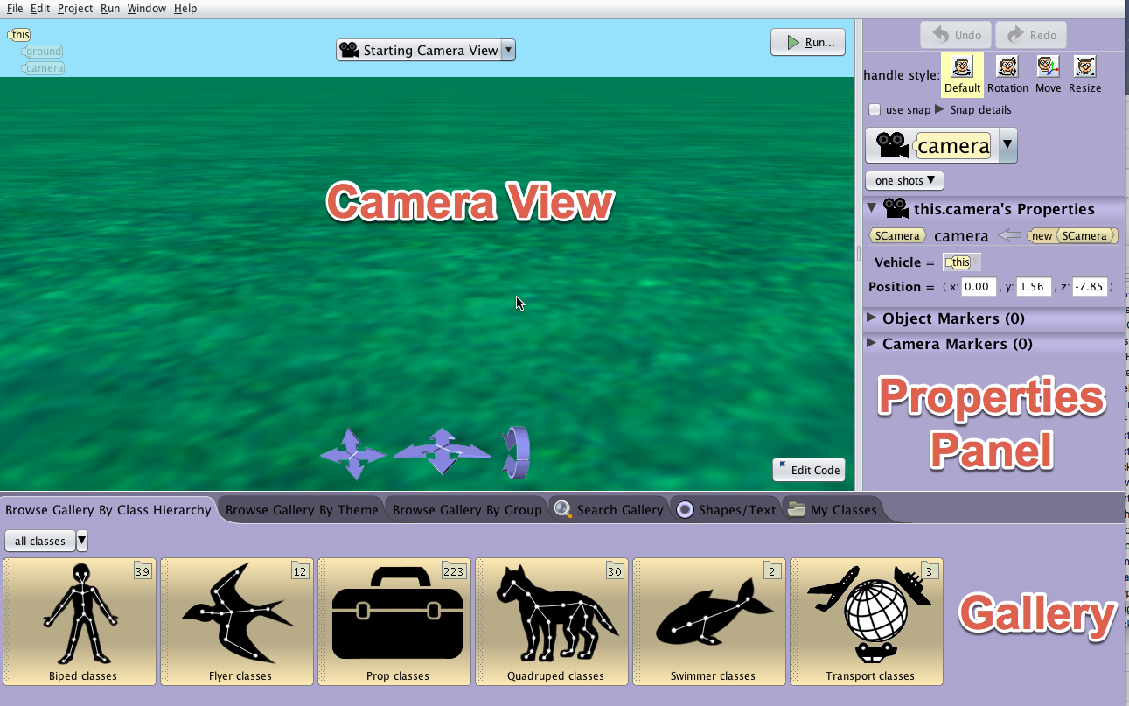
The Alice Scene Editor
Scene Editor Overview
The Scene Editor is composed of:
Camera View
Properties Panel
Gallery

Slide 9
Three
An Alice 3D Object

Slide 10
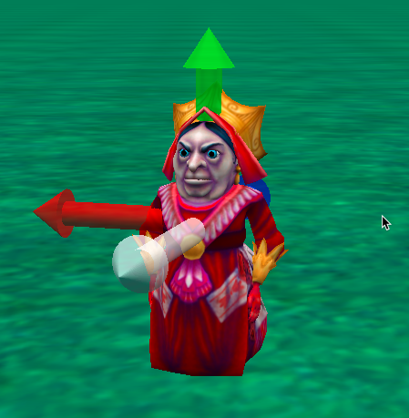
An Alice 3D Object
Virtual Representations
Characters and Vehicles
People
Animals
Vehicles
Props and Construction Pieces
Trees
Furniture
Castle Walls

Slide 11
An Alice 3D Object
Move, Turn, and Roll
The white axis points forward, the red arrow points to the right, the green arrow points upward, and blue arrow points backward.
Objects can move in 6 directions
Up / Down
Left / Right
Forward / Backward
Objects can turn in 2 Directions
Left / Right
Forward / Backward
Objects can roll in 2 directions
Left / Right

Slide 12
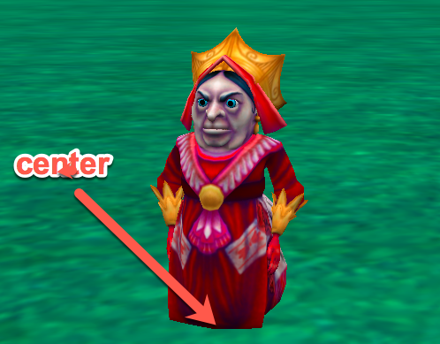
An Alice 3D Object
Pivot Points
Every object has a pivot point around which it turns and rotates.
The Pivot point of an object is different for all objects.
For most objects the pivot point is at the center of where the object intersects with the ground.

Slide 13
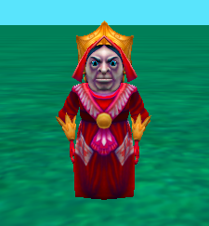
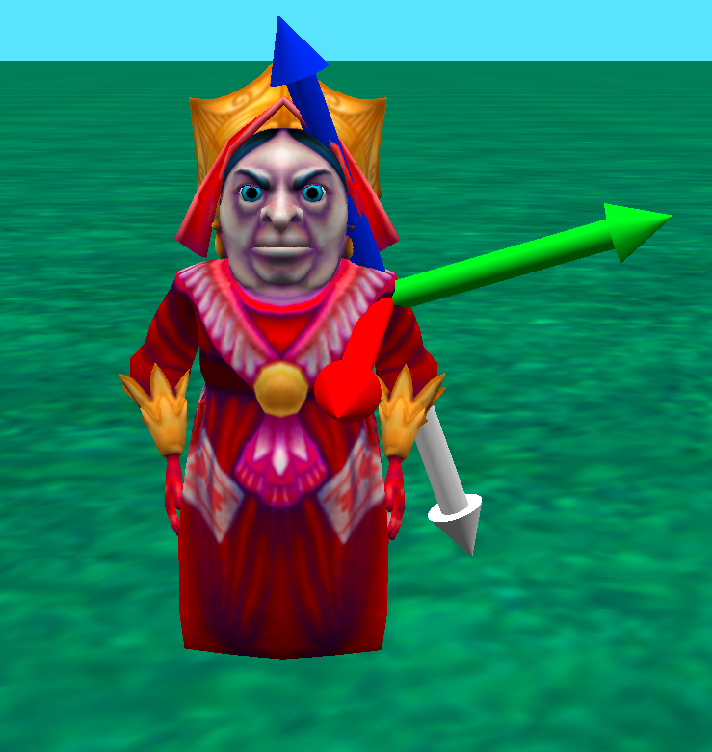
An Alice 3D Object
Internal Joints
Objects usually (not always) have internal joints or skeletons that control subparts of the model.
A joint connects the subparts of the body to the rest of the body.
Joints have a different orientation than the whole object. This orientation determines how turn and roll will control them.

Slide 14
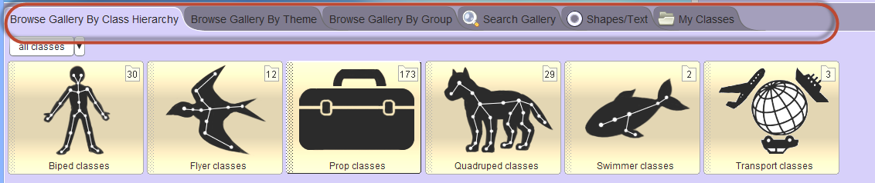
An Alice 3D Object
The Gallery
The Gallery contains the 3D models for adding objects to a scene.
Each gallery tab displays a different organizational scheme for finding classes in the gallery.

Slide 15
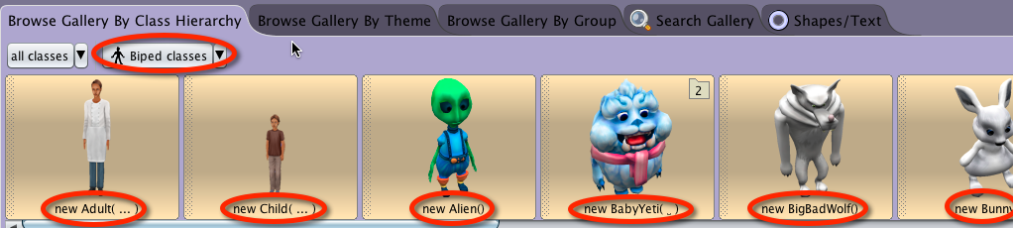
An Alice 3D Object
What is a Class
In Alice, a class defines:
A plan for constructing a new object in an Alice scene
  How it looks
An action that an object of that class can perform
  What it can do

Slide 16
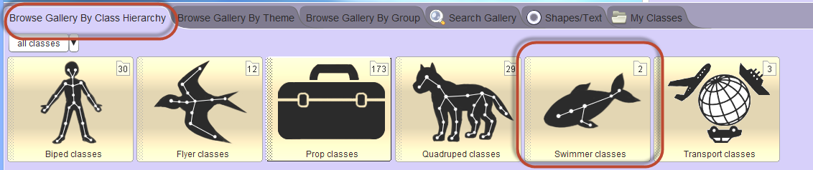
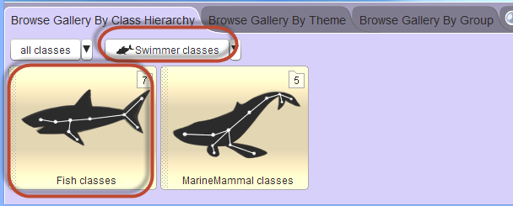
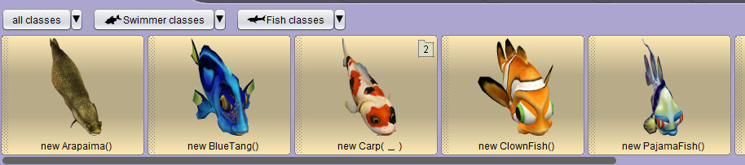
An Alice 3D Object
Class Hierarchy
The skeleton and joints define how objects can be animated and impact the hierarchy at the top.
Subclasses have shared attributes.
At the bottom of the hierarchy, the object's visual appearance is the main variation.

Slide 17
Four
Adding Objects in Alice

Slide 18
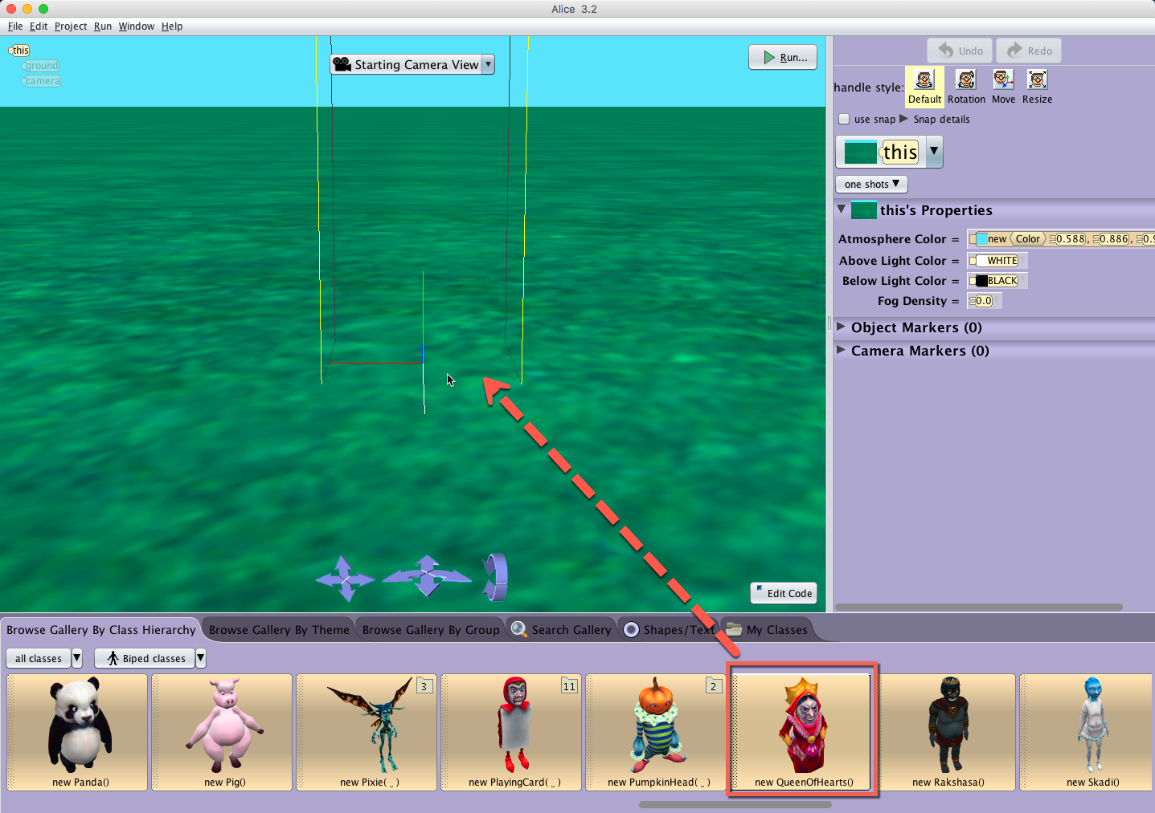
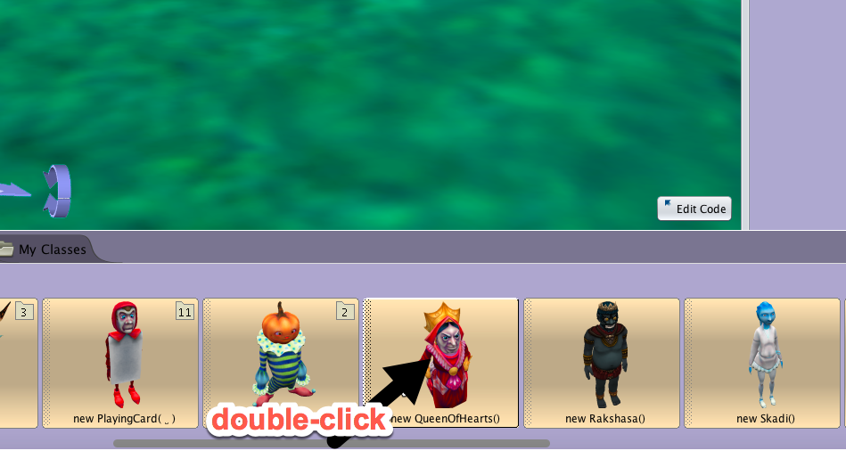
Adding Objects in Alice
Adding Objects
Drag and drop or double click objects to add them to the Scene Editor.
Bounding boxes show where the object will be positioned when dragged into the Scene Editor.
Double clicked objects will be added at the very center of the world (0,0,0).

Slide 19
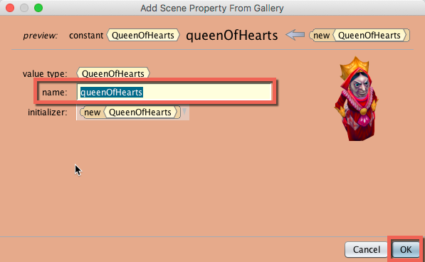
Adding Objects in Alice
Naming Objects
Alice will provide a default name for objects based on the class name selected, but you can enter a different name when adding objects. You will need to adhere to the following rules:
Names must be one continuous word, with no spaces
For names with multiple words try using camelCase
The first character must be a letter and not a number
No special characters (?, @, !)

Slide 20
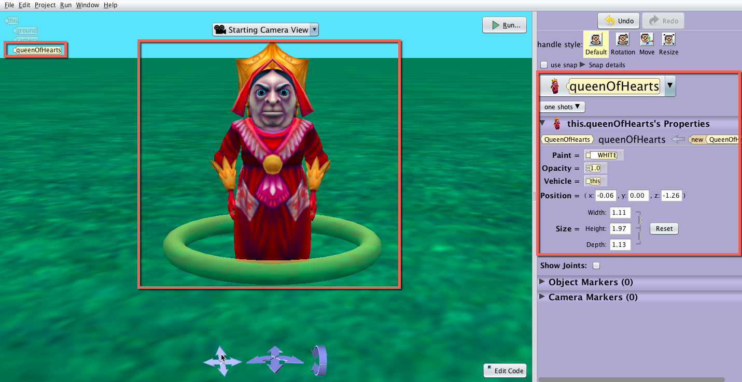
Adding Objects in Alice
Object tile in object tree
Object with default ring handle
Object properties

Slide 21
Adding Objects in Alice
Object position
Object size

Slide 22
Five
Positioning an Object

Slide 23
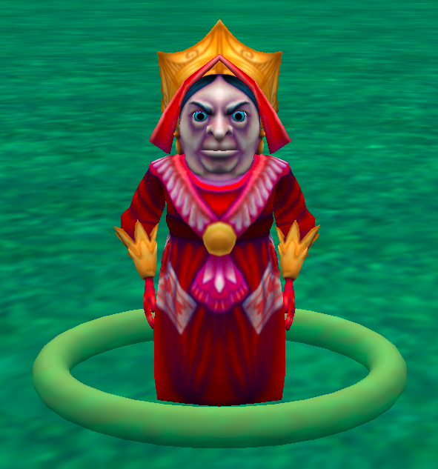
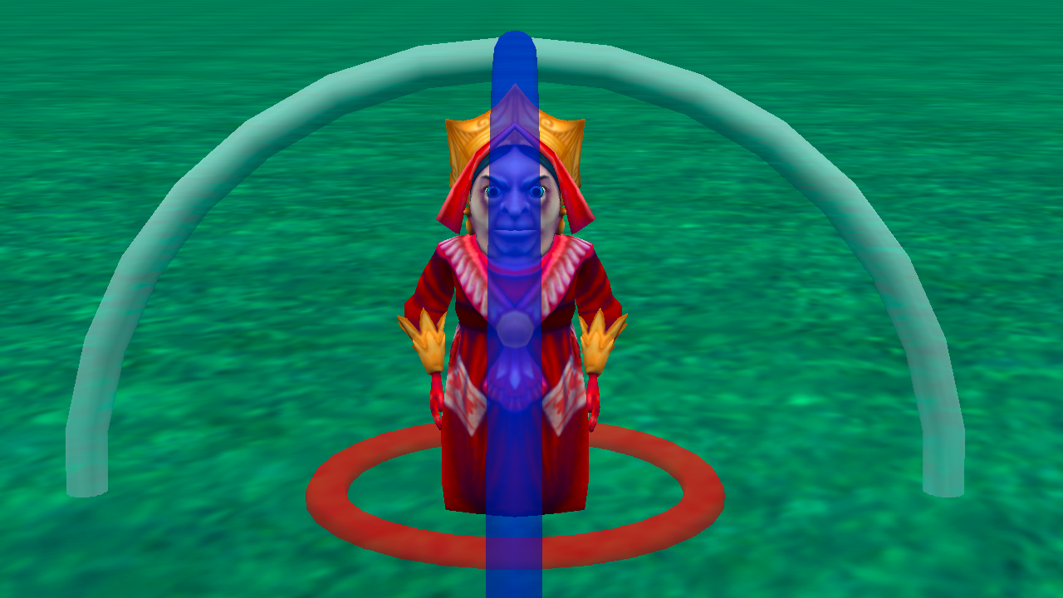
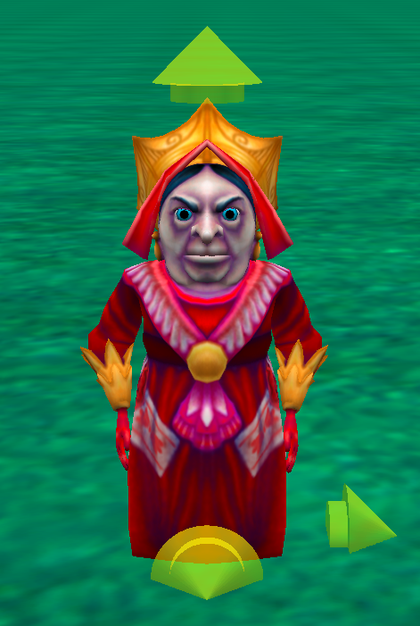
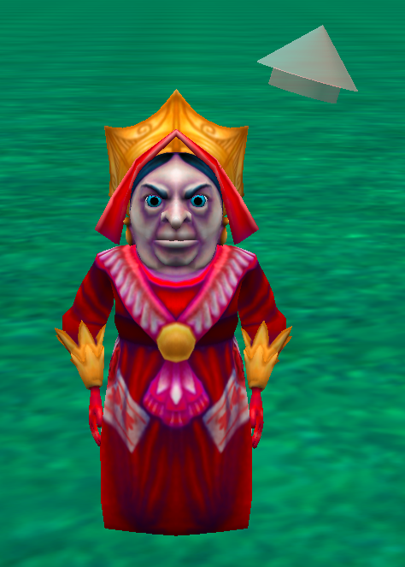

Positioning an Object
Position with Mouse
Move the object on the ground plane, by default clicking on an object and dragging the mouse. A highlighted ring will also appear around the object that can be used to rotate the object.
You can use the handle style buttons to change the mouse behavior:
Rotation - displays circular handles for manipulating turn and roll relative to the object's orientation
Translation - displays handles for moving the object along the major axis relative to the object
Resize - displays a handle for uniformly scaling the object

Slide 24
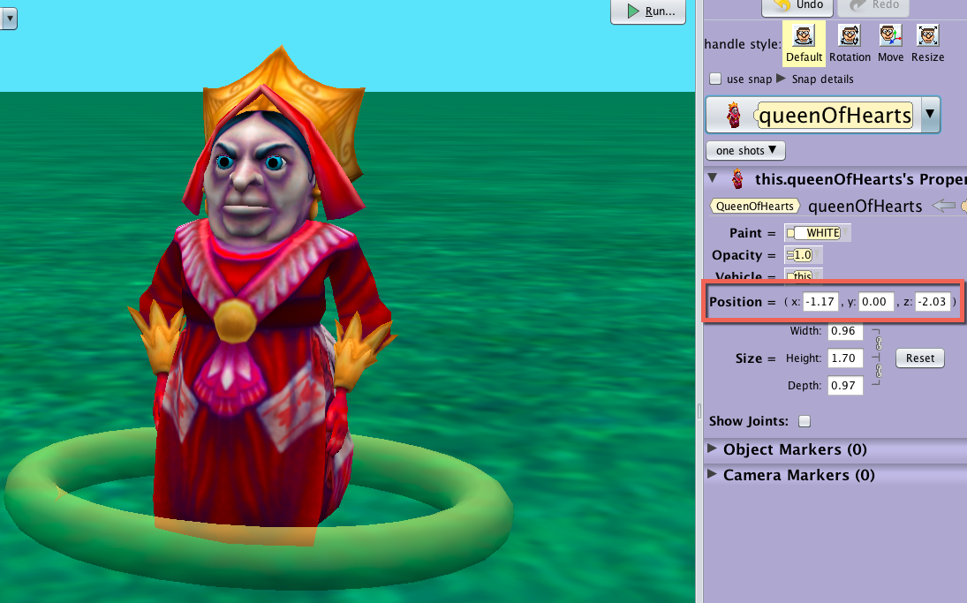
Positioning an Object
Position with Coordinates
For more precise positioning of objects, you can use the properties panel to adjust the absolute position of the objects in the world.
Select the desired object from the object tree or the object drop down menu
Modify the x, y, z coordinates for the object
The properties panel can be used for position but not orientation

Slide 25
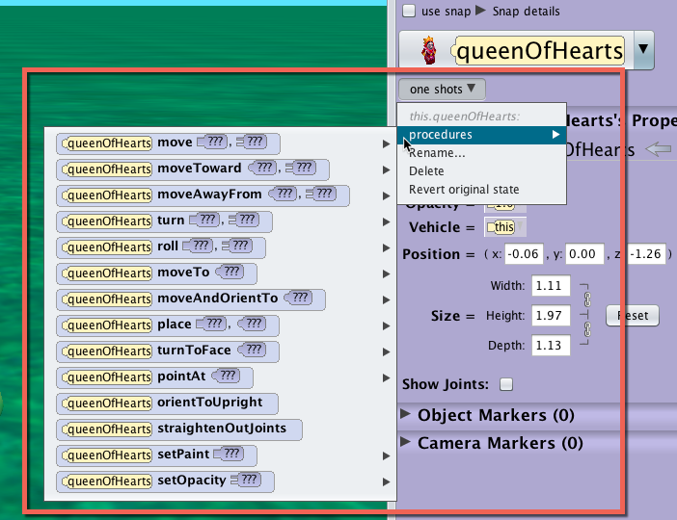
Positioning an Object
Position with One Shots
For more precise positioning of objects, use the one shot menu:
Select the object’s name from the object menu
In the properties panel select a move command from the one shots sub menu
Note: Right click on an object in the scene to access the menu

Slide 26
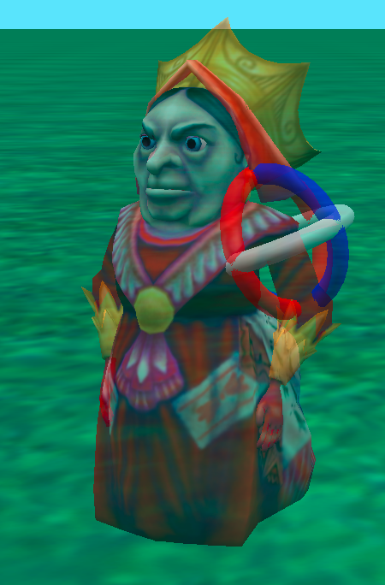
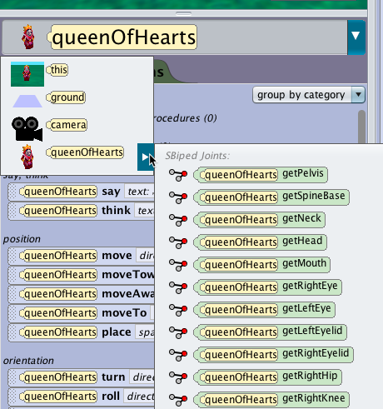
Positioning an Object
Manipulate Object Subparts
To access an object’s joint, click on the arrow next to the object’s name in the object list.
Joints act as the pivot points for the subparts of the objects, extending from the object to its extremities.
Turning and rotating joints may also move other joints and subparts.
Ex: Turning the left elbow joint will also move the wrist, and finger joints, the forearm, and the hand subparts.

Slide 27
Six
The Alice Camera

Slide 28
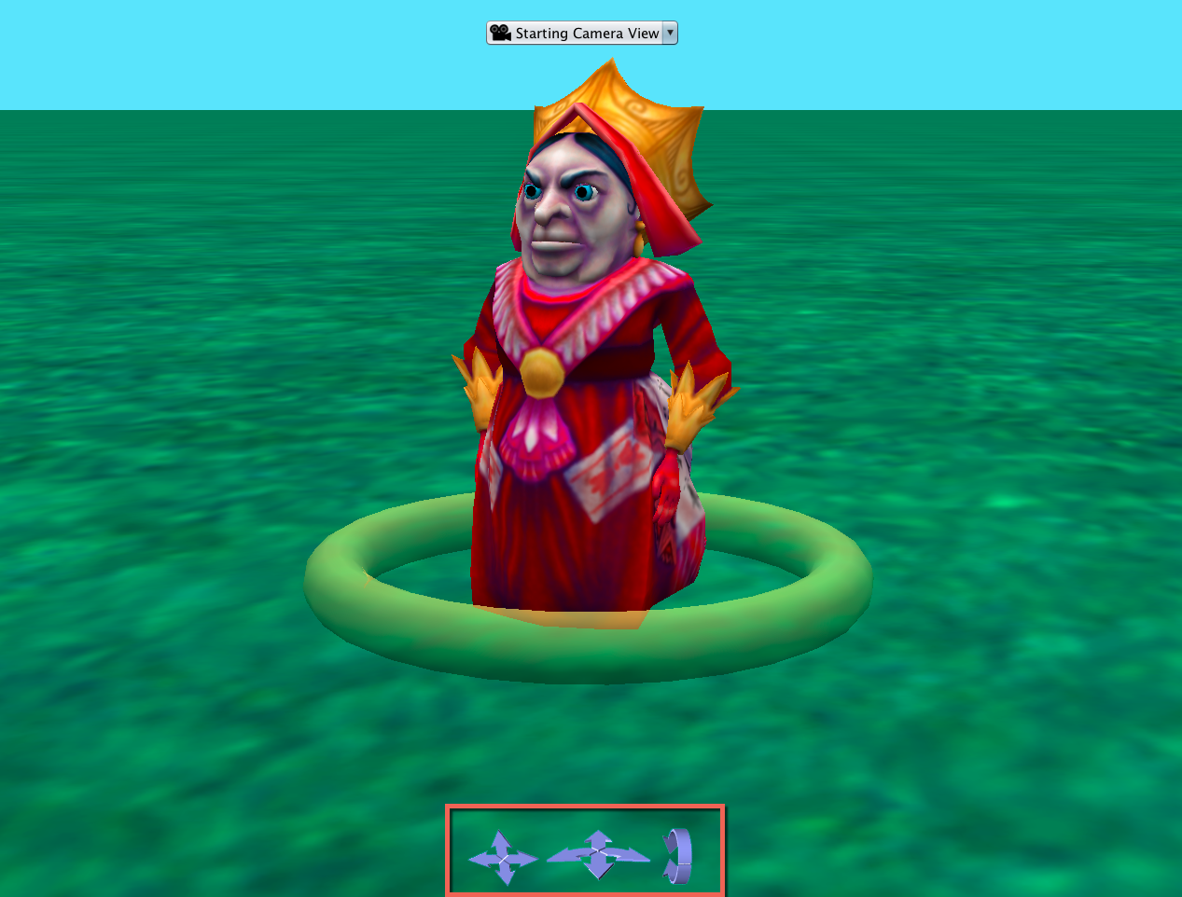
The Alice Camera
Camera Overview
There is only one camera that can be moved around the scene.
Changes in the scene view are achieved by moving the camera, not by switching to different cameras.
The basic camera controls on the bottom of the scene view allow you to reposition the camera view in the Scene Editor.

Slide 29




The Alice Camera
Camera Controls
The left control arrows move the camera up, down, left, and right.
The up down arrows, in the middle controls, move the camera forward and backward.
The right and left arrows, in the middle controls, turn the camera left and right.
The right control arrows turn the camera forward and backward.

Slide 30
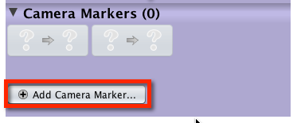
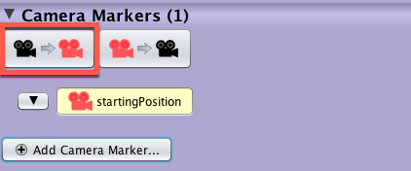
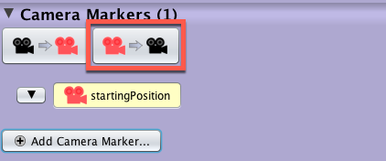
The Alice Camera
What is a Camera Marker?
A camera marker is an invisible object that allows you to mark a location and orientation in the world so that you can quickly move the camera to a saved place.
It is highly recommended to create a camera marker when you start a new scene so that you can return to the starting place in case you accidentally move the camera.
Add a camera marker in the properties menu
Use the left button to move the camera to the selected marker
Use the right button to move the selected marker to the current camera position

Slide 31
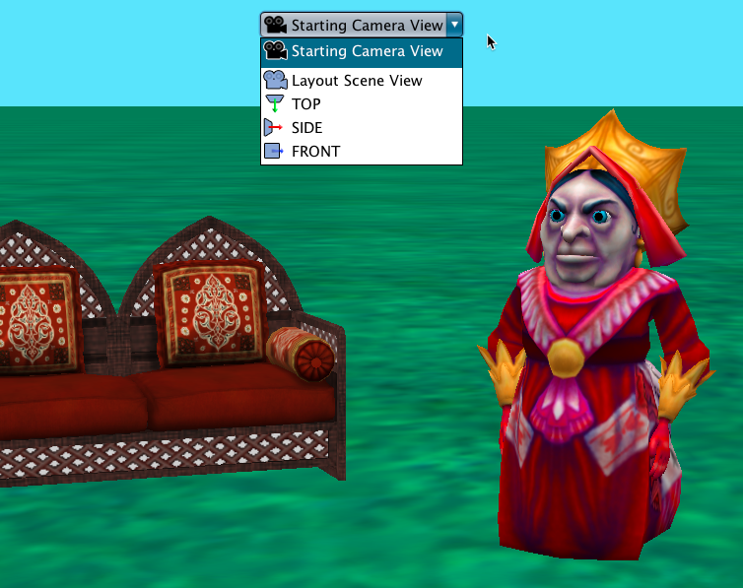
The Alice Camera
Scene Building Viewpoints
In addition to the active scene camera, there are 4 alternate Scene Editor views.
These are not camera locations or camera markers so they cannot be referenced in your code to move the camera or viewpoint.
They are very useful when building a scene to help align and orient objects to each other.

Slide 32
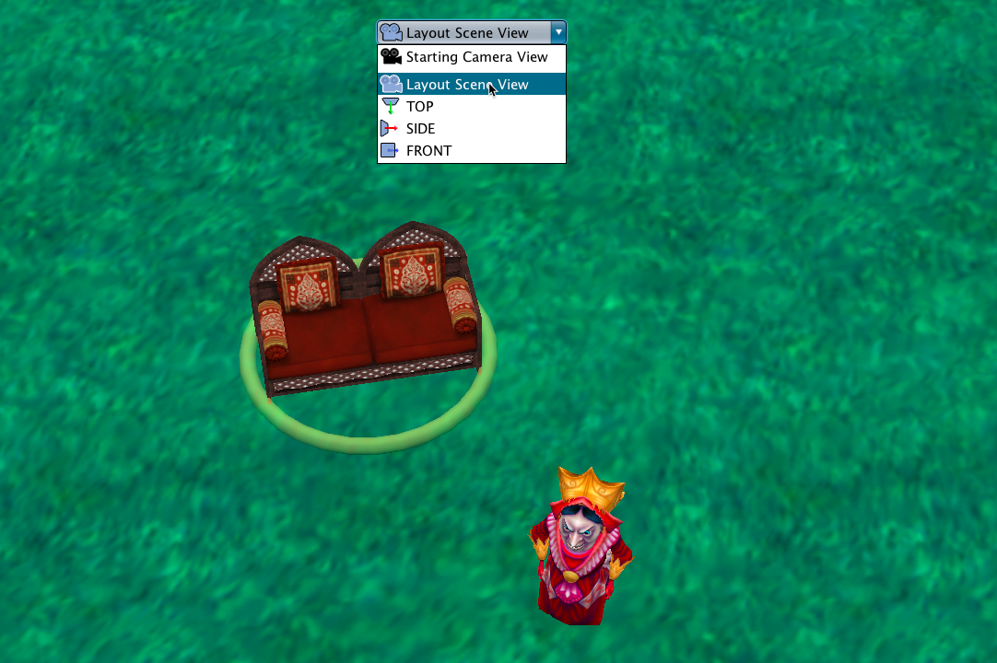
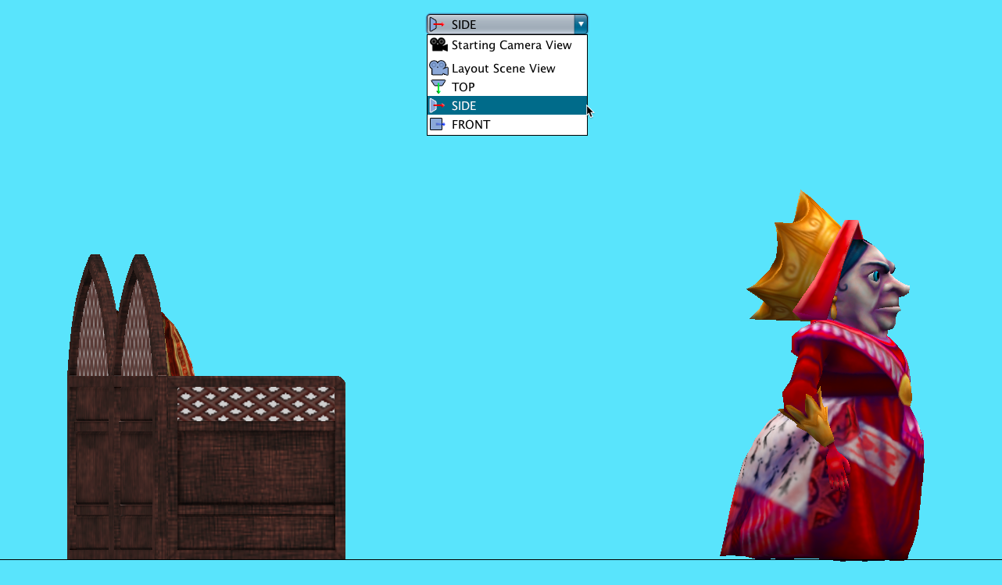
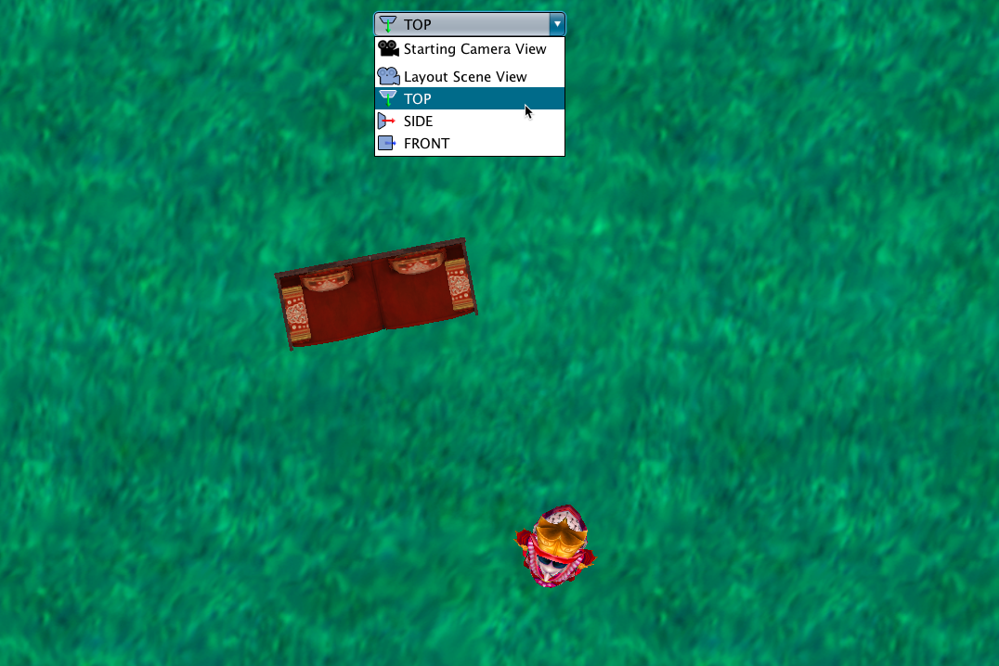
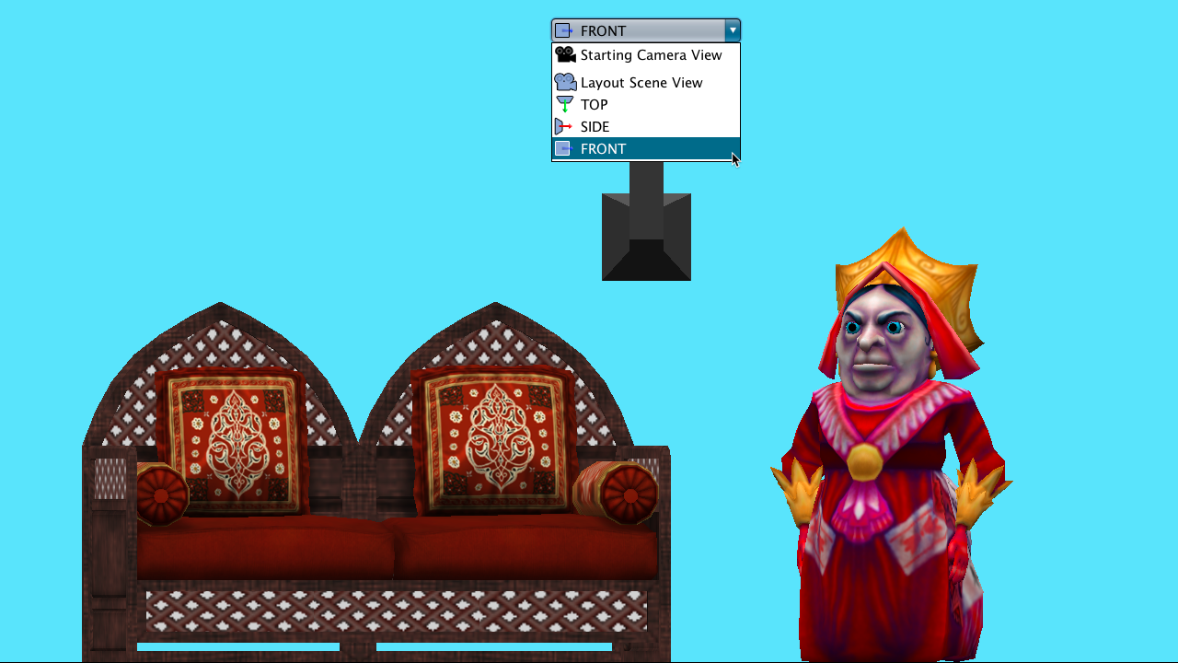
The Alice Camera
Four Scene Editor Views
Layout Scene View
Top View
Side View
Front View

Slide 33
Seven
Tips and Tricks

Slide 34
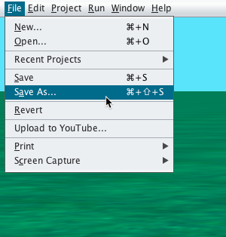
Tips and Tricks
Save Often
Save your project world often - every 10 to 20 minutes.
It is important to use a progressive naming convention, such as adding a character to each new version, for incremental backups.
Later versions of Alice 3 will also have an autosave function that will save incremental backups in case of an issue.

Slide 35
Tips and Tricks
Undo / Redo
You can always use undo and redo to test things.
In addition to the interface buttons, you can use command z (undo) and command y (redo).

Slide 36
Tips and Tricks
Return to Default Handle Styles
After using rotate, translate, or resize be sure to put the button back to default.
Beginner Alice users often forget to return to the default handle style when they go to work on another object.

Slide 37
Tips and Tricks
Object Manipulation Hotkeys
When using the mouse to manipulate objects in the Scene Editor, you can:
Hold down shift and drag the mouse to move the object vertically (up and down).
Hold down ctrl (windows) or option (mac) and drag mouse to turn the object.

Slide 38
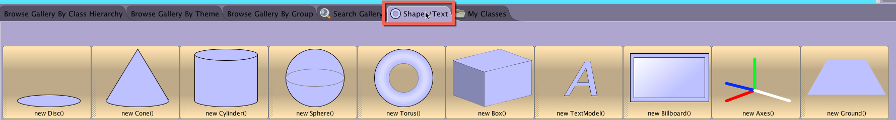
Tips and Tricks
Shape Objects and Billboards
Shapes can be used to create generic objects.
Billboards can have image textures added to them and they can be used for backgrounds or directions.
3D text can be manipulated through code for dynamic text.

