Slide 1
Design Process Introduction
Notes:
https://www.alice.org/resources/lessons/design-process-introduction/
Updated Nov 7th 2019

Slide 2
Where do I start?

Slide 3
Design Thinking
Design Thinking and Problem Solving
Problem Statement
Define the Problem
Understand the Problem
Design a Plan
Implement the Design
Test the Design
Repeat as Necessary
Understand
the problem
Test
Design a
Plan
Implement
Design

Slide 4
Problem Statement
Problem Statement
Problem Statement
First you need to create a concise description of the problem that will be solved. This will help you focus on actionable steps and provide a way to measure how successful you were in achieving a successful solution.
Understand
the problem
Test
Design a
Plan
Implement
Design

Slide 5
Problem Statement
An Alice Problem Statement
Alice is designed to help you solve creative problems. Think of your problem statement as the elevator movie or game pitch:
I want to create a story where ….
I want to build a world where….
I want to build a game where…..

Slide 6
Understand the Problem
Understand the Problem
Problem Statement
What am I making? This stage is intended to go deeper into the problem statement to really understand what you are trying to build.
This can include analysis of the problem, through research, and observation. It is a good idea to break down the problem statement into smaller pieces and then start building that into the larger idea.
Understand
the problem
Test
Design a
Plan
Implement
Design

Slide 7
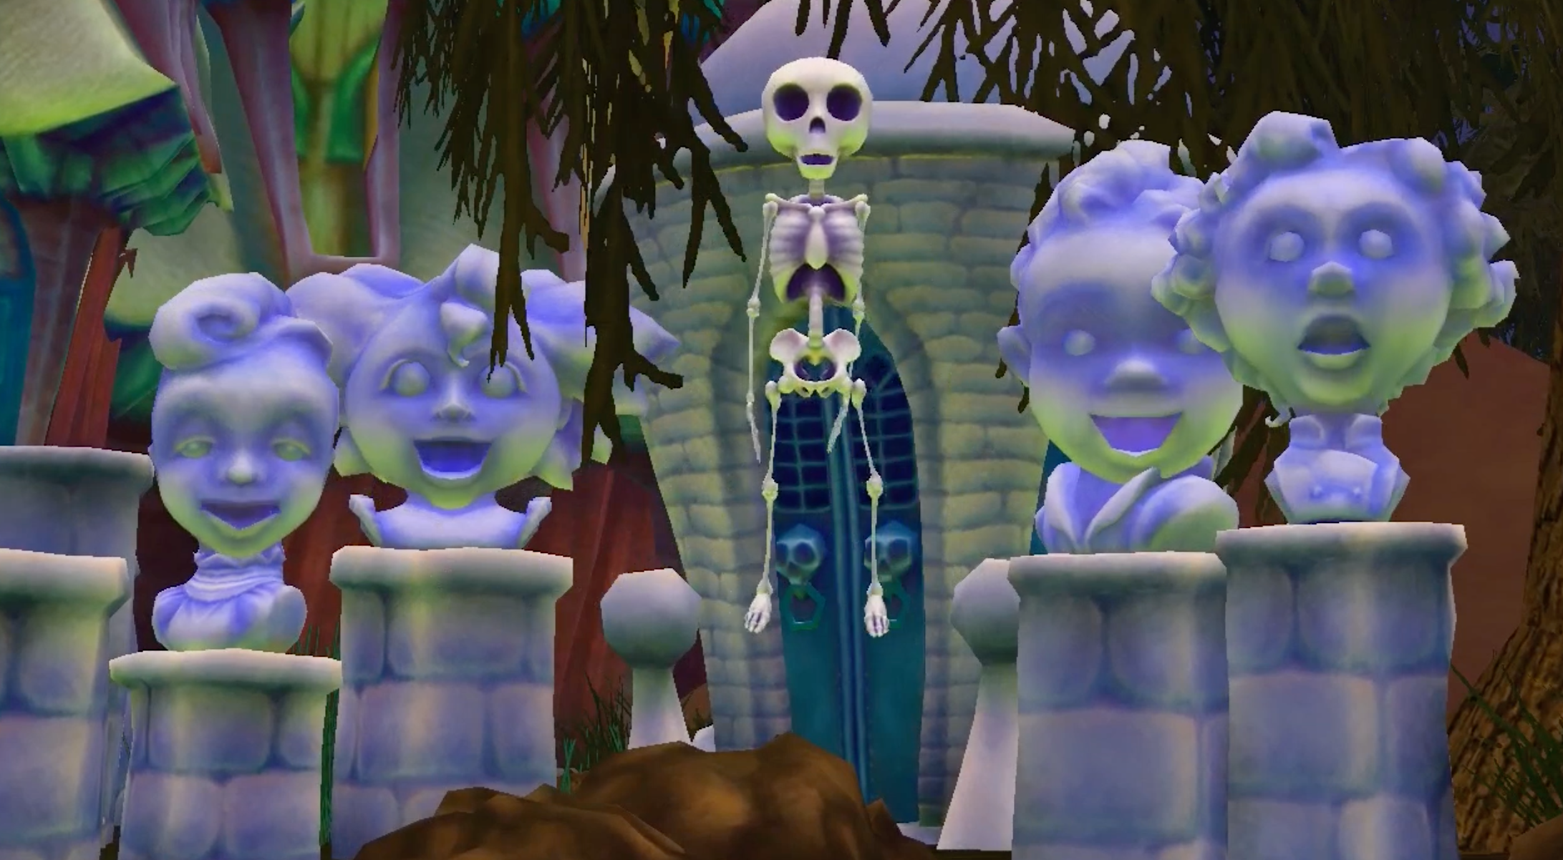
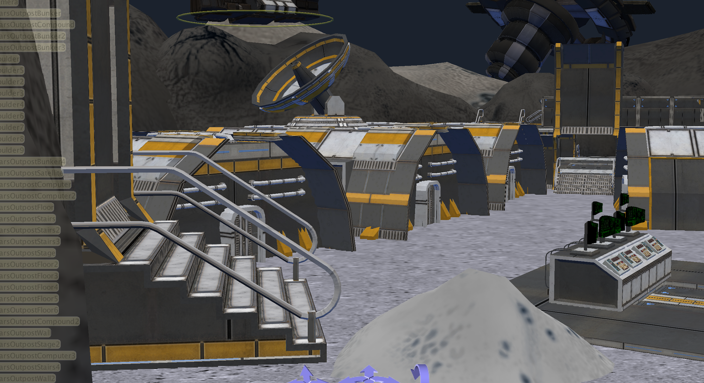
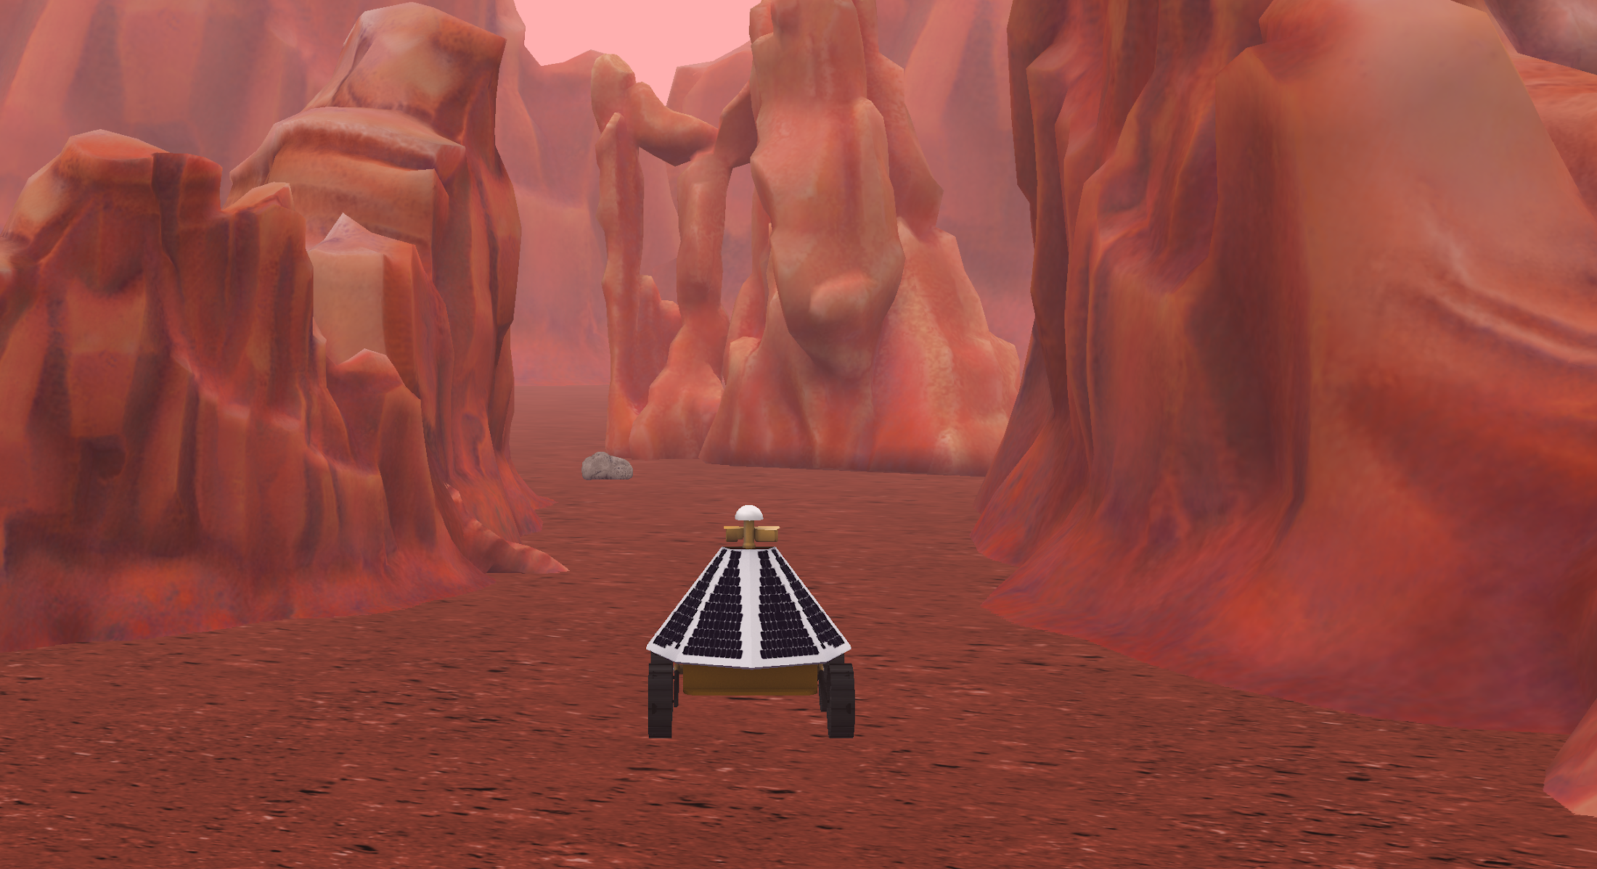
Understand the Problem
Tools for Understanding Different Alice Problems
You could use a written story or storyboard approach for understanding a linear story problem.
A map, storyboards or interaction designs will work for an interactive open worlds.
A game will need a design document that answers questions like “how do you win?” and storyboard or interaction designs for moments in the game.

Slide 8
An Animation Problem
Script Writing and Storyboarding

Slide 9
Understand the Problem
Understanding the Problem
Whether you are writing your own story or dissecting an existing story, it is important to understand what story is being told?
Where does it take place?
Who are the characters?
What actions are taken?
What events happen?

Slide 10
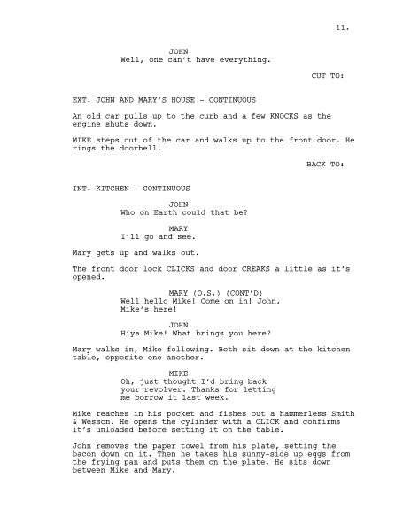
Understand the Problem
Using a Script
A script is a story written as a set of directions that is intended to be used to direct a play, a movie, or a similar. production.
What are the key parts of a script that help you understand your story?
Descriptions of the set and environment
Directions for movements around the space
Specific dialogue

Slide 11
Understand the Problem
Using a Storyboard
A storyboard is a visual representation of a story that is used for planning animations or films. Each frame captures a moment in the story and conveys important information about:
Where the story is taking place
Who is in the scene
What is happening

Slide 12
Understand the Problem
Making a Storyboard
The drawings are not expected to be beautiful artwork. Use stick figures and simple shapes.
Use text comments to give more information when needed.
Add audio notes for intended sounds.

Slide 13
Understand the Problem
Why Storyboard
It can be faster to quickly draw out the scene, rather than to writing out all the information needed.
The frame actually gives you information about the camera view and camera moves.
It contains more visual information to help you build your scene and plan your animation.

Slide 14
Design a Plan
Design a Plan
Problem Statement
Once you understand your problem and have mapped out your story, it is time to start figuring out how you will build your Alice program.
Understand
the problem
Test
Design a
Plan
Implement
Design

Slide 15
Design a Plan
Translating a Story
Designing for Alice requires that you think about the two major components of an Alice World:
Building your scene - The Set Design
Writing your program - Program planning
Set Design
Design a Plan
Program Planning

Slide 16
Set Design
Using Maps and Diagrams

Slide 17
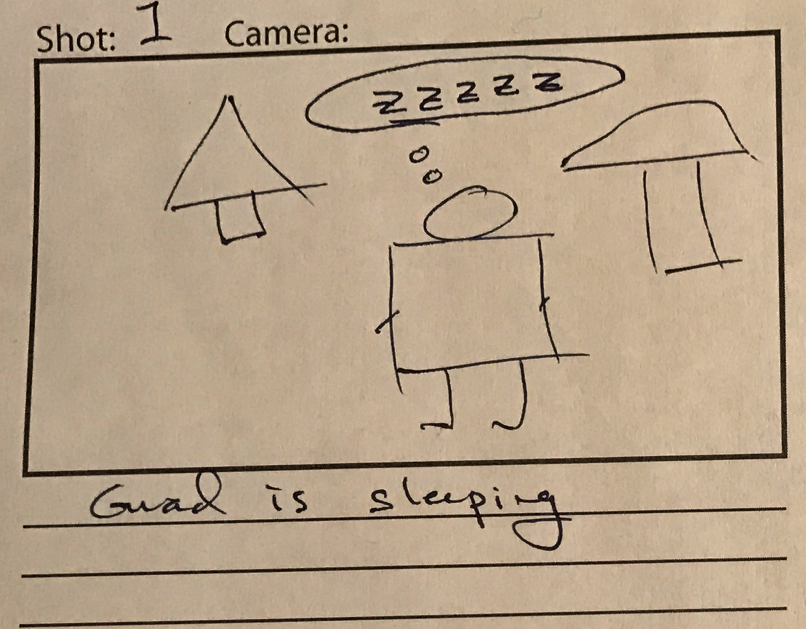
Design a Plan
Finding Scene Information
Information for building your scene comes from:
Scene descriptions in a script
Scene information in your storyboards
Consists of the location information, the props, and the characters

Slide 18
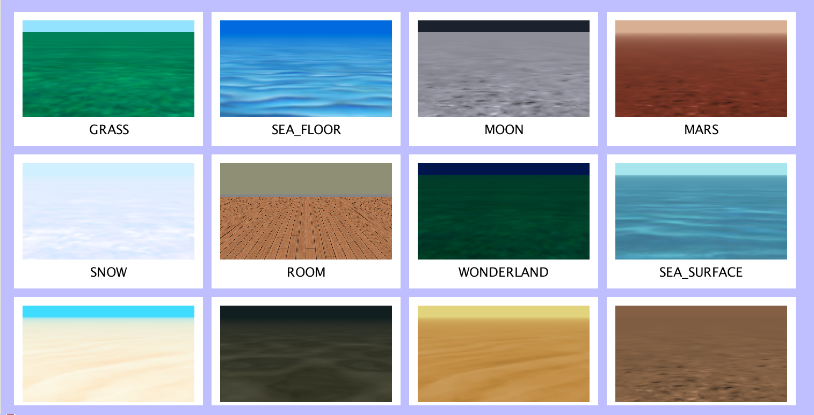
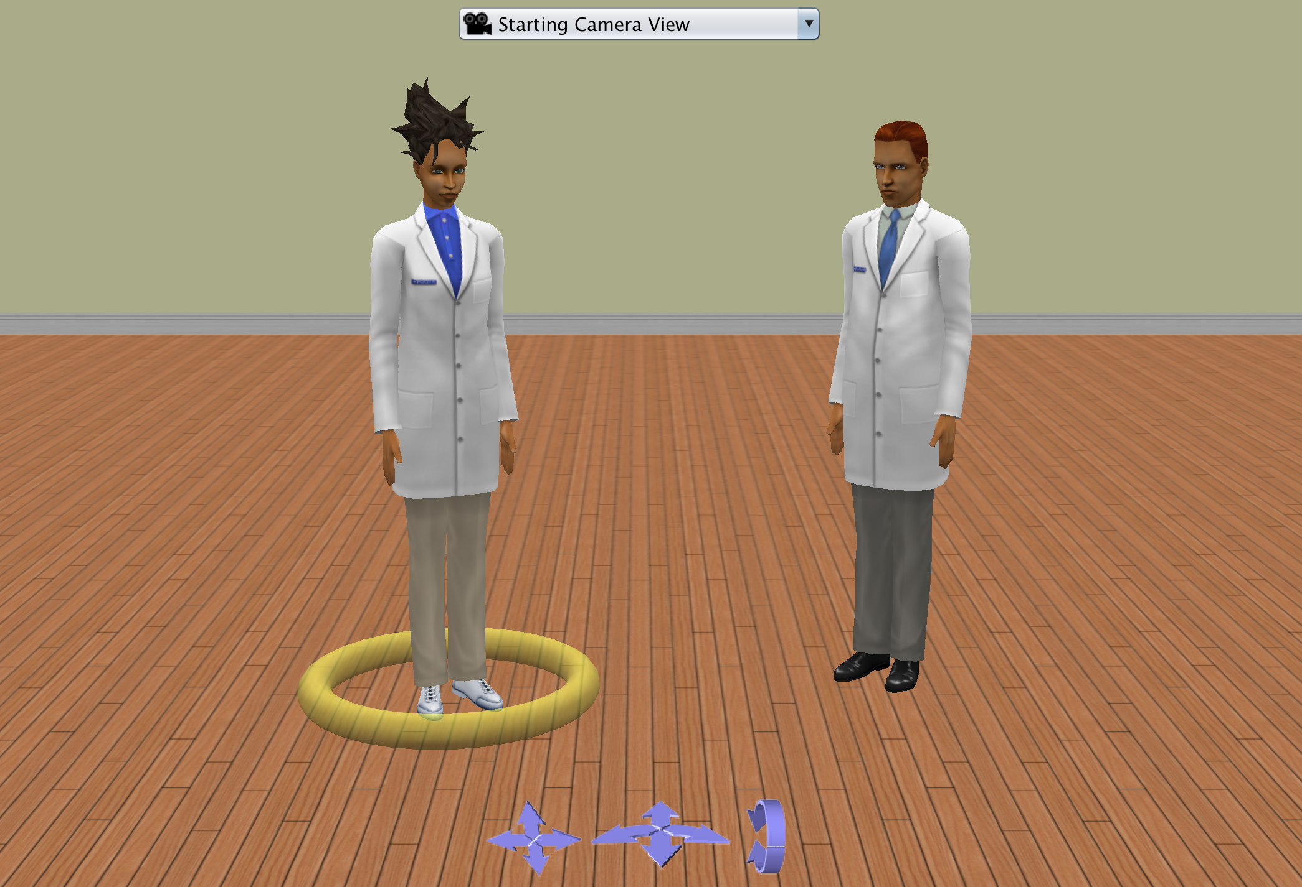
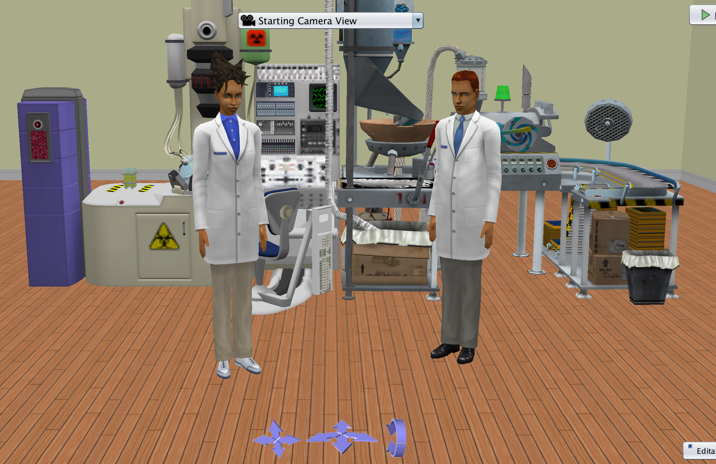
Design a Plan
Scene Design Elements
To plan for your scene set up, you will want to create a set map or at least a list of the following:
A location theme - Look at theme options in Alice for availability
Characters - Look through the Alice galleries for availability
Important Objects or Props - Look through the Alice galleries for availability
Location of different camera views

Slide 19
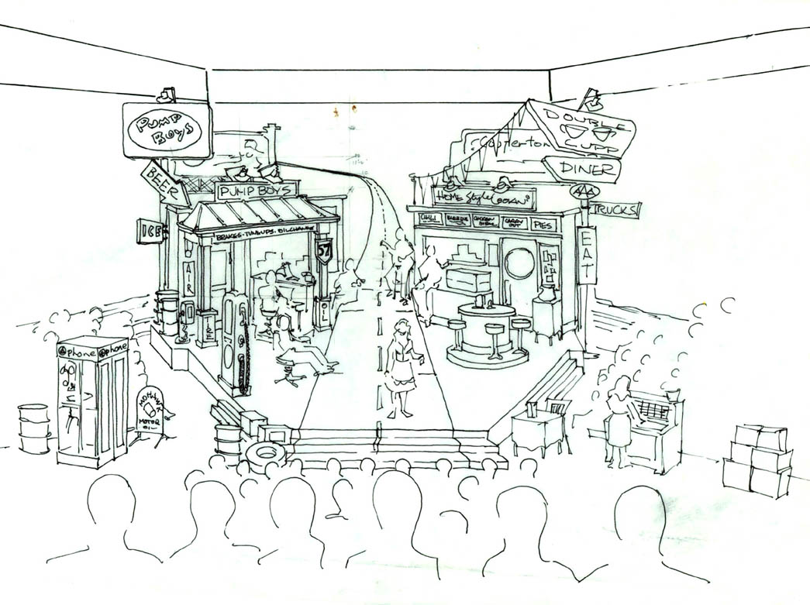
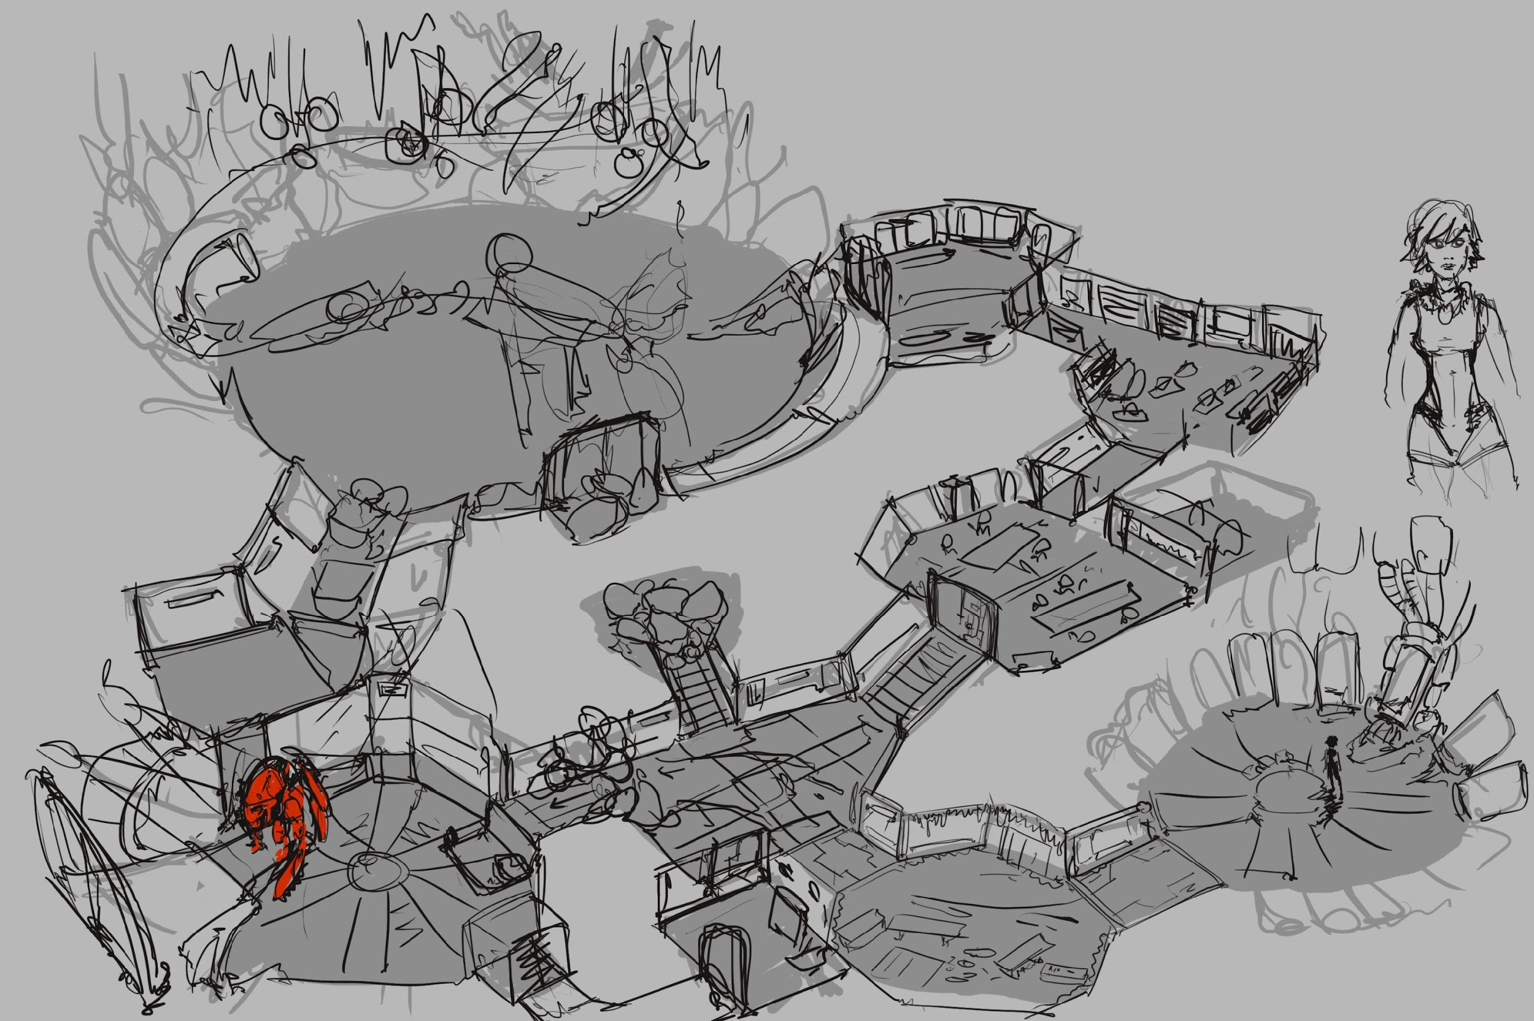
Design a Plan
Scene Design Examples
Other things that can help you plan your scene building:
Set design drawings similar to theater drawings for each camera view.
For large worlds with camera moves think of doing a level or world design drawing to help plan your layout.

Slide 20
Design a Plan
Algorithm Design

Slide 21
Design a Plan
What is an Algorithm
Do In Order
Step 1: Scientist One Says “Why was there thunder and lightning in the lab?”
Step 2: Lightning Flashes
Step 3: Scientist Two Says “I don’t know why?”
Step 4: Scientist One Says “The scientists were brainstorming.”
A set of steps to accomplish a task.
Ex: How to get from home to school or how to sort a deck of cards.
A computer science algorithm is a set of steps for a computer to accomplish a task.
An Alice Algorithm is a set of steps that tells the computer how to animate the virtual environment.

Slide 22
Design a Plan
Translating a Story
The scene opens and we see the first guard sleeping in the queen’s garden that has a tree and a giant mushroom. The queen enters the scene and sees the sleeping guard. The queen attempts to wake the sleeping guard. The guard awakes, and is frightened. The queen turns and calls for a second guard. The second guard enters the scene. The queen angrily points at the first guard and says “Off with his head”. The first guard runs and hides behind the mushroom.
Alice is based on setting up scenes and animating objects.
To translate your story to an animation it is important to define:
What are the nouns (objects)
What are the verbs (actions)

Slide 23
Design a Plan
Translating a Storyboard
In a storyboard a lot of the time the objects or characters (nouns) are easy to determine because they are there for you to see.
It is important to remember that many times in a storyboard the action (verbs) takes place in between the frames (ie the clouds appear).

Slide 24
Design a Plan
Scripted Algorithm Design
Do In Order
Scientist One Says “Why was there thunder and lightning in the lab?”
Lightning Flashes
Scientist Two Says “I don’t know why?”
Scientist One Says “The scientists were brainstorming.”
The text-based approach focuses on writing out and highlighting the objects and actions to form a design that can be translated into a program.
Use different formatting to call out control structures and use step numbers as references for loops.
You can easily break down each step into smaller algorithm designs until you have objects and actions that you can translate to a program.

Slide 25
Design a Plan
Challenges of Text Design
In Alice programming, you will find that because you are animating a scene you will have a lot of things that are happening at the same time or conditional of other events.
Sometimes the set of steps becomes more complicated and have dependencies that make writing them in a list more complicated and hard to understand.
Do Together
Step 1: Scientist One Says “Why was there thunder and lightning in the lab?”
Step 2: Lightning Flashes
Do In Order
Step 3: Scientist Two Says “I don’t know why?”
Do After Step 1-3
Step 4: Scientist One Says “The scientists were brainstorming.”

Slide 26
Program Planning
Using Flowcharts

Slide 27
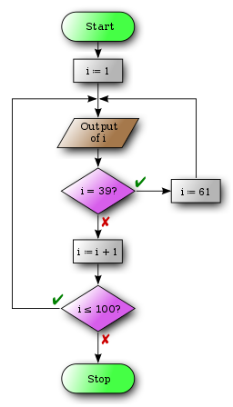
Design a Plan
What is a Flowchart
Flowcharts are used to visually design and document processes or programs. There are several different formats.
Shapes that depict actions, inputs, or processes
Allow visual representations of simultaneous actions and conditional actions
Easily map out decision points and repetitions

Slide 28
Design a Plan
Parts of a Flowchart
The different symbols help you define what happens at each step in the program and the arrows allow you to map how the program will run.
A round rectangle is used to show the start and stop of the program.
A rectangle can be used for each action.
The parallelogram or diamond are for more complicated decision and input representations.

Slide 29
Design a Plan
Benefits of a Flowchart
A flowchart allows you to easily show program flows that include more complex scripts.
The activity diagram format of solid bars allows you to show things happening at the same time and helps figure out timing.
You can also use a mixture of flowcharts and text based design to write out individual nodes of the chart.

Slide 30
Implement Design
Implement Design
Problem Statement
Now that you have a design you can use that to start implementing your solution.
Understand
the problem
Test
Design a
Plan
Implement
Design

Slide 31
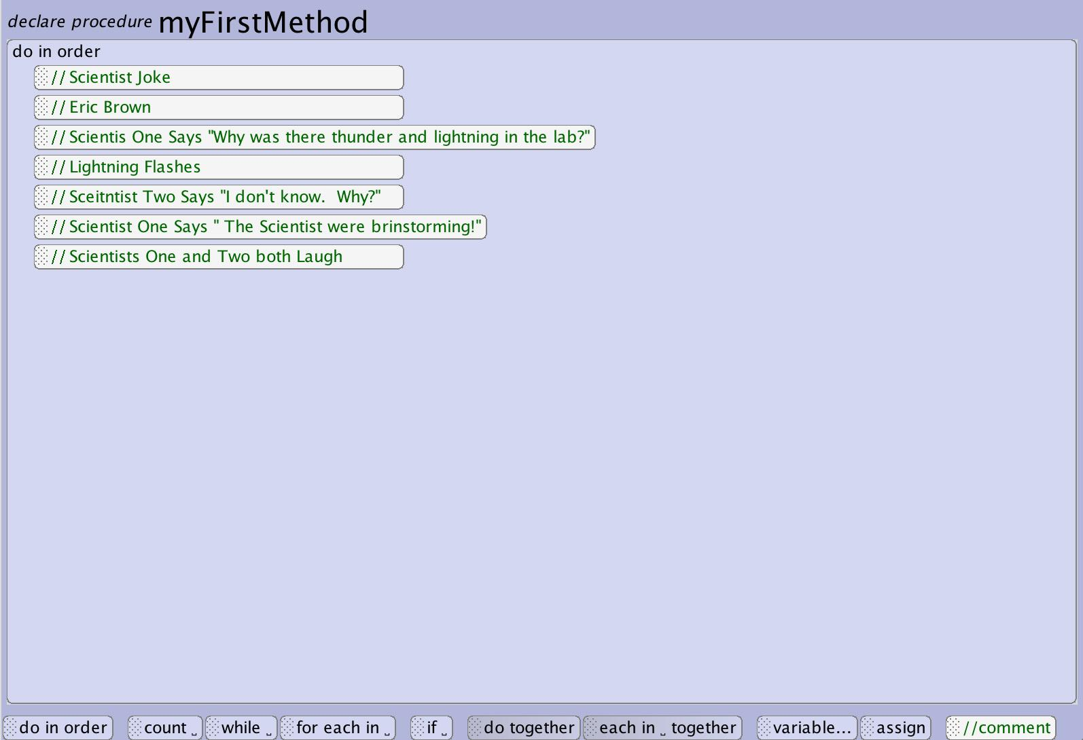
Implement Design
Commenting
Comments are used to display information that the computer will ignore when running your program and are used to:
Give attribution to the author of the code
Help you layout and plan your program
Help other people understand what your program does
Planning out your program with comments first can be a good first step when implementing your design.

Slide 32
Implement Design
Incremental Design
Alice is intended to allow you to easily iterate and test your program as often as you would like.
Start by implementing parts of your animation
Test and refine small sections before moving on to new components
Revise and redesign based on what you find when implementing
Do Together
Step 1: Scientist One Says “Why was there thunder and lightning in the lab?”
Step 2: Lightning Flashes
Do In Order
Step 3: Scientist Two Says “I don’t know why?”
Do After Step 1-3
Step 4: Scientist One Says “The scientists were brainstorming”

Slide 33
Testing
Testing
Problem Statement
Once you have implemented your solution it is important to test your solution and see how it works.
When testing you may find that:
You didn’t understand the problem well enough and return to outlining the problem (story)
Your design didn’t achieve what you wanted and you need to go back to designing the solution
Something went wrong in the implementation and you must go back and do some bug fixing
Understand
the problem
Test
Design a
Plan
Implement
Design

Slide 34
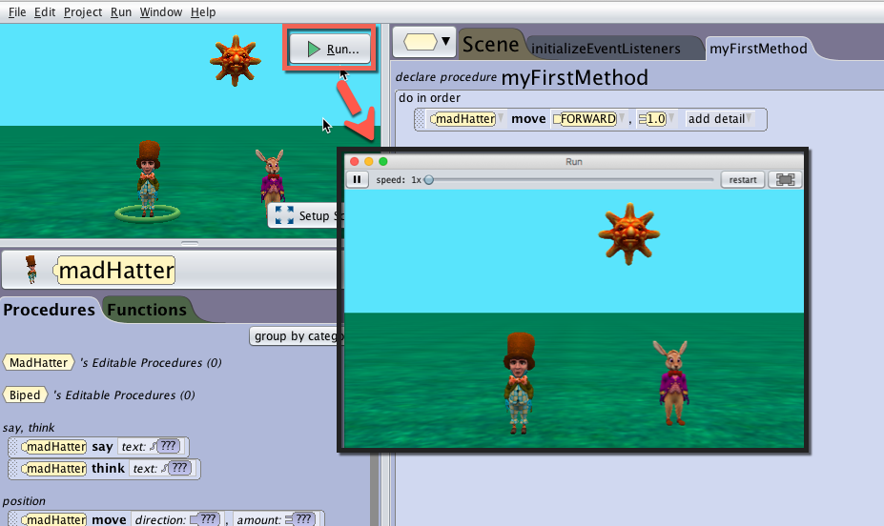
Testing
Run Your Program Often
Alice is designed to make it as easy and fast as pressing a button to run your world so that you can rapidly test and iterate your designs.
* It is a good idea to save your world before running

Slide 35
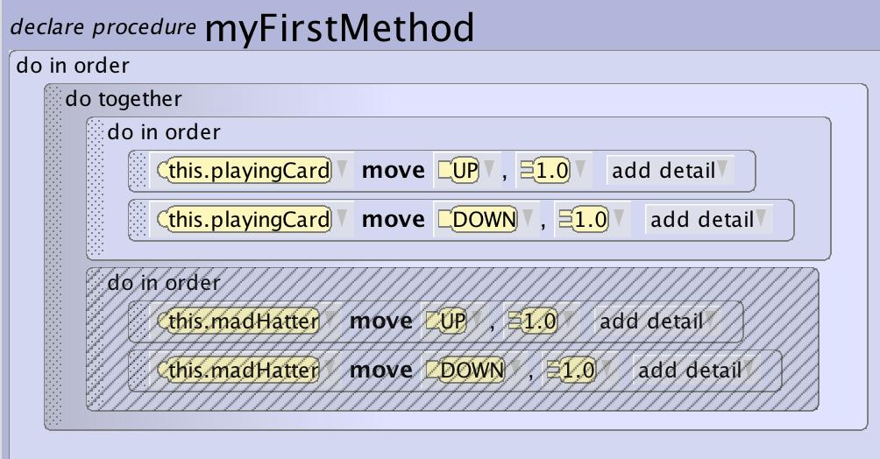
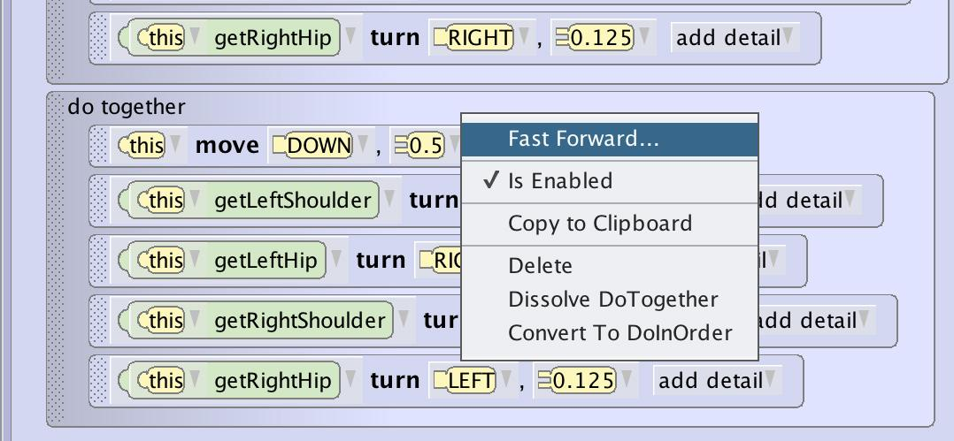
Testing
Run Parts of Your Program
There a couple ways to help you run parts of your program to help you test smaller components.
Use the disable toggle to hide parts of your program and only run the section you are working on.
Use the fast forward drop down to jump the player to the part of code you want to test if that part of the program depends on everything having been executed.

Slide 36
Tips and Tricks

Slide 37
Tips and Tricks
Address Parts of the Whole
Problem Statement
If the problem doesn’t make sense or the design seems too complicated, see if you can break it down further.
You can continue to break down the problem into smaller components and run each smaller component through the full design process.
Understand
the problem
Test
Design a
Plan
Implement
Design

Slide 38
Tips and Tricks
Separate Scenes
Some stories may require that you set up separate scenes and use camera moves to change scenes.
Remember you can time camera moves with ground and sky color and texture changes to make whole new locations.
Scene 1
Camera
Scene 2
Camera

Slide 39
Tips and Tricks
“Off Set” Objects and Characters
Some stories require you to have characters enter and leave the scene. There are two ways to do this:
Build your scene with the characters off set and have them naturally enter and leave.
Set objects and characters to 0 transparency (hidden) and bring them to 1 (visible). Be careful that these objects will still be there for collision and mouse click events.
Off Screen
Camera
Transparent

